Slide 1
Scenarios for Protein Aggregation
Illustrations using Aβ peptides and PrP^{C} as examples

Slide 2
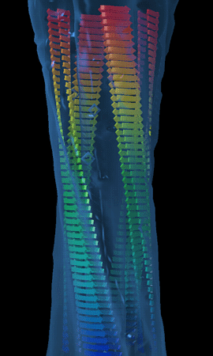
Global Structure of amyloid fibrils
diameter = 4-12 nm (electron microscopy)
cross-β structure (strands perpendicular to long axis of fibril)
4.7 Å inter-strand spacing (along axis)
9 Å inter-sheet spacing (perpendicular on axis)
twist between adjacent strands
2-5 protofilaments (overall helical twist)
(X-ray fiber diffraction,solid state NMR)
Broad goal: Describe structures,
stabilities, kinetics from
monomers to fibrils

Slide 3
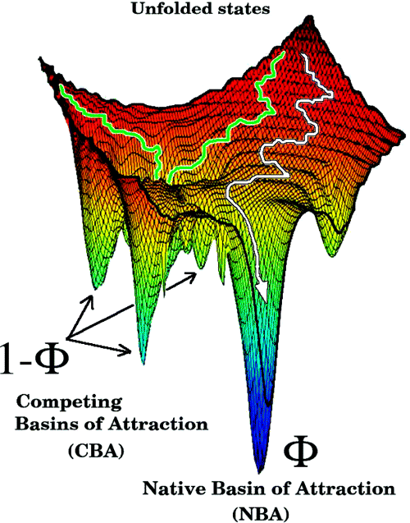
Energy landscape for monomeric folding
Monomer can misfold to
multiple conformations
Structural variations in the CBAs are imprinted in oligomers and fibrils

Slide 4
Aggregation Linked to diseases
Protein deposition diseases
* transmissible spongiform encephalopathies (TSE; Mad Cow Disease)
* Alzheimer’s disease, Parkinson’s disease
* diabetes (type II)
All these diseases = related to misfolding and protein aggregation
Misfolding into multiple amyloid conformations (strains)
Examples: prion proteins (TSE), Alzheimer’s, CWD
Question: What is the nature of the initial events in
oligomer formation?
Two broad scenarios: Illustrations using Aβ peptides and PrP^{C}
Current AD hypothesis: Soluble oligomers are neurotoxic

Slide 5
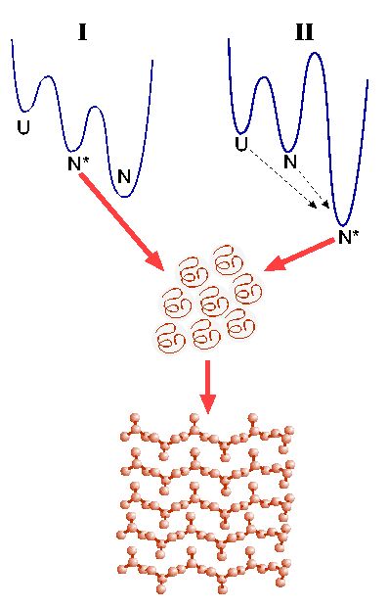
Scenarios for Fibrillization
(D.T., D. Klimov and R.Dima, Curr. Opin. Struct. Biol., 2003)
Aβ and TTR
Prions
N* = metastable
N* formation = partial unfolding
N* = stable
N* formation in prions = unfolding of N
K_{G} depends
on rate of
formation of
N* from N or
U
PrP^{c} is metastable
with respect to PrP*
aggregation prone
particle

Slide 6



Cascade of events to Fibrils
Scenario I (Partial unfolding/ordering)
nAβ₁₆₋₂₂⇔ (Aβ₁₆₋₂₂)_{n}
Polydisperse
Oligomers

Slide 7
Heterogeneous Nucleation and Growth
Differing
O_{n} + kM
Supra-
molecular
Assembly
K_{G} = F(Seq,C,GC)
Heterogeneous Nuclei

Slide 8
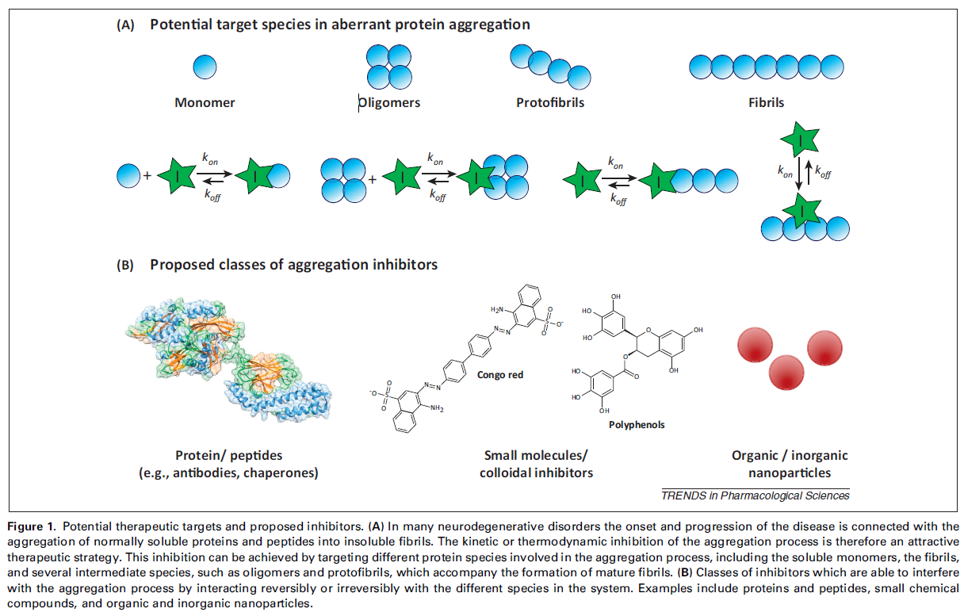
Kinetics of Protein Fibrils Formation

Slide 9
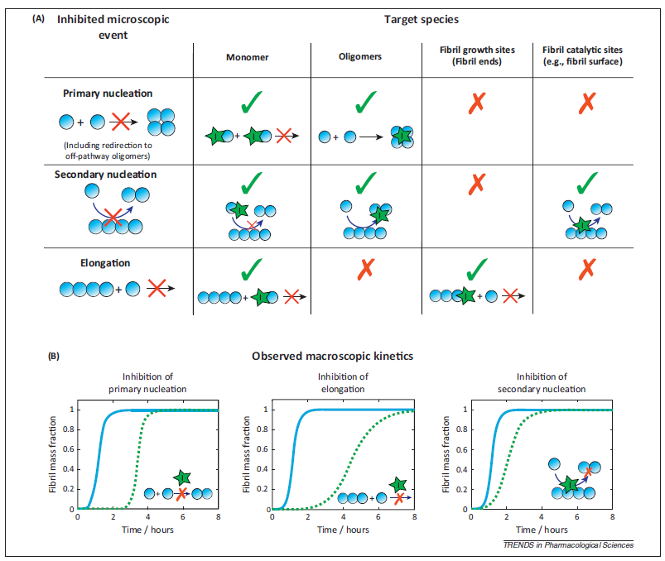
Kinetics of Protein Fibrils Formation

Slide 10
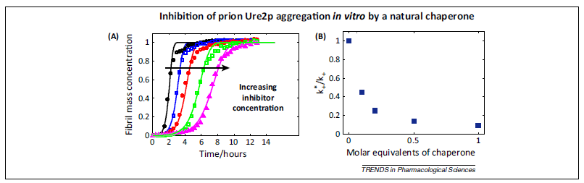
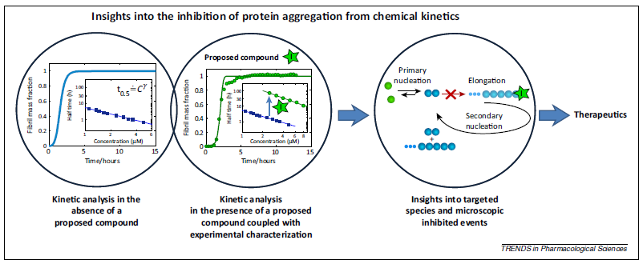
Kinetics of Protein Fibrils Formation

Slide 11
APP ans Aβ amyloid
Amyloid precursor protein (APP) is an integral membrane protein
expressed in many tissues and concentrated in the synapses of neurons.
Its primary function is not known, though it has been implicated as
a regulator of synapse formation,^{[3]} neural plasticity^{[4]} and iron export.
APP is best known as the precursor molecule whose proteolysis
generates beta amyloid (Aβ), a polypeptide containing 37 to 49
amino acid residues whose amyloid fibrillar form is the primary
component of amyloid plaques found in the brains of Alzheimer's
disease patients.

Slide 12
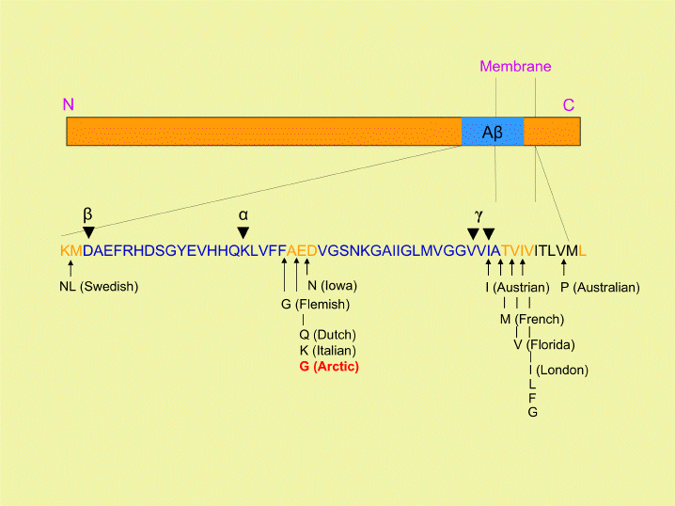
Aβ Sequence

Slide 13

Aβ-peptide in vivo is a metabolic product of precursor protein
Alzheimer’s Disease (AD) is responsible for 50% of cases of senile dementia
Ab-peptide is a normal byproduct of metabolism of Amyloid Precursor Protein (APP)
Cleavage of APP results from action of specific proteases called secretases
Aβ₁₀₋₃₅
Aβ₁₋₄₀ and Aβ₁₋₄₂ peptides
many naturally occurring mutants E22Q “Dutch” mutant
In Selkoe’s “Aβ hypothesis,” AD is a result of the accumulation of Aβ-peptide

Slide 14
Aβ₁₆₋₂₂ For Scenario I
Mechanism and Assembly Pathways
Sequence Effects
Role of water
Fragment has CHC
Interplay of hydrophobic/electrostatic effects

Slide 15
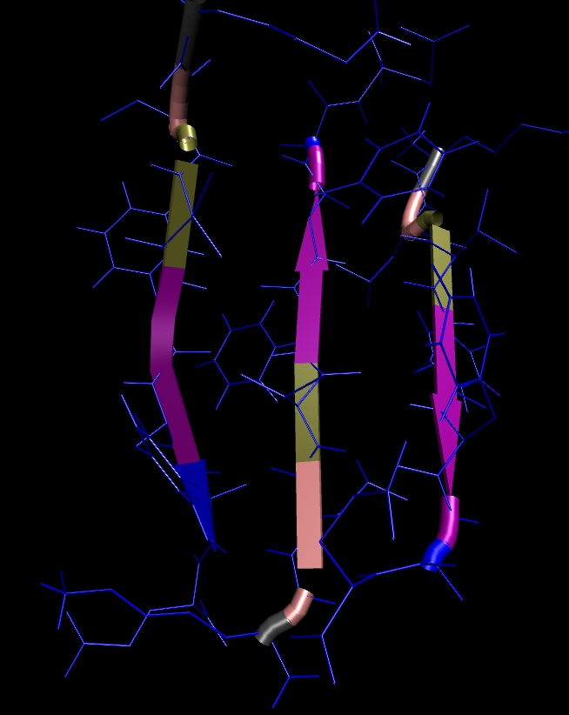
Trimer Structure from MD
Antiparallel β sheets
Monomer is a Random Coil
Structure: Inter-peptide Interaction Driven
Interior is dry:
Desolvation an early event

Slide 16
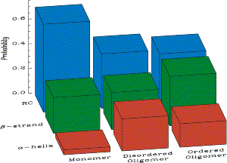
Dominant assembly pathway involves α-helical intermediate
Teplow JMB 2001
“Effective confinement”
induces helix formation
α-helical intermediate
“entropically” stabilized

Slide 17
Origin of α-helical Intermediate
Case I
C < C*
Low Peptide Concentration
C* = Overlap concentration
R_{jk} ≈ C^{-(1/3)}
R_{jk}
R_{jk}/R_{g} >> 1
Polypeptide is mostly a random coil

Slide 18
C > C* Peptides Interact
R_{jk} / R_{g} ~ O(1)
Peptide j is entropically
confined
j
In peptide j confinement
induces transient structure
k
For Aβ₁₆₋₂₂ interaction drives transient α-helix formation

Slide 19
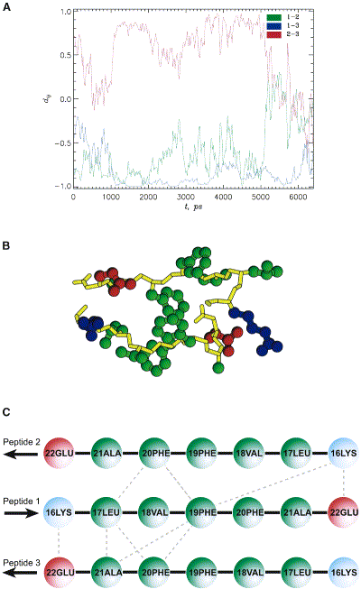
Hydrophobic and charged residues stabilize oligomers
1
⁺NH₃
COO⁻
2
⁻OOC
NH₃⁺
3
⁺NH₃
COO⁻
Principle of Organization
Anti-parallel registry satisfies
Hydrophobic and charged
interactions

Slide 20
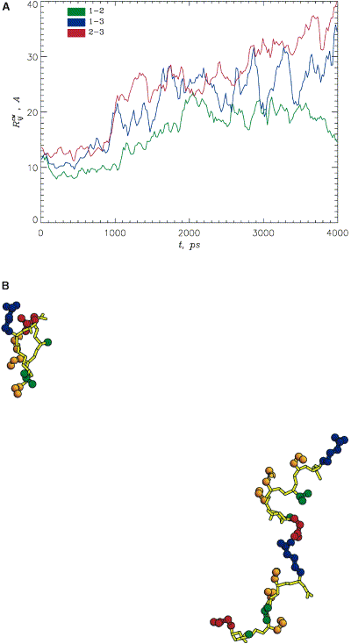
Mutations in the CHC destabilize Aβ₁₆₋₂₂ Oligomers
L17S/F19S/F20S mutant
Hydrophobic Packing
stabilizes oligomers

Slide 21
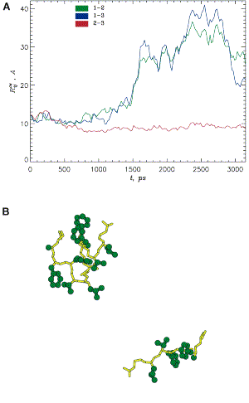
Structural orientation requires charged residues
“Long-range” correlations between charged residues in protein families linked to disease-related
proteins (Dima and DT, Bioinformatics (2003)
K16G/E22G trimer is unstable
Kinetics and stability of
Oligomerization determined
By balance of hydrophobic and
Charged interactions
Enhanced growth kinetics in E22Q
due to change in charged states
Massi,Klimov,DT, Straub (2002)

Slide 22
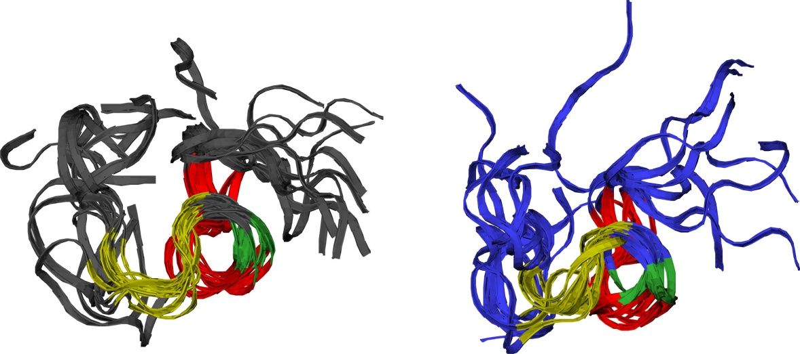
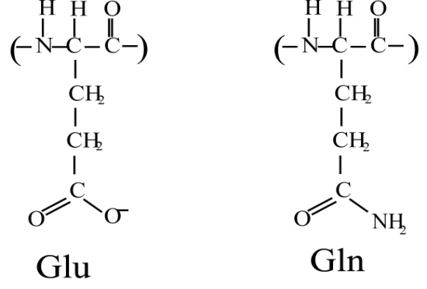
Electrostatics interactions essential in amyloid formation: Charged states
E22Q “Dutch” mutant peptide shows enhanced rate of amyloid formation@
Aβ₁₀₋₃₅-NH₂
Aβ₁₀₋₃₅-NH₂E22Q
Lower propensity for amyloid formation in WT peptide due to Glu⁻ charged states (versus Glnº)
Proposed INVERSE correlation between charge and aggregation rate - now seen experimentally%
*Zhang et al. Fold. Des. 3:413 (1998).
@ Miravalle et. Al., J. Biol. Chem., 275, 27110-27116 (2000).
#Massi and Straub, Biophys. J. 81:697 (2001); Massi, Klimov, Thirumalai and Straub, Prot. Sci. 11:1639 (2002).
% Chiti, Stefani, Taddei, Ramponi and Dobson, Nature 424:805 (2003).

Slide 23
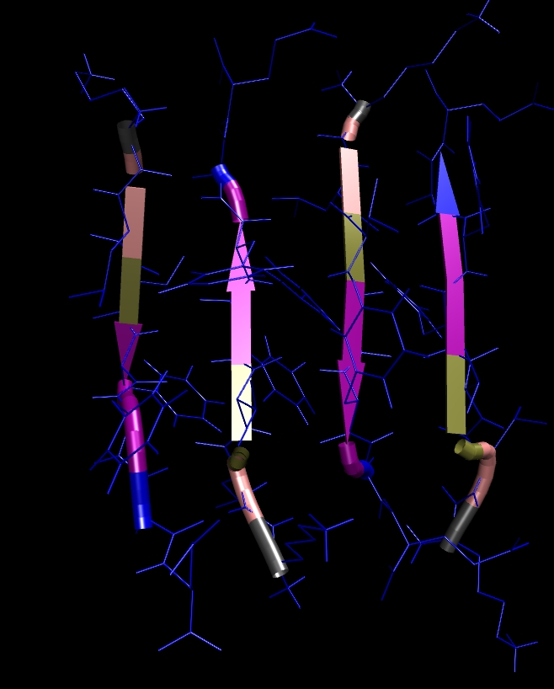
Templated assembly
Seed = Trimer
Insert Aβ₁₆₋₂₂ monomer
Tetramer forms rapidly
Nucleus > 4
Barrier to addition

Slide 24
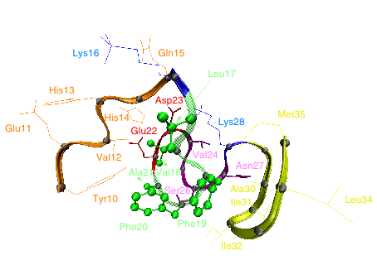
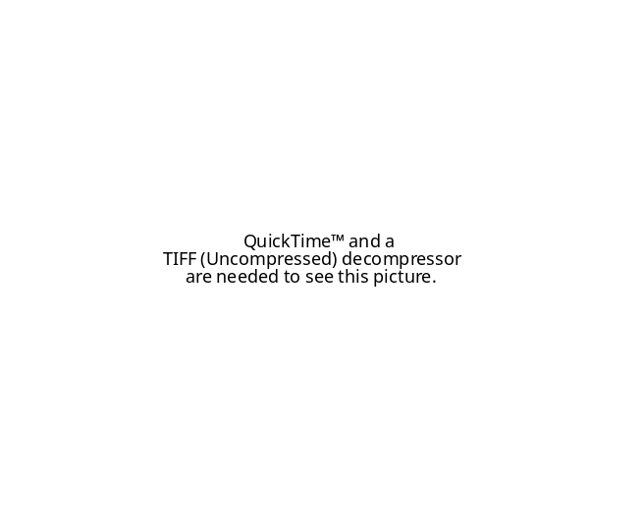
Important structural motifs in Aβ−peptide monomer and fibrils
Aβ-peptide structure determined in aqueous solution by NMR by Lee and coworkers*
Monomer Aβ₁₀₋₃₅ peptide has well-defined “collapsed coil” structure
Collapsed coil is stabilized by VGSN turn region and LVFFA central hydrophobic cluster#
central hydrophobic LVFFA cluster
* S. Zhang et al., J.Struct. Biol. 130, 130-141 (2000).
# Massi, Peng, Lee and Straub, Biophys. J. 80:31 (2001).
% Tycko and coworkers, PNAS 99: 16742 (2002).
VGSN turn region

Slide 25
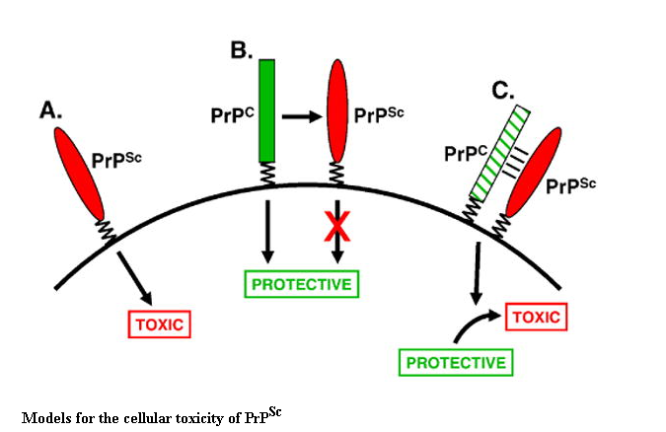
Scenario II (Global unfolding of PrP^{C})
Major prion protein (PrP), is encoded in the human by the PRNP gene also known as CD230
Prion diseases are caused by conversion of a normal cell-surface glycoprotein (PrP^{C}) into a conformationally altered isoform (PrP^{Sc}) that is infectious in the absence of nucleic acid. Although a great deal has been learned about PrP^{Sc} and its role in prion propagation, much less
is known about the physiological function of PrP^{C}

Slide 26
Scenario II (Global unfolding of PrP^{C})
(D.T., D. Klimov and R.D., Curr. Op. Struct. Biol., 2003)
Aβ, TTR
Prions
N* = metastable
N* formation = partial unfolding
N = metastable
N* formation involves global unfolding of N
PrP^{Sc} growth kinetics
Depends on rate of
N→N* transition K_{N→N*}
K_{N→N*} depends on sequence and ΔG† between N and N*

Slide 27
Mechanism of assembly and propagation
Prions
normal form PrP^{C} = mostly α-helical
scrapie form PrP^{Sc} = mostly β−strand
the “protein-only hypothesis”: (Prusiner et al., Cell 1995 and Science 2004)
PrP^{Sc} = template to catalyze conversion of normal form into the aggregate
β
Fluctuation
Nucleation
α
β*
β
β
Growth
PrP^{C}*
?
Propagation by recruitment

Slide 28
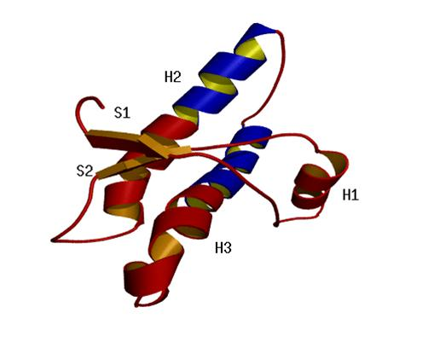
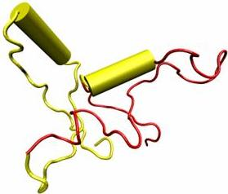
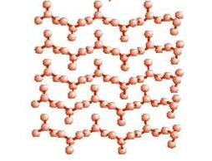
Question and Hypothesis
Minimal infectious unit
90
121
231
Disordered in PrP^{C}
Ordered
Proposal:
PrP^{Sc} formation is preceded by transition from
α → PrP^{C*} state
Unfolded
PrP^{C}
PrP^{C}*
?
PrP^{Sc}
(48% β, 25% α)
(45% α, 8% β)
(20% α)

Slide 29

NMR Structure of Cellular form (PrP^{C})
Prions:
“…Prion is a proteinaceous particle that lacks nucleic acid”
(Prusiner, PNAS, 1998)
mPrP^{C}(121-231)
PrP^{C}: 45% α, 8% β
PrP^{Sc}(90-231): 25% α, 48% β
(Caughey et al. Biochemistry 30, 7672 (1991))
Wuthrich 1997
(Cys179-Cys214)

Slide 30
Predictions using Bioinformatics
A. Study of NMR structures and sequences of prions
(R.I. Dima. and D.T., Biophys. J., 2002)
certain regions besides (90-120) must undergo conformational transition:
C-terminus of H2 and parts of H3
H1 has high helical propensity: unlikely to undergo conformational change
Large barrier because core (H2+H3) changes conformation
ΔG‡ > 20 kcal/mol
Unfolded
PrP^{C}
(Prusiner et al. JBC 276, 19687 (2001))
PrP^{C}*

Slide 31
H1 in mammalian PrP^{C} is helical
Charge patterns in H1 is rarely found in PDB, E. Coli and
Yeast genomes

Slide 32
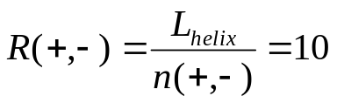
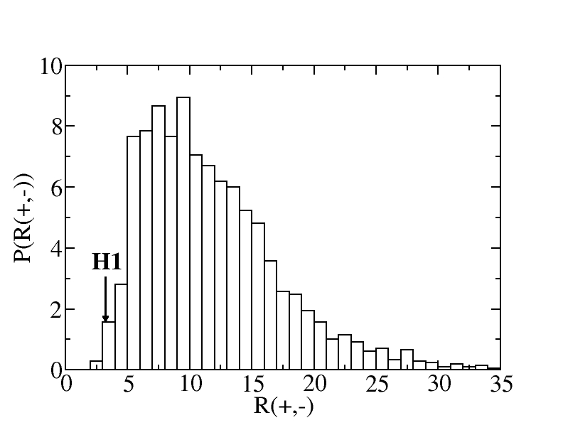
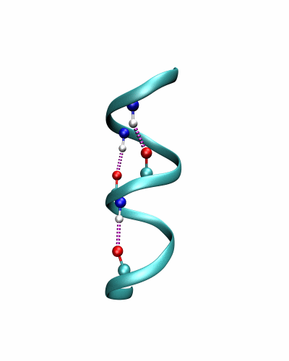
Pattern search for H1 in PrP^{C}
Random considerations:
(i,i+4) = oppositely charged residues
search sequences of 2103 PDB helices (L_{helix} ≥ 6)
(i,i+4) salt-bridges in mPrP^{C}

Slide 33
Sequence analysis shows PrP^{C} H1 is a helix
- X - - + X X + - X
search PDBselect (1210 proteins)
      23 (1.9%) sequences
      83% = α-helical, 17% = random coil
search E. Coli (4289 proteins) genome
      51 (1.2%) sequences
search yeast (8992 proteins) genome
      253 (2.8%) sequences
Pattern of charged residues in H1 is unusual and NEVER associated with β-strand

Slide 34
Experiments and MD simulations show H1 is very stable
Conformational fluctuations and stability of H1 with two force
fields
Stability is largely due to the three salt bridges in the
10 residue H1 from mPrP^{C}

Slide 35
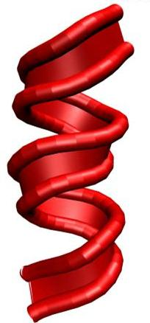
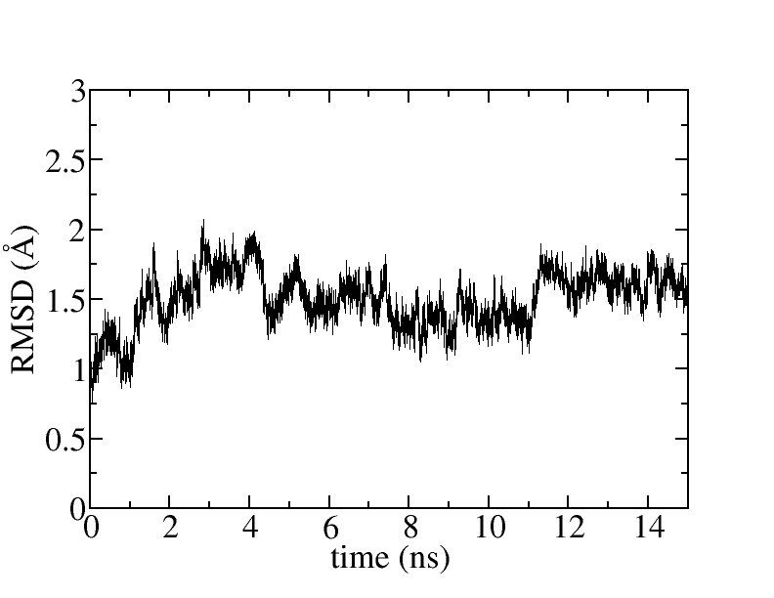
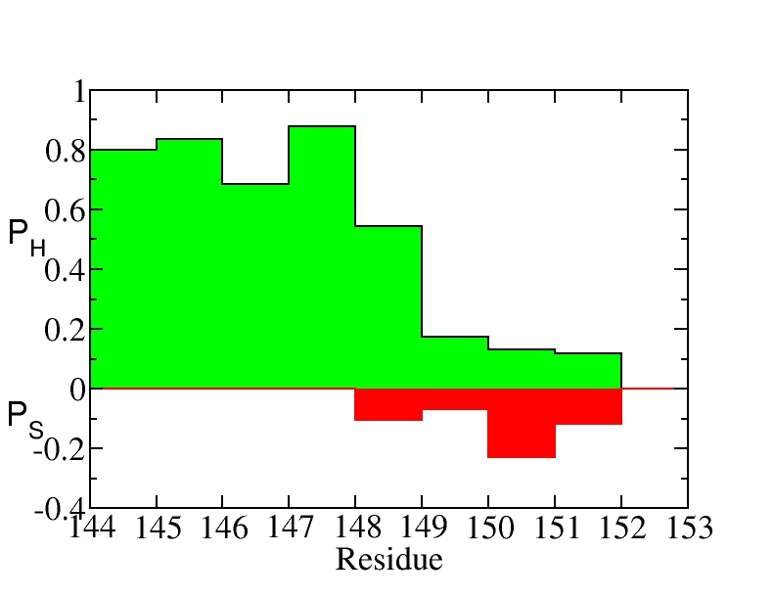
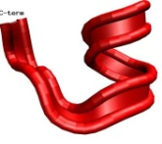
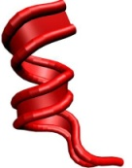
High helical propensity at all positions in H1
MOIL package (Amber and OPLS) (R. Elber et al.)
H1 from mPrP (10 residues)
positions 144-153
773 TIP3P water, 30 Ǻ cubic box, 300 K, neutral pH
5 trajectories, 85 ns
PDB
Helix
Strand

Slide 36
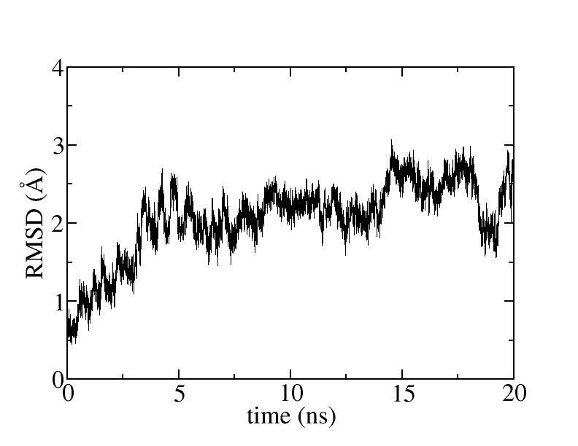
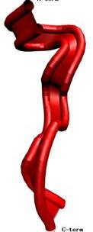
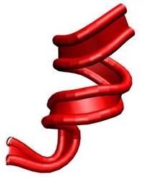
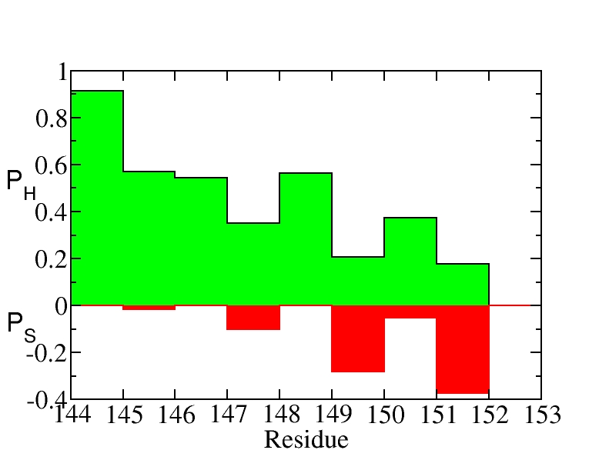
Loss of stability upon disruption of salt bridge
MOIL package (Amber and OPLS)
[D147A,R151A] mutant of H1
4 trajectories, 105 ns
Large fluctuations on short times
Helix
Strand

Slide 37
Experiments show that H1 is a stable helix
NMR and CD spectroscopy on (143-158) from mPrP
(Wuthrich et al., Biopolymers 51, 145, 1999)
144-151 = very stable in α-helix conformation
(fraction helical = 0.42)
From simulations: fraction helical (wt-H1) = 0.65
NMR and CD spectroscopy on (140-158) from huPrP
(Schwarzinger et al., J. Biol. Chem. 278, 50175, 2003)
144-151 is a highly stable α-helix
huPrP(140-158)D147A = destabilized compared to wt-huPrP(140-158)
From simulations: fraction helical ([D147A,R151A]H1) = 0.55

Slide 38
Unusual hydrophobicity pattern in H2
X X X H H X X H H X H X H X X X X H P P P P X
search PDBAstral40 (6000 proteins)
      12 (0.2%) sequences
      the sequence is NEVER entirely α-helical
      (last 5 residues = non-helical in 87% of cases)
search E. Coli (4289 proteins) genome
      46 (1%) sequences
search yeast (8992 proteins) genome
      122 (1.4%) sequences
Pattern of hydrophobicity of H2 is rare and NEVER entirely in a α-helix

Slide 39
H2+H3 in mammalian PrP^{C} frustrated in helical state
R. I. Dima and DT Biophys J. (2002); PNAS (2004)
Conformational fluctuations in H2+H3 implicate a role for second
half of H2 in the PrP^{C} → PrP^{C}* transition

Slide 40
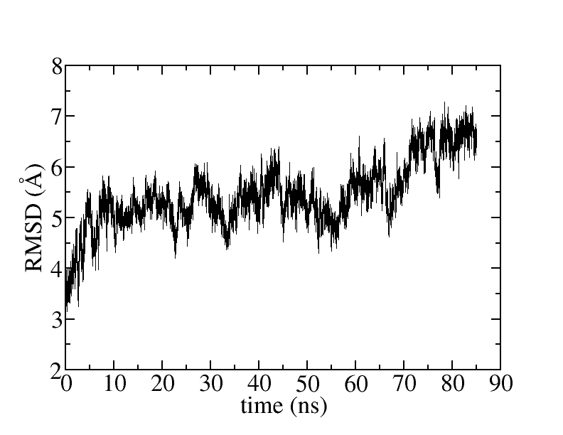
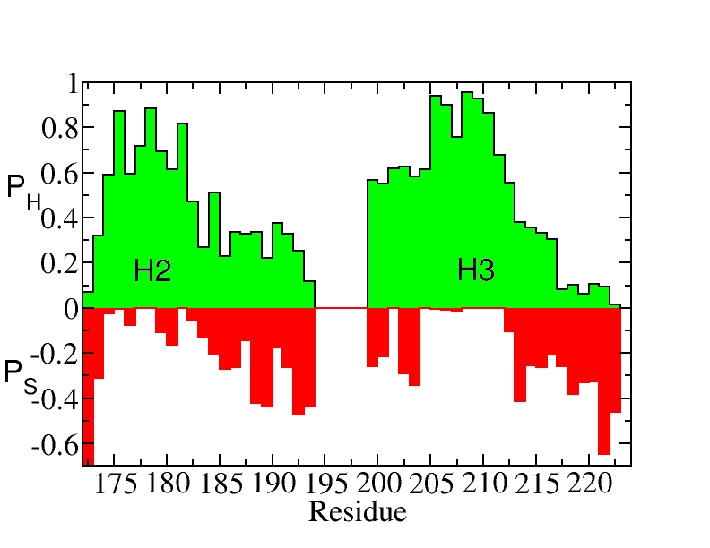
Enhanced strand propensity in H2 & H3
NAMD package (Charmm) (K. Schulten et al.)
H2+H3 in mPrP , S-S bond
positions 172-224
1553 water molecules, 40 Å cubic box, 300 K, neutral pH
3 trajectories, 285 ns
Helix
Strand

Slide 41
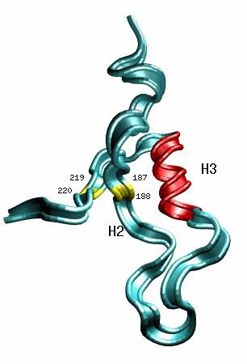
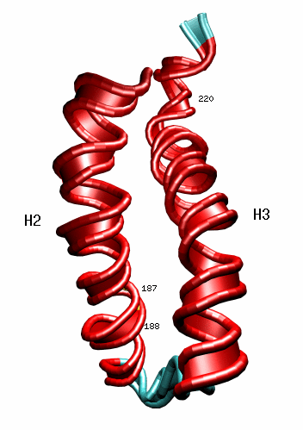
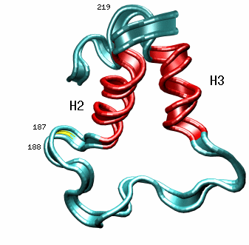
Structural transitions in H2+H3
NAMD package (Charmm)
H2+H3 in mPrP , S-S bond
H2 starts to unwind around position 187
unwinding by stretching and bending

Slide 42
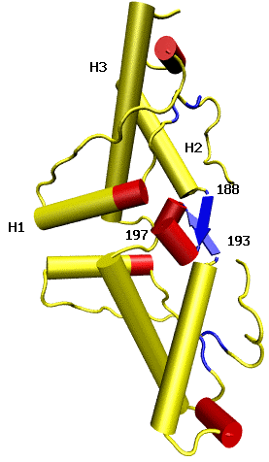
X-ray structure of PrP^{C} dimer shows changes in H2 and H3
Domain-swapped dimer of huPrP^{C} (Surewicz et al., NSB 8, 770, 2001)
H1: 144-153
(monomer: 144-153)
H2: 172-188 and 194-197
(monomer: 173-194)
H3: 200-224
(monomer: 200-228)
PDB file 1i4m

Slide 43
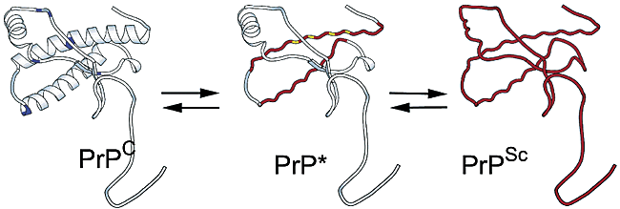
Rarely populated PrP^{C}* shows changes in H2 and H3
¹⁵N-¹H 2D NMR under variable pressure and NMR relaxation analysis on shPrP(90-231)
(James et al., Biochemistry 41, 12277 (2002) and 43, 4439 (2004))
in PrP^{C*} C-terminal half of H2 and part of H3 are disordered
98.99%
1.0%
0.01%

Slide 44
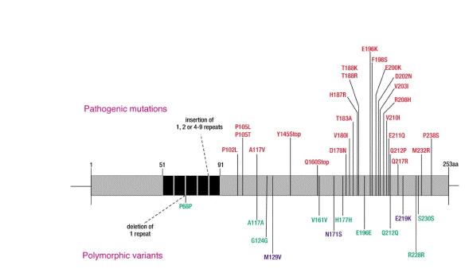
Many pathogenic mutations are clustered around H2 and H3
From Collinge (2001)
H2 and H3 region

Slide 45
Scenario for initiation of PrP^{C} aggregation
Finding:
transition α → PrP^{C*} state
initiated in second half of H2 and does not involve H1
ΔG†
Unfolded
ΔG† /K_{B}T >> 1
PrP^{C}
PrP^{C}* formation
improbable
PrP^{C}*
(45% α, 8% β)
PrP^{Sc}
(48% β, 25% α)
(20% α)

Slide 46
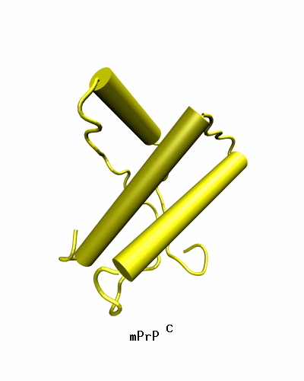
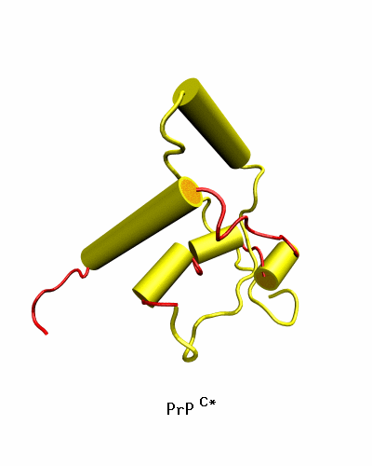
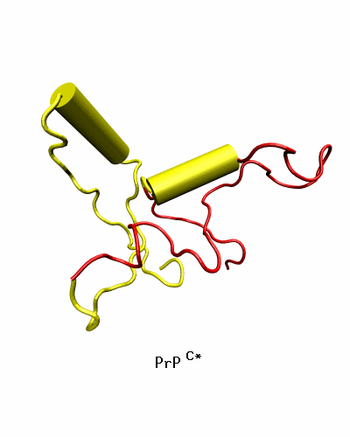
Proposed structures for PrP^{C*}
PDB
Amber and OPLS
Charmm
(48% α-helix)
(30% α-helix)
(20% α-helix)
H1 still α-helical
H3 only partially α-helical

Slide 47
Conclusions
Multiple routes and scenarios for fibril formation
Electrostatic and hydrophobic interactions determine structure and kinetics
Conformational heterogeneity in N* controls oligomer and fibril morphology (may be relevant for strains)
Phase diagram (T, C) plane for a single amyloidogenic protein is complex due to structural variations in the misfolded N*
Templated growth occurs by addition of one monomer at a time
Nucleus size and growth mechanism depends on protein

