Slide 1
Classical Molecular Dynamics Simulations of Proteins

Slide 2
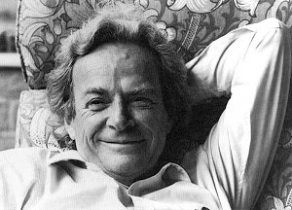
“everything that living things do can be understood in terms of the jigglings and wigglings of atoms.”
The Feynman Lectures in Physics vol. 1, 3-6 (1963)

Slide 3
What is Molecular Dynamics?
“The science of simulating the motions of a system of particles” (Karplus & Petsko)
From systems
  As small as an atom
  As large as a galaxy
Equations of motion
Time evolution

Slide 4
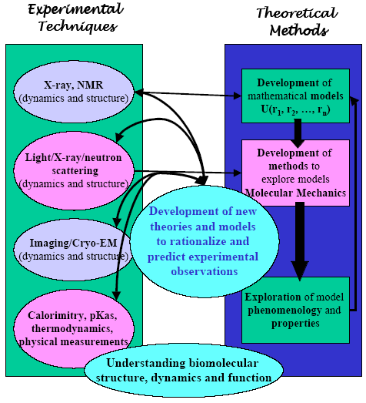
Why?

Slide 5
Essential Elements
Knowledge of the interaction potential for the particles Forces
Classical Newtonian equations of motion
Many particle systems simulation
Maxwell-Boltzmann averaging process for thermodynamic properties: time averaging
Many particles impossible analytically
One particle
easy analytically

Slide 6
Basis: Molecular Mechanics
Theoretical foundation
Potential energy functions
Energy minimization
Molecular dynamics

Slide 7
Uses of simulation & modelling
Conformational searching with MD and minimization
Exploration of biopolymer fluctuations and dynamics & kinetics
MD as an ensemble sampler

Slide 8
Free energy simulations
Example applications
Energy minimization as an estimator of binding free energies
Protein stability
Approximate association free energy of molecular assemblies
Approximate pKa calculations

Slide 9
Theoretical Foundations
Force field parameters for families of chemical compounds
System modelled using Newton’s equations of motion
Examples: hard spheres simulations (Alder & Wainwright, 1959); Liquid water (Rahman & Stillinger, 1970); BPTI (McCammon & Karplus, 1976); Villin headpiece (Duan & Kollman, 1998)

Slide 10
Protein Motion
Protein motions of importance are torsional oscillations about the bonds that link groups together
Substantial displacements of groups occur over long time intervals
Collective motions either local (cage structure) or rigid-body (displacement of different regions)
What is the importance of these fluctuations for biological function?

Slide 11
Effect of fluctuations
Thermodynamics: equilibrium behaviour important; e.g., energy of ligand binding
Dynamics: displacements from average structure important; e.g., local sidechain motions that act as conformational gates in oxygen transport myoglobin, enzymes, ion channels

Slide 12
Local Motions
0.01-5 Å, 1 fs -0.1s
Atomic fluctuations
  Small displacements for substrate binding in enzymes
  Energy “source” for barrier crossing and other activated processes (e.g., ring flips)
Sidechain motions
  Opening pathways for ligand (myoglobin)
  Closing active site
Loop motions
  Disorder-to-order transition as part of virus formation

Slide 13
Rigid-Body Motions
1-10 Å, 1 ns – 1 s
Helix motions
  Transitions between substates (myoglobin)
Hinge-bending motions
  Gating of active-site region (liver alcohol dehydrogenase)
  Increasing binding range of antigens (antibodies)

Slide 14
Large Scale Motion
> 5 Å, 1 microsecond – 10000 s
Helix-coil transition
  Activation of hormones
  Protein folding transition
Dissociation
  Formation of viruses
Folding and unfolding transition
  Synthesis and degradation of proteins
Role of motions sometimes only inferred from two or more conformations in structural studies

Slide 15
Typical Time Scales ....
Bond stretching: 10⁻¹⁴ - 10⁻¹³ sec.
Elastic vibrations: 10⁻¹² - 10⁻¹¹ sec.
Rotations of surface sidechains: 10⁻¹¹ - 10⁻¹⁰ sec.
Hinge bending: 10⁻¹¹ - 10⁻⁷ sec.
Rotation of buried side chains: 10⁻⁴ - 1 sec.
Protein folding: 10⁻⁶ - 10² sec.
Timescale in MD:
A Typical timestep in MD is 1 fs (10⁻¹⁵ sec)
(ideally 1/10 of the highest frequency vibration)

Slide 16
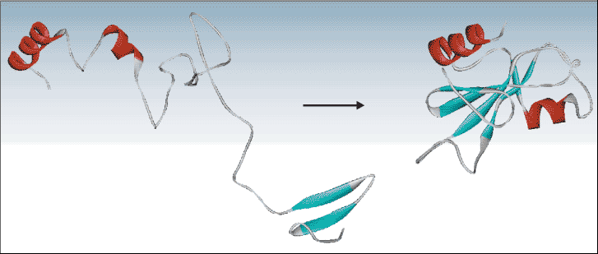

Ab initio protein folding simulation
Physical time for simulation 10^{–4} seconds
Typical time-step size 10^{–15} seconds
Number of MD time steps 10¹¹
Atoms in a typical protein and water simulation 32,000
Approximate number of interactions in force calculation 10⁹
Machine instructions per force calculation 1000
Total number of machine instructions 10²³
BlueGene capacity (floating point operations per second) 1 petaflop (10¹⁵)
➔ Blue Gene will need 3 years to simulate 100 μsec.
[ http://www.research.ibm.com/bluegene/ ]

Slide 17
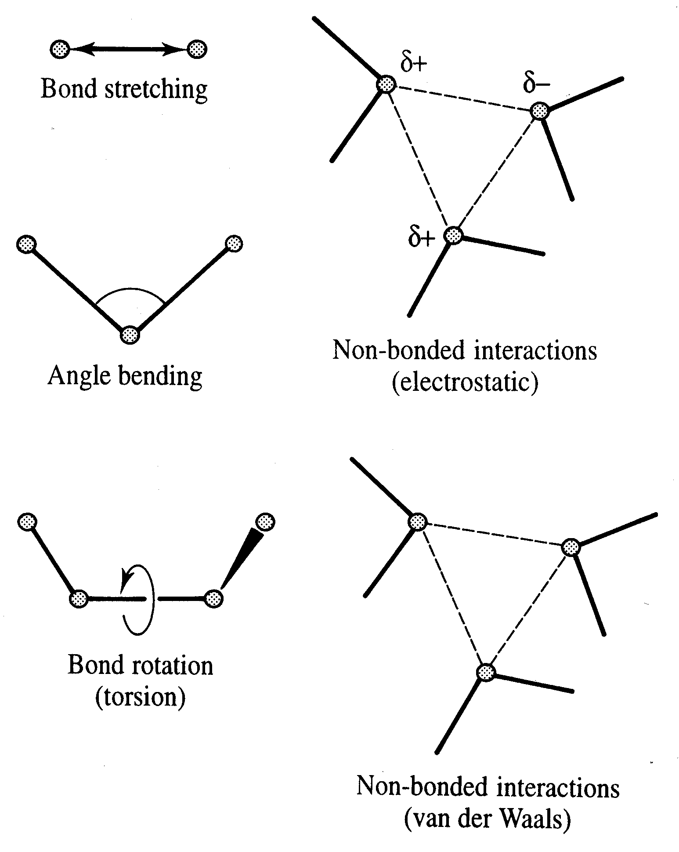
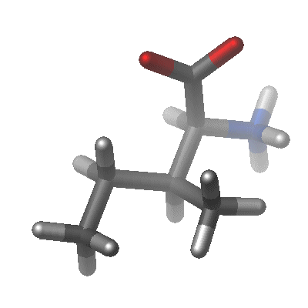
Empirical Force Fields and Molecular Mechanics
describe interaction of atoms or groups
the parameters are “empirical”, i.e. they are dependent on others and have no direct intrinsic meaning

Slide 18
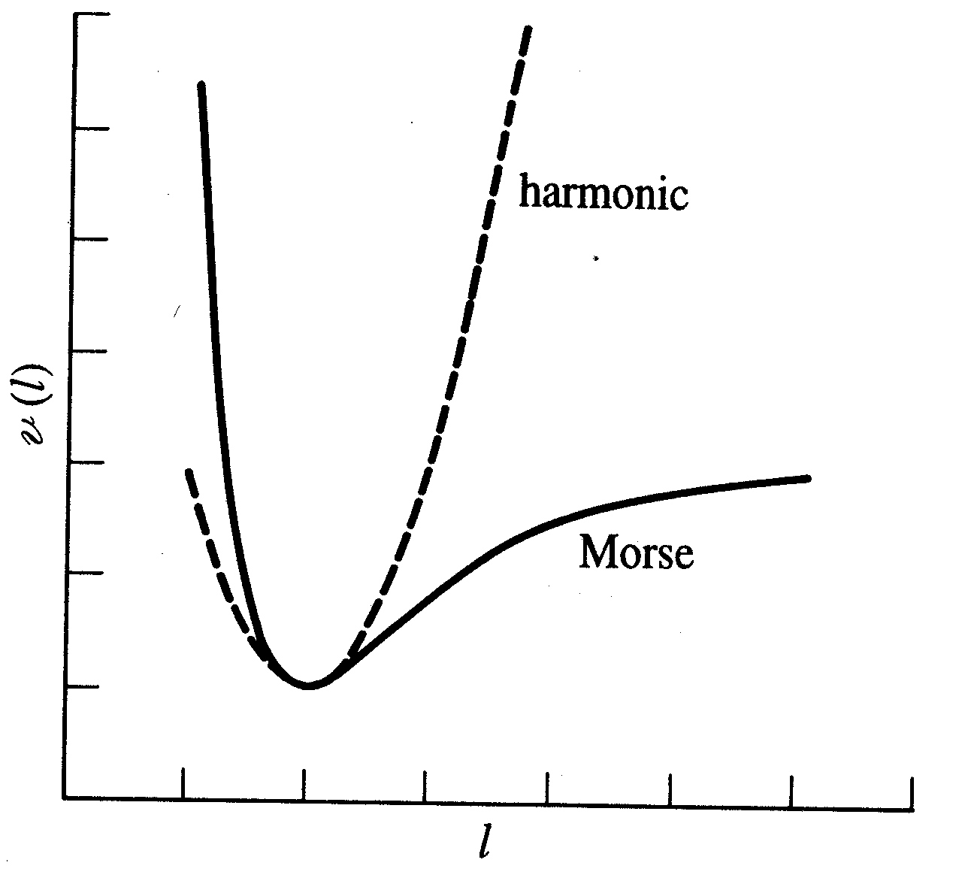
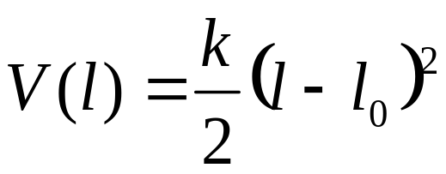
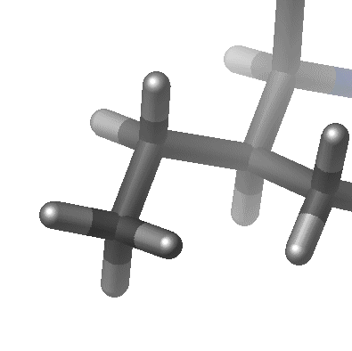
Bond stretching
Approximation of the Morse potential by an “elastic spring” – model
Hooke’s law as reasonable approximation close to reference bond length l₀
k : Force constant
l : distance
l

Slide 19
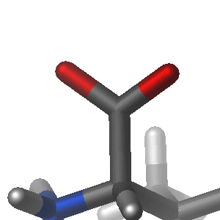
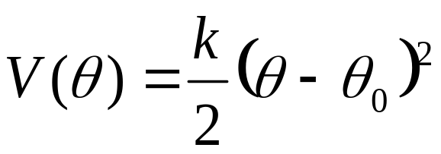
Angle Bending
Deviation from angles from their reference angle θ₀ often described by Hooke’s law:
θ
k : Force constant
θ : bond angle
Force constants are much smaller than those for bond stretching

Slide 20
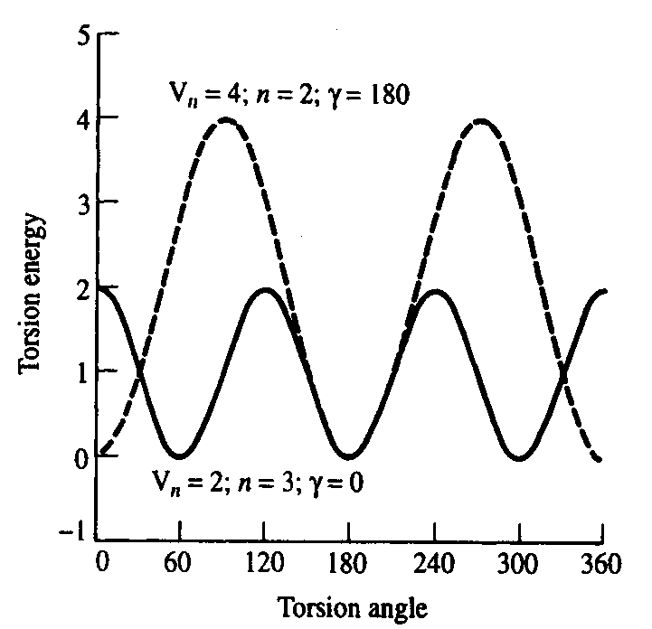
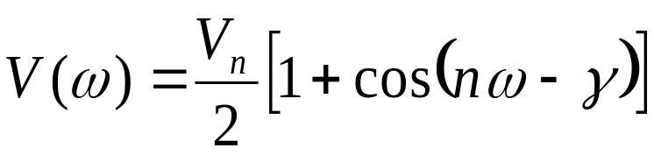
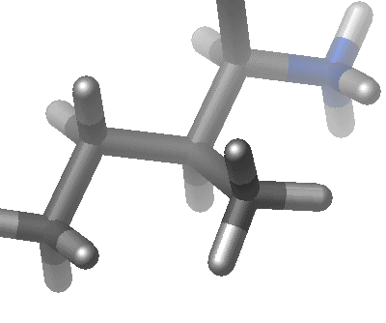
Torsional Terms
Hypothetical potential function for rotation around a chemical bond:
V_{n} : ‘barrier’ height
n : multiplicity (e.g. n=3)
ω : torsion angle
γ : phase factor
Need to include higher terms for non-symmetric bonds
(i.e. to distinguish trans, gauche conformations)

Slide 21
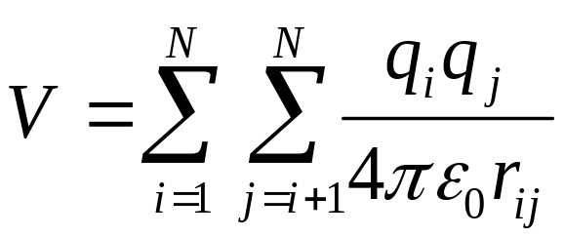
Electrostatic interactions
Electronegative elements attract electrons more than less electronegative elements
Unequal charge distribution is expressed by fractional charges
Electrostatic interaction often calculated by Coulomb’s law:
q
+
+
r
-

Slide 22
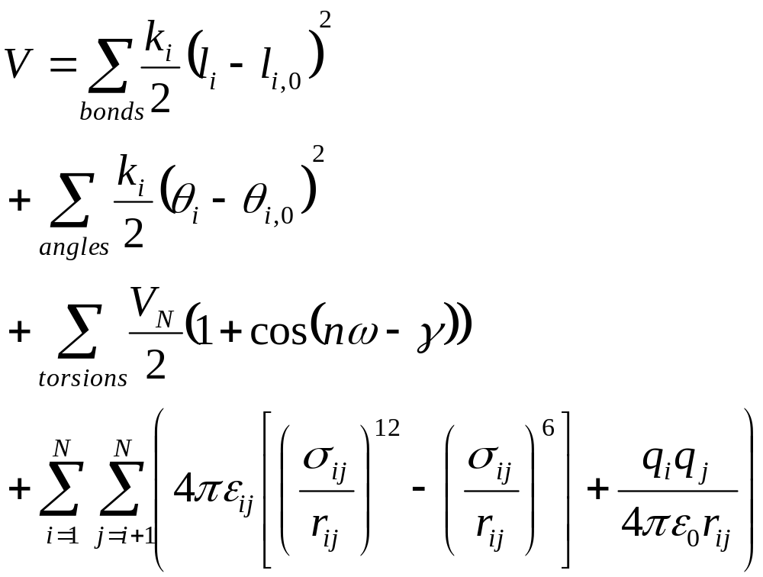
Example for a (very) simple Force Field:

Slide 23
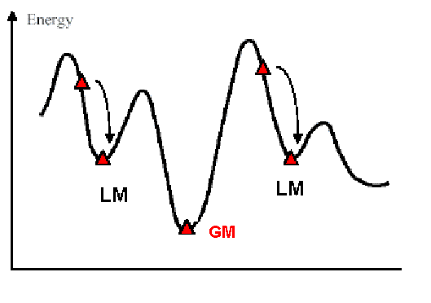
Molecular Mechanics - Energy Minimization
The energy of the system is minimized. The system tries to relax
Typically, the system relaxes to a local minimum (LM).

Slide 24
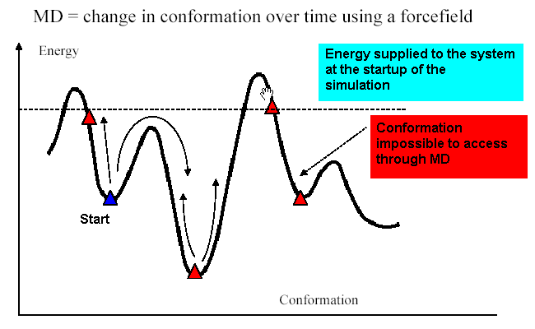
Molecular Dynamics (MD)
In molecular dynamics, energy is supplied to the system, typically using a constant temperature (i.e. constant average constant kinetic energy).

Slide 25
Newton’s Laws of Motion
A body maintains its state of rest or of uniform motion in a straight line, unless acted upon by a force.
The applied force is equal to the rate of change of momentum.
Two isolated bodies acting upon each other experience equal and opposite forces.

Slide 26
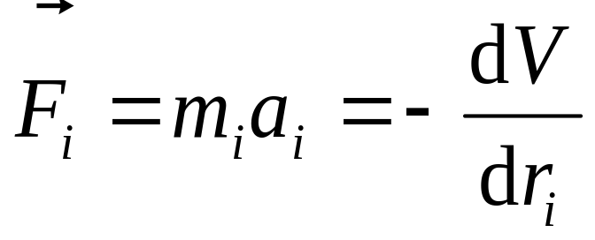
Molecular Dynamics (MD)
Use Newtonian mechanics to calculate the net force and acceleration experienced by each atom.
Each atom i is treated as a point with mass m_{i} and fixed charge q_{i}
Determine the force F_{i} on each atom:
Use positions and accelerations at time t (and positions from t - δ t) to calculate new positions at time t +δ t

Slide 27

Cutoffs

Slide 28
(a) Estimate the total number of possible structures of a polypeptide consisting of 10 amino acid residues. State and justify any assumptions that you make.
(b) Calculate the number of pairwise interactions which need to be evaluated to calculate the energy of a 10-residue peptide, stating any assumptions you make. If a computer capable of calculating one million pairwise interactions per second is used, and the time to perform a systematic search of all conformations is one structure per 10⁻¹³ seconds, estimate both the simulation time required to fold the peptide and the time it would take to calculate the energy of all the conformers.

Slide 29
*** Molecular Dynamics
Notes:
Personal history
Faculty at Columbia, computer science, doing computer architecture
Levinthal: protein folding
Left for Wall St. to apply mathematical, computational techniques to identify underpriced investments
Field that’s come to be known as computational finance
Meanwhile, genome decoded, IC technology advanced
20 years later, I realized time was right – not just for protein folding, but broader
Wrote letter to investors
In this talk, I’ll try to give you some sense for why I gave up running a successful company with 550 employees to return to hands-on scientific research and lead a group with 29 people – even there, scientifically, not administrative management
Briefly, I’ve never seen a research opportunity as exciting as this one
I think major scientific discoveries, possibly major contributions to biomedical research, are about to be made due to efforts of people with backgrounds like those of yours and mine.
Couldn’t sit back and watch from a distance while it happened
First, I’ll have to provide some background on the science

Slide 30
Molecular Dynamics
Divide time into discrete time steps
t
~1 fs time step
Notes:
Why 1 ms? Proteins fold, biologically significant conformational changes
1000x longer than current state of the art
Why communication required? (Bring together data from pairs of atoms; send force components back)
PREPARE A FIGURE SLIDE TO FOLLOW THIS ONE, WITH SCALING CURVES (WE HOPE TO MOVE FROM ONE THAT REACHES DIMINISHING RETURNS QUICKLY TO ONE THAT DOES SO SLOWLY)

Slide 31
Molecular Dynamics
Calculate forces
Molecular mechanics
force field
Notes:
Why 1 ms? Proteins fold, biologically significant conformational changes
1000x longer than current state of the art
Why communication required? (Bring together data from pairs of atoms; send force components back)
PREPARE A FIGURE SLIDE TO FOLLOW THIS ONE, WITH SCALING CURVES (WE HOPE TO MOVE FROM ONE THAT REACHES DIMINISHING RETURNS QUICKLY TO ONE THAT DOES SO SLOWLY)

Slide 32
Molecular Dynamics
Move atoms
Notes:
Why 1 ms? Proteins fold, biologically significant conformational changes
1000x longer than current state of the art
Why communication required? (Bring together data from pairs of atoms; send force components back)
PREPARE A FIGURE SLIDE TO FOLLOW THIS ONE, WITH SCALING CURVES (WE HOPE TO MOVE FROM ONE THAT REACHES DIMINISHING RETURNS QUICKLY TO ONE THAT DOES SO SLOWLY)

Slide 33
Molecular Dynamics
Move atoms
... a little bit
Notes:
Why 1 ms? Proteins fold, biologically significant conformational changes
1000x longer than current state of the art
Why communication required? (Bring together data from pairs of atoms; send force components back)
PREPARE A FIGURE SLIDE TO FOLLOW THIS ONE, WITH SCALING CURVES (WE HOPE TO MOVE FROM ONE THAT REACHES DIMINISHING RETURNS QUICKLY TO ONE THAT DOES SO SLOWLY)

Slide 34
Molecular Dynamics
Iterate
Iterate
Iterate
... and iterate
Iterate
... and iterate
Integrate Newton’s
laws of motion
Notes:
Why 1 ms? Proteins fold, biologically significant conformational changes
1000x longer than current state of the art
Why communication required? (Bring together data from pairs of atoms; send force components back)
PREPARE A FIGURE SLIDE TO FOLLOW THIS ONE, WITH SCALING CURVES (WE HOPE TO MOVE FROM ONE THAT REACHES DIMINISHING RETURNS QUICKLY TO ONE THAT DOES SO SLOWLY)

Slide 35
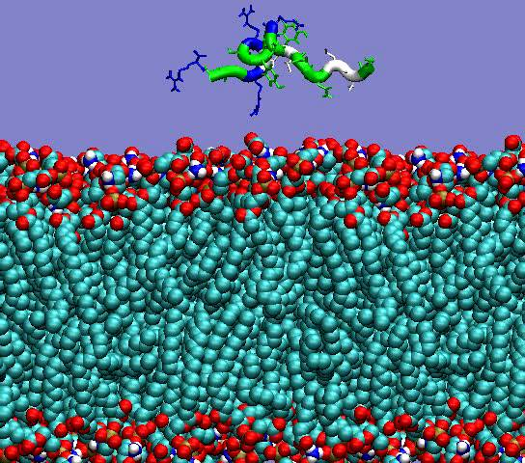
Example of an MD Simulation
Notes:
Explain what this simulation is. John Klepeis, defensins, what we hope to learn.

Slide 36
Main Problem With MD
Too slow!
Example I just showed:
  2 ns simulated time
  3.4 CPU-days to simulate

Slide 37
*** Goals and Strategy
Notes:
Personal history
Faculty at Columbia, computer science, doing computer architecture
Levinthal: protein folding
Left for Wall St. to apply mathematical, computational techniques to identify underpriced investments
Field that’s come to be known as computational finance
Meanwhile, genome decoded, IC technology advanced
20 years later, I realized time was right – not just for protein folding, but broader
Wrote letter to investors
In this talk, I’ll try to give you some sense for why I gave up running a successful company with 550 employees to return to hands-on scientific research and lead a group with 29 people – even there, scientifically, not administrative management
Briefly, I’ve never seen a research opportunity as exciting as this one
I think major scientific discoveries, possibly major contributions to biomedical research, are about to be made due to efforts of people with backgrounds like those of yours and mine.
Couldn’t sit back and watch from a distance while it happened
First, I’ll have to provide some background on the science

Slide 38
Thought Experiment
What if MD were
  Perfectly accurate?
  Infinitely fast?
Would be easy to perform
arbitrary computational experiments
  Determine structures by watching them form
  Figure out what happens by watching it happen
  Transform measurement into data mining

Slide 39
Two Distinct Problems
Problem 1: Simulate many short trajectories
Problem 2: Simulate one long trajectory

Slide 40
Simulating Many Short Trajectories
Can answer surprising number of interesting questions
Can be done using
  Many slow computers
  Distributed processing approach
  Little inter-processor communication
E.g., Pande’s Folding at Home project

Slide 41
Simulating One Long Trajectory
Harder problem
Essential to elucidate many biologically interesting processes
Requires a single machine with
  Extremely high performance
  Truly massive parallelism
  Lots of inter-processor communication

Slide 42
DESRES Goal
Single, millisecond-scale MD simulations (long trajectories)
  Protein with 64K or more atoms
  Explicit water molecules
Why?
  That’s the time scale at which many biologically interesting things start to happen

Slide 43
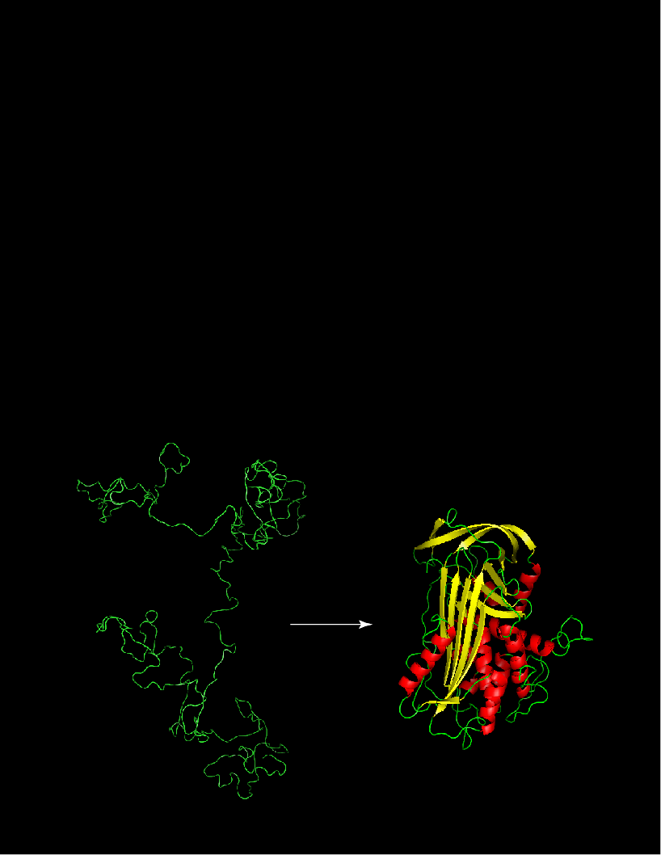
Protein Folding
Image: Istvan Kolossvary & Annabel Todd,
D. E. Shaw Research
Notes:
We know experimentally -- microsecond to millisecond time frame
Including membrane proteins

Slide 44
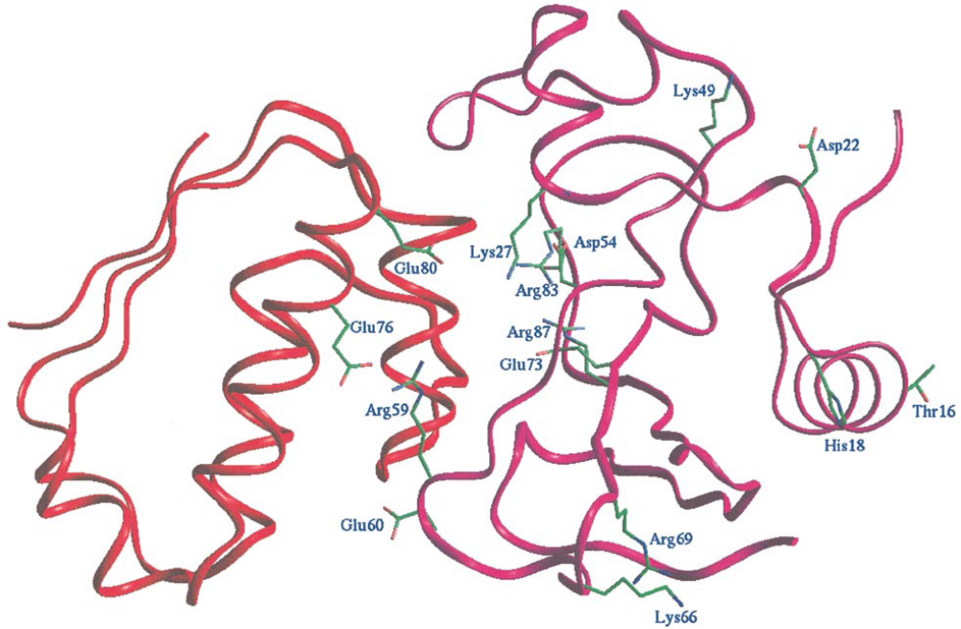
Interactions Between Proteins
Image: Vijayakumar, et al., J. Mol. Biol. 278, 1015 (1998)
Notes:
Barnase-barstar complex

Slide 45
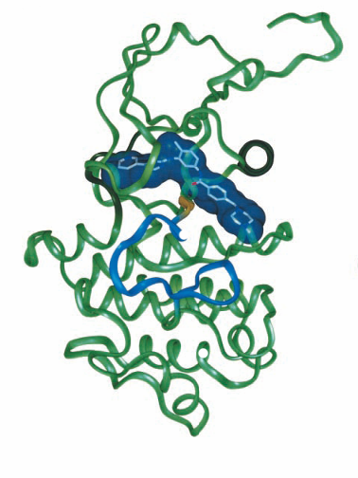
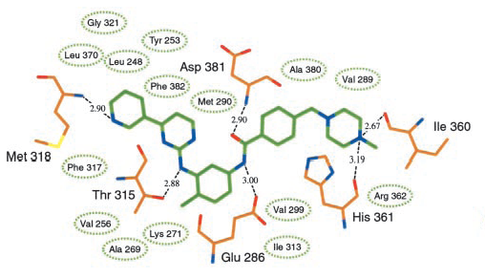
Binding of Drugs to their Molecular Targets
Image: Nagar, et al., Cancer Res. 62, 4236 (2002)
Notes:
Binding of proteins to either endogenous or pharmaceutical ligands.
Induced fit.
Microsecond to millisecond time frame
(This one shows the binding of imatinib, a tyrosine kinase inhibitor that’s now been approved by the FDA under the name Gleevec, to the BCR/ABL fusion protein.)

Slide 46
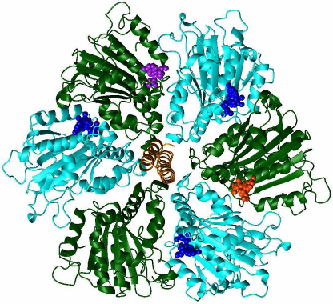
Mechanisms of Intracellular Machines
Image: H. Grubmüller, in Attig, et al. (eds.), Computational Soft Matter (2004)
Notes:
Mechanisms in simple intracellular machines

Slide 47
What Will It Take to Simulate a Millisecond?
We need an enormous increase in speed
  Current (single processor): ~ 100 ms / fs
  Goal will require < 10 ms / fs
Required speedup:
  > 10,000 x faster than current single-processor speed
  ~ 1,000x faster than current parallel implementations
Can’t accept >10,000x the power (~5 Megawatts)!

Slide 48
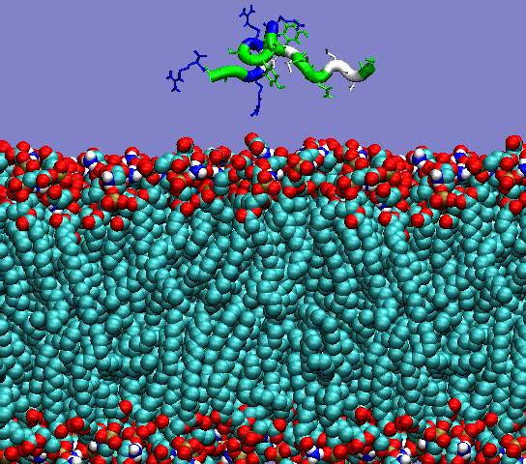
Target Simulation Speed
3.4 days today
(one processor)
~ 13 seconds on
HP machine
(one segment)
Notes:
Explain what this simulation is. John Klepeis, defensins, what we hope to learn.

Slide 49
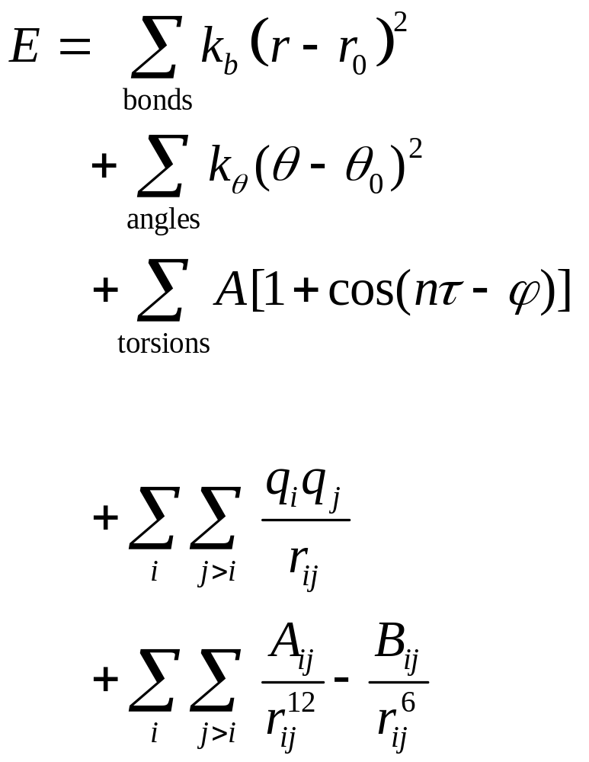
Molecular Mechanics Force Field
Stretch
Bend
Torsion
Electrostatic
Van der Waals
Bonded
Non-
Bonded

Slide 50
What Takes So Long?
Inner loop of force field evaluation looks at all pairs of atoms (within distance R)
On the order of 64K atoms in typical system
Repeat ~10¹² times
Current approaches too slow by several orders of magnitude
What can be done?

Slide 51
Our Strategy
New architectures
  Design a specialized machine
  Enormously parallel architecture
  Based on special-purpose ASICs
  Dramatically faster for MD, but less flexible
  Projected completion: 2008
New algorithms
  Applicable to
    Conventional clusters
    Our own machine
  Scale to very large # of processing elements

Slide 52
Interdisciplinary Lab
Computational Chemists and Biologists
Computer Scientists and Applied Mathematicians
Computer Architects and Engineers

