Slide 1
Solvation Models

Slide 2
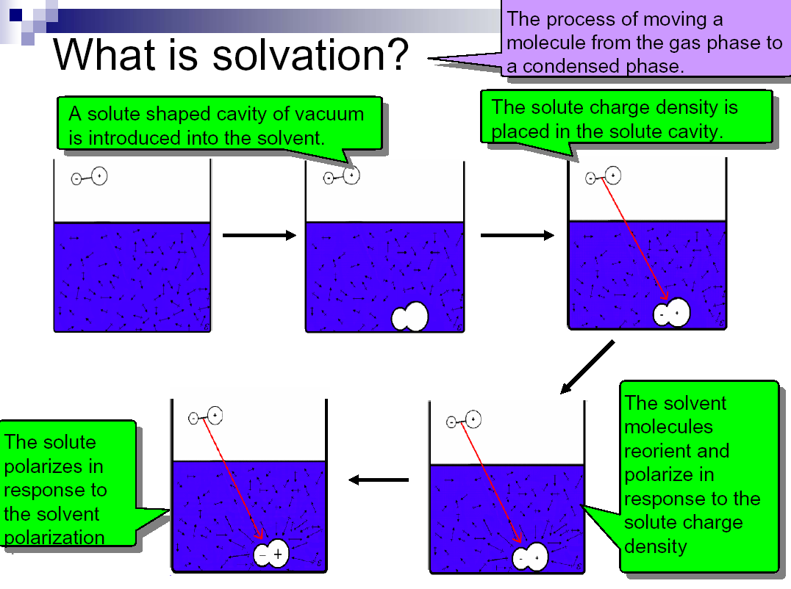

Slide 3
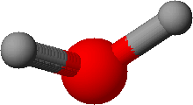
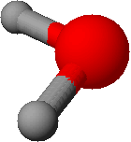
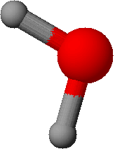
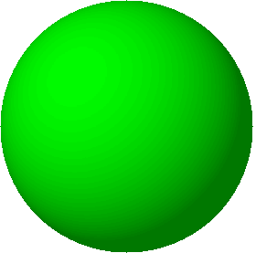
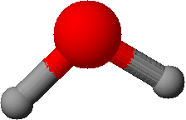
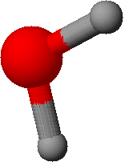
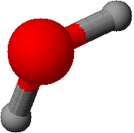
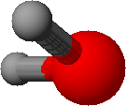
Solvent Effects
Many reactions take place in solution
Short-range effects
  Typically concentrated in the first solvation sphere
  Examples: H-bonds, preferential orientation near an ion
Long-range effects
  Polarization (charge screening)

Slide 4
Solvation Models
Some describe explicit solvent molecules
Some treat solvent as a continuum
Some are hybrids of the above two:
  Treat first solvation sphere explicitly while treating surrounding solvent by a continuum model
  These usually treat inner solvation shell quantum mechanically, outer solvation shell classically
Each of these models can be further subdivided according
to the theory involved: classical (MM) or quantum mechanical

Slide 5
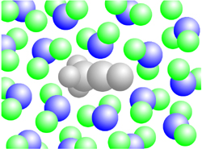

Solvation Methods in Molecular Simulations
explicit solvent
Explicit Solvent vs. Implicit Solvent
  Explicit: considering the molecular details of each solvent molecules
  Implicit: treating the solvent as a continuous medium (Reaction Field Method)
implicit solvent
solvent

Slide 6
Two Kinds of Solvatin Models
Models | Explicit solvent models | Continuum solvation models
Features | All solvent molecules are explicitly represented. | Respresent solvent as a continuous medium.
Advantages | Detail information is provided. Generally more accurate. | Simple, inexpensive to calculate
Disadvantages | Expensive for computation | Ignore specific short-range effects. Less accurate.

Slide 7
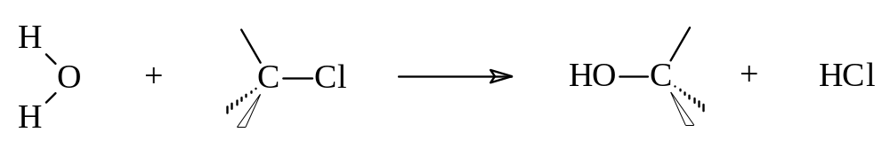
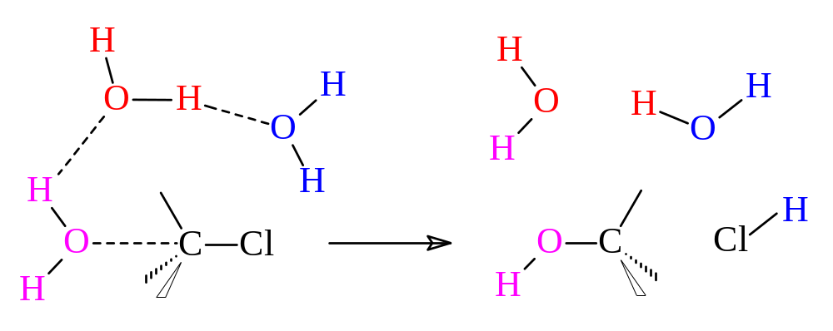
Explicit QM Water Models
Sometimes as few as 3 explicit water molecules can be used to model a reaction adequately:
Could use HF, DFT, MP2, CISD(T) or other theory.

Slide 8
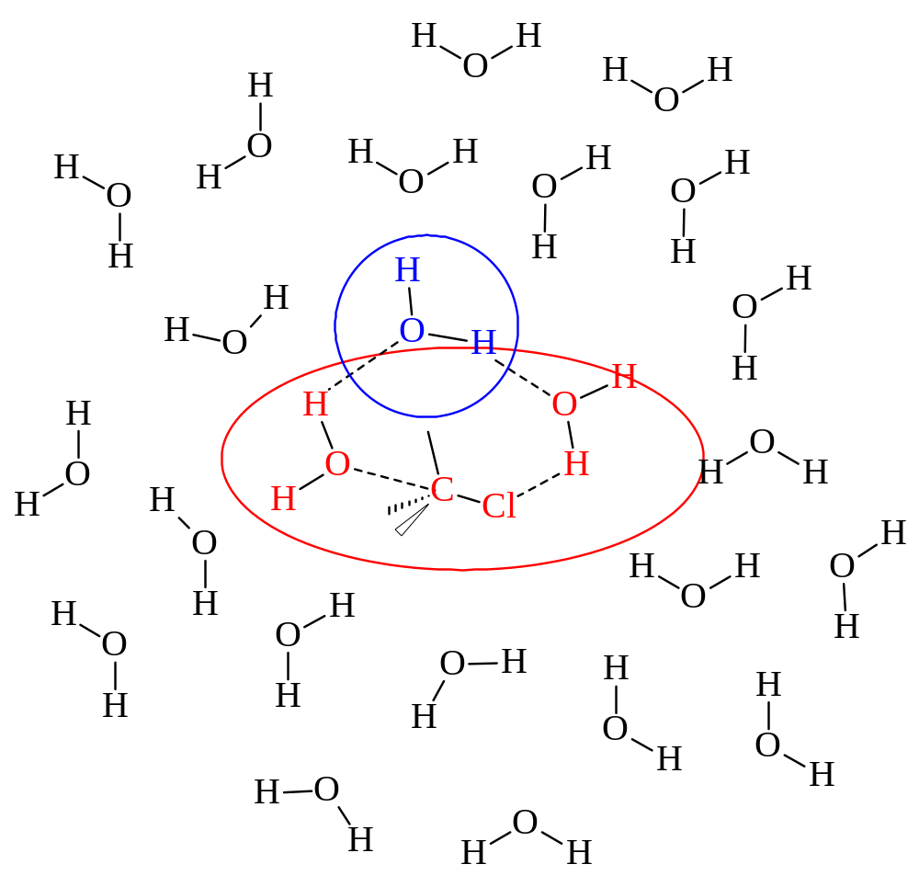
Explicit Hybrid Solvation Model
Red = highest
level of theory
(MP2, CISDT)
Blue = intermed.
level of theory
(HF, AM1, PM3)
Black = lowest
level of theory
(MM2, MMFF), or Continuum

Slide 9
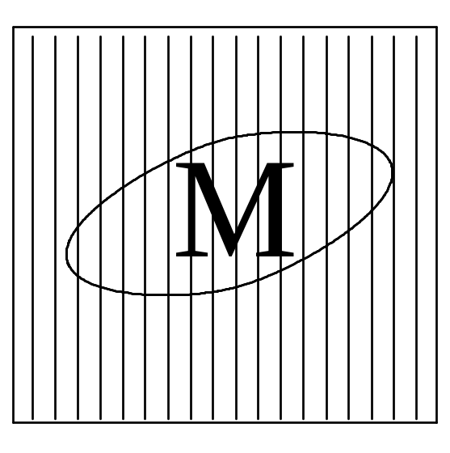
Continuum (Reaction Field) Models
Consider solvent as a uniform polarizable medium of fixed dielectric constant ε having a solute molecule M placed in a suitably shaped cavity.
ε

Slide 10
Self-Consistent Reaction Field
Solvent: A uniform polarizable medium with a dielectric constant ε
Solute: A molecule in a suitably shaped cavity in the medium
Solvation free energy:
ΔG_{solv} = ΔG_{cav} + ΔG_{disp} + ΔG_{elec}
M
ε
Create a cavity in the medium costs energy (destabilization).
Dispersion (mainly Van der Waals) interactions between solute and solvent lower the energy (stabilization).
Polarization between solute and solvent induces charge redistribution until self-consistent and lowers the energy (stabilization).

Slide 11
Models Differ in 5 Aspects
Size and shape of the solute cavity
Method of calculating the cavity creation and the dispersion contributions
How the charge distribution of solute M is represented
Whether the solute M is described classically or quantum mechanically
How the dielectric medium is described.
(these 5 aspects will be considered in turn on the following slides)

Slide 12
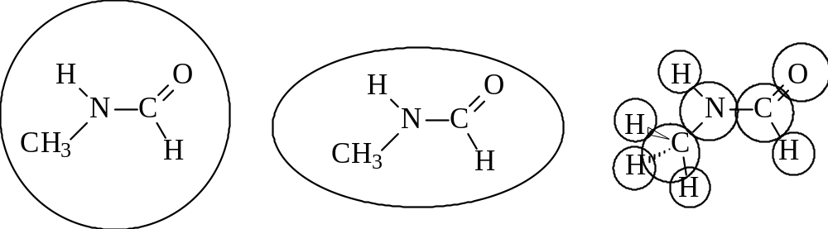
Solute Cavity Size and Shape
Spherical Ellipsoidal van de Waals
(Born) (Onsager) (Kirkwood)
r
r

Slide 13
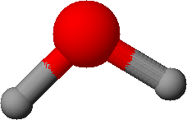
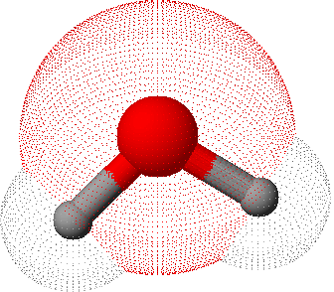
The Cavity
Simple models
Sphere
Ellipsoid
Molecular shaped models
Van der Waals surface
Not accessible to solvent
Solvent accessible surface
Determined by QM wave function and/or electron density

Slide 14
Description of Solute M
Solute molecule M may be described by:
  classical molecular mechanics (MM)
  semi-empirical quantum mechanics (SEQM),
  ab initio quantum mechanics (QM)
  density functional theory (DFT), or
  post Hartree-Fock electron correlation methods (MP2 or CISDT).

Slide 15
Describing the Dielectric Medium
Usually taken to be a homogeneous static medium of constant dielectric constant ε
May be allowed to have a dependence on the distance from the solute molecule M.
In some models, such as those used to model dynamic processes, the dielectric may depend on the rate of the process (e.g., the response of the solvent is different for a “fast” process such as an electronic excitation than for a “slow” process such as a molecular rearrangement.)

Slide 16
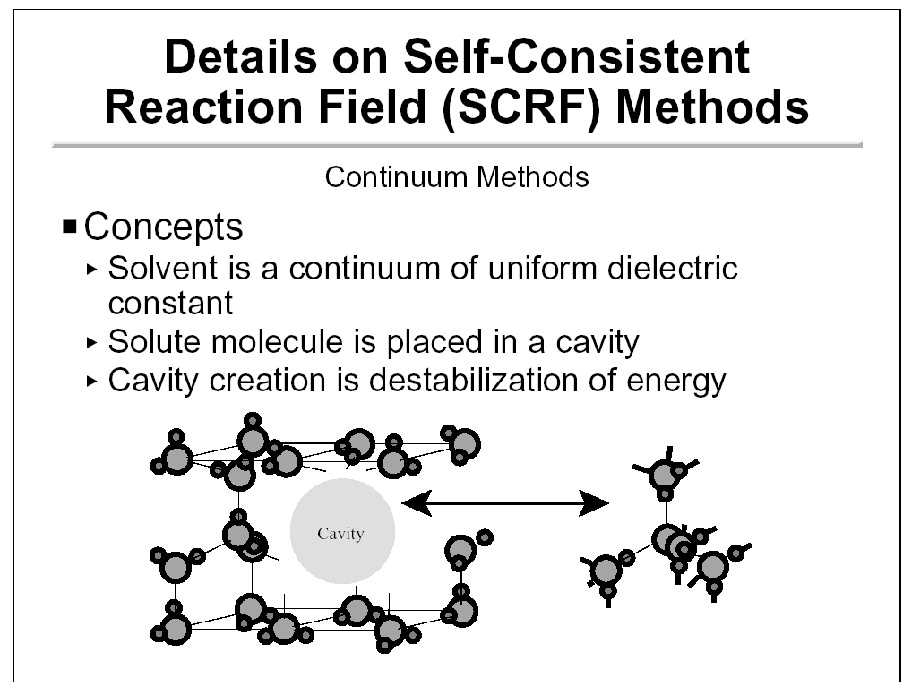

Slide 17
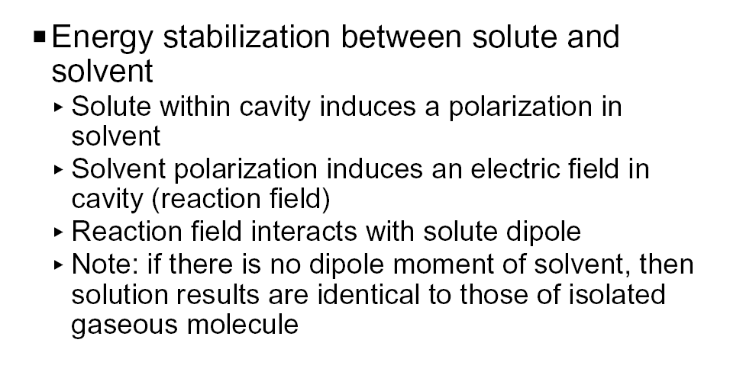

Slide 18
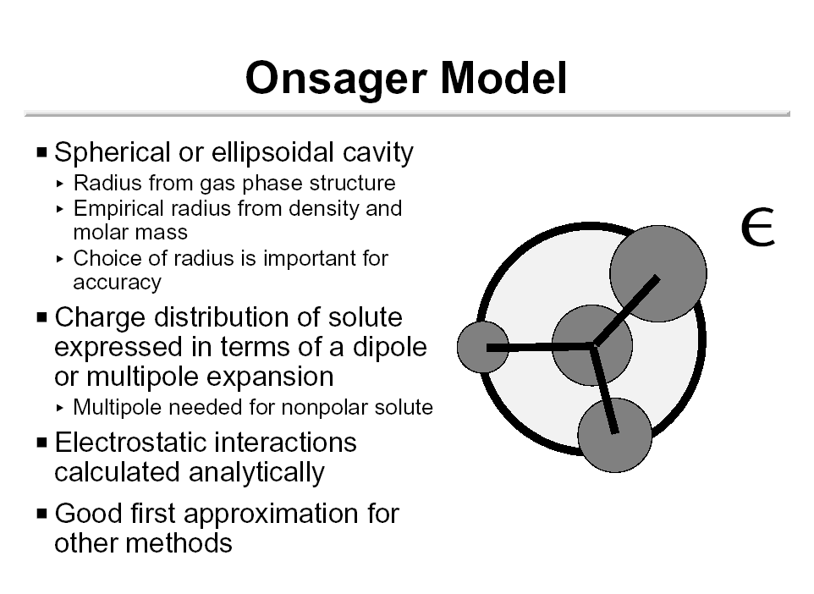

Slide 19
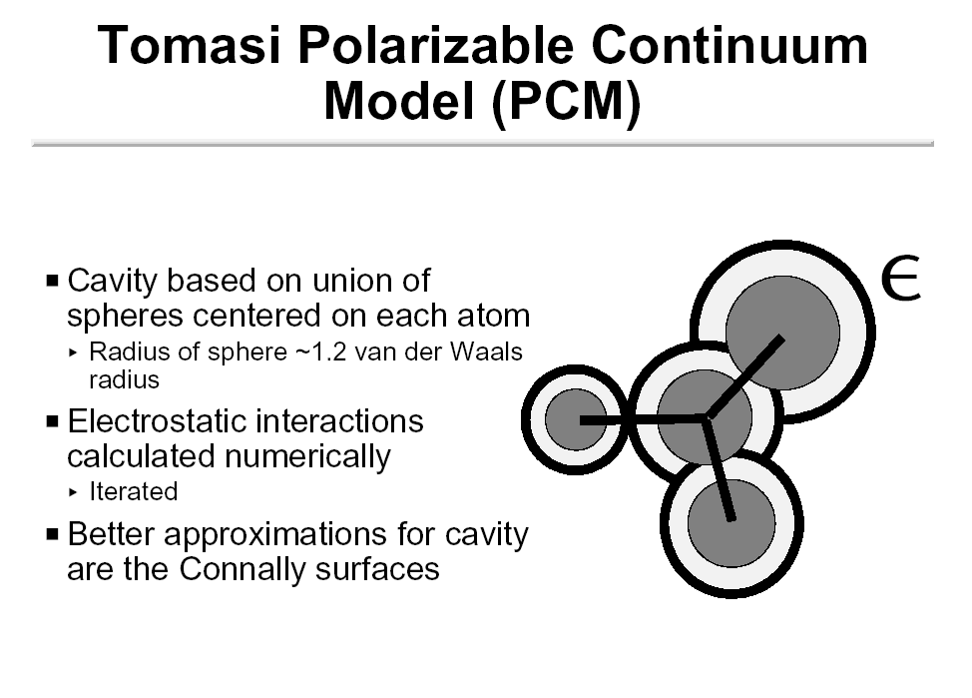

Slide 20
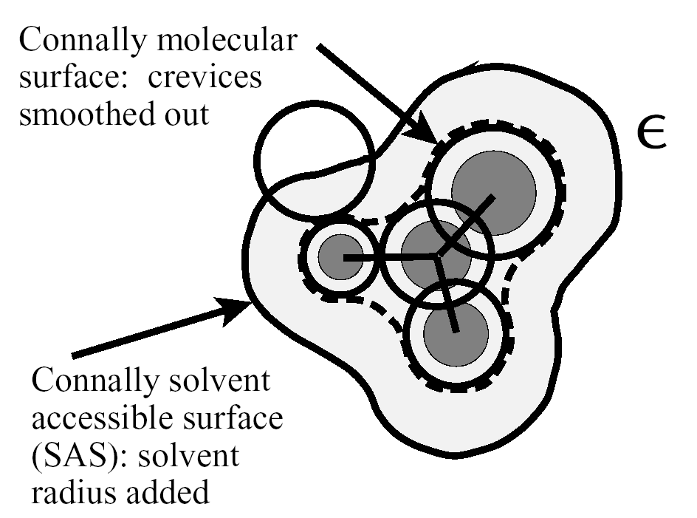

Slide 21
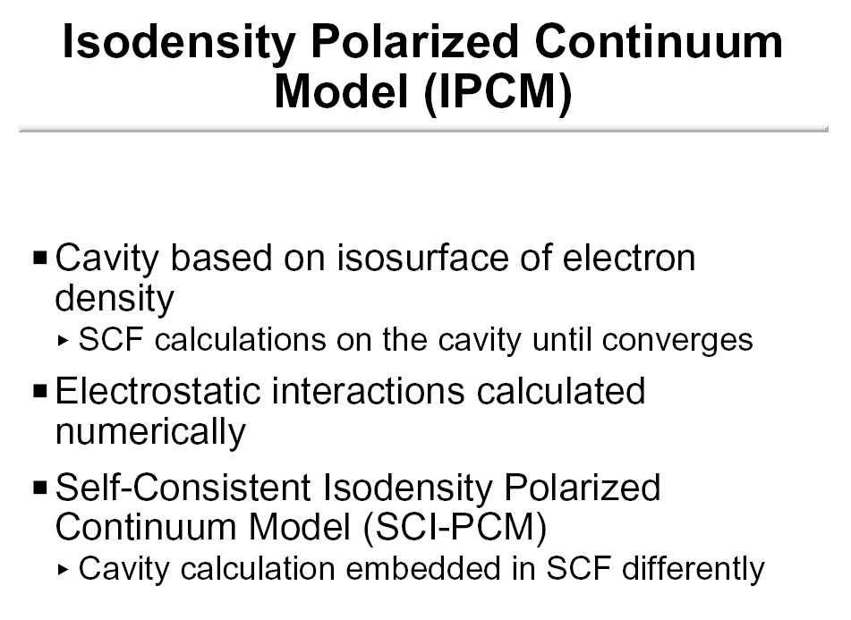

Slide 22
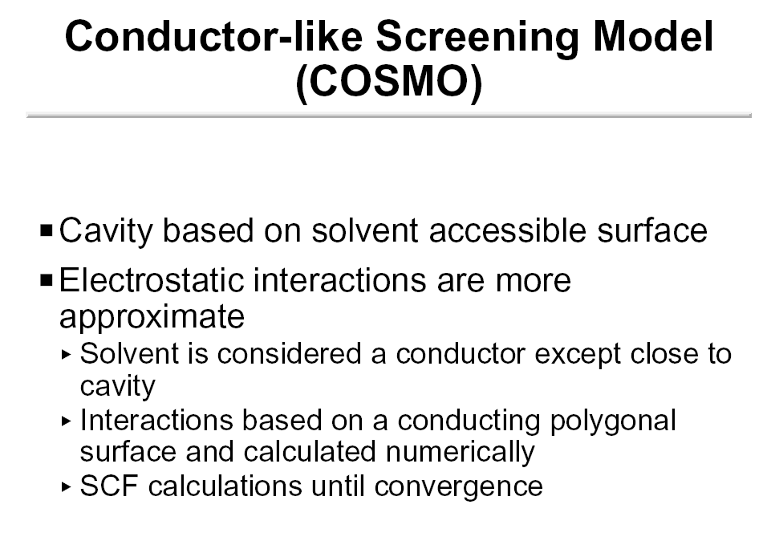

Slide 23
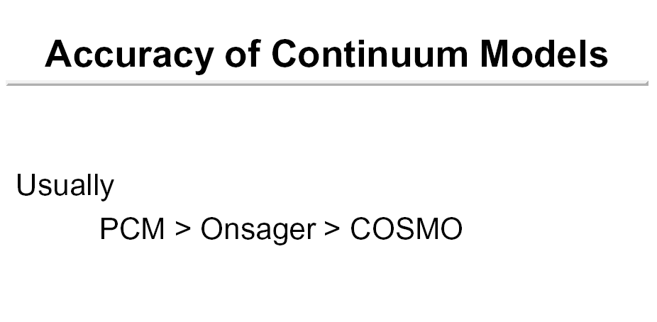

Slide 24
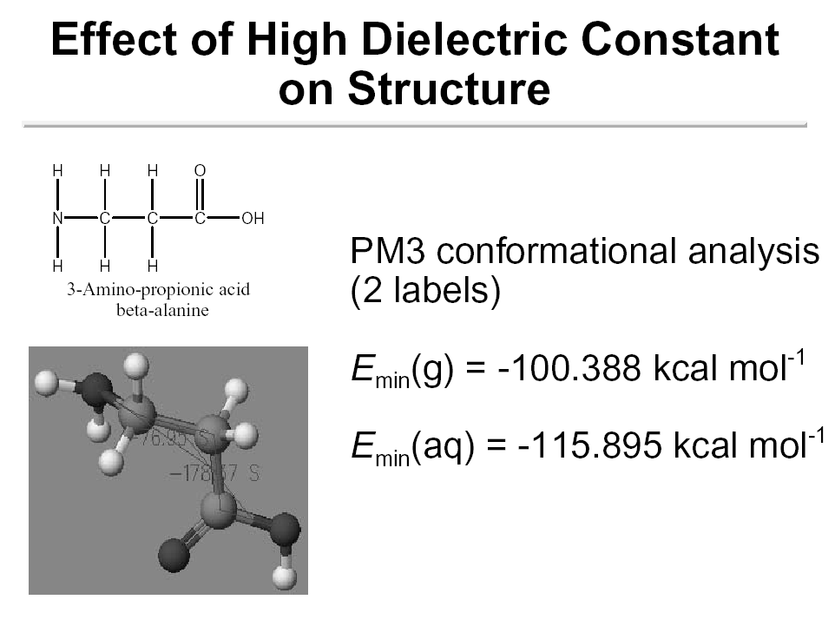

Slide 25
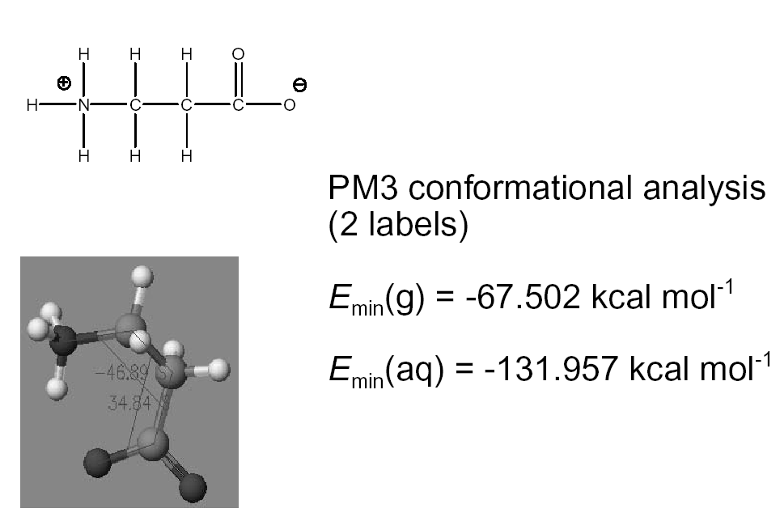

Slide 26
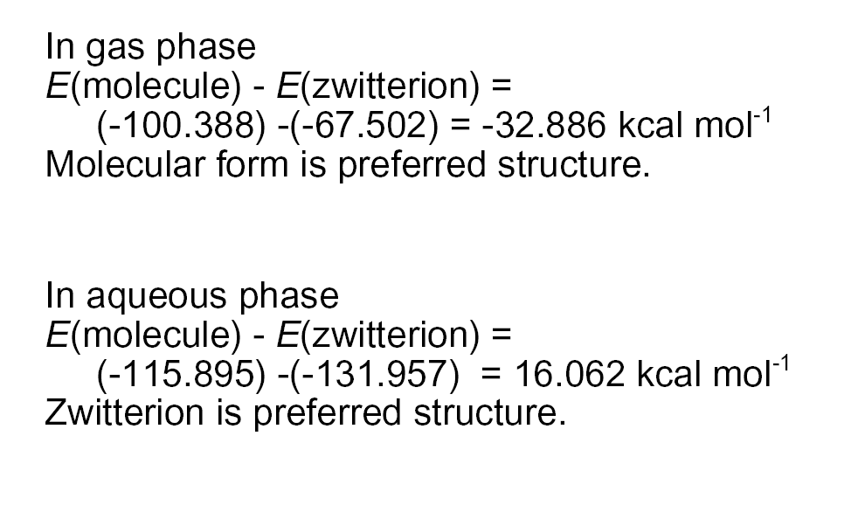

Slide 27
Why Implicit Solvent?
Method | Explicit Solvent (all-atom description) | Implicit Solvent (Continuum description)
Pros | Full details on the molecular structures Realistic physical picture of the system | No explicit solvent atoms Treatment of solute at highest level possible (QM)
Cons | Many atoms--> expensive Long runs required to equilibrate solvent to solute Often solvent and solute are not polarizable. Large fluctuations due to use of small system size | Need to define an artificial boundary between the solute and solvent No “good” model for treating short range effects (dispersion and cavity)

