Slide 1
zaujala ma jedna otázka na včerajšej prednáške, ohľadne proteínov
s definovanou štruktúrou bez sekundárnych štruktúr
(ak teda odhliadneme od polyprolínových helixov I/II a kolagénu, napr.).
Napadlo mi totiž, že existujú metalotioneíny, slúžiace na detoxifikáciu
od ťažkých kovov, ktoré sami o sebe žiadnu štruktúru nemajú
(ako stojí napr. v článku
https://academic.oup.com/metallomics/article/11/5/894/5962196), ale
pri naviazaní na kovy majú celkom slušne definovanú štruktúru, a to
bez výskytu sekundárnych štruktúr. Prítomnosť beta- a iných ohybov
posúdiť úplne nedokážem, ale neobsahujú alfa-helixy ani beta-listy.
Pre ukážku, v tomto článku
(https://www.pnas.org/doi/abs/10.1073/pnas.89.21.10124) porovnávajú
NMR štruktúru a štruktúru z röntgenovej kryštalografie, vizualizáciu
prikladám nižšie (PDB 1MRT (30 AA) a 4MT2 (61 AA)).
Modrá štruktúra (PDB 4MT2) je z kryštalografie a síce tam nejaké
zárodky alfa-helixu sú, ale vždy len o dĺžke troch aminokyselín
(alfa-helix musí mať aspoň 4, takže súdim, že je to skôr zvýraznené
podľa dihedrálnych uhlov než vodíkových väzieb):

Slide 3
obdobne prikladám NMR štruktúru metalotioneínu so striebrom,
kde rôzne riešenia NMR sú si veľmi podobné, čo by som takisto
pokladal za celkom slušne definovanú štruktúru (PDB 1AQQ):

Slide 4
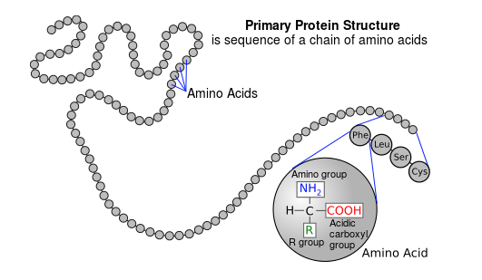
Physical Properties of Proteins

Slide 5
Colour and Taste
Proteins are colourless and usually tasteless. These are homogeneous
and crystalline.
Shape and Size
The proteins range in shape from simple crystalloid spherical structures to
long fibrillar structures. Two distinct patterns of shapehave been recognized :
A. Globular proteins- These are spherical in shape and occur mainly
in plants, esp., in seeds and in leaf cells. These are bundles formed by
folding and crumpling of protein chains. e.g., pepsin, edestin, insulin, etc.
B. Fibrillar proteins- These are thread-like or ellipsoidal in shape and
occur generally in animal muscles. Most of the studies regarding protein
structure have been conducted using these proteins. e.g., fibrinogen,
myosin etc.
C.Intrinsically disordered proteins
Molecular Weight
The proteins generally have large molecular weights ranging between
5 × 10³ and 1 × 10⁶. It might be noted that the values of molecular weights
of many proteins lie close to or multiples of 35,000 and 70,000.

Slide 6
Colloidal Nature
Because of their giant size, the proteins exhibit many colloidal properties,
such as; Their diffusion rates are extremely slow and they may produce
considerable light-scattering in solution, thus resulting in visible turbidity
(Tyndall effect).
Denaturation
Denaturation refers to the changes in the properties of a protein. In other
words, it is the loss of biologic activity. In many instances the process of
denaturation is followed by coagulation— a process where denatured
protein molecules tend to form large aggregates and to precipitate
from solution.
Amphoteric Nature
Like amino acids, the proteins are amphoteric, i.e., they act as acids and
alkalies both. These migrate in an electric field and the direction of migration
depends upon the net charge possessed by the molecule. The net charge
is influenced by the pH value. Each protein has a fixed value of isoelectric
point (pl) at which it will move in an electric field.

Slide 7
Ion Binding Capacity
The proteins can form salts with both cations and anions based on
their net charge.
Solubility
The solubility of proteins is influenced by pH. Solubility is lowest at
isoelectric point and increases with increasing acidity or alkalinity.
This is because when the protein molecules exist as either cations or
anions, repulsive forces between ions are high, since all the molecules
possess excess charges of the same sign. Thus, they will be more
soluble than in the isoelectric state.
Optical Activity
All protein solutions rotate the plane of polarized light to the left, i.e.,
these are levoratotory.

Slide 8
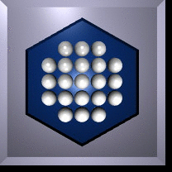
Proteins - Intermolecular Forces
Jiri Vondrasek
Handout 1: Introduction to Intermolecular Forces
I: Introduction
Evidence for Intermolecular Forces
The nature of Intermolecular Forces
Electric Multipoles
II: Intermolecular Interactions
Types of Intermolecular Interactions
Many-Body Energies
Total Energy
Comparison of Intermolecular Forces

Slide 9
Overview
Intermolecular forces are critically important in determining the properties of matter.
We will discuss the forces that exist between atoms and molecules.
Evidence (taken from thermodynamic, structural and other experimental studies) will be provided for the existence of intermolecular forces.
The various types of intermolecular forces will be described: including the origin of the forces and their distance-dependence.
A more detailed discussion of the consequences and implications of intermolecular forces will follow.
Finally, the “anomalous” properties of water and the importance of hydrogen bonding and the “hydrophobic effect” in biological systems will be analysed.

Slide 10
Learning Objectives
To recognise the importance of intermolecular forces in determining the physical properties of matter;
To know the experimental evidence for the existence of intermolecular forces;
• To understand the origins of the various types of intermolecular forces;
To know the distance-dependence of intermolecular forces of various types;
To understand the origins of the so-called “anomalous” properties of water.
To recognise the importance of hydrogen bonding and the hydrophobic effect in biological systems.

Slide 11
References
Fundamentals
P. W. Atkins, The Elements of Physical Chemistry (3rd edition), OUP, Oxford, 2000.
P. W. Atkins, J. de Paula, Atkins' Physical Chemistry (7th edition), OUP, Oxford, 2001.
K. A. Dill, S. Bromberg, Molecular Driving Forces, Garland Science, New York, 2003.
More Advanced
M. Rigby, E. B. Smith, W. A. Wakeham, G. C. Maitland, The Forces Between Molecules, OUP, Oxford, 1986.
A. J. Stone, The Theory of Intermolecular Forces, OUP, Oxford, 1997.

Slide 12
1. Evidence for Intermolecular Forces
Solid and Liquid States of Matter – In the absence of interatomic or intermolecular forces, all matter would exist in the gas form, even at 0K!
Gas Imperfection – The failure of real gases to obey the perfect/ideal gas equation of state (PV = nRT).
Non-Ideal Mixtures / Solutions – e.g. Deviations from Raoult’s Law for an A-B mixture are due to different strengths of the A–A, B–B and A–B intermolecular forces.
Transport Properties of Dilute Gases – The transport of momentum, energy or mass through a dilute gas, under the influence of a gradient of velocity, temperature or concentration, is affected by molecule-molecule collisions. The corresponding transport coefficients (shear viscosity, thermal conductivity, diffusion) are directly related to the intermolecular forces between the gas molecules.

Slide 13
States of Matter
Solids: Kinetic Energy (KE) of atoms/molecules small compared to strength of intermolecular interaction energies (KE << U_{inter}).
⇒ small amount of movement around equilibrium positions
⇒ regular crystalline structures usually adopted (long range order)
⇒ doesn’t take shape of or fill a container
⇒ very low compressibility
Liquids: KE ≈ U_{inter}
  ⇒ atoms/molecules can move around (diffusion)
  ⇒ on average, some local order exists
  ⇒ takes shape of (but doesn’t fill) a container
  ⇒ low compressibility
Gases: KE >> U_{inter}
  ⇒ atoms/molecules move quite freely
  ⇒ less frequent collisions than in liquids
  ⇒ takes shape of and fills a container
  ⇒ high compressibility

Slide 14
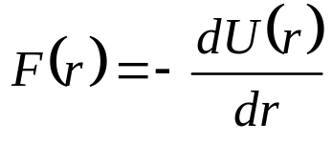
2. The Nature of Intermolecular Forces
2.1 Intermolecular Interactions
The interaction energy (U_{inter}) between two particles (atoms or molecules) is defined as the pair potential (energy), U(r), which depends on the intermolecular separation, r.
The force, F(r), between the two particles is obtained as the negative of the gradient of the pair potential:
At very large separations (as r→∞), the interparticle interaction is negligible (U→0, F→0).
At shorter separations, the particles attract (F < 0, particles pulled together). The dimer is more stable than the two isolated particles, hence U(r) < 0.
At very short separations (r→0), the particles repel each other (F > 0, particles pushed apart).
At r = r_{e}, U(r) is at its minimum (U_{min}) and the interparticle force, F = 0.

Slide 15
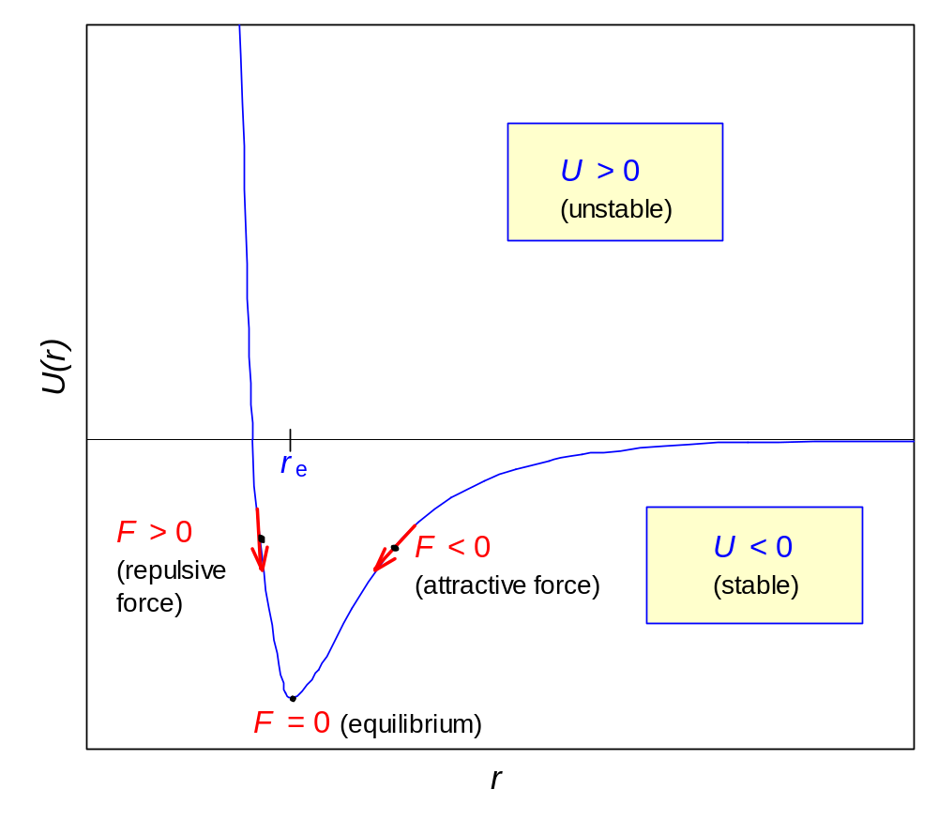
0
U_{min}

Slide 16
2.2 Note on Terms Adopted
Instead of talking about particles and interparticle forces etc., in this course we will refer to molecules and Intermolecular Forces (IMFs), though some of these interactions can also apply to atoms.
Although we refer to Intermolecular Forces, in the following discussion of types of IMFs, their origin and their range (distance-dependence), we will actually refer to the intermolecular potential energy function, U(r), rather than the force F(r).
Note: the previous diagram showed the total potential energy between 2 molecules. We are now going to discuss the various contributions to this total energy.

Slide 17
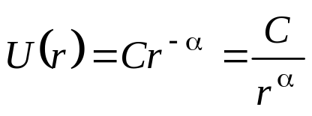
2.3 Long- and Short-Ranged Interactions
IMFs can be divided into two classes: long-ranged and short -ranged, according to the dependence of the potential energy U on the separation r.
For a particular type of IMF, the intermolecular potential energy function is generally modelled by a power law in r :
(where C is a constant).
Long-ranged interactions: α ≤ 6 e.g. Coulombic U(r) ∝± 1/r
        dispersion U(r) ∝− 1/r⁶
Short-ranged interactions: α > 6 or e^{−αr} e.g. exchange repulsion
Attractive interactions: U(r) < 0
Repulsive interactions: U(r) > 0

Slide 18
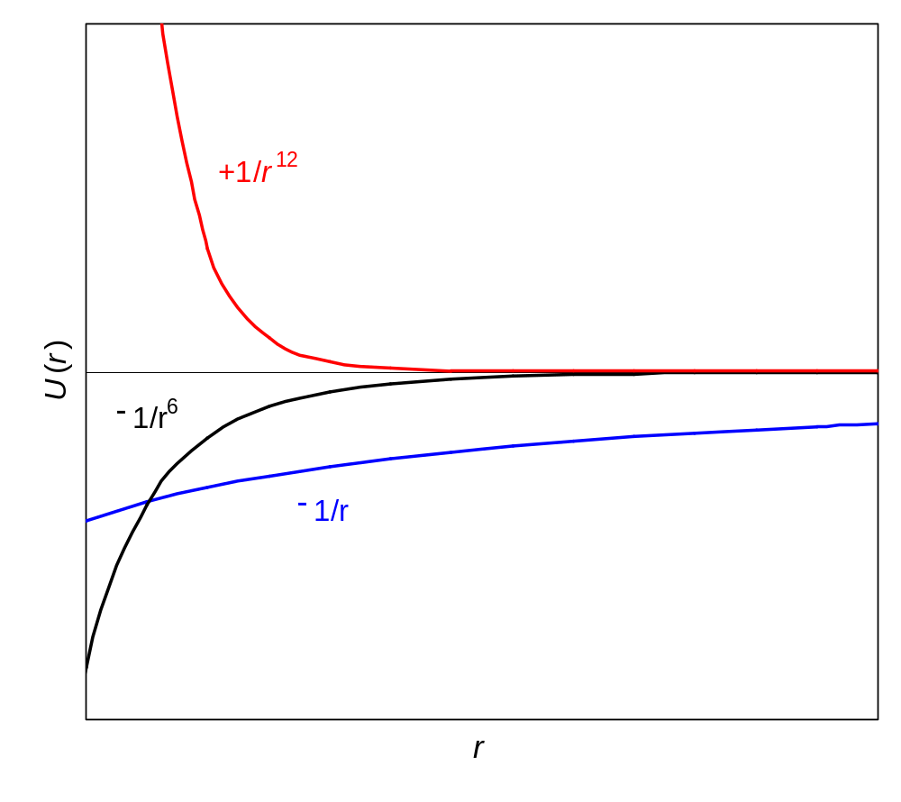
Distance dependence of various potentials

Slide 19
3. Electric Multipoles
3.1 Definitions
Monopole: a point charge (e.g. Na⁺, Cl⁻).
Dipole: an asymmetric charge distribution in a molecule, where there is no net charge but one end of the molecule is negative (partial charge = −q) relative to the other (partial charge = +q).
Molecules may possess higher order electric multipoles, arising from their non-spherical charge distributions.
Each type of multipole has an associated multipole moment: the monopole moment is the charge of the atom/molecule; the dipole moment is a vector whose magnitude is the product of the charge and distance between the charge centres. Higher order multipole moments have tensor properties.
+
−
−q
+q

Slide 20
  3.2 Molecular Dipoles
  A polar molecule is one which possesses a permanent dipole moment: there is an asymmetric charge distribution, with one end of the molecule relatively negative (−q) with respect to the other (+q). NB: q is a multiple of e (q = ae) but a doesn’t have to be an integer and may be less than 1).
  Examples: F−Cl (where the F atom is negative with respect to the Cl atom) and the polyatomic molecule HCCl₃ (where the H end of the molecule is positive with respect to the three Cl atoms).
  The magnitude of the dipole moment (which by definition points from the negative toward the positive end) is given by μ = q, where  is the distance between the centres of the two opposite charges.
μ
−q
+q
●

Slide 21
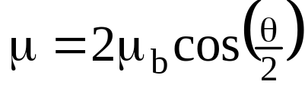
The dipole is a vector quantity: the total molecular dipole (μ) for a polyatomic molecule can be obtained by summing the vectors corresponding to bond dipoles (μ_{b}) pointing along each bond:
For 2 equal bond dipoles (μ_{b}) at an angle θ to each other, the resultant total molecular dipole (μ) is given approximately by:
Sometimes bond dipoles cancel out, so that the molecule as a whole has no dipole moment:
H
Cl
μ_{b1}
μ
O
μ_{b2}
H
Cl
μ_{b}
μ
θ
μ_{b}
O
C
O
Cl
Cl

Slide 22
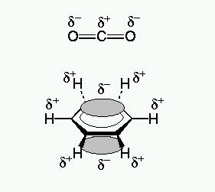
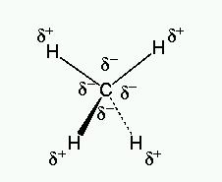
3.3 Higher Multipoles
Although the linear molecules CO₂ (O=C=O) and acetylene (H−C≡C−H) and the planar molecule benzene (C₆H₆) do not have dipole moments, they have non-zero quadrupole moments.
For more symmetrical molecules, the first non-zero multipole moments have higher order: thus, the methane molecule (CH₄) has no dipole or quadrupole moment, but it has a non-zero octopole moment.

Slide 23
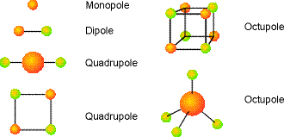
Shapes of Electric Multipoles

Slide 24
Dipole moments (μ) and polarizability volumes (α′ = α/4πε₀) for some atoms and molecules (1D (1 Debye) = 3.336×10⁻³⁰ C m).
Atom/Molecule | μ / (10⁻³⁰ C m) | μ / D | α′ / (10⁻³⁰ m³)
He | 0 | 0 | 0.20
Ar | 0 | 0 | 1.66
H₂ | 0 | 0 | 0.819
N₂ | 0 | 0 | 1.77
CO₂ | 0 | 0 | 2.63
CH₄ | 0 | 0 | 2.60
CH₃Cl | 6.24 | 1.87 | 4.53
CH₂Cl₂ | 5.24 | 1.57 | 6.80
CHCl₃ | 3.37 | 1.01 | 8.50
CCl₄ | 0 | 0 | 10.5
C₆H₆ | 0 | 0 | 10.4
HF | 6.37 | 1.91 | 0.51
HCl | 3.60 | 1.08 | 2.63
HBr | 2.67 | 0.80 | 3.61
H₂O | 6.17 | 1.85 | 1.48
NH₃ | 4.90 | 1.47 | 2.22

Slide 25
4. Types of Intermolecular Interactions
  4.1 Overview
  Electrostatic: interactions between charged atomic or molecular
  species (ions = monopoles) or between asymmetric charge
  distributions (dipoles, quadrupoles etc.) in neutral molecules.
  Induction: an electric charge (monopole) or higher multipole
  causes polarization of neighbouring atoms/molecules and
  induced multipoles. The attractive interaction between the original
  multipole and the induced multipole gives rise to the induction
  energy.
  Dispersion: attractive interactions between instantaneous dipoles (and
  higher multipoles) arising due to fluctuating charge distributions in
  atoms and molecules.
  Hydrogen Bonding: attractive interactions of the form X−H☹Y – a
  hydrogen atom is covalently bound to one electronegative atom (X =
  N, O, F etc.) and interacts with a second electronegative atom (Y).

Slide 26
Electrostatic interactions can be attractive or repulsive, depending on ionic charges and the orientation of the molecular multipoles.
The range of the interaction energies depends on the type of interaction.
van der Waals forces: a term used to cover electrostatic, induction and dispersion interactions between discrete neutral molecules or atoms. The most important contributions have
1/r ³ or 1/r ⁶ distance dependence.
These IMFs should be contrasted with covalent bonds, where molecules are bound by the sharing of electrons. Covalent bonds are typically much stronger than IMFs.

Slide 27
4.2 Short-Ranged Repulsions
There is a limit to the compressibility of matter, due to repulsive interactions (due to overlap of electron densities) which dominate at short range.
At short internuclear separations there are electrostatic repulsions between the atomic nuclei, as well as between the electrons (both valence and core) on neighbouring atoms.
There is also a short range Pauli or Exchange Repulsion between the electrons on neighbouring atoms, which is quantum mechanical in origin and derives from the Pauli exclusion principle.
The total short range repulsive interaction is generally modelled by a steep 1/r ^{n} (where n is usually 12) dependence on interatomic distance, though an exponential (e^{−αr}) dependence is more accurate.

Slide 28
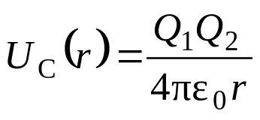
4.3 Electrostatic Energy
Ion-Ion (Coulomb) Energy
The interaction of two stationary point charges (Q₁ and Q₂), separated by a distance r is given by the Coulomb potential energy:
where Q = ±ne (n is an integer and e is the magnitude of the charge on an electron = 1.602 ×10⁻¹⁹ C), r is in metres and ε₀ ( = 8.854×10⁻¹² J⁻¹ C² m⁻¹) is the vacuum permittivity.
Note: like charges (+ + or − − ) repel U_{C}(r) > 0
opposite charges (+ −) attract U_{C}(r) < 0
The Coulomb interaction ( ∝ r ⁻¹) is very long-ranged – it falls off very slowly with distance.
Q₁
Q₂
r

Slide 29
Dielectric Constant
In a dielectric medium, the vacuum permittivity (ε₀) is replaced by the permittivity of the medium (ε), where:
ε = ε₀.ε_{r}
ε_{r} is the relative permittivity (since ε_{r} = ε/ε₀) – also known as the dielectric constant.
Highly polar solvents have high dielectric constants ε_{r}
  e.g. ε_{r} (H₂O) = 78
This leads to a large reduction in the Coulombic potential between ions in polar solvents.
vacuum
dielectric
ε₀
ε
r
r

Slide 30
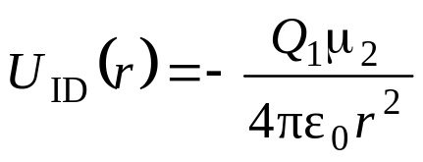
Ion-Dipole Energy
The interaction energy between a stationary point charge Q₁ and a permanent dipole μ₂, separated by a distance r (for the most stable arrangements shown below) is given by:
where Q₁ (= ne) has units of C and μ₂ (= q) has units of C m.
Note: the interaction energy now depends upon the orientation of the dipole relative to the point charge (and the sign of the charge).
+Q₁
−q
+q
μ₂
r
−Q₁
+q
−q
μ₂

Slide 31
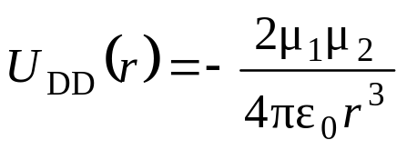
  Dipole-Dipole Energy
  When two polar molecules are close to each other there is a tendency for their dipoles to align, with the attractive head-to-tail arrangement (1) being lower in energy than the repulsive head-to-head or tail-to-tail arrangements (2 and 3).
  The energy of interaction of two co-linear dipoles (μ₁ and μ₂), arranged in a head-to-tail fashion, is given by:
  where r is the distance between the centres of mass of the two molecules.
1
r
2
3

Slide 32
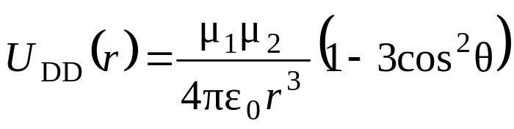
The potential energy of interaction between two parallel dipoles which are not co-linear (i.e. where the inter-molecular vector makes an angle θ to the intra-molecular bonds) is given by:
For general intermolecular geometries, a function of the three angles that define the relative orientations of the two dipoles, must be included. [See workshop question.]
In the side-on arrangement, antiparallel dipoles (1) are favoured energetically over parallel dipoles (2).
θ
1
2

Slide 33
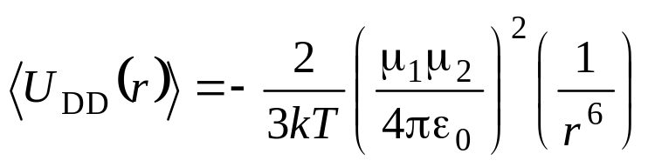
The alignment of molecular dipoles is opposed by the effect of thermal energy, which leads to rotation of the dipoles.
At temperatures where the thermal energy (kT) is greater than the electrostatic dipole–dipole interaction energy (U_{DD}), the rotationally averaged energy of interaction between two dipoles μ₁ and μ₂, separated by a distance r, can be obtained from a Boltzmann-weighted average:
Note: the rotationally averaged dipole-dipole interaction is shorter-ranged than when the dipoles are static!

Slide 34
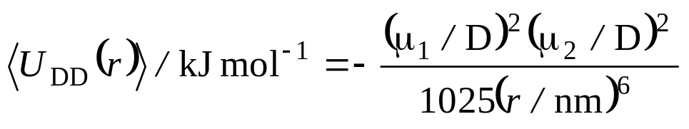
At room temperature (T = 300 K), this gives:
where the dipole moments are in Debye (1 D = 3.336×10⁻³⁰ C m).
Example: at room temperature, two molecules with dipole moments of 1 D (e.g. HCl), at a separation of r = 0.3 nm, have an average dipole–dipole interaction energy of approximately −1.4 kJ mol⁻¹.
Due to the r⁻⁶ distance dependence, doubling the distance reduces the interaction energy by a factor of 2⁶ (64).

Slide 35
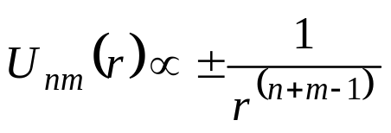
Multipole-Multipole Interactions
The electrostatic interaction between higher order multipoles can be treated in an analogous fashion to that described above for dipole–dipole interactions.
The distance-dependence of the interaction energy between an n-pole and an m-pole (assuming no molecular rotation) is given by:
where n and m are the orders of the multipoles:
n,m = 1 (monopole), 2 (dipole), 3 (quadrupole), 4 (octopole) …
Examples:
  monopole-monopole (coulomb) U(r) ∝ r ⁻¹
  monopole-dipole U(r) ∝ r ⁻²
  dipole-dipole U(r) ∝ r ⁻³
  dipole-quadrupole U(r) ∝ r ⁻⁴
  quadrupole-quadrupole U(r) ∝ r ⁻⁵
Note: The higher the order of the multipole, the shorter-ranged the interaction (the more rapidly it falls off with distance).

Slide 36
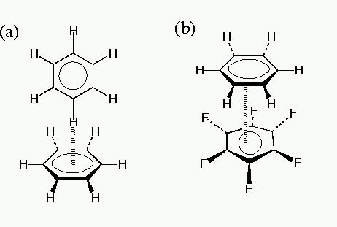
Quadrupole-Quadrupole Interactions
In cases where quadrupolar interactions dominate, T-shaped intermolecular geometries are generally adopted, with the positive regions of one quadrupole being attracted to the negative regions of another.
Example: the benzene dimer (C₆H₆)₂, which has a T-shaped geometry (a) where one C−H bond of one molecule is oriented towards the π-electron cloud of the other. (In the benzene molecule, the ring C atoms are relatively negative with respect to the H atoms.)
However, the quadrupole in perfluorobenzene (C₆F₆) is the opposite way round to that of benzene (i.e. the peripheral F atoms carry more electron density than the C atoms of the ring). Therefore, the mixed dimer (C₆H₆)(C₆F₆) has a . π-stacked geometry (b), with parallel rings.

Slide 37
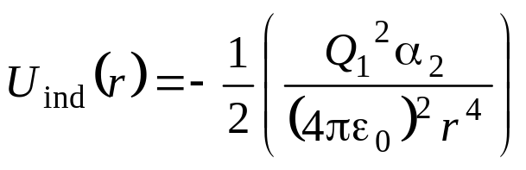
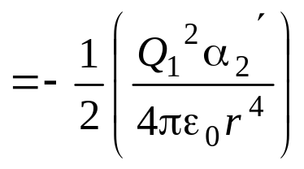
4.4 Induction Energy
A charge (i.e. an ion = electric monopole), or asymmetric charge distribution (dipole, quadrupole etc.) gives rise to an electric field (E) which causes the polarization of neighbouring atoms or molecules and the creation of an induced dipole, μ_{ind} = αΕ (where α is the polarizability of the atom or molecule).
Ion-Induced Dipole Energy
r
Q₁
−q
+q
−
+
α₂
+
−
+
−
+
μ_{ind}

Slide 38
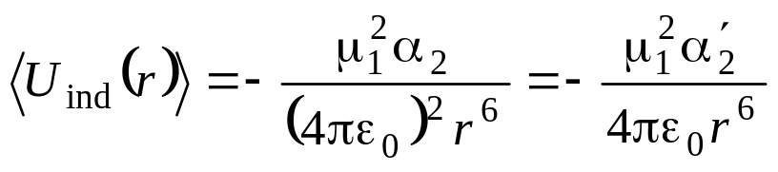
Dipole-Induced Dipole Energy
The induced dipole (μ_{ind}) interacts in an attractive fashion with the original (permanent) dipole (μ₁).
The (induction) interaction energy between a permanent dipole (μ₁) on molecule 1 and an induced dipole on molecule 2 (which has no dipole but has polarizability α₂), at a distance r, is given by:
where α′₂ is the polarizability volume of molecule 2 (α′₂ = α₂/(4πε₀)).
r
−q₁
+q₁
−q₂
+q₂
μ₁
μ_{ind}

Slide 39
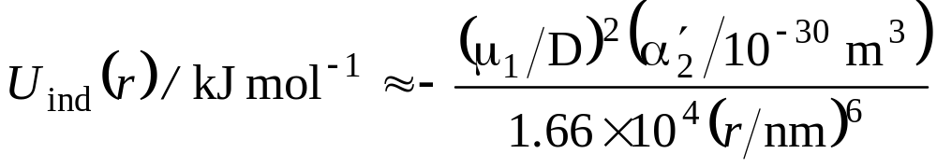
As the direction of the induced dipole follows that of the permanent dipole, the effect survives even if the permanent dipole is subject to thermal reorientations.
The above equation can be rewritten as:
Example: For a polar molecule with μ ≈ 1 D (e.g. HCl), at a distance r = 0.3 nm from a non-polar molecule with polarizability volume α′ ≈ 10×10⁻³⁰ m³ (e.g. benzene), the dipole–induced–dipole interaction energy is approximately −0.8 kJ mol⁻¹.

Slide 40
Note: if both molecules are polar, then they will induce dipoles in each other.
Note: this induction energy is in addition to the electrostatic interaction energy, U_{DD}(r), between the two permanent dipoles.
Dipoles (and higher multipoles) can also be induced by neighbouring molecules with permanent charges (monopoles) or high-order multipoles, and similar expressions can be derived for the interactions between these permanent and induced multipoles.

Slide 41
  4.5 Dispersion Energy
  The intermolecular forces between nonpolar molecules and closed shell atoms (e.g. rare gas atoms He, Ne, Ar …) is dominated by “London” or dispersion forces.
  The dispersion energy contributes to the intermolecular interactions between all pairs of atoms or molecules. It is also generally the dominant contribution, even for polar molecules.
  Long range attractive dispersion forces arise from dynamic electron correlation: fluctuations in electron density give rise to instantaneous electronic dipoles (and higher multipoles), which in turn induce dipoles in neighbouring atoms or molecules.
  The instantaneous dipoles are correlated so they do not average to zero.
r

Slide 42
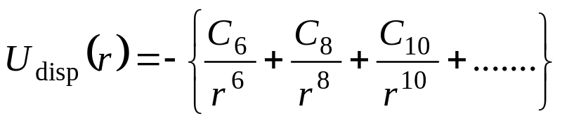
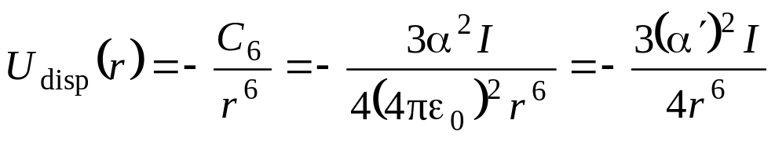
  A general expansion for the attractive energy (U_{disp}(r)) due to these dispersion forces can be written:
  where the terms C_{n} are constants and r is the interatomic distance.
  The first term represents the instantaneous dipole–dipole interaction and is dominant, so the higher terms (which contribute less than 10% of the total dispersion energy) are often omitted when calculating dispersion energies.
  A reasonable approximation to the dispersion energy is given by the London formula (derived by London, based on a model by Drude), in which the dispersion energy between two identical atoms/molecules is given by:
  where α, α′ and I are the polarizability, polarizability volume and ionization energy of the atom/molecule.

Slide 43
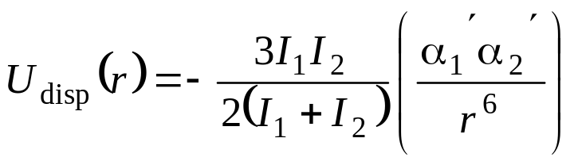
  The α² term arises because the magnitude of the instantaneous dipole depends on the polarizability of the first atom/molecule and the strength of the induced dipole (in the second atom/molecule) also depends on α.
  Example: the (rotationally averaged) dispersion energy of interaction between two CH₄ molecules (α′ = 2.6×10⁻³⁰ m³, I = 700 kJ mol⁻¹), at a separation of r = 0.3 nm, is approximately −5 kJ mol⁻¹.
  The dispersion energy between two unlike molecules (with polarizability volumes α₁′ and α₂ ′ and ionization energies I₁ and I₂) is given by:

Slide 44
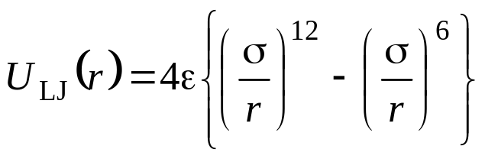
  The Lennard-Jones Potential
  Taking into account both repulsive and attractive (dispersion) interactions, a good approximation to the total potential energy of interaction between two neutral atoms or non-polar molecules is given by the Lennard-Jones (LJ) potential:
  where ε is the depth of the energy well and σ is the separation at which U_{LJ}(r) = 0.
  The equilibrium separation (the position of the minimum in U_{LJ}(r)) occurs at r_{e} = 2^{1/6}σ. [U_{LJ}(r_{e}) = −ε.]
  Note: due to the r⁻⁶ dependence of the attractive term, the LJ potential has also been used to approximate the interaction energy between rotating dipoles.

Slide 45
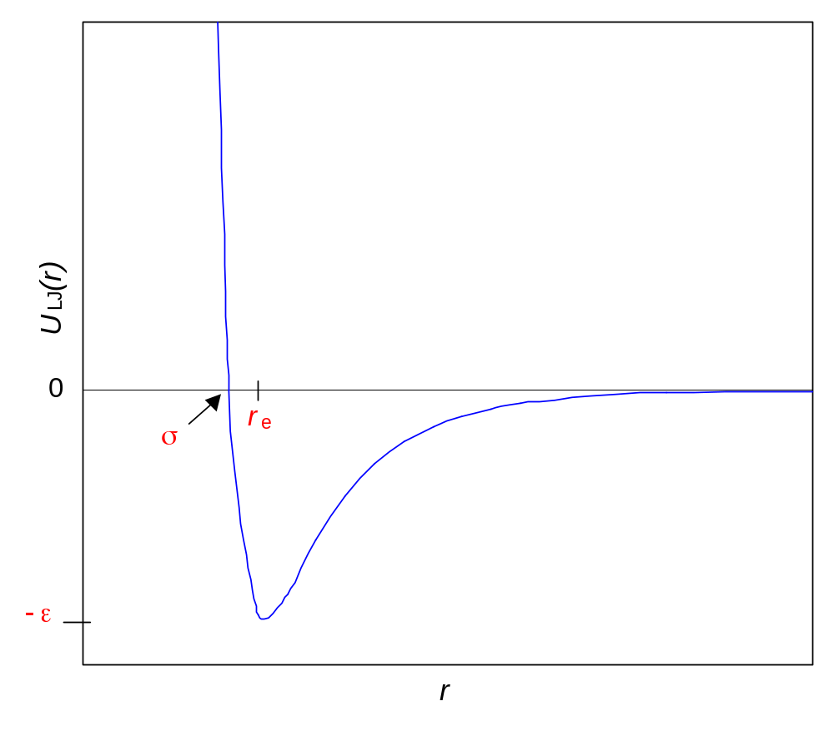
The Lennard-Jones Potential
U_{LJ} ∝ +r ⁻¹²
U_{LJ} ∝ −r ⁻⁶

Slide 46
Table of LJ well depths (ε) for rare gas dimers and boiling temperatures (T_{b})
and melting temperatures (T_{m}) of the rare gas elements.
Atom | ε / kJ mol⁻¹ | T_{b} / K | T_{m} / K
He | 0.09 | 4.2 | (p = 26 atm.) 0.95
Ne | 0.39 | 27.1 | 24.6
Ar | 1.17 | 87.3 | 83.8
Kr | 1.59 | 120 | 116
Xe | 2.14 | 165 | 161
Rn | ---- | 211 | 202

Slide 47
  The increase in ε on going to heavier rare gases reflects the increase in the attractive dispersion forces because of the higher polarizability due to the lower effective nuclear charge experienced by the outer electrons in the heavier rare gas atoms.
  The boiling temperatures (T_{b}) of the rare gas elements follows the same trend as that observed for the ε values of the dimers (i.e. increasing with increasing atomic number) because of the increasing dispersion forces.
  The same trend is observed for the melting temperatures (T_{m}) of the rare gas elements.
  Note: helium cannot be solidified at pressures lower than 25 atmospheres.

Slide 48
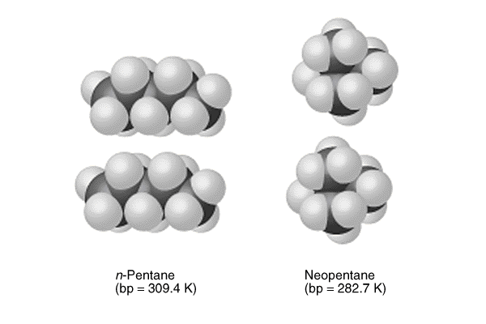
  As molecules are larger and (usually) more polarizable than rare gas atoms, typical binding energies due to dispersion forces are of the order ε  10 kJ mol⁻¹ per intermolecular interaction—i.e. ε(Mol₂) ≈ 10ε(Rg₂).
  Example: the magnitude of the dispersion energy for two methane molecules separated by 0.3 nm is approximately −4.7 kJ mol⁻¹ (i.e. ε ≈ 4.7 kJ mol⁻¹).
  Comparing isomers of alkane
  molecules, straight chain
  isomers generally have higher
  boiling/melting points, due to
  increased dispersion forces
  (larger instantaneous dipoles and
  shorter intermolecular distances)
n-pentane
T_{b} = 309.4 K
neo-pentane
T_{b} = 282.7 K

Slide 49
4.6 Hydrogen Bonding
Definition
A hydrogen bond is an intermolecular linkage of the form X−H☹Y, where a hydrogen atom is covalently bound to one electronegative atom (X = N, O, F etc.) and interacts with a second electronegative atom (Y), which has an accessible lone-pair of electrons.
X−H hydrogen bond donor.
Y hydrogen bond acceptor.
Characteristic properties of hydrogen bonds:
  hydrogen-bonding is directional (depends on bond orientations) and short-ranged.
  the ∠X−H☹Y angle is normally close to 180°; the H☹Y distance is significantly longer than a H−Y covalent bond;
  lengthening of the X−H bond;
  large red-shift of the X−H stretching vibration;
  broadening and gain of intensity of the X−H stretch;
  deshielding of the hydrogen-bonded proton (observed as a shift in its NMR signal).
  typical hydrogen bond strengths lie in the range 10–25 kJ mol⁻¹.

Slide 50
Contributions to Hydrogen Bonding
The major component (probably around 80%) is electrostatic, as a H atom bonded to an electronegative atom (X), will carry a significant fractional positive charge (+q) which will undergo an attractive interaction with the fractional negative charge (−q) on the neighbouring electronegative atom (Y).
Other important contributions come from induction and dispersion forces, as well as from charge transfer—which can be regarded as incipient covalent bond formation—from atom Y to the hydrogen atom.
Example: contributions to the interaction energy between two water molecules, at the equilibrium geometry (in kJ mol⁻¹):
Electrostatic | −25.8
Repulsion | 21.3
Dispersion | −9.2
Induction | −4.5
Charge transfer | −3.7
Total | −21.9

Slide 51
Consequences of Hydrogen Bonding
The anomalously high boiling points of ammonia, water and hydrogen fluoride can be attributed to the occurrence of hydrogen bonding, which is significantly stronger for these elements than for their heavier congeners.
The tetrahedral three-dimensional structure of ice and the local structure of liquid water is a consequence of hydrogen bonding, as is the fact that ice is less dense than water!
The existence of life on Earth is a direct consequence of the hydrogen bonding present in water and the high range (100°C) over which water remains liquid.
Hydrogen bonding plays a very important role in biology, being responsible for the structural organization of proteins and other bio-molecules and governing crucial in vivo proton-transfer reactions.

Slide 52
5. Many-Body Energies
On moving from dimers to larger aggregations of atoms (clusters), or to the bulk liquid or solid phase, accurate modelling of the interatomic forces between the rare gases requires the addition of non-pairwise additive many-body energies.
Even for a rare gas trimer (Rg₃), the total potential energy is not just the sum of the three pair interactions: U_{abc} ≠ U_{ab} + U_{bc} + U_{ca}.
This non-pair-additivity reflects the fact that the dispersion attraction between two atoms is modified by the presence of other neighbouring atoms.
[Note: induction energies are also non-pair-additive because the polarization of an atom/molecule by an ion/dipole etc. will be affected by the presence of any other ions or dipoles nearby.]

Slide 53
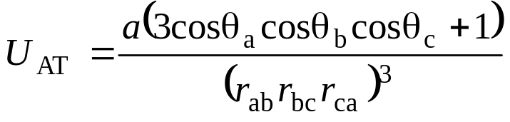
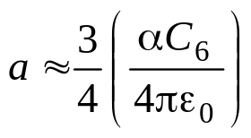
The major correction to the dispersion energy due to many-body interactions is the Axilrod-Teller (3-body) potential:
c
r_{ca}
θ_{c}
r_{bc}
a
θ_{a}
θ_{b}
b
r_{ab}
U_{AT} < 0
Linear arrangement: introduction of c increases attraction between a and b.
a
b
c
c
U_{AT} > 0
Triangular arrangement: introduction of c decreases attraction between a and b.
a
b

Slide 54
In condensed phases (liquids and solids), maximisation of the pair-wise additive van der Waals energies usually leads to close-packed-type structures with a large number of triangles. Therefore, the many-body energy (U_{AT}) is usually positive (leading to a decrease in the total interaction energy).
For the rare gases, the many-body energy is generally small, accounting for only 10% of the total interaction energy in liquid or solid argon, for example. In the gas phases the effect is even smaller.
For non-spherical molecules, U_{AT} will depend on the relative orientations of the molecules, as well as their positions.
Many-body forces are large for metals and semiconductors, both in the liquid and the solid phases.

Slide 55
6. Total Energy
In many cases, more than one types of intermolecular force may be in operation, depending upon whether the molecules carry a net charge or possess permanent multipole moments.
The total potential energy is given by the sum of the short-range repulsive energy and the longer-ranged attractive energy. For neutral molecules, these attractive components correspond to van der Waals and (where appropriate) hydrogen-bonding energies:
U_{tot} = U_{rep} + U_{vdW} + U_{HB}
(Ignoring any small many-body effects) this yields the familiar pair potential curve for U_{tot}(r).

Slide 56
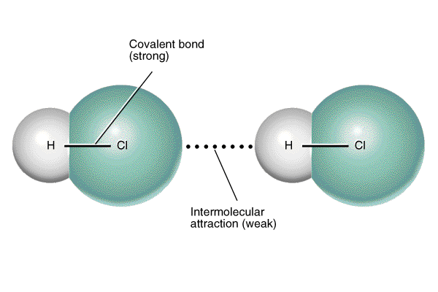
7. Comparison of Intermolecular Forces
With the exception of small, highly polar molecules (such as H₂O), the dispersion energy is the largest contribution to intermolecular bonding between uncharged molecules.
Induction energies are small unless one of the molecules is charged.
Note: intermolecular forces (vdW energies typically < 30 kJ mol⁻¹) are much weaker than the covalent bonds (typically hundreds of kJ mol⁻¹) within molecules:

Slide 57
Distance-dependence and typical magnitudes of different types of IMF
IMF | Distance-dependence | Other Factors | Typical Magnitude | Comments
Covalent Bonding | e^{−αr} |  | 400 kJ mol⁻¹ | Directional
Short-range Repulsion | e^{−αr}
Electrostatic
Ion-Ion | r ⁻¹ | Q₁Q₂ | 250 kJ mol⁻¹
Ion-Dipole | r ⁻² | Q₁μ₂ | 15 kJ mol⁻¹
Dipole-Dipole (static) | r ⁻³ | μ ₁μ₂ | 2 kJ mol⁻¹
Dipole-Dipole (rotating) | r ⁻⁶ | μ ₁μ₂ | 0.6 kJ mol⁻¹
Induction |  |  |  | Always attractive Non-additive
Ion-Induced Dipole | r ⁻⁴ | Q₁² α₂ | 10 kJ mol⁻¹
Dipole-Induced Dipole | r ⁻⁶ | μ ₁² α₂ | < 1 kJ mol⁻¹
Dispersion | r ⁻⁶ | α₁α₂(I₁I₂/(I₁+I₂)) | 5 kJ mol⁻¹ | Always attractive Non-additive
Hydrogen Bonding | e^{−αr} |  | 20 kJ mol⁻¹ | Directional

Slide 58
The relative strengths of intermolecular forces can be seen in the following Table, which lists the boiling points (T_{b}) and effective Lennard–Jones potential well depths (ε) for a variety of dimers of molecules, and compares them with the rare gases neon, argon and xenon.
Note: these are only effective LJ well depths, since not all of these dimers are held together by dispersion forces.

Slide 59
Comparison of boiling points (T_{b}) and effective Lennard–Jones potential well depths ε for atomic and molecular dimers
Atom/Molecule | ε / kJ mol⁻¹ | T_{b} / K
Ne | 0.4 | 27
Ar | 1.2 | 87
Xe | 2.1 | 165
H₂ | 0.3 | 20
N₂ | 0.9 | 77
CO₂ | 2.0 | (subl.) 195
CH₄ | 1.3 | 112
CCl₄ | 3.2 | 350
C₆H₆ | 3.1 | 353
H₂O | 20.0 | 373

Slide 60
Small, non-polar molecules (e.g. H₂ and N₂) have low intermolecular binding energies (weaker than the interatomic forces in argon).
Larger molecules (e.g. CCl₄ and C₆H₆) have significantly higher interactions.
The boiling points of these molecular sytems follow the same general trend as the well depth.
Hydrogen bonded dimers have significantly greater well depths—for example an estimate of the effective pair potential well depth for H₂O☹H₂O gives a value of 2,400 K, which is consistent with the relatively high boiling temperature (373 K) of liquid water.

Slide 61
Comparison of melting points (T_{m}) of various elements and compounds
Species | T_{m} / °C | Comments
Ne | −249 | Dispersion only
O₂ | −218 | Q-Q
N₂ | −210 | Q-Q
HCl | −114 | D-D
Xe | −112 | Dispersion only
NH₃ | −78 | H-bonding
CO₂ | −56 | Q-Q
CCl₄ | −23 | O-O
Br₂ | −7 | Q-Q
H₂O | 0 | H-bonding
C₆H₆ | 5 | Q-Q
I₂ | 114 | Q-Q
NaCl | 801 | Ionic
Au | 1065 | Metallic
C (graphite) | (subl.) 3427 | Covalent

