Slide 11
CS-ROSETTA

Slide 12
The ROSETTA Procedure
Monte Carlo fragment replacement
Monte Carlo side chain packing
Monte Carlo minimization
As t goes to infinity (cubed? more?), it converges to the answer!

Slide 13
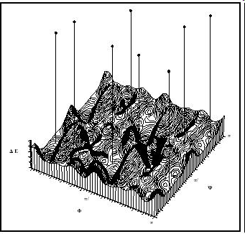
Monte Carlo (Random Sampling)
Randomly (or pseudorandomly) pick a configuration and evaluate its energy.
If acceptably low, store result.
If not, move a distance away from that point as a function of the energy (Metropolis criterion, a.k.a. simulated annealing) and evaluate again
When some convergence threshold or time limit is met, stop and return stored results.
http://www.chemistryexplained.com/images/chfa_03_img0571.jpg

Slide 14
Advantages of Monte Carlo
Individual computations are cheap
  Exponential search spaces are slow to search exhaustively
  Probabilistic worst case is identical to simple brute-force
Can be done as an empirical black box
  Can approximate molecular dynamics with empirical energy functions

Slide 15
When Should Monte Carlo Be Used?
No provable bounds on running time
  Monte Carlo linear algebra?
  Monte Carlo comparison sort? (Bozo Sort)
No provable bounds on accuracy
  Convergence != global minimum
Only sample what you can’t reasonably deterministically predict

Slide 16
Application to ROSETTA
Monte Carlo fragment replacement
  Randomly select a position, and the 8 residues following it
  Randomly select a 9 residue fragment from database, and match the fragment’s bond angles

Slide 17
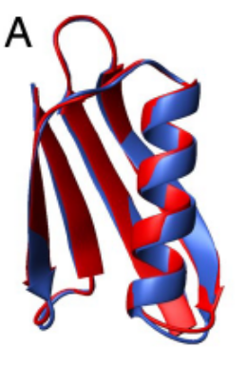
Chemical-Shift Rosetta
Use NMR data as an additional criterion in fragment selection phase.
Experimental NMR data
PDB
MFR
Fragment Database
ROSETTA
From fig. (3)

Slide 18
Molecular Fragment Replacement (MFR)
Given AA sequence (from genomic data or otherwise) search PDB for best possible matches.
Find fragments of known proteins that best match the sequence and predicted chemical shift best fit experimental data.
  Chemical shifts predicted via SPARTA, which was trained on 200 proteins and is 10% more accurate than SHIFTX

Slide 19
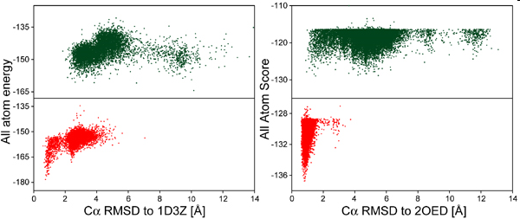
Results
MFR-selected fragments generate lower energy structures than standard ROSETTA fragments
Lowest-energy conformations for C^{α} deviated 1~2 Å from reference structure
Some exceptions, but ROSETTA doesn’t consider the chemical shifts, and adding it to the empirical energy function improved results

Slide 20
Robustness
When backbone chemical shift assignments are incomplete, CS-ROSETTA is still better at picking fragments than ROSETTA
If a whole section of the protein’s chemical data is missing then it’s like that part is just being run with vanilla ROSETTA

Slide 21
Convergence
Convergence is concluded when the newly derived structure has rmsd approx. 2Å from the lowest energy structure so far.
Baker et al. suggest identifying a “funneling phenomenon”

Slide 22
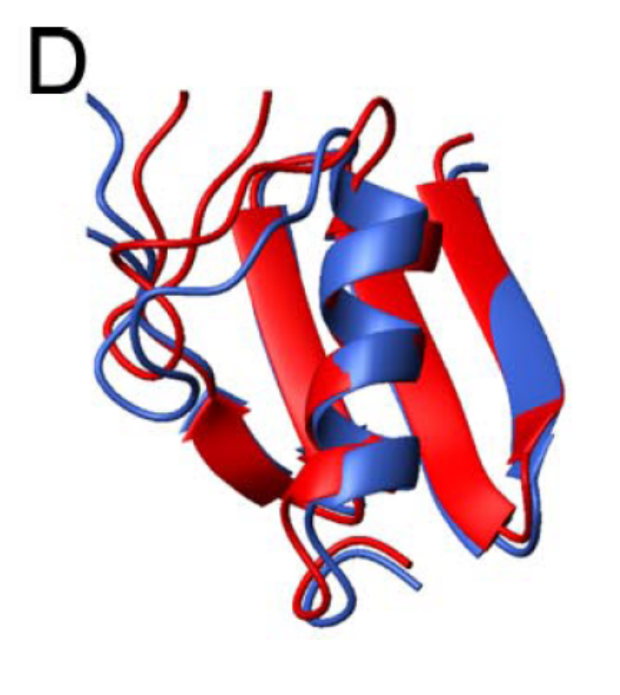
Convergence
Convergence rapidly decreases with increasing protein size, and CS-ROSETTA begins to fail at around 130 residues.
Convergence is also adversely affected by long, disordered loops in the reference structure
From fig(5)

Slide 23
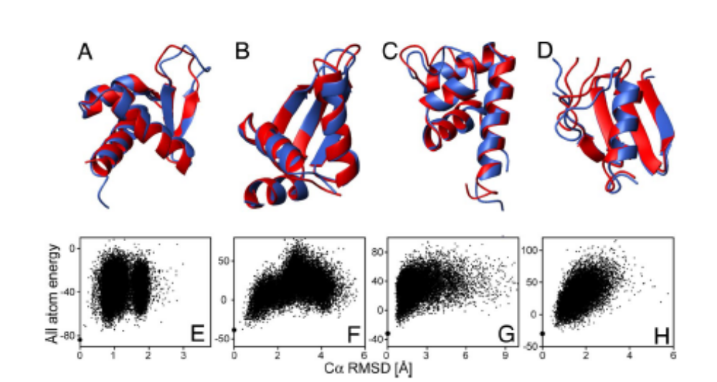
Blind Prediction
The ordered portions have remarkably good rmsd, values <1 Å for 6 and less than approx. 2 for the other 3

Slide 24
Blind Prediction
Structures are strikingly similar:
  ROSETTA’s energy model favors hydrogen bonds, which results in extended secondary structure by a few residues
  Disordered sections can be detected by chemical shifts with Random Coil Index and thus prohibited from contributing to secondary structure
  Core side-chain packing was also less accurate

Slide 25
Conclusions
CS-ROSETTA is faster and thus able to handle bigger problems than traditional ROSETTA.
CS-ROSETTA is 50% faster than traditional triple-NMR structure determination
CS-ROSETTA is perhaps better able to determine the structure of systems not stable enough for conventional NMR…?

Slide 26
CS-ROSETTA?
Is there a mathematically derived limit on how big a protein can be?
  ROSETTA runs 28,000 iterations, so if the search space of a protein exceeds 28000n for some n it is most likely going to fail?
Each additional sample gives us more information. Is it possible to identify the “statistically significant global minimum?”
Given assignments, Chemical shifts should also tell us more about secondary structure (guided side chain packing and minimization?)

Slide 27
