Slide 1
Visualizing Protein Structures
What we hope to learn
Core
The basic building blocks: amino acids
Secondary structure
Forces that drive folding
Motifs or supersecondary structure
Domains
Finding out more about structures
How to visualize molecules with VMD
How to edit Protein Data Bank files

Slide 2
Why we should care more about structure and less about informatics…

Slide 3
Why we should care more about structure and less about informatics…
Structure and dynamics are needed to infer function.

Slide 4
Why we should care more about structure and less about informatics…
Structure and dynamics are needed to infer function.
There is more to bioinformatics than AGCT or protein sequence

Slide 5
Why we should care more about structure and less about informatics…
Structure and dynamics are needed to infer function.
There is more to bioinformatics than AGCT or protein sequence
RNA is more important than DNA

Slide 6
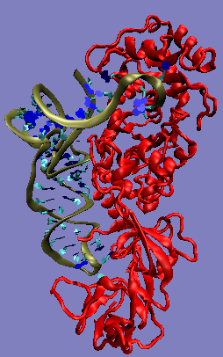
Ribozymes, Riboswitches, RNAi
“The known biological functions of RNA continue to grow in number and to expand in scope. RNA has been transformed from a molecule with a minor role in protein synthesis, to an important player in all of molecular biology.”
“Furthermore, it has been shown that stem-loops in the mRNA can bind to the protein product of the message to regulate its synthesis, pseudoknots in retroviral mRMAs cause programmed frameshifts that produce the correct ratios of proteins required for viral propagation.”
Tinoco, “How RNA folds.” J Mol Biol. 1999 Oct 22;293(2):271-81. Review.

Slide 7
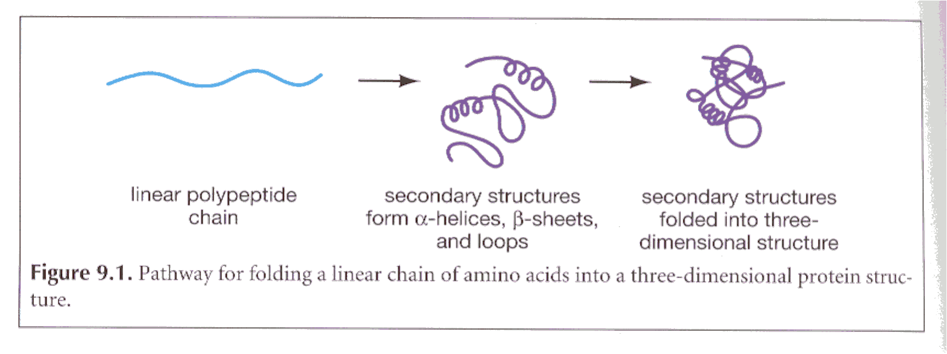
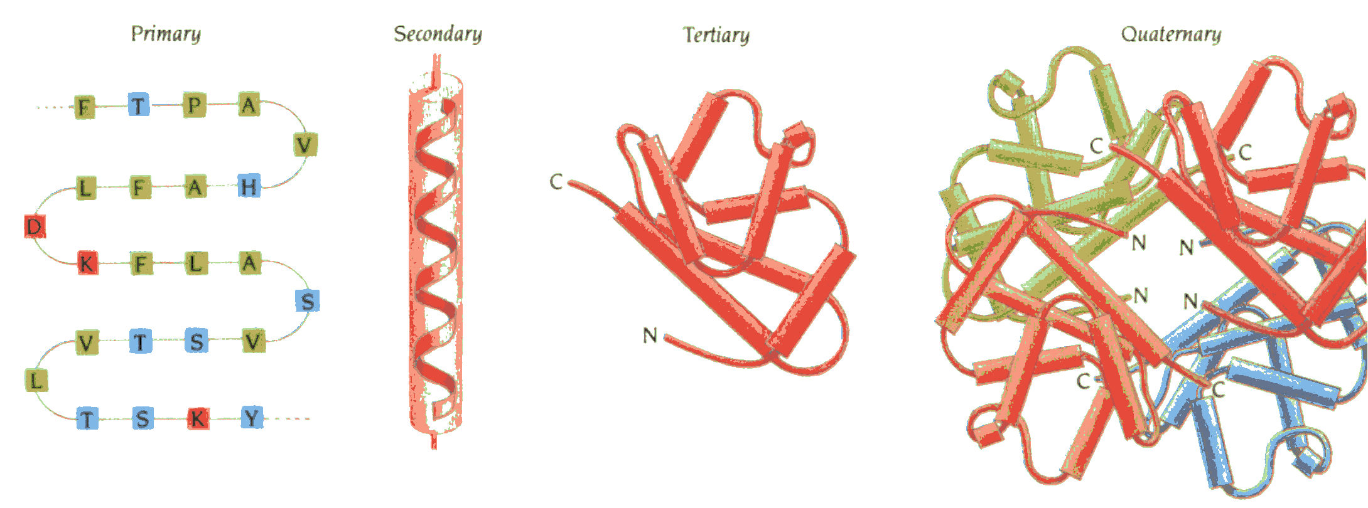
(from Mount, “Bioinformatics Sequence and Genome Analysis”
primary (1º) secondary (2º) tertiary (3º) quaternary (4º)
From: Brandon & Tooze, “Introduction to Protein Structure”

Slide 8
(from Mount)
primary (1º) secondary (2º) tertiary (3º) quaternary (4º)
From: Brandon & Tooze, “Introduction to Protein Structure”

Slide 9
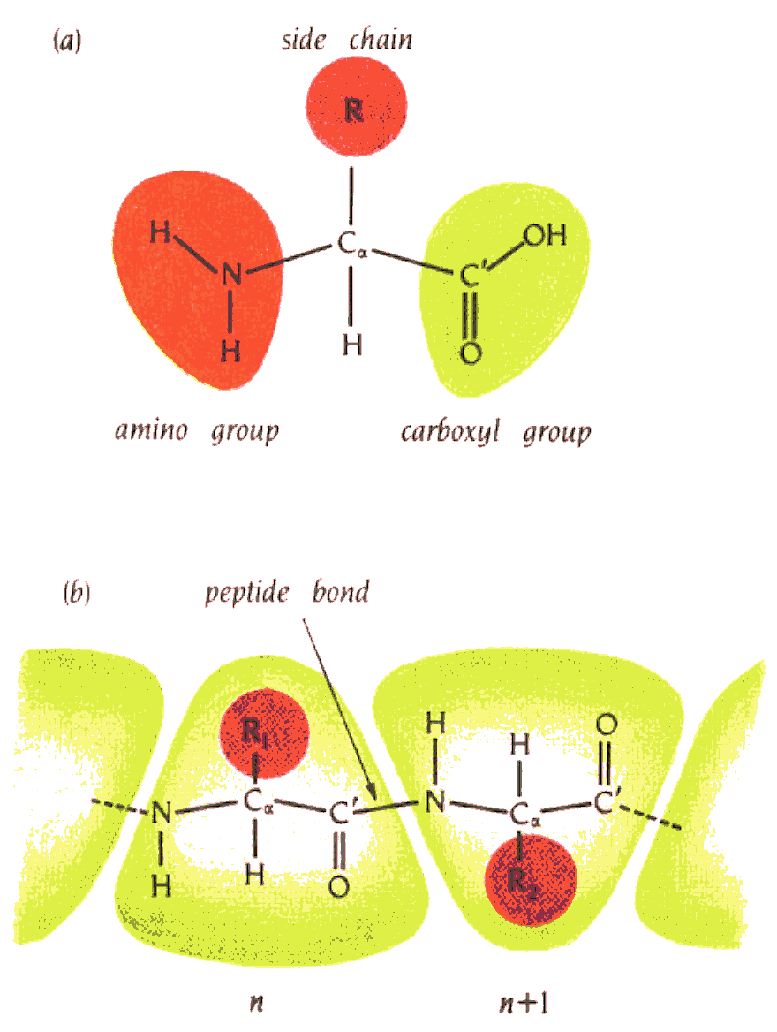
amino acids/proteins:
Glycine GLY G
Alanine ALA A
Phenylalanine PHE F
Leucine LEU L
Isoleucine ILE I
Valine VAL V
Proline PRO P
Methionine MET M
Glutamic acid GLU E
Aspartic acid ASP D
Glutamine GLN Q
Asparagine ASN N
Lysine LYS K
Arginine ARG R
Serine SER S
Threonine THR T
Tyrosine TYR Y
Tryptophan TRP W
Histidine HIS H
Cysteine CYS C
Core
From: Brandon & Tooze, “Introduction to Protein Structure”

Slide 10
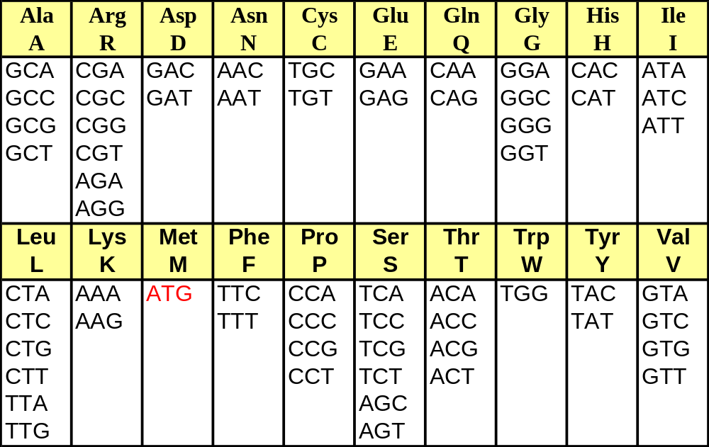
The Genetic Code
Core
starts with atg (Met)
ends with a stop codon (taa, tag or tga).

Slide 11
amino acids/proteins:
Glycine GLY G
Alanine ALA A
Phenylalanine PHE F
Leucine LEU L
Isoleucine ILE I
Valine VAL V
Proline PRO P
Methionine MET M
Glutamic acid GLU E
Aspartic acid ASP D
Glutamine GLN Q
Asparagine ASN N
Lysine LYS K
Arginine ARG R
Serine SER S
Threonine THR T
Tyrosine TYR Y
Tryptophan TRP W
Histidine HIS H
Cysteine CYS C
Hydrophobic amino acids

Slide 12
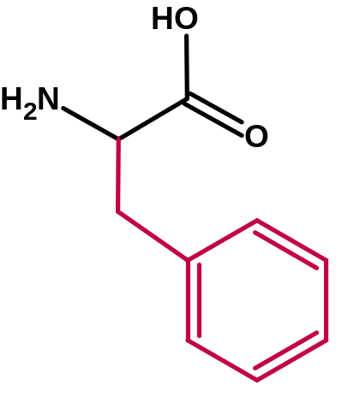
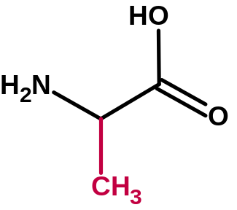
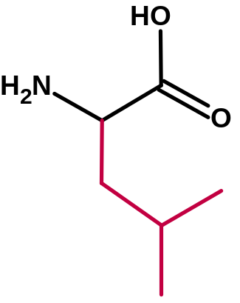
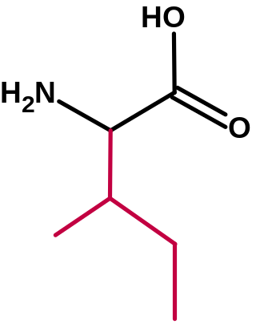
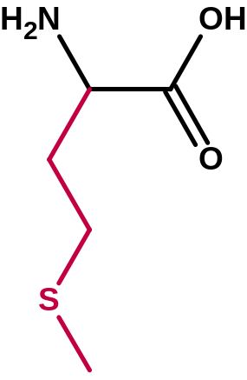
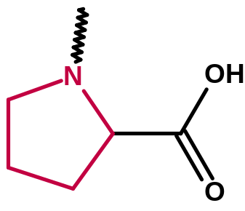
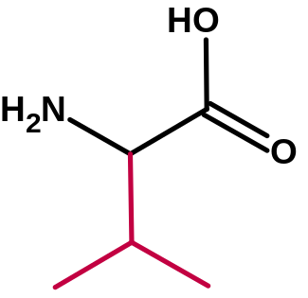
Hydrophobic amino acids
Alanine ALA A
Phenylalanine PHE F
Leucine LEU L
Isoleucine ILE I
Valine VAL V
Proline PRO P
Methionine MET M
Alanine
Phenylalanine
Leucine
Isoleucine
Proline
Methionine
Valine

Slide 13
Hydrophobic amino acids
Alanine ALA A
Phenylalanine PHE F
Leucine LEU L
Isoleucine ILE I
Valine VAL V
Proline PRO P
Methionine MET M
Alanine
Phenylalanine
Leucine
Isoleucine
Proline
Methionine
Helix breaker
(except at N-caps)
Valine

Slide 14
amino acids/proteins:
Glycine GLY G
Alanine ALA A
Phenylalanine PHE F
Leucine LEU L
Isoleucine ILE I
Valine VAL V
Proline PRO P
Methionine MET M
Glutamic acid GLU E
Aspartic acid ASP D
Glutamine GLN Q
Asparagine ASN N
Lysine LYS K
Arginine ARG R
Serine SER S
Threonine THR T
Tyrosine TYR Y
Tryptophan TRP W
Histidine HIS H
Cysteine CYS C
Charged amino acids
Charged residues tend to reside on protein surface
?

Slide 15
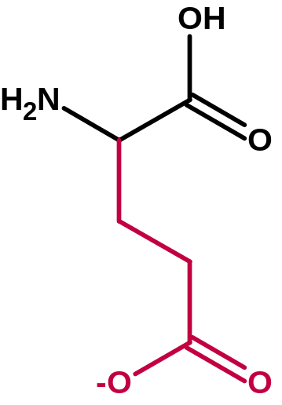
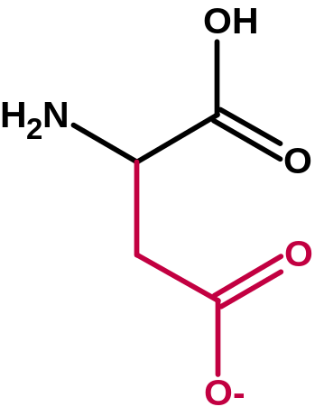
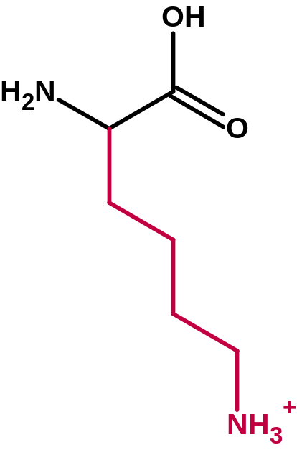
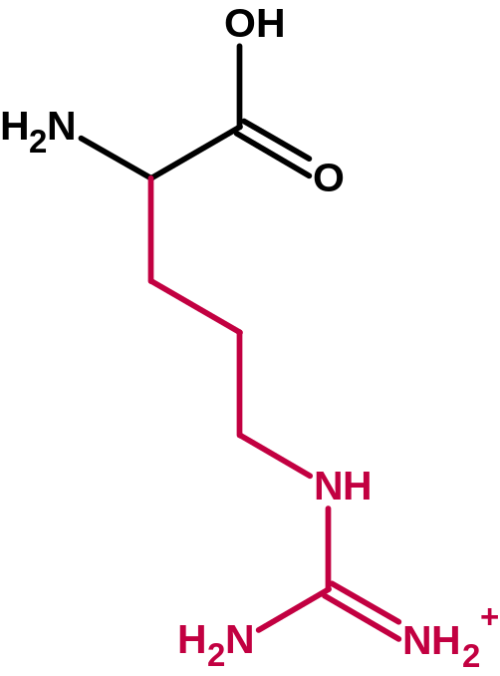
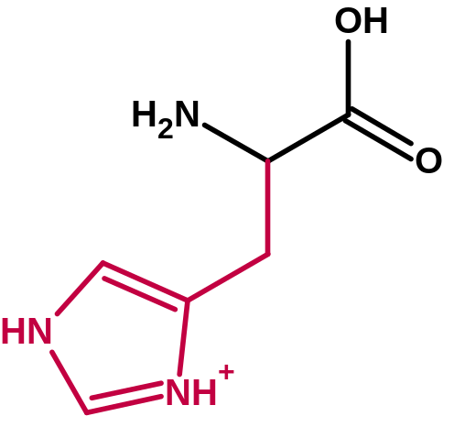
Charged amino acids:
Glutamic acid GLU E
Aspartic acid ASP D
Lysine LYS K
Arginine ARG R
Histidine HIS H
Glutamic acid
Aspartic acid
Histidine
Lysine
Arginine

Slide 16
Charged amino acids:
Glutamic acid GLU E
Aspartic acid ASP D
Lysine LYS K
Arginine ARG R
Histidine HIS H
Glutamic acid
Aspartic acid
Histidine
Lysine
Arginine

Slide 17
amino acids/proteins:
Glycine GLY G
Alanine ALA A
Phenylalanine PHE F
Leucine LEU L
Isoleucine ILE I
Valine VAL V
Proline PRO P
Methionine MET M
Glutamic acid GLU E
Aspartic acid ASP D
Glutamine GLN Q
Asparagine ASN N
Lysine LYS K
Arginine ARG R
Serine SER S
Threonine THR T
Tyrosine TYR Y
Tryptophan TRP W
Histidine HIS H
Cysteine CYS C
Polar
amino acids

Slide 18
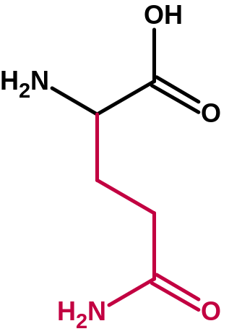
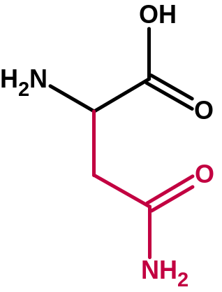
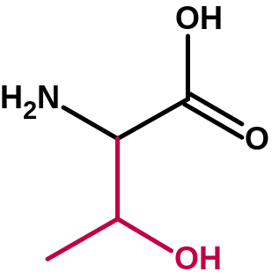
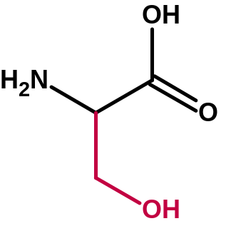
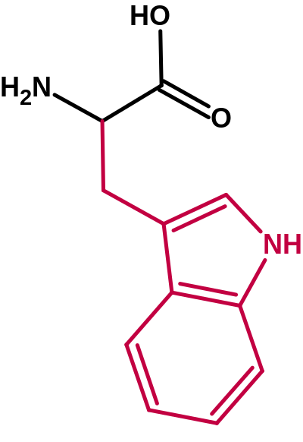
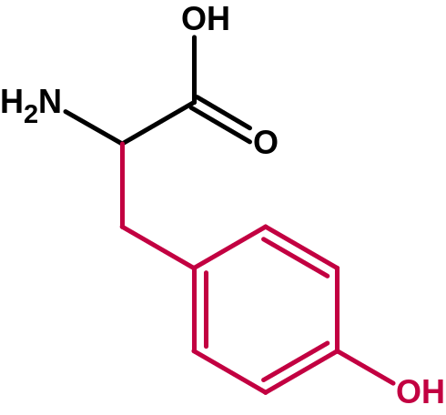
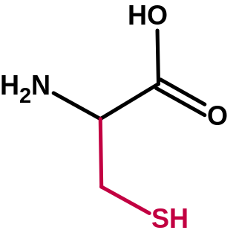
Polar amino acids:
Glutamine GLN Q
Asparagine ASN N
Serine SER S
Threonine THR T
Tyrosine TYR Y
Tryptophan TRP W
Histidine HIS H
Cysteine CYS C
Glutamine
Asparagine
Serine
Threonine
Cysteine
Tyrosine
Tryptophan

Slide 19
?

Slide 20

O
peptide bond is relatively rigid and planar
(significant barrier to rotation, ~20 kcal/mol)
trans peptide bond is favored over cis by 10³ (steric clash)
Except PRO: trans favored by only 80:20
C
N
H
phi
φ
psi
ψ
H
O
R
C
N
N
C
R
O
R
H
The planar peptide bonds can rotate about the Cα carbon
Ф and Ψ are 180º in the conformation shown and increase
in the clockwise direction when view from the Cα carbon

Slide 21
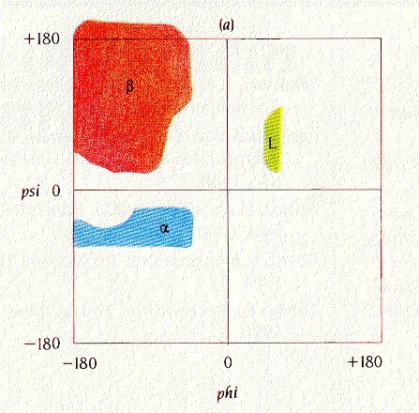
phi
φ
psi
ψ
H
O
R
Core
C
N
N
C
R
O
R
H
Ramachandran plot:
Shows sterically allowed conformational angles phi and psi
Steric interactions eliminate a large fraction of possible comformations.
Brandon & Tooze
Introduction to Protein Structure, Figure 1.7a

Slide 22
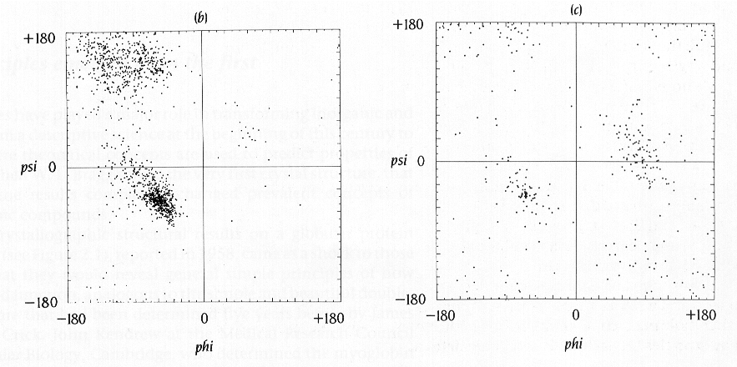
phi
φ
psi
ψ
H
O
R
Brandon & Tooze
Introduction to Protein Structure, Figure 1.7b.c
From J. Richardson, Adv. Prot. Chem. 34, 174-174 (1981)
C
N
N
C
R
O
R
H
All amino acids (except glycine) from high resolution crystals
GLY: much more freedom

Slide 23
amino acids/proteins:
ala, gly, leu, ile, val, glu, asp, gln, asn, pro,
lys, arg, ser, thr, tyr, trp, phe, his, cys, met
Core
Secondary structure
α-helix
β-sheet
loop or turn
random coil
From: Brandon & Tooze, “Introduction to Protein Structure”

Slide 24
Can we predict 2° structure?

Slide 25
Can we predict 2° structure?
-- helical propensities
-- mining structural databases for known sequence-structure relationships
-- sequence contexts?
-- neural nets, …
Yes! …but accuracy is poor ☹
However: a given sequence may adopt multiple structures.
Kabsch W & Sander C Proc. Natl. Acad. Sci. 81, 1075-1078 (1984)
“On the use of sequence homologies to predict protein structure: Identical pentapeptides can have completely different conformations”

Slide 26
Rost B & Eyrich VA “EVA: Large-scale analysis of secondary structure prediction” Proteins Suppl 5, 192-199 (2001).
WWW server that automatically tests other 2° structure prediction servers with new structures from crystal database.
Example programs: JPred2, PROFking, PSIPRED, PSSP, SAM-t99sec, Sspro, PHDsec, PHDpsi, PROFphd

Slide 27
Can we predict properties of unknown Proteins?

Slide 28
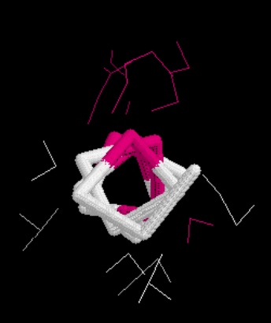
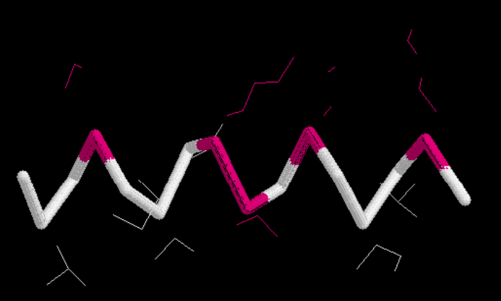
Can we predict properties of unknown Proteins?
Yes!
Core
Sequence: LAKMVVKTAEAILKD
α Helix
3.6 amino acids per turn
10 Å (3 turns) 10 amino acids
N-H•••O=C H-bond between every 4th residue
Transmembrane α Helix ≈ 19 hydrophobic AA long

Slide 29
Parametric Sequence Analysis http://www.expasy.org/tools/
Core
● Parameters assigned to residues
• Amino acids, dipeptides etc.
• Bases, dinucleotides, triplets etc.
● Values averaged over a sliding window (or pattern)
• Arithmetic average, geometric average, etc.
• Values can be weighted based on position in the window
● Threshold learned from training sequences
• Requires a gold standard known to belong to set
• Requires sequences known not to belong to set
Example: Kyte-Doolittle assigned a value to each amino acid based on its hydrophobicity

Slide 30
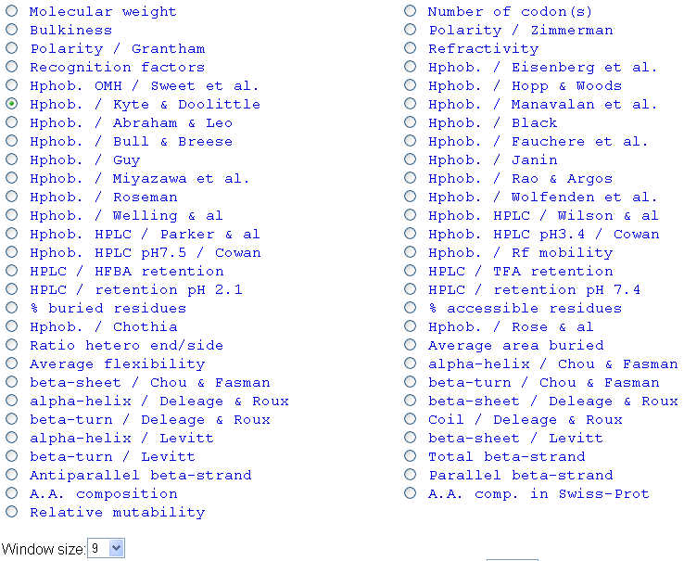
Protscale Parameters http://www.expasy.ch/tools/protscale.html

Slide 31
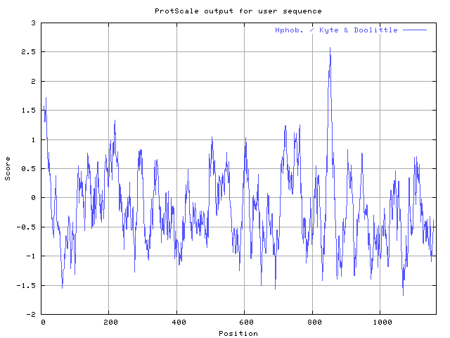
Kyte-Doolittle of Leptin Receptor
1.7

Slide 32
Why does 2° structure form?
Why do proteins “fold”?
Secondary structure
α-helix
β-sheet
loop or turn
random coil
From: Brandon & Tooze, “Introduction to Protein Structure”

Slide 33
Digression:
Chemical forces
intra- and inter- molecular interaction

Slide 34
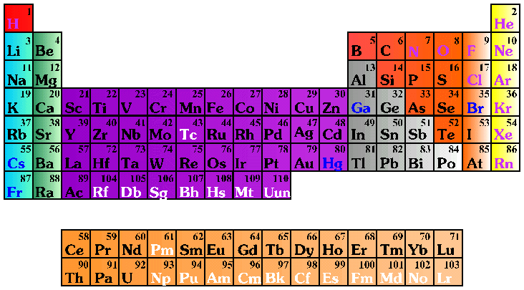
the basic bio-elements…

Slide 35
O
H
C
N
C
N
O
H
H
H

Slide 36
Double bond character of C-N bond, the peptide bond is essentially planar
O⁻
H
C
O
H
C
N⁺
N
H
H
C
N
O
H
H
H

Slide 37
δ-
O
H
C
δ+
H
O
δ-
N
H
H
H
H
δ+
Peptides and Water have large Dipoles

Slide 38
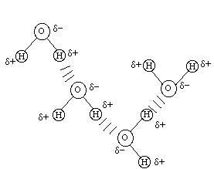
HBONDs H•••:O N or F
δ-
Core
δ+
H
O
δ-
H
δ+
increasing electronegativity
R
R
O
C
N
C
H
increasing electronegativity
O
N
H
…important for protein and nucleic acid structure

Slide 39
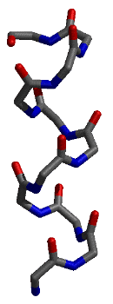
Intermolecular interactions
HBONDs is one of the stongest Intermolecular Interactions.
Are there others?

Slide 40
forces/energies/lengths
R
HBONDs
O
C
N
H
NH₂
δ⁺ δ⁻
O
C
~3 Å
R
~strength (kcal/mol)
hydrogen-bond
-1 to –10 (?)
H H
dipole-dipole interaction
Due to unequal sharing of electrons in a covalent bond (differing electronegativities).
Short range, angle dependent
1.0 Å
10⁻¹⁰ m
0.1 nm
C H
1.4 Å

Slide 41
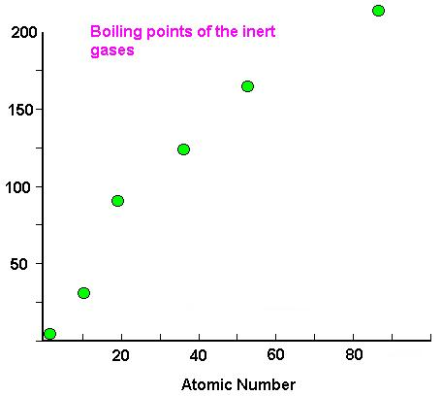
Intermolecular interactions
Why does helium liquify, solidify?
2 He → He₂
1s
He
? non-covalent (no sharing of e⁻)
? not electrostatic (neutral)
http://www.chem.uidaho.edu/~chem103/inert.jpg

Slide 42
Intermolecular interactions
Why does helium liquify, solidify?
2 He → He₂
1s
He
? non-covalent (no sharing of e⁻)
? not electrostatic (neutral)
+
+
DISPERSION-ATTRACTION (London forces)
Correlated motions of the electrons leading to instantaneous induced dipole-dipole interaction as atoms approach…

Slide 43
Intermolecular interactions
DISPERSION-ATTRACTION (London forces)
Correlated motions of the electrons leading to instantaneous induced dipole-dipole interaction as atoms approach…
E_{dispersion} = -- B_{ij} / r_{ij}⁶ + higher order terms in r_{ij}⁻⁸, r_{ij}⁻¹⁰
Depends on polarizability (↑) and ionization potential (↓)
+
+

Slide 44
Why doesn’t He₂ collapse?
cannot occupy same orbitals
electron pair repulsion
PAULI EXCHANGE REPULSION
E_{repulsion} = + A_{ij} / r_{ij}¹² or A_{ij} e^{-Cijrij}

Slide 45
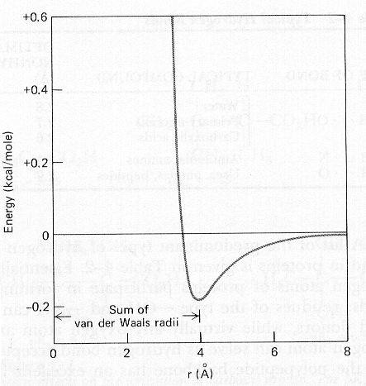
Core
σ
---
r_{ij}
12
σ
---
r_{ij}
6
V = 4ε --
or
σ
r∗
---
r_{ij}
12
r∗
---
r_{ij}
6
V = ε -- 2
ε
6
σ 2 = r*
r∗
Representation of the energy of van der Waals interaction as a function of distance, r, between the centers of two atoms. The energy was calculated using the empirical equation
E = A_{ij}/r_{ij}¹² – B_{ij}/r_{ij}⁶
A_{ij} and B_{ij} represent pre-mixed parameters (A_{ij} = A_{i}A_{j})

Slide 46
Net Van der Waals interaction
E = A_{ij}/r_{ij}¹² – B_{ij}/r_{ij}⁶
Creates Steric Repulsions when atoms are close.
Creates weak binding when atoms are apart.
van der Waals 0.5-1.0 kcal/mol London or dispersion attraction or
induced dipole. Short range. Temperature
dependent.
Most prevalent in aliphatic (hydrocarbon)
or aromatic systems.
+
+

Slide 47
The last and strongest intermolecular force is Ionic
Hydrogen bonds 1.0-10.0 kcal/mol dipole-dipole interaction
Due to unequal sharing of electrons in a
covalent bond (differing electronegativities).
Short range, angle dependent
van der Waals 0.2-1.0 kcal/mol London or dispersion attraction or
induced dipole. Short range. Temperature
dependent.
Most prevalent in aliphatic (hydrocarbon)
or aromatic systems.
Ionic 5.0 kcal/mol least affected by temperature and distance
δ-
δ+
H
O
δ-
H
δ+
+
+
O
O-
+
Na

Slide 48
Why does 2° structure form?
Why do proteins “fold”?
Secondary structure
α-helix
β-sheet
loop or turn
random coil
From: Brandon & Tooze, “Introduction to Protein Structure”

Slide 49

(from Mount)
Why don’t salt bridges dominate as the force for protein stability?
Why is the difference in free energy between a folded
and unfolded state only a few kcal/mol?
~strength (kcal/mol)
hydrogen-bond
change bond angle by 10º
stretch bond by 0.1 Å
break bond
pack two atoms close
two + charges at 3.3 Å
-1 to –5 (?)
+2.0
+2.5
100-300
-0.2
+100.0

Slide 50
forces/energies/lengths
ΔG = ΔH – TΔS = -RT ln K_{eq}
(1)
(2)
≈ -0.6 kcal/mole ln Keq
Compensating interactions/energetics: To form a salt bridge requires desolvating the two ions
Example:
…
(NH₂)₂-C=NH₂⁺
⁻⁻O₂C-CH₃
K = 0.37 to 0.5
~= -0.6*ln K = 0.36 to 0.41 kcal/mol
C. Tanford, JACS 79, 945-946 (1954)
B. Spriggs & P. Haake, Bioorg. Chem. 6, 181-190 (1977)

Slide 51
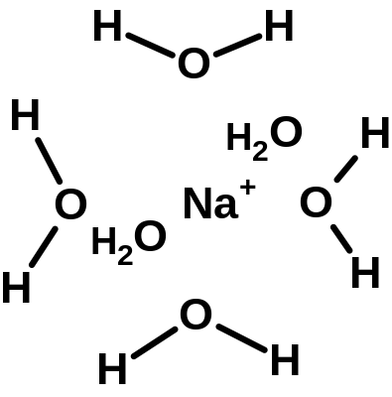
What about solvation?
O
O-
+
Na
To form the salt pair, you must desolvate the ions
Dissolving the ions is often favorable
Desolvating ions is unfavorable

Slide 52
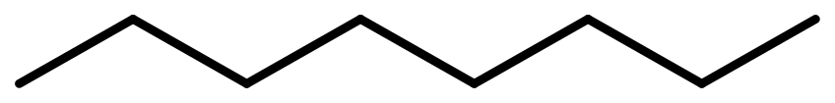
What about solvation?
O
O-
+
Na
To form the salt pair, you must desolvate the ions
Dissolving the ions is often favorable
Desolvating ions is unfavorable
Why are oils not very soluble in water?
octane, lipids, …
Why do lipid bilayers and micelles form?

Slide 53
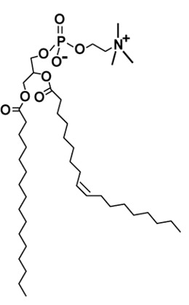
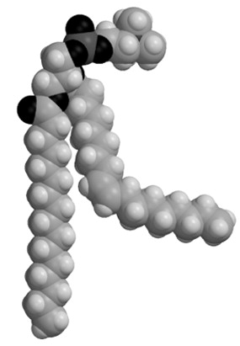
polar head group
Hydrophobic, greasy part
saturated and unsaturated alkyl chains
phosphatidylcholine

Slide 54
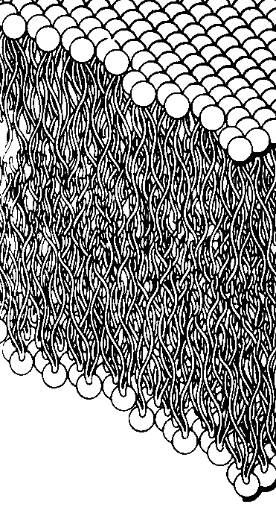
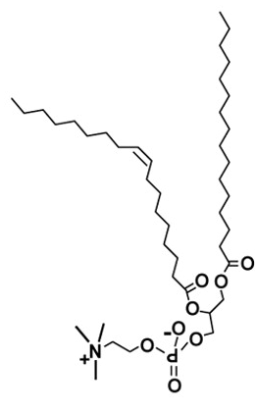
Schematic of a lipid bilayer

Slide 55
Schematic of a POPC lipid micelle?
Hydrophobic effect

Slide 56
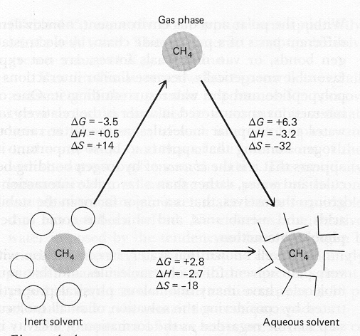
ΔG, ΔH in kcal/mol
ΔS in entropy units, cal/mol/K
Core
ΔH: why so favorable?
We don’t expect better vdw with water
ΔH loss of vdw
ΔS large (since gas)
Thermodynamics of the hydrophobic effect.
T. Creighton, Proteins (Freeman & Co, NY). Figure 4-4
[adapted from WP Jencks, Catalysis in Chemistry and Enzymology (1969) McGraw-Hill

Slide 57
ΔG, ΔH in kcal/mol
ΔS in entropy units, cal/mol/K
ΔH: why so favorable?
We don’t expect better vdw with water
Better h-bonding of solvent, ↑ H
But, significant entropy loss of waters!
ΔH loss of vdw
ΔS large (since gas)
Thermodynamics of the hydrophobic effect.
T. Creighton, Proteins (Freeman & Co, NY). Figure 4-4
[adapted from WP Jencks, Catalysis in Chemistry and Enzymology (1969) McGraw-Hill

Slide 58
Hydrophobic effect: non-polar molecules want to associate
2
+ 4
ΔG favors association due to “freeing” of water
“With nonpolar solutes, the interactions between water and the solute appear to be negligible relative to the initial unfavorable energy required to form the initial cavity in water. Consequently, an inverse linear relationship is found between the solubility of hydrocarbons in water and the surface area of the cavity required to accommodate the solute”
Creighton, Proteins, pg 146

Slide 59
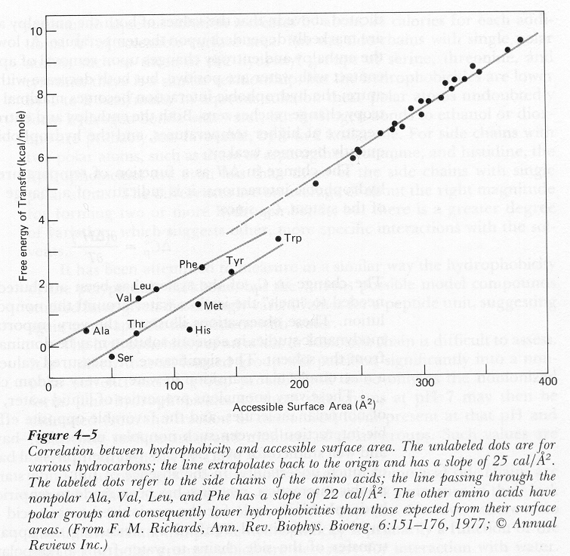
…the line passing through the nonpolar Ala, Val, Leu and Phe has a slope of 22 cal/Å²
Core

Slide 60
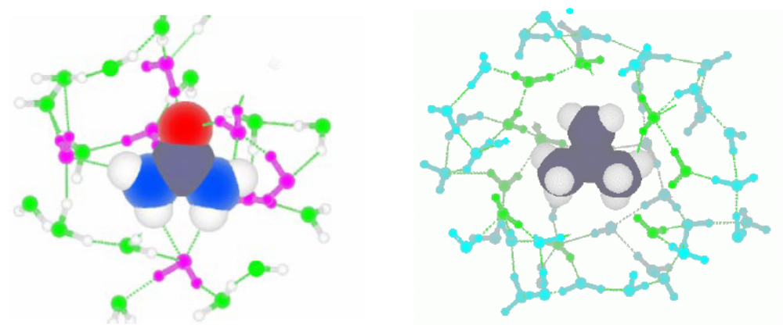
Hydrophobic and Hydrophilic Solutes
POLAR AND NON-POLAR SOLUTES have very different effects on water structure. We show two solutes that have the same Y-shaped geometry but different partial charges. The polar solute, urea (left), has partial charges on its atoms. Consequently, it is able hydrogen-bond to water molecules and to fit right into the water hydrogen-bond network. In contrast, the non-polar solute, isobutene (right), does not have (substantial) partial charges on any of its atoms. It, thus, can not hydrogen-bond to water. Rather, the water molecules around it “turn away” and interact strongly only with other water molecules, forming a sort of hydrogen-bond “ice cage” around the isobutene.

Slide 61
Summary of Protein Folding Interactions
Electrostatic Interactions
Core
Hydrogen bonds -1.0 to -10.0 kcal/mol dipole-dipole interaction
1/r² Short range, angle dependent
van der Waals -0.2 to -1.0 kcal/mol Induced dipole
1/r⁶ Very Short range. Temperature dependent
Ionic ±5.0+ kcal/mol ion-ion interaction
1/r least affected by temperature and distance
Hydrophobic Interactions
Hydrophilic ΔG = ΔH – T Δ S Solvation is favored by ΔH < 0
reduces ion-ion interactions
Hydrophobic ΔG = ΔH – T Δ S Desolvation is favored by Δ S > 0
Surface area and Temperature dependent

Slide 62
What we hope to learn
Review of Forces that drive folding
Motifs or supersecondary structure
Structural Domains
Finding out more about structures
UniProt Classification Databases
Discussion of Chapter 1 (C&H)
Assignments:
Finish VMD Laboratory
Start constructing your Web Page

Slide 63
Secondary structure
α-helix
β-sheet
loop or turn
random coil
From: Brandon & Tooze, “Introduction to Protein Structure”

Slide 64
i to i+4 connectivity
3.6 residues per turn
(phi, psi) ~= (-60º, -50º)
α-helix

Slide 65
C=O --
i to i+4 connectivity
3.6 residues per turn
(phi, psi) ~= (-60º, -50º)
All NH and C=O groups are connected
except for first NH group and last C=O
ends are polar (hence usually at protein surface)
orientation of h-bonds leads to net dipole
NH +
α-helix

Slide 66
i to i+4 connectivity
3.6 residues per turn
(phi, psi) ~= (-60º, -50º)
All NH and C=O groups are connected
except for first NH group and last C=O
ends are polar (hence usually at protein surface)
orientation of h-bonds leads to net dipole
Different side chains have different helical propensities
ALA, GLU, LEU, MET: good α-helix formers
PRO, GLY, TYR, SER: poor α-helix formers
α-helix
PRO is OK as a N-cap
ASP is a good N-cap (balances +)

Slide 67
hydrophillic
hydrophobic
i to i+4 connectivity
3.6 residues per turn
(phi, psi) ~= (-60º, -50º)
All NH and C=O groups are connected
except for first NH group and last C=O
ends are polar (hence usually at protein surface)
orientation of h-bonds leads to net dipole
Different side chains have different helical propensities
ALA, GLU, LEU, MET: good α-helix formers
PRO, GLY, TYR, SER: poor α-helix formers
α-helix
…weak tendency (not strong enough for prediction since hydrophobic residue can be on surface) for amino acids to change from hydrophillic to hydrophobic with a periodicity of 3-4 residues

Slide 68
Left handed helix is also possible,
(phi, psi) ~= (+60°, +60°)
i to i+3: 3₁₀ helix
i to i+5: π helix
hydrophillic
hydrophobic
i to i+4 connectivity
3.6 residues per turn
(phi, psi) ~= (-60º, -50º)
All NH and C=O groups are connected
except for first NH group and last C=O
ends are polar (hence usually at protein surface)
orientation of h-bonds leads to net dipole
Different side chains have different helical propensities
ALA, GLU, LEU, MET: good α-helix formers
PRO, GLY, TYR, SER: poor α-helix formers
α-helix
…weak tendency (not strong enough for prediction since hydrophobic residue can be on surface) for amino acids to change from hydrophillic to hydrophobic with a periodicity of 3-4 residues

Slide 69
β-sheet structure
built up from combinations of several regions of polypeptide chain
β-strands are usually 5-10 residues long
β-strands are usually almost fully extended
β-strands are usually aligned adjacent to one another to form C=O
to N-H bonds between the strands
when several β-strands are together, this is called pleated (with C_{α}
atoms above and below plane). antiparallel or parallel

Slide 70
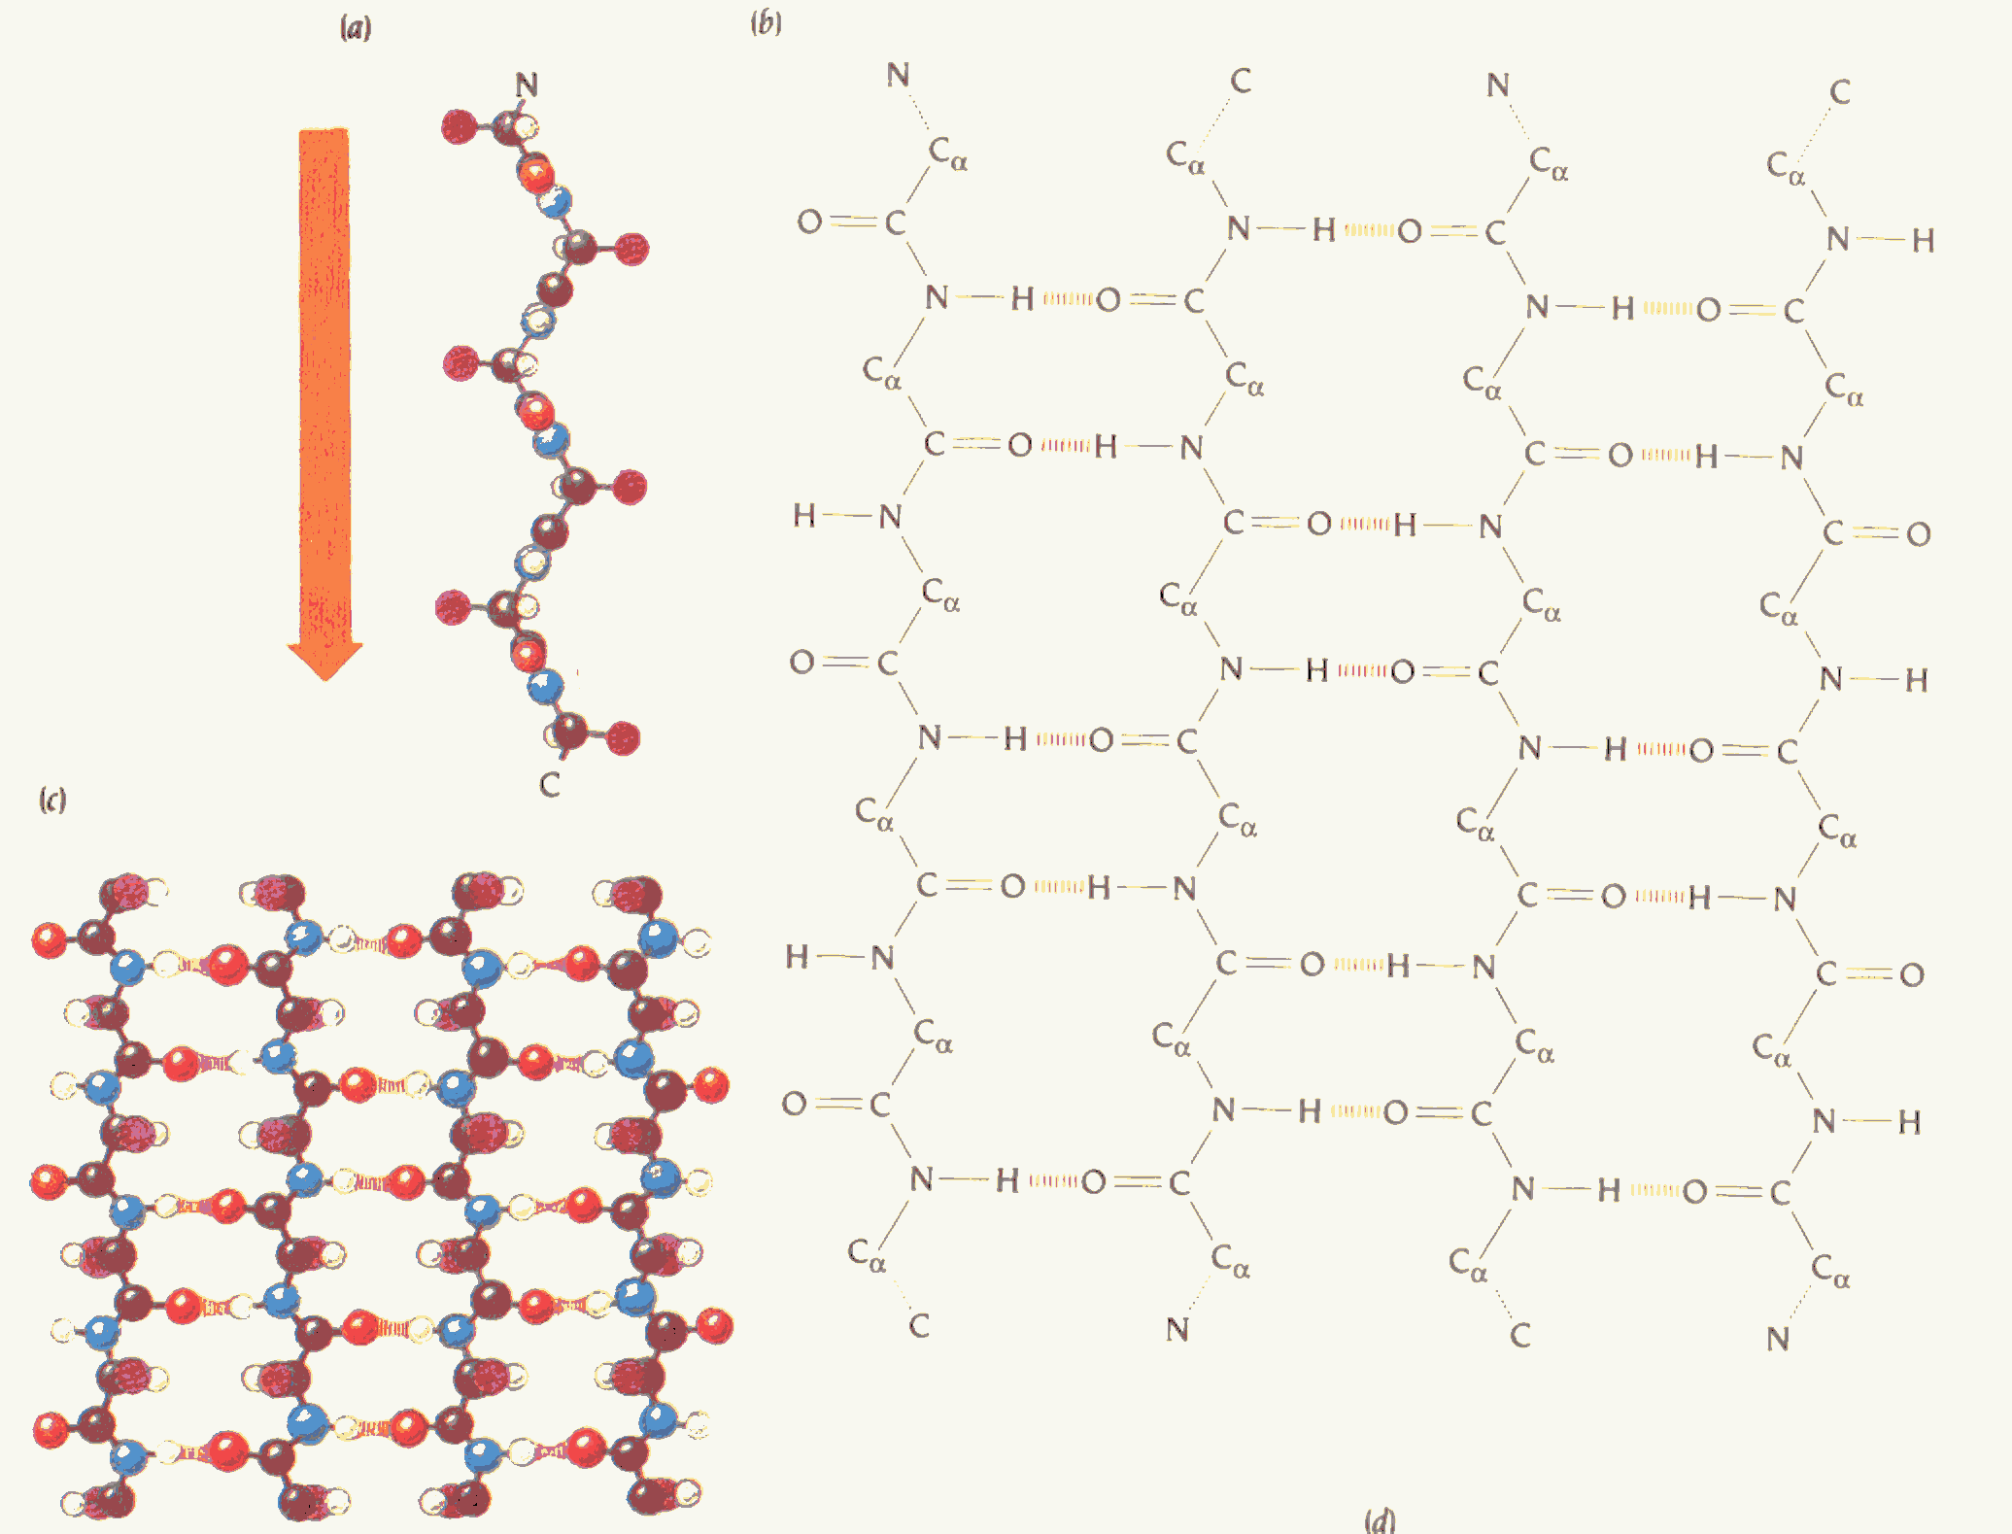
antiparallel β-sheet

Slide 71
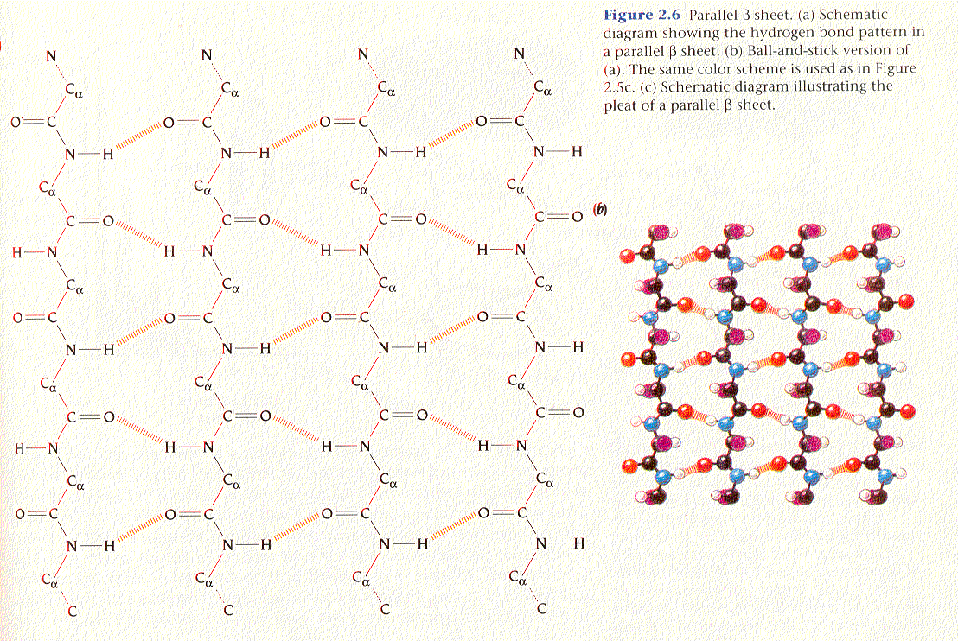
parallel β-sheet

Slide 72
anti-parallel vs. parallel β-sheet

Slide 73
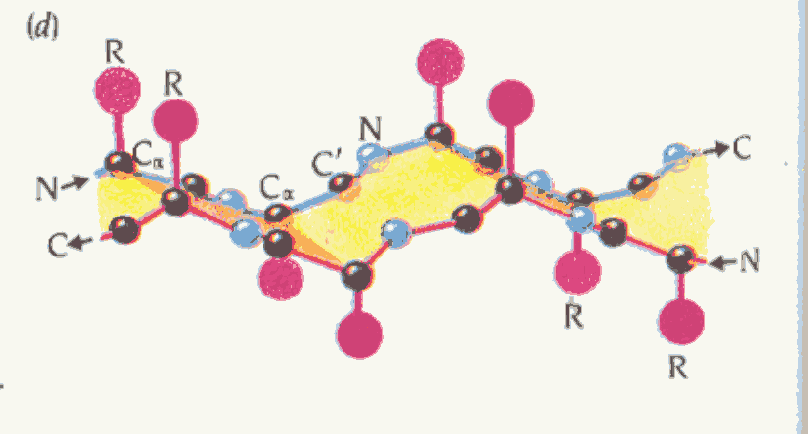
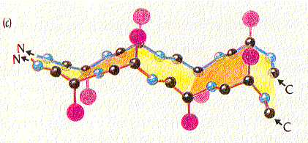
pleating in antiparallel vs. parallel β-sheet

Slide 74
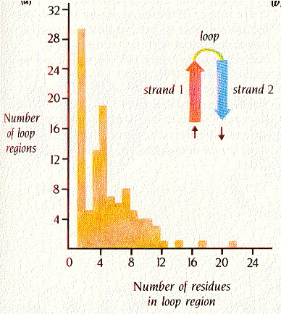
loops and turns:
Figure 2.8, Brandon & Tooze

Slide 75
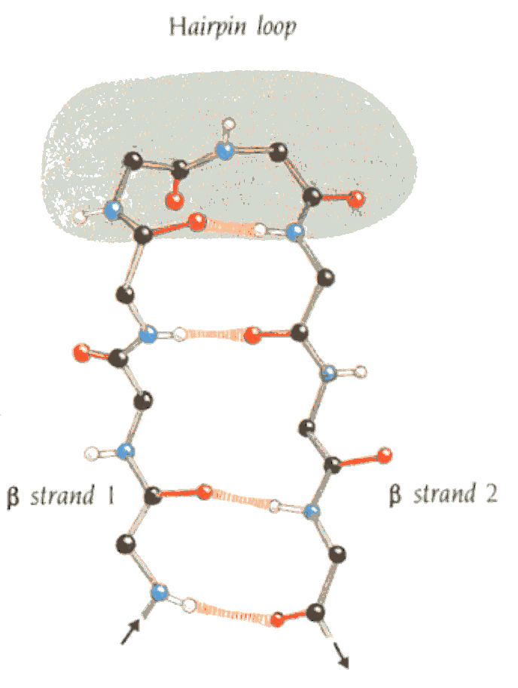
Loops and turns:
Figure 2.8, Brandon & Tooze

Slide 76

Classical types of reverse turns
Figure 6-18, Creighton, Proteins
no side chain may be present on third residue in type II turn (i.e. GLY only)
I
II
III
Resembles 3₁₀ helix
(arrow denotes helical axis)

Slide 77
Classical types of reverse turns
Figure 6-18, Creighton, Proteins
no side chain may be present on third residue in type II turn (i.e. GLY only)
I
II
III
Bend type φ₂ Ψ₂ φ₃ Ψ₃
Resembles 3₁₀ helix
(arrow denotes helical axis)
I -60 -30 -90 0
I’ 60 30 90 0
II -60 120 80 0
II’ 60 -120 -80 0
III -60 -30 -60 -30
III’ 60 30 60 30
IV (bend with 2 or more angles differing by 40° from above)
V -80 80 80 -80
V’ 80 -80 -80 80
VI cis PRO at position 3

Slide 78

protein structural motifs
Simple combinations of secondary structural elements,
called motifs or supersecondary structure.
Examples:
helix-turn-helix or helix-loop-helix
Figure 2.12 Brandon & Tooze

Slide 79

protein structural motifs
Simple combinations of secondary structural elements,
called motifs or supersecondary structure.
Examples:
helix-turn-helix or helix-loop-helix
hairpin β
Figure 2.14 Brandon & Tooze

Slide 80

protein structural motifs
Simple combinations of secondary structural elements,
called motifs or supersecondary structure.
Examples:
helix-turn-helix or helix-loop-helix
hairpin β
Greek key
Figure 2.15 Brandon & Tooze

Slide 81

protein structural motifs
Simple combinations of secondary structural elements,
called motifs or supersecondary structure.
Examples:
helix-turn-helix or helix-loop-helix
hairpin β
Greek key
beta-alpha-beta
Found almost in every protein structure with a parallel β-sheet
2 possible hands: left-handed connection (shown on the right) has only been found in 1-protein (subtilisin)
Figure 2.18 Brandon & Tooze

Slide 82
Domains are built from structural motifs
3 main classes of protein structures:
α-domains
β-domains (antiparallel β)
α/β domains
14729 PDB Entries (1 Oct 2001). 35685 Domains. 35 Literature References (excluding nucleic acids and theoretical models)
Class Number of folds # superfamilies # families
All alpha proteins 144 231 363
All beta proteins 104 190 303
α/β proteins 107 180 409
α + β proteins 194 276 428
Multi-domain proteins 32 32 45
Membrane/cell surface 11 17 28
Small proteins 56 81 123
Total 648 1007 1699

Slide 83

Structural Classification Of Proteins http://scop.mrc-lmb.cam.ac.uk/scop/
Hand-curated hierarchical taxonomy of proteins based on their structural and evolutionary relationships.
Classes
Fold Level
Super Families
Families
Superfamily
Family
Chothia, Murzin (Cambridge)

Slide 84

CATH Protein Structural Data Base http://www.biochem.ucl.ac.uk/bsm/cath/cath.html
Semiautomatic domain classification of PDB crystal structures.
Thornton (London)
Class
Architecture
Topology
Homology
Sequence

Slide 85


UniProt http://www.uniprot.org/

