Slide 1
Lecture 3.
Physical and chemical properties of proteins. Denaturation.

Slide 2
Physical properties
Size
Colloidal solutions
Charge
UV absorption
Solubility

Slide 3
Protein molecular size
Molecular weight:
Vary from 6000 to million Daltons (Da)
Protomeric proteins: 50 000 to 100 000 Da
Oligomeric proteins: > 100 000 Da

Slide 4
Colloidal properties
Solution （< 1 nm）
Colloid （1 – 100 nm）
Suspension (> 100 nm)
Protein
  Particle size of 2~20 nm
  Protein solution has colloidal properties (high viscosity, high absorption capacity, light distraction, do not pass through a semipermeable membrane …

Slide 5
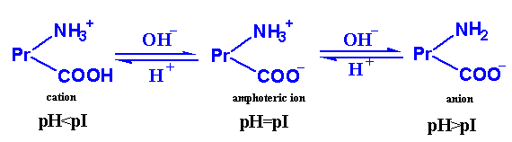
Protein charge
The pH at which the protein has zero net-charge is referred to as isoelectric point (pI).
Amphoteric properties.

Slide 6
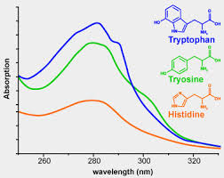
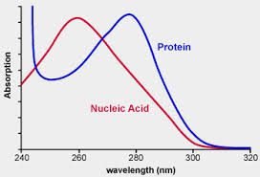
UV absorption
Trp, Tyr, Phe, and His have aromatic groups of resonance double bonds.
Proteins have a strong absorption at 280nm.

Slide 7
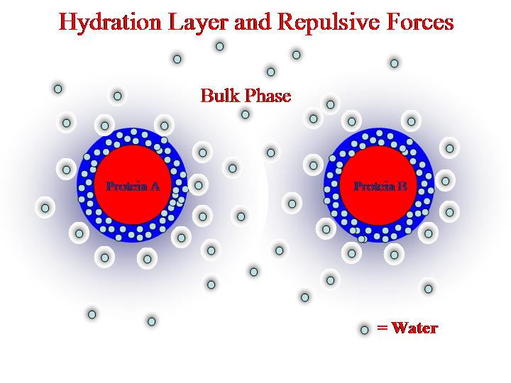
Solubility
Affected by the balance of hydrophobic and hydrophilic amino acids on its surface
Charged amino acids play the most important role in keeping the protein soluble
Solubility determined by repulsion forces among protein molecules and a hydration water layer

Slide 8
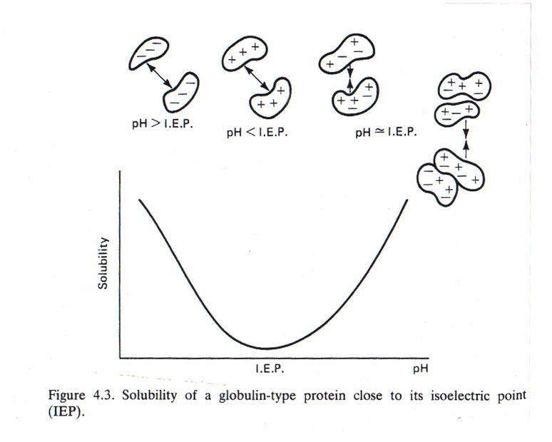
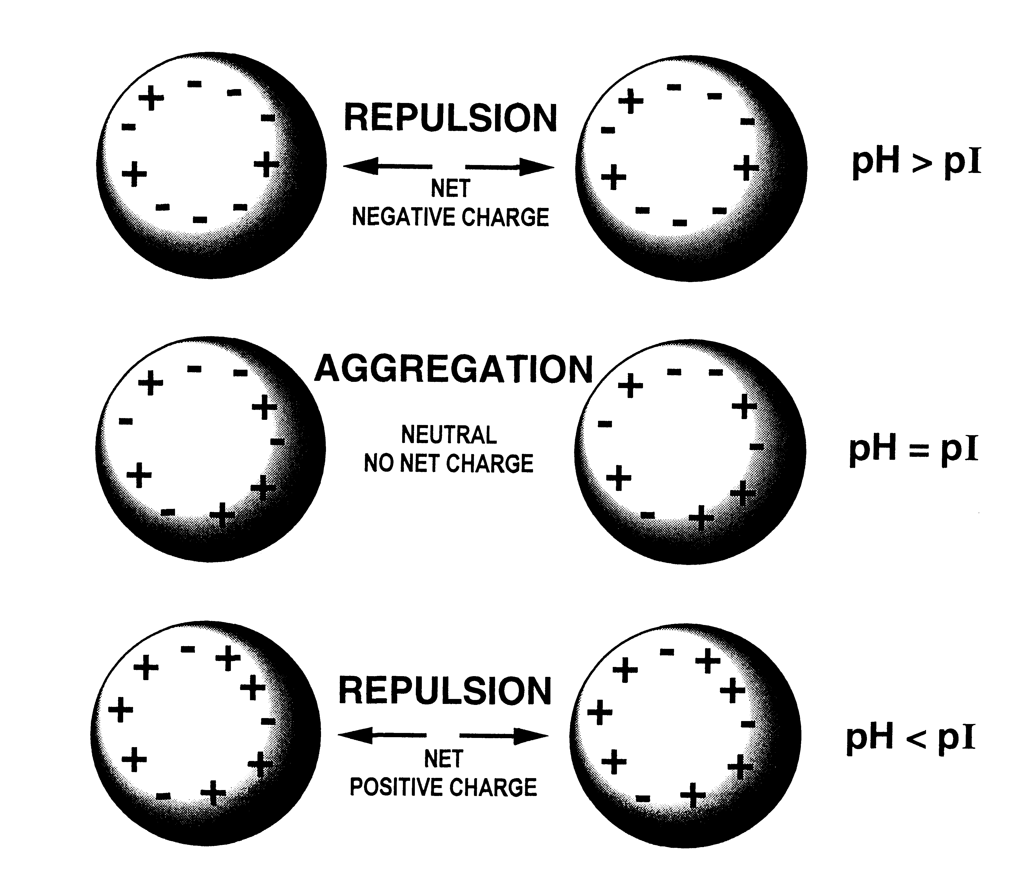
Influence of pH on protein solubility
  The proteins are least soluble at their isoelectric point (no net charge)
  The protein become increasingly soluble as pH is increased or decreased away from the pI

Slide 9
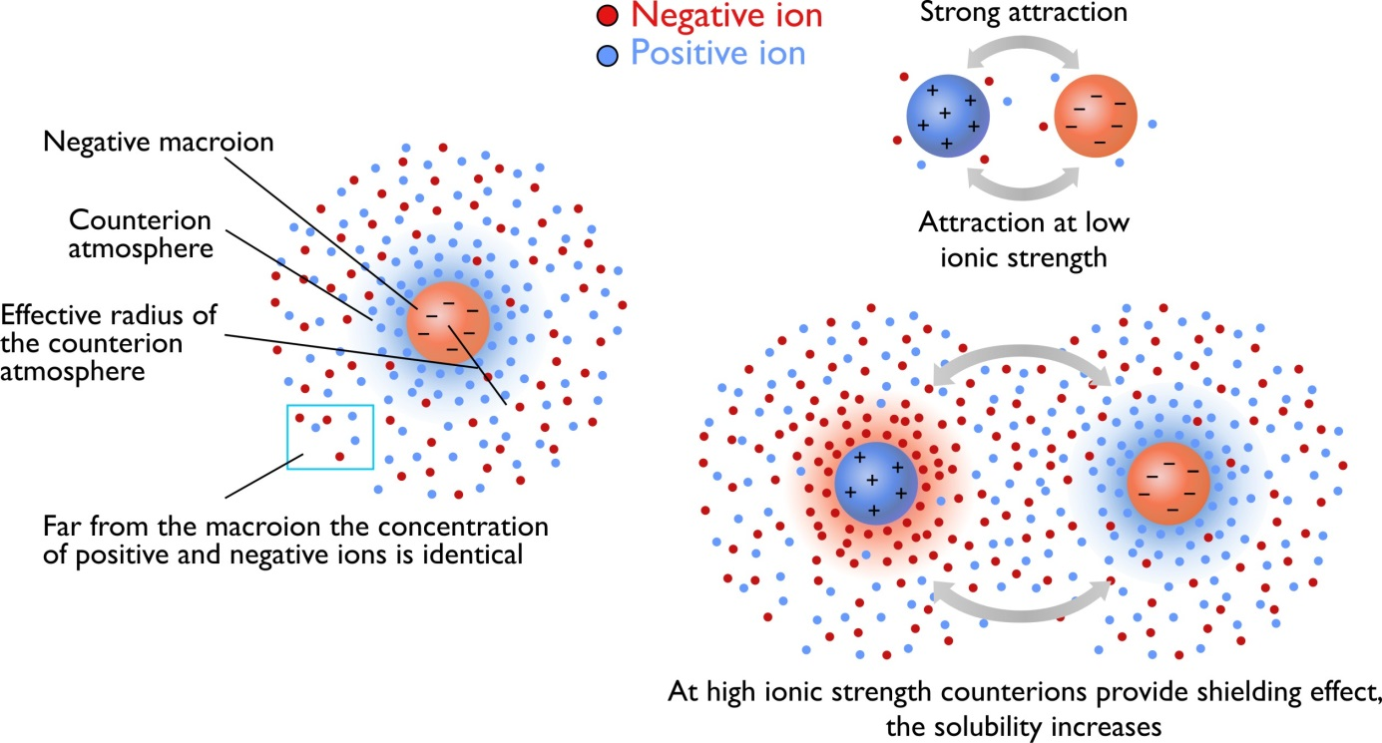
Influence of salt on protein solubility
Positively and negatively charged small ions in solution can cluster around charged side groups
These ions can “screen” interacting side groups from each other
Charged side groups of proteins can collect a cloud of ions called a counterion atmosphere
Extent of the counterion atmosphere depends on the ionic strength of the charged ions in solution

Slide 10
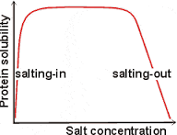
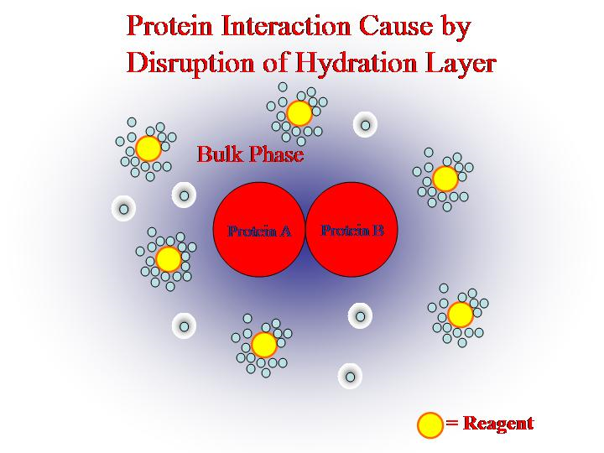
Influence of salt concentration on protein solubility
  At low salt concentrations protein solubility increases (salting-in): interactions between side groups at the pI are screened which prevent aggregation.
  At high salt concentrations protein solubility decreases (salting-out): salt ions bound to water molecules and disrupt hydrolytic layer of proteins.

Slide 11
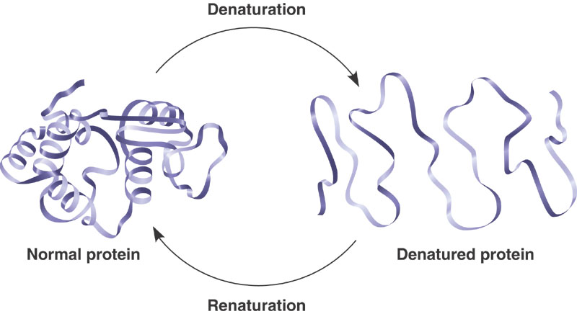
Protein denaturation
Proteins exist in two main states
DENATURED STATE
Loss of native conformation
  Altered secondary, tertiary or quaternary structure
  Disruption of disulfide bonds (covalent) and non-covalent bonds (H-bond, ionic bond, hydrophobic interaction
  Peptide bonds are not affected
NATIVE STATE
Usually most stable
Usually most soluble
Polar groups usually on the outside
Hydrophobic groups on inside
  The proteins can regain their native state when the denaturing influence is removed-Renaturation.

Slide 12
Denaturing agents
100
Physical agents
  Thermal treatment
  High temperature destabilizes the non-covalent interactions holding the protein together causing it to eventually unfold. Increase molecular energy and motion.
  Hydrogen bonds are affected the most.
  Freezing can also denature due to ice crystals and weakening of hydrophobic interactions.
%Denatured
0
0
100
T (C)

Slide 13
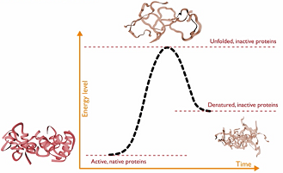
  Thermal treatment
At a slow increasing temperature, protein conformation remains intact in a relatively broad temperature range.
Abrupt loss of structure (and function) occurs in a narrow temperature range

Slide 14
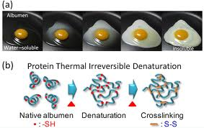
  Thermal treatment: an example

Slide 15
Denaturing agents: Physical agents
  Hydrostatic pressure (5 000 to 10 000 atm): Destabilize hydrophobic interactions; Water molecules can penetrate hydrophobic protein core.
  http://www.researchgate.net/profile/Vadim_Mozhaev/publication/227836660_High_pressure_effects_on_protein_structure_and_function/links/0f31752e01a8a03a30000000.pdf
  UV radiation: similar to high temperature treatment effect: higher kinetic energy increases the vibration of molecules thus disrupting H-bonds.

Slide 16
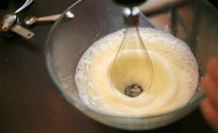
Denaturing agents: Physical agents
  X-rays
  Violent shaking (H-bond disruption).

Slide 17
Denaturing agents: Chemical agents
Acids and alkalis; Altered pH
Organic solvents (ether, alcohol)
Salts of heavy metals (Pb, Hg)
Chaotropic agents
Detergents
Reducing/oxidizing agents

Slide 18
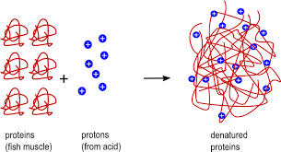
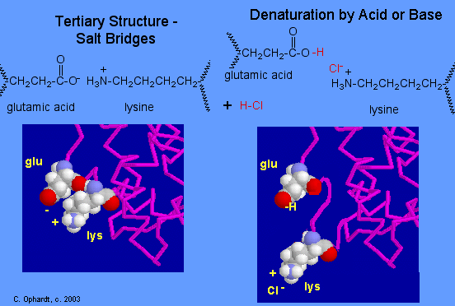
Acids and alkalis
Disrupt ionic bonds
Example: protein denaturation by gastric juices

Slide 19
Denaturing agents: Chemical agents
  pH and denaturation
Proteins are more stable against denaturation at their isoelectric point than at any other pH.
At extreme pH values, strong intramolecular electrostatic repulsion caused by high net charge results in swelling and unfolding of the protein molecule.
100
%Denatured
0
0
pH
12

Slide 20
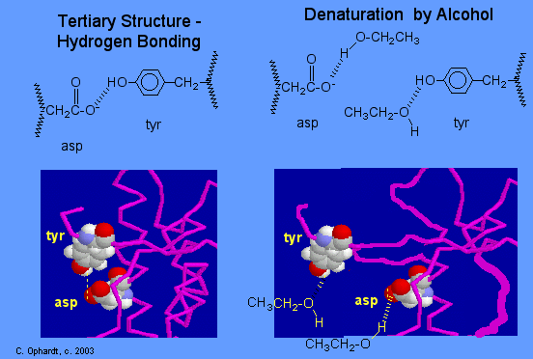
Organic solvents (ether, alcohol)
Organic solvents denature proteins by disrupting the side chain intramolecular hydrogen bonding.
New hydrogen bonds are formed instead between the new organic solvent molecule and the protein side chains.

Slide 21
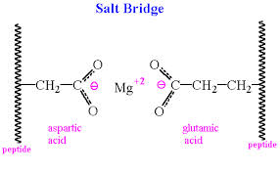
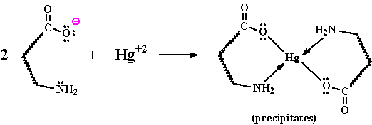
Salts of heavy metals (Pb⁺², Cd⁺² Hg⁺²…)
Disrupt ionic bonds
The reaction of a heavy metal salt with a protein usually leads to an insoluble metal protein salt.

Slide 22


Chaotropic agents
A chaotropic agent is a molecule in water solution that can disrupt the hydrogen bonding network between water molecules. This has an effect on the stability of the native state of other molecules in the solution such as proteins.
Compete for hydrogen bonds
Examples:
urea
guanidinium chloride

Slide 23
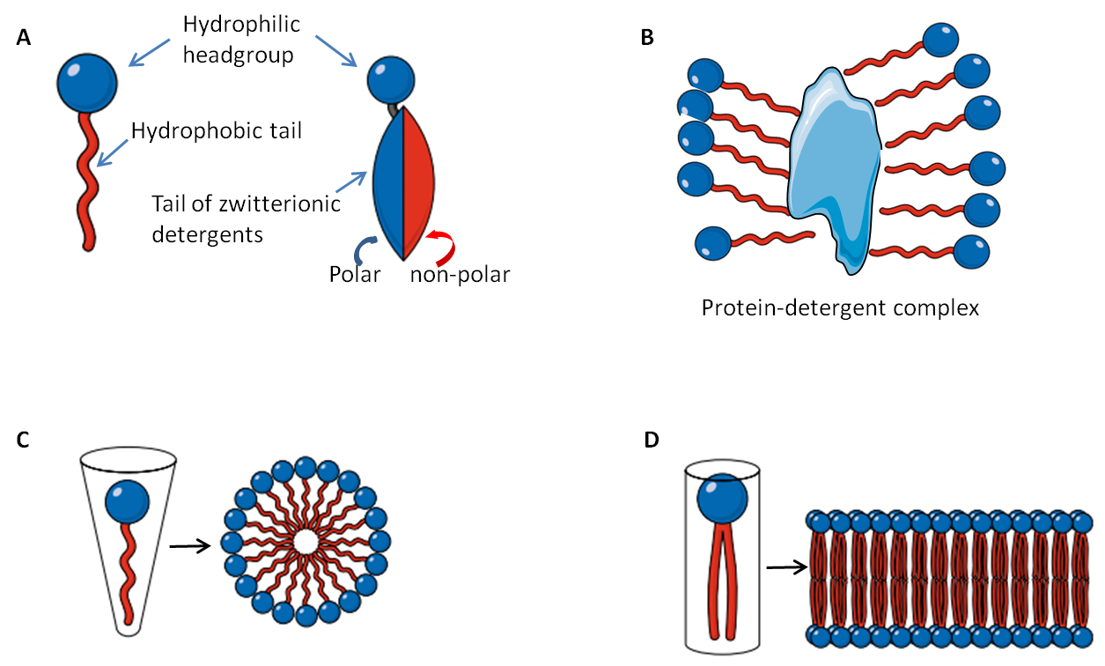
Detergents
Disrupt hydrophobic interactions in protein molecules.
Detergents are amphiphilic molecules which contain both hydrophobic and hydrophilic parts.
Hydrophobic parts of the detergent associates with the hydrophobic parts of the protein.
Hydrophilic parts of the detergent interact with water molecules
Thus, hydrophobic parts of the protein do not need to interact with each other.

Slide 24
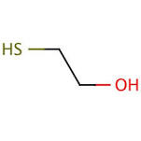
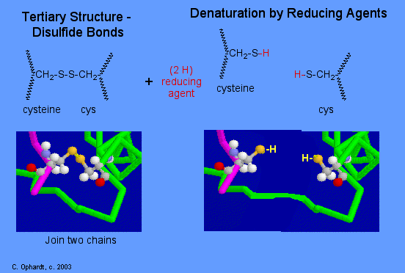
Reducing agents
Mercaptoethanol

Slide 25
Protein denaturation: consequences
Change in physical, chemical and biological properties of proteins.
  Increased viscosity
  Altered functional properties
  Loss of enzymatic activity

Slide 26
  Altered solubility
Denaturation of the protein can both increase or decrease solubility of proteins.
E.g. very high and low pH denature but the protein is soluble since there is much repulsion
Very high or very low temperature on the other hand will lead to loss in solubility since exposed hydrophobic groups of the denatured protein lead to aggregation (may be desirable or undesirable in food products)
+
+
Low pH
+
+
+
+
+
+
+
+
+
+
Insoluble complex

Slide 27
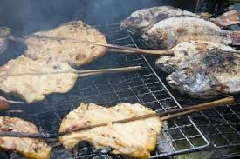
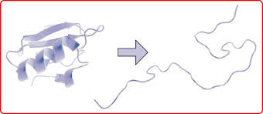
  Increased digestibility
Denatured protein is more easily digested due to enhanced exposure of peptide bonds to enzymes.
Cooking causes protein denaturation and therefore, cooked food is more easily digested.

Slide 28
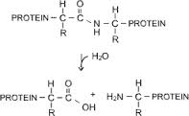
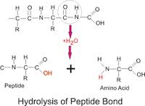
Chemical properties of proteins
Hydrolysis
  Proteins can be hydrolyzed (the peptide bond) by acid or enzymes to give peptides and free amino acids (e.g. soy sauce, fish sauce etc.)

Slide 29
Chemical properties of proteins: consequences
  Modifies protein functional properties
    E.g. increased solubility
  Increases bioavailability of amino acids
    Excessive consumption of free amino acids is not good however

Slide 30
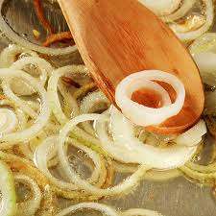
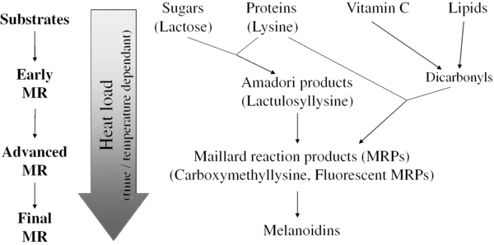
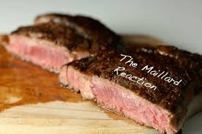
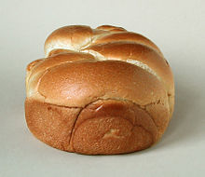
Maillard reaction (carbonyl - amine browning)
  Changes functional properties of proteins
  Changes color
  Changes flavor
  Decreases nutritional quality (amino acids less available)

Slide 31
Alkaline reactions
  Soy processing (textured vegetable protein)
    0.1 M NaOH for 1 hr @ 60°C
    Denatures proteins
    Opens up its structure due to electrostatic repulsion
    The peptide bond may also be hydrolyzed

Slide 32
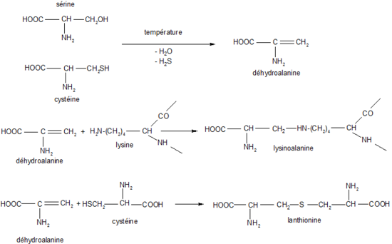
Alkaline reactions (cont.)
    Some amino acids become highly reactive
      NH₃ groups in lysine
      SH groups and S-S bonds become very reactive (e.g. cysteine)
  Lysinoalanine formation (LAL)
    Lysine becomes highly reactive at high pH and reacts with dehydroalanine forming a cross-link
      Lysine, an essential amino acid, becomes unavailable

Slide 33
  Lysinoalanine formation (LAL)
    Problem:
      Lysine is the limiting amino acid in cereal foods.
        Limiting amino acid: Essential amino acid of least quantity.
      Lysinoalanine can lead to kidney toxicity in rats, and possibly humans.

Slide 34
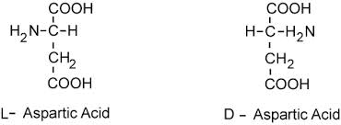
Alkaline reactions (cont.)
  Isomerization (racemization)
    L- to D-amino acids
    We cannot metabolize D-amino acids
    Not a very serious problem in texturized vegetable protein production.

Slide 35
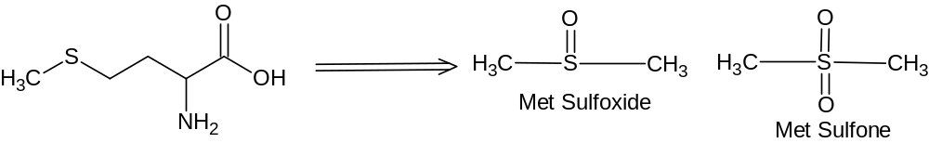
4. Oxidation
  Lipid oxidation
    Aldehyde, ketones react with lysine making it unavailable
    Usually not a major problem
  Methionine oxidation (no major concern)
    Sulfoxide or sulfone
    Met sulfoxide still active as an essential amino acid
    Met sulfone – no or little amino acid activity
http://onlinelibrary.wiley.com/doi/10.1111/1541-4337.12127/epdf

Slide 36


