Slide 1
PROTEIN PHYSICS
LECTURES 22-23
PROTEIN STRUCTURE PREDICTION
FROM ITS AMINO ACID SEQUENCE:
Homology
Secondary structure
Tertiary structure
BIOINFORMATICS
PROTEIN ENGINEERING AND DESIGN

Slide 2
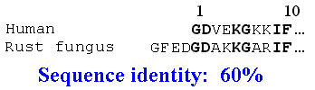
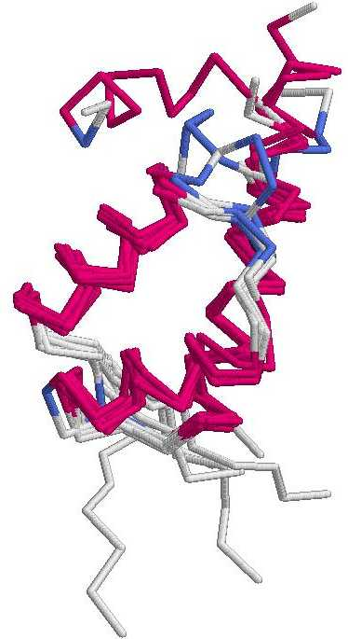
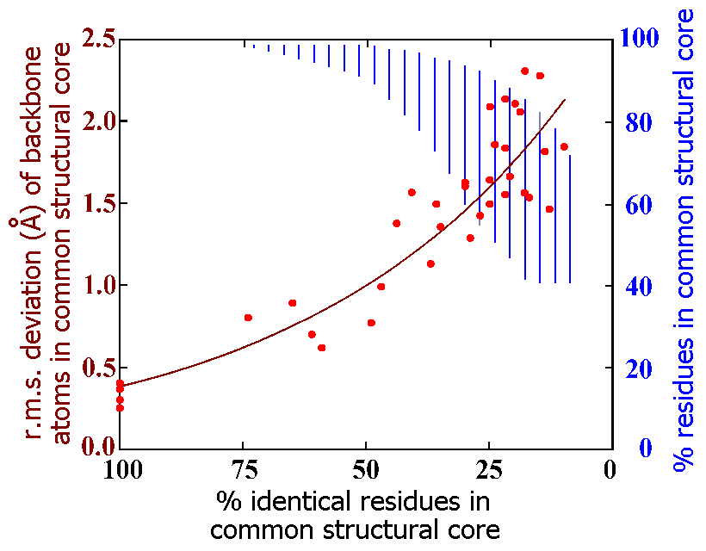
Homology
- - - - - -

Slide 3
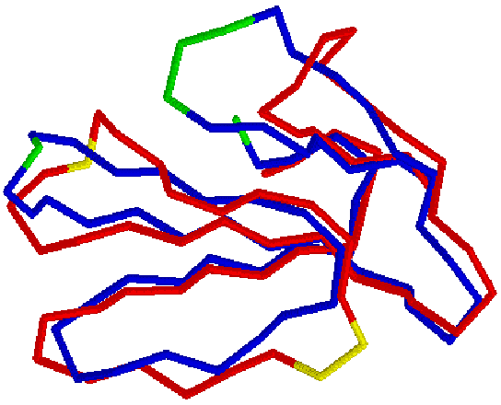
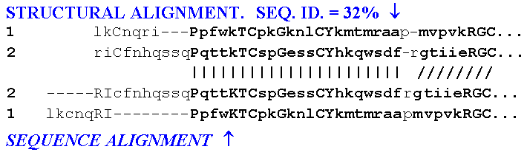
PREDICTION FROM
HOMOLOGY
SIMILAR SEQUENCES ⬅➔
SIMILAR FOLDS
______ __________________ _______
ACCURACY = t / (t+ f)
SEQUENCE ALIGNMENT: SMITH-WATERMAN, BLAST,…

Slide 4
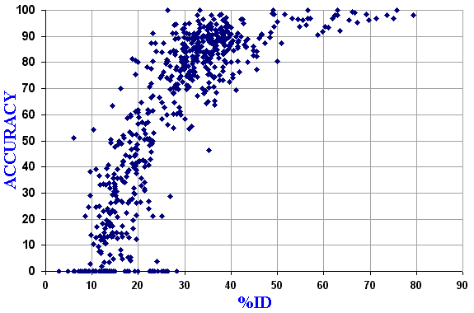
N0 ⬅TWILIGHT➔ ======= GOOD PREDICTION =======

Slide 5

PREDICTION FROM HOMOLOGY
cytochromes c
High homology:
“TWILIGHT ZONE”: 10-25% IDENTITY:
Low but existing homology. Sequence identity: 15%
αβ
NO homology. Sequence identity: 15%

Slide 6
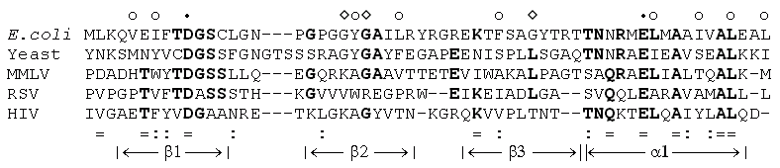
Multiple homology
key sites
(core, 2⁰ structure, active site)
“PROFILES”
“HIDDEN MARKOV MODELS” (HHMer)
etc.
BIOINFORMATICS

Slide 7
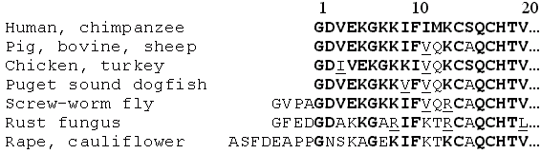
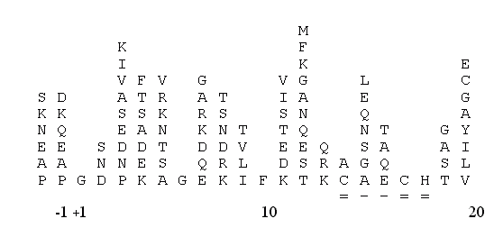
Multiple homology
PROFILE
TARGET ...A P G D E F G - - H I K K L M A A T C...
SEQUENCE

Slide 8
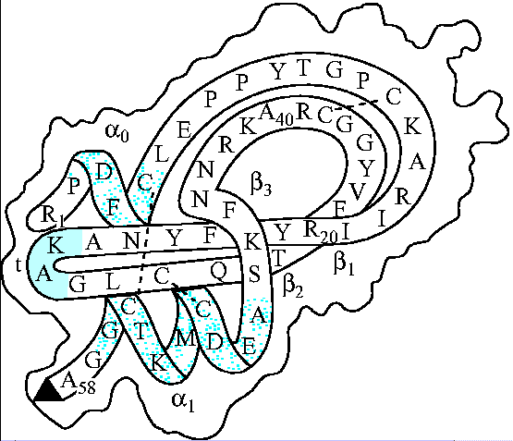
PREDICTION
FROM
PHYSICS:
PROTEIN CHAIN
FOLDS
SPONTANEOUSLY
➔ SEQUENCE HAS
ALL INFO TO
PREDICT:
2^{O} STRUCTURE,
3D STRUCTURE,
SIDE CHAIN ROTAMERS,
S-S BONDS, etc.

Slide 9
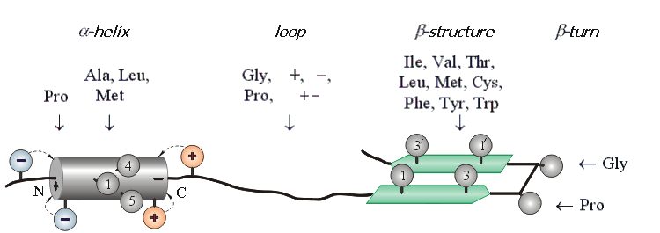
PREDICTION FROM PHYSICS
(OR PROTEIN STATISTICS)
2^{O} STRUCTURES

Slide 10
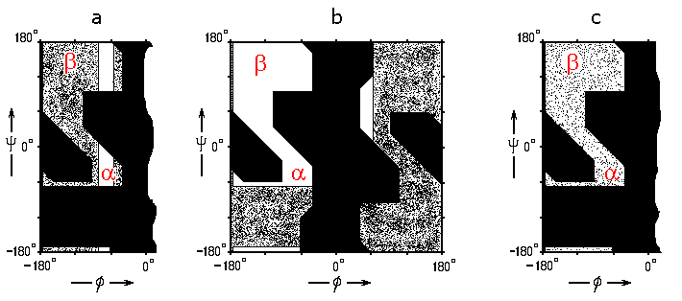
Pro
no С^{β} (Gly): coil
С^{β}, ≤1 γ: α, β, coil
- np - --p--
imino: coil,
turn, α_{N}
С^{β}, 2 γ: β
(3 rot.)

Slide 11
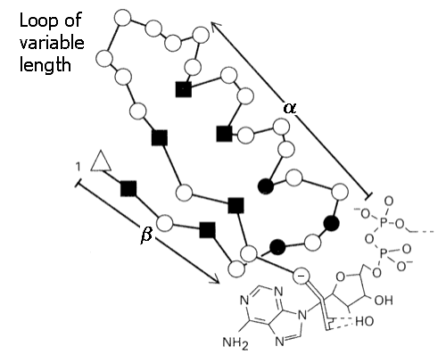
PREDICTION FROM PROTEIN STATISTICS
(OR PHYSICS)
TEMPLATE OF SUPER-SECONDARY STRUCTURE
np
Gly
-

Slide 12
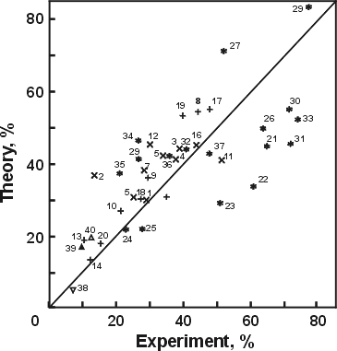
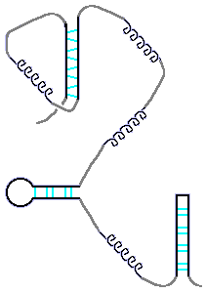
FLUCTUATING
SECONDARY
STRUCTURE
IN UNFOLDED
POLYPEPTIDE
CHAIN
OLYGO- &
POLYPEPTIDES
ALB

Slide 13
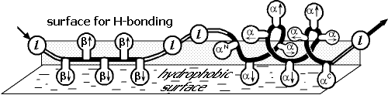
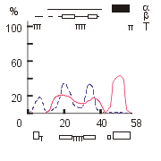
FLUCTUATING
SECONDARY
STRUCTURE
AT THE
“AVERAGE”
SURFACE OF
A GLOBULE
PHD,
JPRED,
PSIPRED,…
bpti
ALB

Slide 14
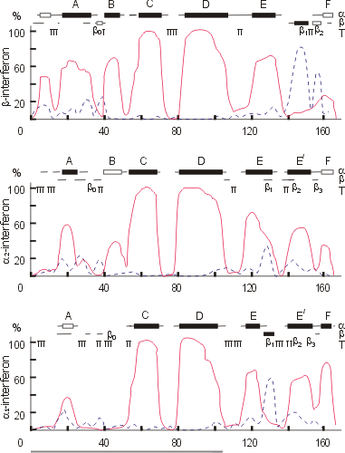
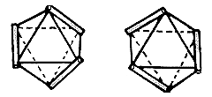
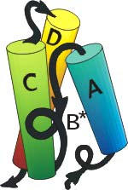
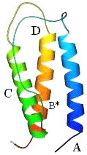
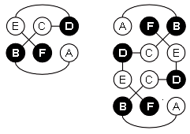
Prediction, 1985 X-ray str.,1990
β γ
A B C D .---different---

Slide 15
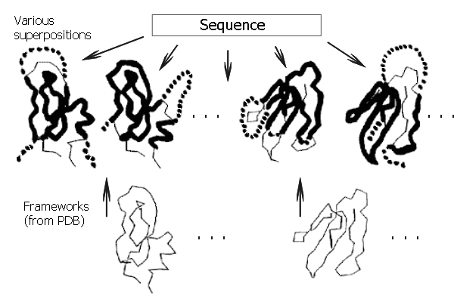
THREADING
BIOINFORMATICS

Slide 16
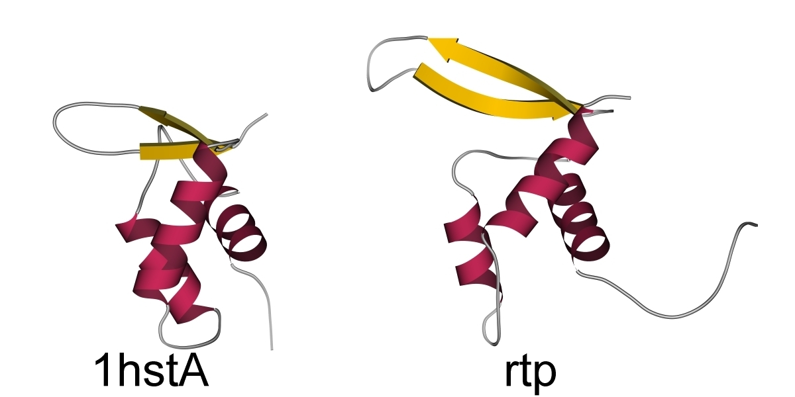
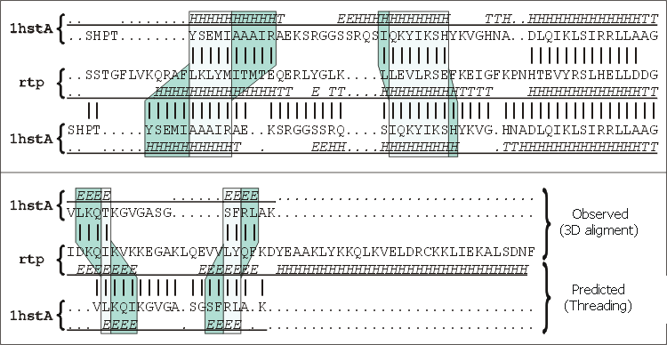
THREADING:
CORRECT FOLD,
BAD ALIGNMENT

Slide 17
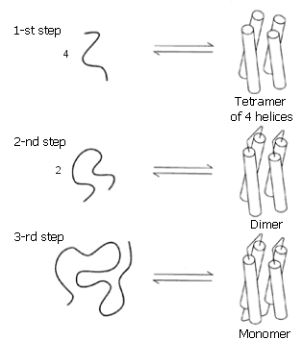
ENGINEERING & DESIGN
DeGrado, 1989
DOES NOT MELT !
MOLTEN GLOBULE…
+ ION BINDING ➔ SOLID

Slide 18
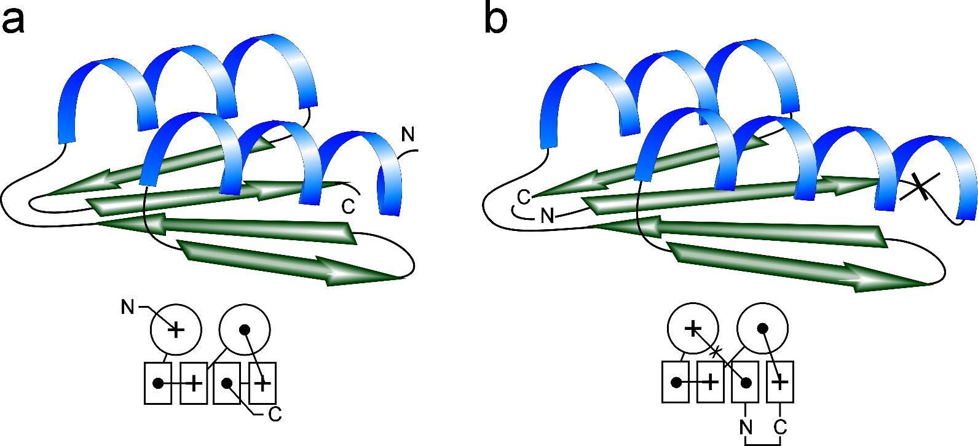
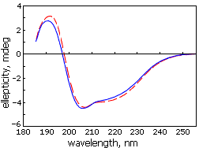
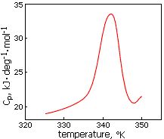
Ptitsyn
Dolgikh
Finkelstein
Fedorov
Kirpichnikov
1987-97
Albebetin,
Albeferon,
…

Slide 20
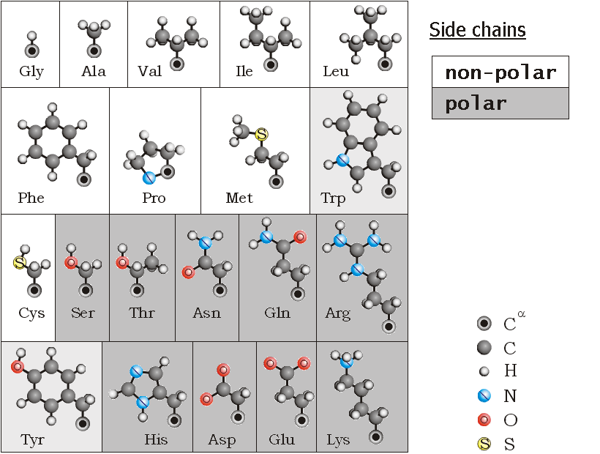
non-polar: core
polar: surface

