Slide 1
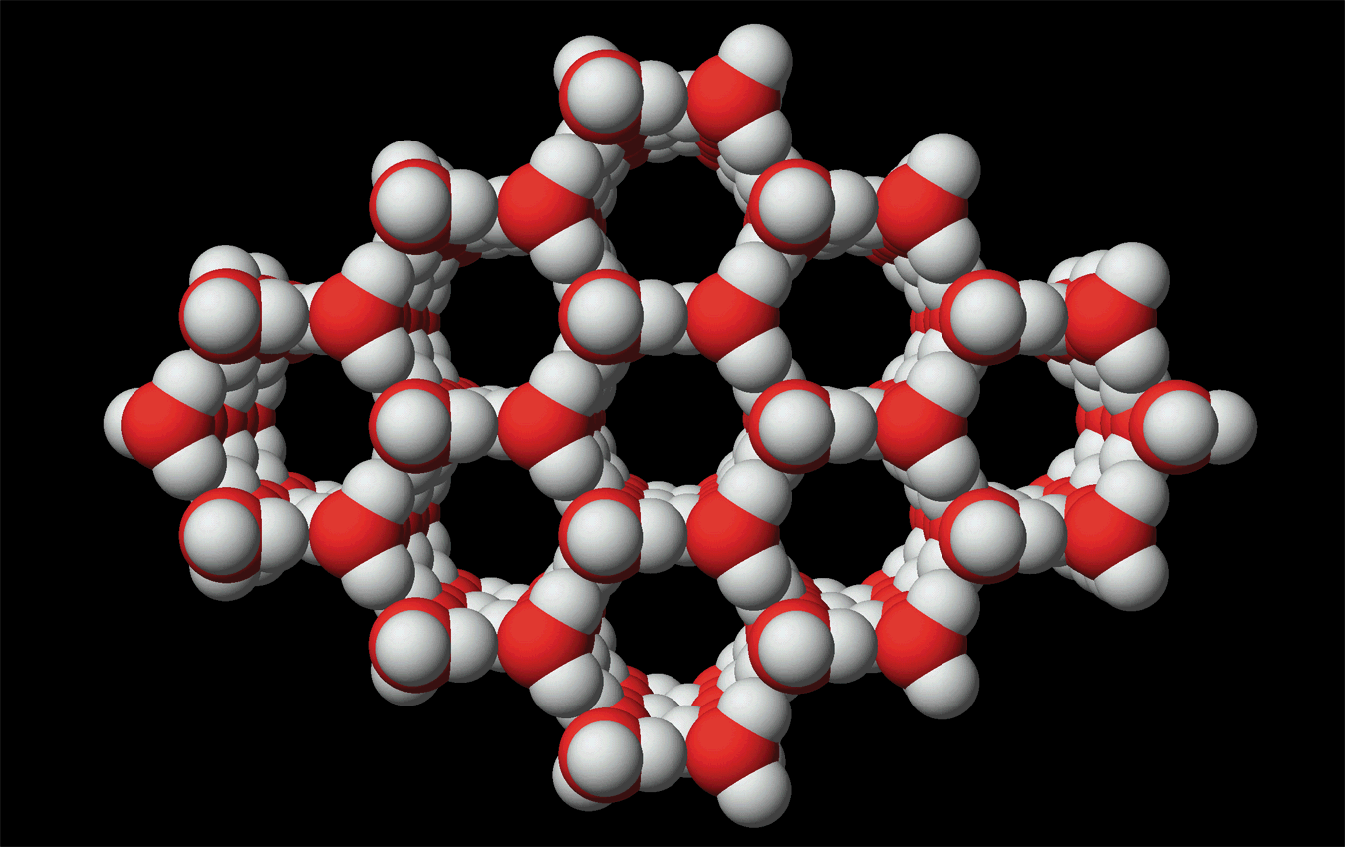
INTERMOLECULAR FORCES
Chapter 13
1-15 + all bold numbered problems

Slide 2
CHAPTER 13
This chapter examines the forces of attraction between molecules, or atoms, that are responsible for forming the liquid and solid states as a function of temperature.

Slide 3
13.1 PHASES OF MATTER AND THE KINETIC MOLECULAR THEORY
Gases are highly compressible because of the large distance between molecules in the gaseous state.
Liquids and solid are relatively incompressible because the molecules in these states are much closer together.
For example, one mole of water in the gaseous state at STP occupies 22,400 mL, but that same amount of water in the liquid state at STP occupies only 18 mL!!!

Slide 4
PHASES OF MATTER AND THE
KINETIC MOLECULAR THEORY
As the temperature of a substance increases, the average kinetic energy of the molecules increases.
This increased energy overcomes the forces of attraction between the molecules in the solid state bringing about the liquid state.
Further increases in temperature overcome theses weakened forces and bring the substance to the gaseous state.
The relative magnitude of the attractive forces determines the temperatures at which these changes occur.

Slide 5
13.2 INTERMOLECULAR FORCES
Intermolecular forces are the attractive forces between molecules, between ions, or between ions and molecules.
Table 13.1, page 585, illustrates the relative magnitude of these various forces.

Slide 6

Inter-molecular Forces
Have studied INTRA molecular forces—the forces holding atoms together to form molecules.
Now turn to forces between molecules — INTER molecular forces.
Forces between molecules, between ions, or between molecules and ions.
Table 13.1: summary of forces and their relative strengths.

Slide 7
Covalent, very strong, complex bonding, CH₄,NH₃
Ion-Ion, very strong, 1/r, LiF, MgO
Ion-Dipole, strong, 1/r²,
Dipole-Dipole, medium strong, 1/r³
^{H-Bonding}
Ion-Induced Dipole, weak, 1/r⁴
Dipole-Induced Dipole, very weak, 1/r⁶
Induced-Induced Dipole, very weak, 1/r⁶
H
F
e
+
3
O
H
H
δ
+
δ
−
F
H
O
H
δ
−
δ
+
F
e
+
3
O
O
δ
+
δ
−
F
H
O
O
δ
+
δ
−
O
O
O
O

Slide 8
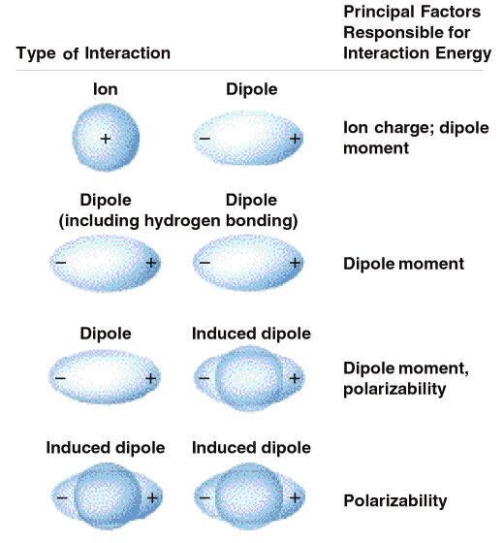
Table 13.1

Slide 9
Ion-Ion Forces
The strongest force, not listed, is the ion - ion force and is considered later in the section on ionic solids.
These forces (ion-ion) increase as the size of the ion decreases and as the magnitude of the charge increases.
Remember that anions are larger than the atoms they are derived from and cations are smaller than the atoms they are derived from.

Slide 10
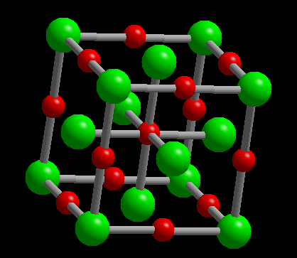
Intermolecular Forces
Ion-Ion Forces
Na⁺ — Cl⁻ in salt.
These are the strongest forces.
Lead to solids with high melting temperatures.
NaCl, mp = 800 ºC
MgO, mp = 2800 ºC

Slide 11
Ion - Dipole Forces
Ion - dipole forces exist between ions and polar molecules.
The magnitude of these forces increases as:
  the distance between the ion and the polar molecule decreases
  the magnitude of the charge on the ion increases
  the magnitude of the dipole of the polar molecule increases.

Slide 12
Ion - Dipole Forces
Hydration energies for cations and anions is an excellent example of this concept. The table on page 587 supplies data for comparisons.
When these hydration bond form, energy is released, exothermic.
This energy is then used to break the ion - ion forces in the ionic solid.
When the hydration energy is large enough, the ionic solid is soluble in water.

Slide 13
Ion - Dipole Forces
Solubility trends for ionic solid can be explained by using this combination for forces.
Explain the trend in hydration energies for Fe⁺², Ca⁺², and Fe⁺³. The calcium ion has the largest radius and the Fe⁺³ is the smallest radius.

Slide 14
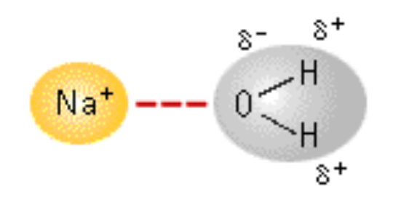
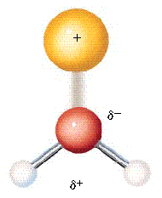
Attraction Between Ions and Permanent Dipoles
••
-
δ
water
dipole
O
••
H
H
+
δ
Water is highly polar and can interact with positive ions to give hydrated ions in water.

Slide 15
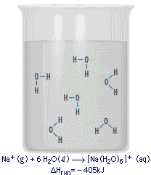
Attraction Between Ions and Permanent Dipoles
••
-
δ
water
dipole
O
••
H
H
+
δ
Water is highly polar and can interact with positive ions to give hydrated ions in water.

Slide 16
CuSO₄(s) → CuSO₄•4H₂O + heat
H₂O

Slide 17
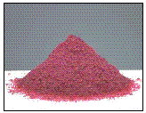
Attraction Between Ions and Permanent Dipoles
Many metal ions are hydrated.
It is the reason metal salts dissolve in water.
Co(H₂O)₆²⁺

Slide 18
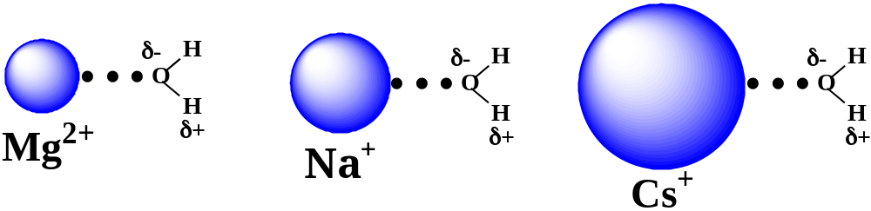
Attraction Between Ions and Permanent Dipoles
Attraction between ions and dipole depends on ion charge and ion-dipole distance.
Measured by ΔH for M^{n+} + H₂O --> [M(H₂O)_{x}]^{n+}
-1922 kJ/mol
-405 kJ/mol
-263 kJ/mol
See Example 13.1, page 588.

Slide 19
Dipole - Dipole Forces
The strength for dipole - dipole forces increases as the magnitude of the dipole increases and the distance between the molecules decreases.
Figure 13.5, page 588, illustrates one possible way dipoles can interact.
Solubility of a solute in a solvent can be estimated by considering the energy required to break bonds and the energy released when bonds form.

Slide 20
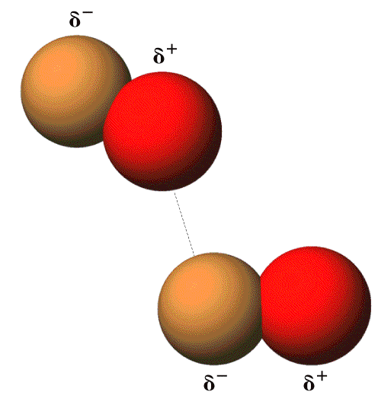
Dipole-Dipole Forces
Figure 13.5

Slide 21
Dipole - Dipole Forces
Solubility of polar substances in polar liquids can be explained by considering the energy required to break the solute - solute "bonds" and the solvent - solvent "bonds" in comparison to the energy released when the solvent - solute "bonds" form.
If the latter is too small when compared to the former, the substance is not soluble.

Slide 22
Dipole - Dipole Forces
Since this energy balance is rarely achieved between substances which are not similar, an often quoted axiom is " like dissolves like".
" Like dissolves like” is a statement of fact NOT, it is an explanation of the phenomenon.

Slide 23
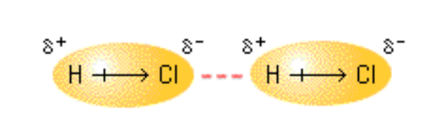
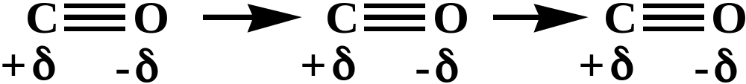
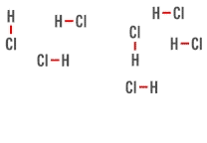
Dipole-Dipole Forces
Such forces bind molecules having permanent dipoles to one another.

Slide 24
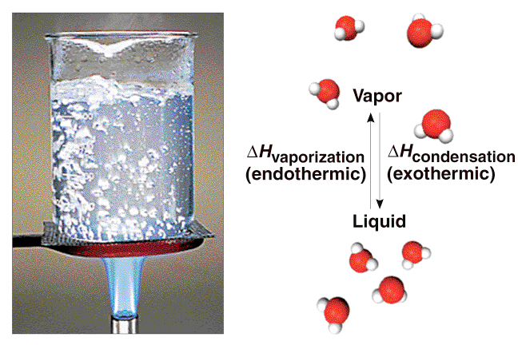
Figure 13.6

Slide 25
Dipole - Dipole Forces
The relative magnitude of these forces can also be used to explain trends in melting points and boiling points.
It must be remembered that both melting point and boiling point tend to increase with increasing molar mass, all other factors being equal.

Slide 26
Dipole-Dipole Forces
Influence of dipole-dipole forces is seen in the boiling points of simple molecules.
Compd Mol. Wt. Boil Point
N₂ 28 -196 ºC
CO 28 -192 ºC
Br₂ 160 59 ºC
ICl 162 97 ºC

Slide 27
Hydrogen Bonding
Hydrogen bonding is a special case of dipole - dipole forces, and only exists between hydrogen atoms bonded to F, N, or O, and F, N, and O atoms bonded to hydrogen atoms.
Figure 13.8, 13.9, 13.10, and the bottom of page 591, illustrate the concepts of hydrogen bonding.

Slide 28
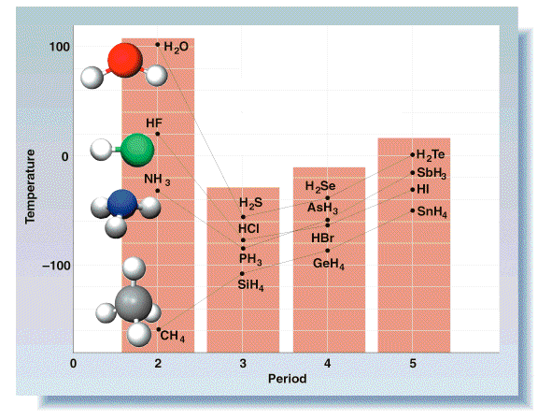
Hydrogen Bonding
Figure 14.8

Slide 29
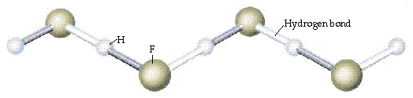
Hydrogen Bonding
A special form of dipole-dipole attraction, which enhances dipole-dipole attractions.
Hydrogen bonding in HF
H-bonding is strongest when X and Y are N, O, or F

Slide 30
Hydrogen Bonding
Example 13.2, page 592, provides comparison data for a hydrogen bonded and non hydrogen bonded compound with the same molar mass. C₂H₆O.
Why is NH₃ more soluble in H₂O than H₂S is in H₂O?

Slide 31
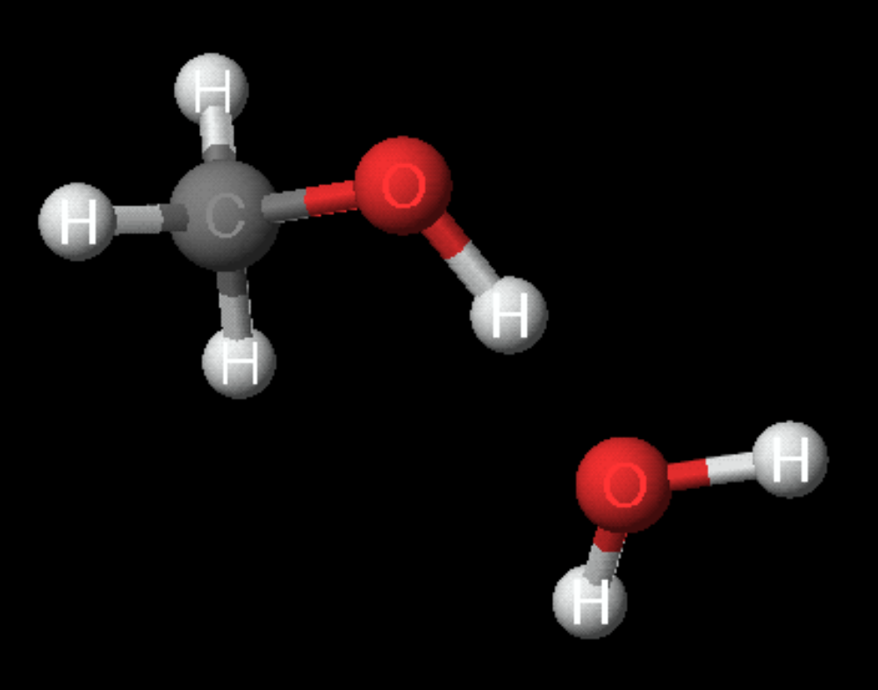
H-Bonding Between Methanol and Water
-δ
H-bond
+δ
-δ

Slide 32
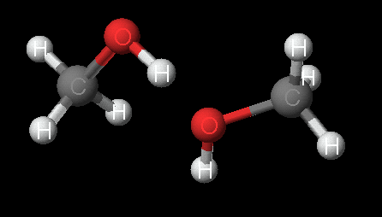
H-Bonding Between Two Methanol Molecules
-δ
+δ
-δ
H-bond

Slide 33
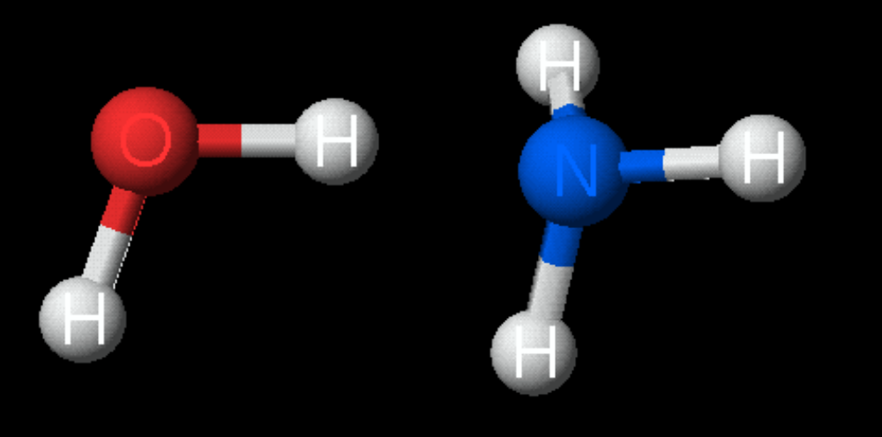
H-Bonding Between Ammonia and Water
-δ
+δ
-δ
H-bond
This H-bond leads to the formation of NH₄⁺ and OH⁻

Slide 34
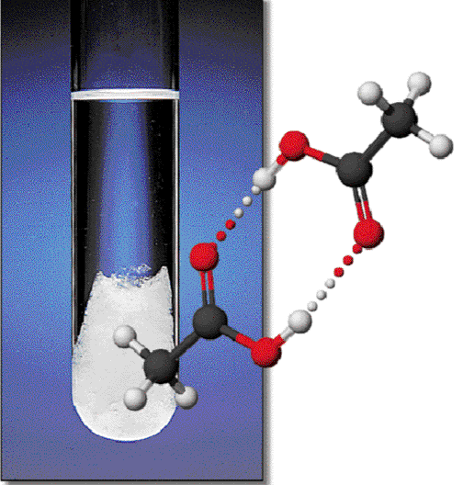
Hydrogen Bonding
Figure 13.9

Slide 35
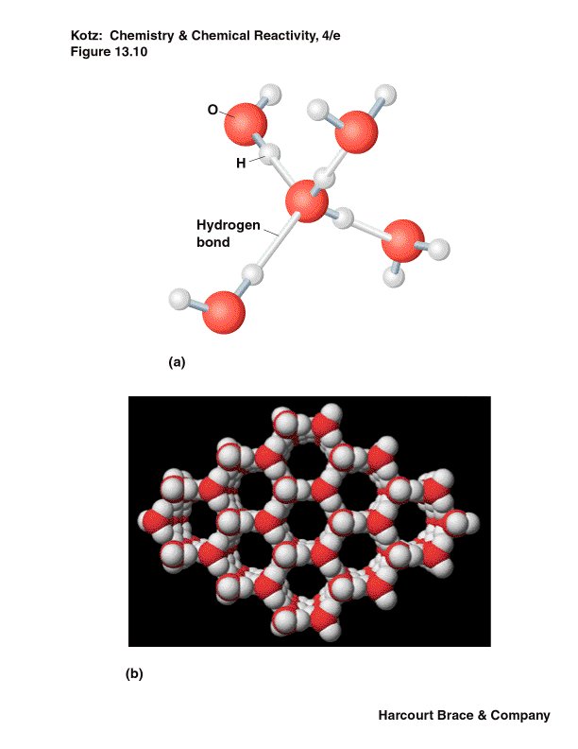
Hydrogen Bonding
Figure 13.10

Slide 36
Hydrogen Bonding
H-bonding is especially strong in biological systems — such as DNA.
DNA — helical chains of phosphate groups and sugar molecules. Chains are helical because of tetrahedral geometry of P, C, and O.
Chains bind to one another by specific hydrogen bonding between pairs of Lewis bases.
—adenine with thymine
—guanine with cytosine
See O.H. #88

Slide 37
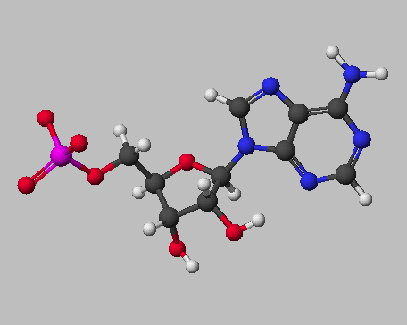
AMP = Adenosine monophosphate

Slide 38
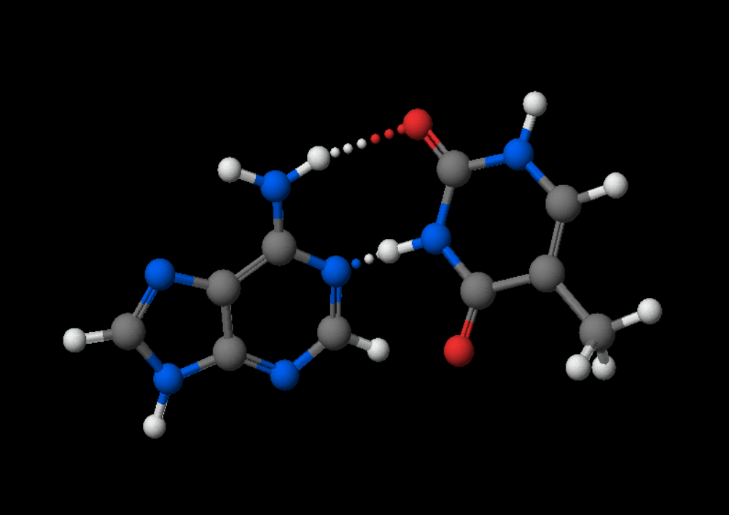
Adenine
Thymine
38

Slide 39
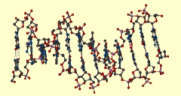
Hydrogen Bonding
Hydrogen bonding and base pairing in DNA

Slide 40
Unusual Properties of Water:
Consequences of Hydrogen Bonding
Water has a very high specific heat, heat of fusion, heat of vaporization, thermal conductivity, and dielectric constant.
Ice is less dense than liquid water
  (very uncommon).
Fig. 13.13 show the open structure of ice.
Page 594, Figure 13.G.
The relative density of ice.

Slide 41
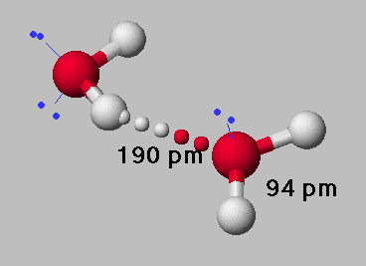
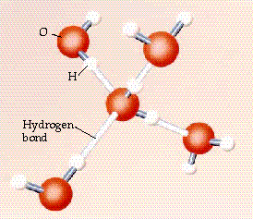
Hydrogen Bonding in H₂O
H-bonding is especially strong in water because
the O—H bond is very polar
there are 2 lone pairs on the O atom
Accounts for many of water’s unique properties.
Figure 13.10

Slide 42
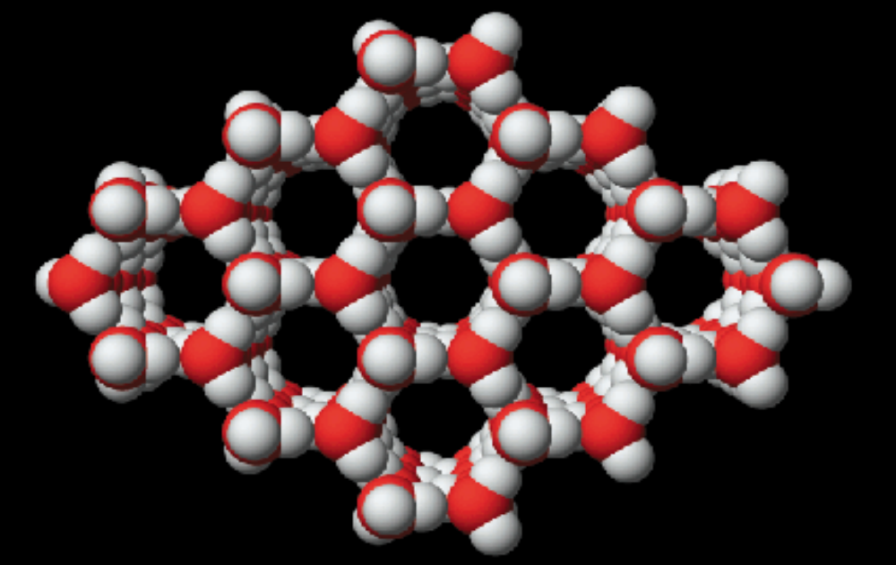
Hydrogen Bonding in H₂O
H-bonding in H₂O open lattice like structure of ice.
Ice density is less than that of liquid, and solid floats on water.

Slide 43
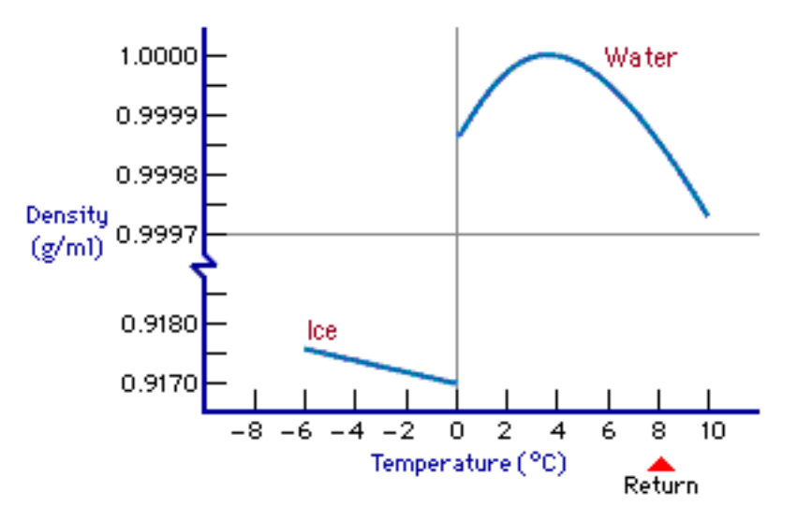
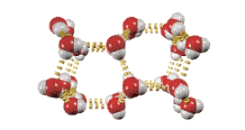
Hydrogen Bonding in H₂O
H-bonding in H₂O ----> open lattice like structure of ice.
Ice density is less than that of liquid, and solid floats on water.
Page 594

Slide 44

Hydrogen Bonding in H₂O
H bonds ---> abnormally high specific heat capacity of water (4.184 J/g•K).
This is the reason water is used to put out fires, it is the reason lakes/oceans control climate, and is the reason thunderstorms release huge energy.

Slide 45
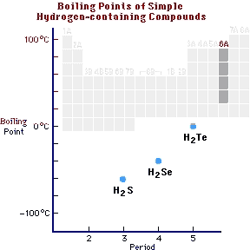
Hydrogen Bonding
H bonds ---> abnormally high boiling point of water.

Slide 46
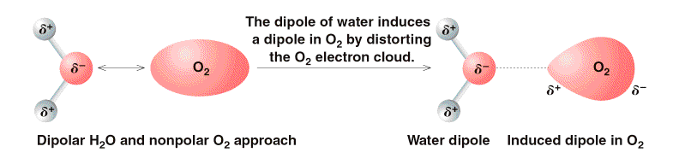
FORCES INVOLVING
INDUCED DIPOLES
Figure 13.12

Slide 47
Dispersion Forces:
Interactions Involving Induced Dipoles
Nonpolar molecules have no permanent dipole moment, but transient dipoles exist due to the random motion of the electrons about the positive charge center.
The relative magnitude of these forces is governed by the relative polarizability of the molecule.

Slide 48
Interactions Involving
Induced Dipoles
The polarizability increases with:
  increasing size and mass
  increases as the shape of the molecule becomes less spherical, that is flatter and more elongated.
There are two subcategories for these forces:
  dipole - induced dipole
  induced dipole - induced dipole.

Slide 49
Interactions Involving
Induced Dipoles
In the former, the force depends on the magnitude of the dipole of the polar molecule and the polarizability of the nonpolar molecule.
The last category depends on the polarizability of the molecules.

Slide 50
Interactions Involving
Induced Dipoles
Table 13.1 shows that these forces can be very strong.
Table 13.4, page 601, provides data for comparing the relative magnitude of these forces.
O.H. old tables with similar data.

Slide 51
Interactions Involving
Induced Dipoles
Figure 13.14, page 597, is a flowchart to aid the student in making decisions regarding the relative magnitude of intermolecular forces.
The proper understanding of these forces allows the student to predict the relative magnitude of boiling points, freezing points, solubility, etc.

Slide 52
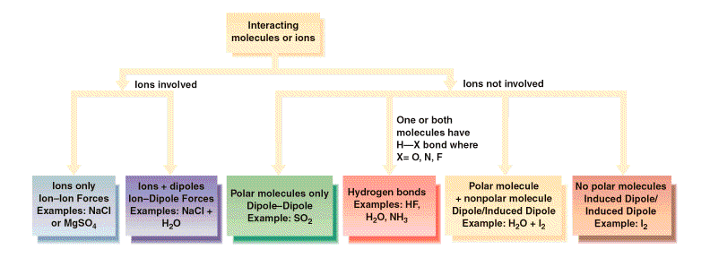
Figure 13.14

Slide 53
FORCES INVOLVING INDUCED DIPOLES
How can non-polar molecules such as Br₂, I₂, and N₂ condense to form liquids and solids?
Consider I₂ dissolving in alcohol, CH₃CH₂OH.
-
δ
ROH dipole
distorts or
The alcohol temporarily creates or INDUCES a dipole in I₂.
I-I
I-I
polarizes the
I
electron
+
δ
2
cloud
-
δ
O
δ
-
O
R
H
R
H
+
δ
δ
+

Slide 54

FORCES INVOLVING INDUCED DIPOLES
Water induces a dipole in nonpolar O₂ molecules, and consequently O₂ can dissolve in water.

Slide 55
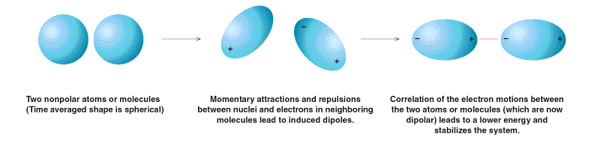
FORCES INVOLVING INDUCED DIPOLES
Figure 13.13

Slide 56

FORCES INVOLVING INDUCED DIPOLES
Formation of a dipole in two nonpolar I₂ molecules.

Slide 57
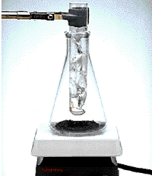
FORCES INVOLVING
INDUCED DIPOLES
The induced forces between I₂ molecules are very weak, so solid I₂ sublimes (goes from a solid to gaseous molecules).

Slide 58
FORCES INVOLVING
INDUCED DIPOLES
The size of the dipole depends on the tendency to be distorted, polarizability.
Higher molecular weight ---> larger induced dipoles.
Molecule Boiling Point (ºC)
CH₄ (methane) - 161.5
C₂H₆ (ethane) - 88.6
C₃H₈ (propane) - 42.1
C₄H₁₀ (butane) - 0.5

Slide 59
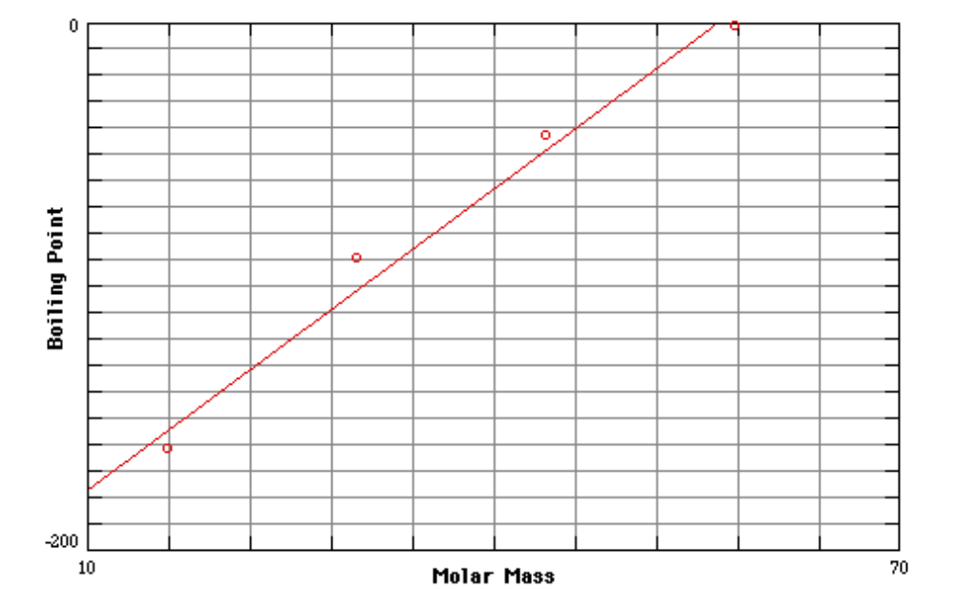
Boiling Points of Hydrocarbons
C₄H₁₀
C₃H₈
C₂H₆
CH₄
Note linear relation between B.P. and molar mass.

Slide 60
Check Question
Identify the type of interaction in each pair and rank their relative magnitudes from strongest to weakest:
F₂, F₂; HF, HF; Al⁺³, H₂O; K⁺, Cl⁻;
CH₃OCH₃, CH₃OCH₃; I₂, CH₂F₂; H₂, H₂

Slide 61
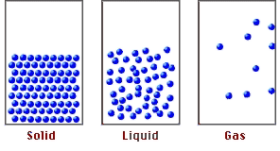
Liquids
Section 13.3
In a liquid
• Molecules are in constant motion
• There are appreciable intermolecular forces
• Molecules close together
• Liquids are almost incompressible
• Liquids do not fill the container

Slide 62
13.3 PROPERTIES OF LIQUIDS
In the liquid state the molecules are much closer together than in the gaseous state, but they are still free to move.
Liquids occupy only the lower portion of the container as it is filled.
Enthalpy of Vaporization
Vaporization is an endothermic process.
Energy must be added to replace the energy that is lost when the fast moving molecules escape into the vapor state.
At higher temperatures, more of the molecules have sufficient energy to escape.

Slide 63
Enthalpy of Vaporization
Figure 13.15 and 13.16, illustrate these concepts.
Since vaporization is an endothermic process, condensation is an exothermic process.
The magnitude of ΔH_{vap} is related to the type and magnitude of the inter-molecular forces found in the liquid.

Slide 64
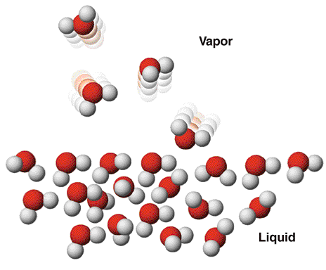
Liquids
Figure 13.16

Slide 65
Liquids
The two key properties we need to describe are EVAPORATION and its opposite—CONDENSATION
evaporation
LIQUID
Add energy
VAPOR
break IM bonds
make IM bonds
Remove energy
condensation

Slide 66
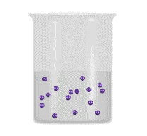
Liquids
To evaporate, molecules must have sufficient energy to break IM forces.
Breaking IM forces requires energy.
The process of evaporation is endothermic.

Slide 67
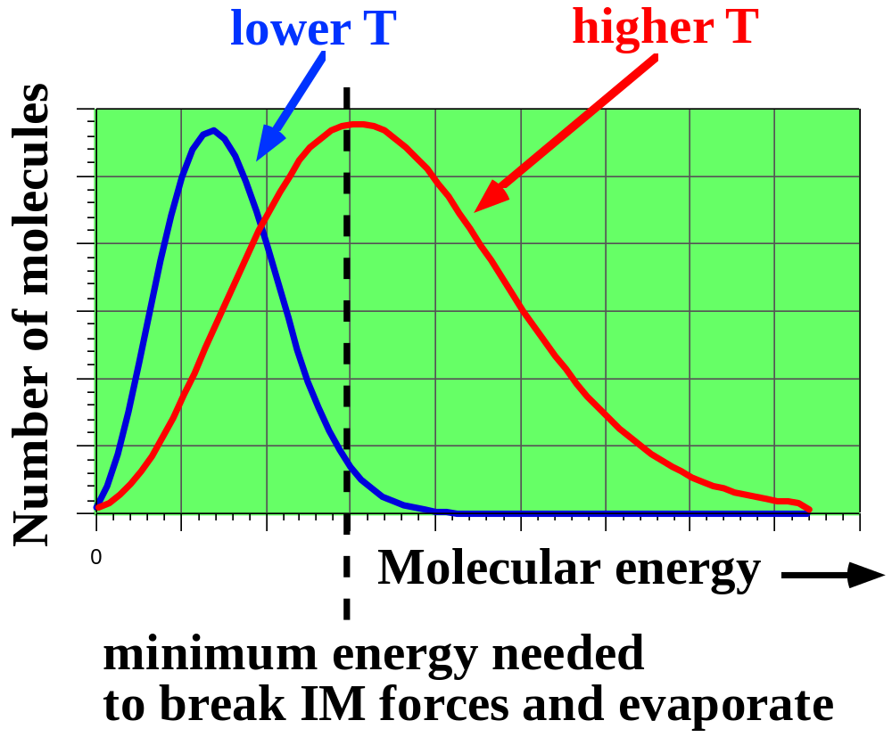
Liquids
Distribution of molecular energies in a liquid.
KE is proportional to T.
See Figure 13.15

Slide 68
Liquids
At higher T a much larger number of molecules has high enough energy to break IM forces and move from liquid to vapor state.
High E molecules carry away E. You cool down when sweating or after swimming.
lower T
higher T
Number of molecules
.
0
Molecular energy
minimum energy needed
to break IM forces and evaporate

Slide 69
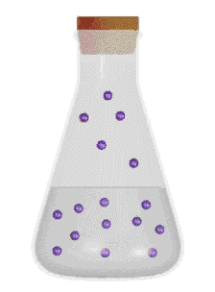
Liquids
When molecules of liquid are in the vapor state, they exert a VAPOR PRESSURE
EQUILIBRIUM VAPOR PRESSURE is the pressure exerted by a vapor over a liquid in a closed container when the rate of evaporation = the rate of condensation.
See Fig. 13.18

Slide 70
Vapor Pressure
The vapor pressure is the equilibrium pressure of the vapor above the liquid at a given temperature.

Slide 71
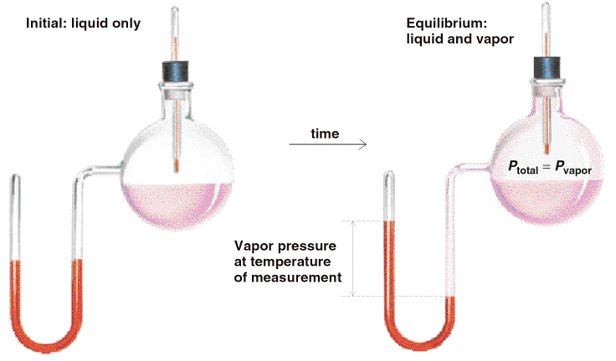
Vapor Pressure
Figure 13.18

Slide 72
Vapor Pressure
Compounds with higher vapor pressures are more volatile than those with lower vapor pressures.
The stronger the inter- molecular forces, the lower the vapor pressure.

Slide 73
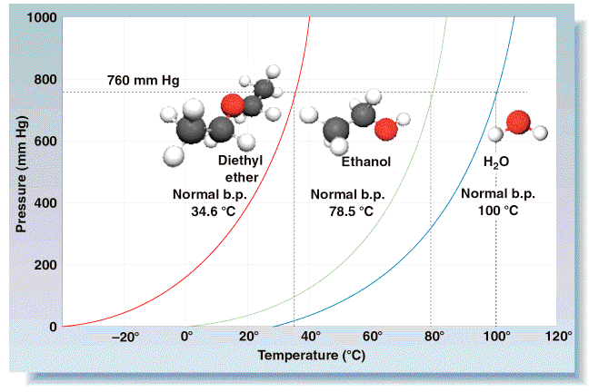
Vapor Pressure
Figure 13.19

Slide 74
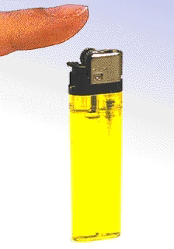
Vapor Pressure

Slide 75
Liquids
FIG. 13.19 shows VP as a function of T.
1. The curves show all conditions of P and T where LIQ and VAP are in EQUILIBRIUM.
2. The VP rises with T.
3. When VP = external P, the liquid boils.
* This means that BP’s of liquids change with altitude.

Slide 76
Vapor Pressure
As the temperature increases, the vapor pressure increases since there are more higher energy molecules at the higher temperature. Figure 13.15.
Example 13.5 and Exercises 13.4 and 13.5, page 604, illustrate the vapor pressure concepts.
The Clausius-Clapeyron equation for P vs T.
−
Δ
H
⎡
1
1
⎤
[
]
l
n
P
/
P
=
vap
⎢
−
⎥
2
1
R
T
T
⎣
⎦
2
1

Slide 77
Liquids
HEAT OF VAPORIZATION is the heat required (at constant P) to vaporize the liquid.
LIQ + heat ---> VAP
Cmpd. ΔH_{vap} (kJ/mol) IM Force
H₂O 40.7 (100 ºC) H-bonds
SO₂ 26.8 (-47 ºC) dipole
Xe 12.6 (-107 ºC) induced dipole

Slide 78
Boiling Point
The boiling point, T_{b}, is the temperature when the equilibrium vapor pressure equals the external pressure.
The normal boiling point, T_{b}º, is the temperature when the equilibrium vapor pressure equals one atmosphere pressure or 760 torr.
Figure 13.19 illustrates T_{b}º with a dashed horizontal line.

Slide 79
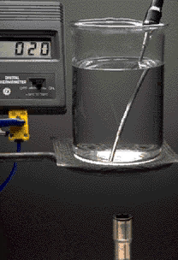
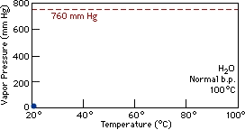
Boiling Liquids
A liquid boils when its vapor pressure equals atmospheric pressure.

Slide 80
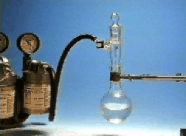
Boiling Point at Lower Pressure
When pressure is lowered, the vapor pressure can equal the external pressure at a lower temperature.

Slide 81
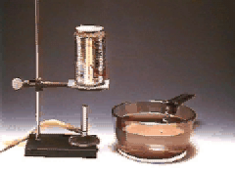
Consequences of Vapor Pressure Changes
When can cools, VP of water drops. Pressure in the can is less than that of atmosphere, so can is crushed.

Slide 82
Liquids
FIGURE 13.19 shows VP as a function of T.
4. If external P = 760 mm Hg, T of boiling is the NORMAL BOILING POINT
5. VP of a given molecule at a given T depends on IM forces. Here the VP’s are in the order:
ether
alcohol
water
O
O
O
H
C
C
H
H
C
H
H
H
5
2
2
5
5
2
dipole-
extensive
dipole
H-bonds
H-bonds
increasing strength of IM interactions

Slide 83
Critical Temperature and Pressure
The critical temperature, T_{c} , is the temperature at which the liquid state no longer exists since all molecules have sufficient energy to be separated from each other.
The critical pressure, P_{c} , is the pressure corresponding to the critical temperature, where no further increase in pressure will cause the gas phase to condense into the liquid phase.
This (T_{c} , P_{c}) point is called the critical point on the vapor pressure graph.
More on this later!!

Slide 84
Surface Tension, Capillary Action, and Viscosity
Surface tension is the result of the intermolecular force acting at the surface of a liquid.
Capillary action, ie. rising of a fluid in a very small diameter tube, results from the combination of adhesive forces, between a solid (like glass) and the liquid and the cohesive forces, between the molecules of the liquid.

Slide 85
Surface Tension, Capillary Action, and Viscosity
If the cohesive forces are stronger, the liquid forms an upward rounded meniscus.
A downward rounded meniscus forms if the adhesive forces are stronger.
Viscosity is the resistance to flow, and is at least partially a function of the intermolecular forces.

Slide 86
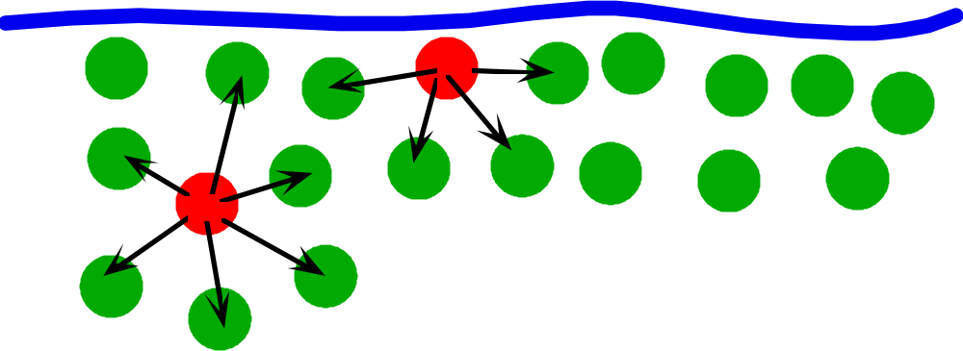
Liquids
Molecules at surface behave differently than those in the interior.
Molecules at surface experience net INWARD force of attraction.
This leads to SURFACE TENSION — the energy required to break the surface.

Slide 87
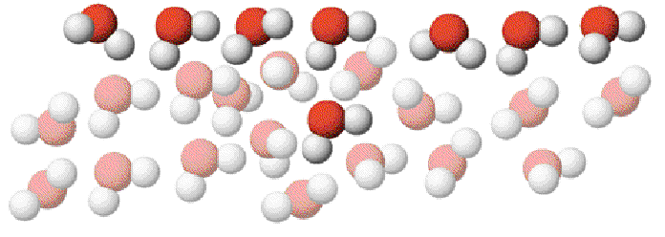
Liquids
Surface Tension
Figure 13.22

Slide 88
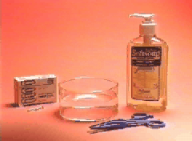
Surface Tension
SURFACE TENSION also leads to spherical liquid droplets.

Slide 89
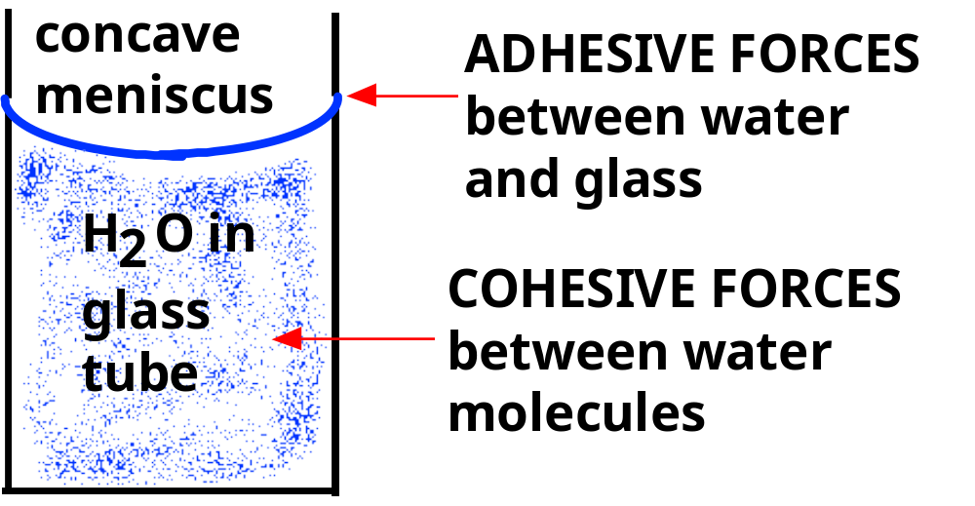
Liquids
IM forces also lead to CAPILLARY action and to the existence of a concave meniscus for a water column.

Slide 90

Capillary Action
Movement of water up a piece of paper depends on H-bonds between H₂O and the OH groups of the cellulose in the paper.

