Slide 1
Predicting from Protein Sequence

Slide 2
Starting Point
Broad Goal: To determine or predict as much as we can from a “new” protein sequence
Have covered how to find protein motifs such as targets for post-translational modification (Profiles/PSSMs/HMMs)
Have covered how to find homologous proteins - we will need them perhaps to predict something from their properties

Slide 3
Starting Point
Some properties or “propensities” can be directly calculated from individual amino acids
These properties are useful in themselves and may also be used in place of the original sequence for some prediction methods (or in addition to sequence)

Slide 4
Use of amino acid properties in prediction schemes
Sequence
Propensity function
Other inputs
Sequence
Vector of propensities
Prediction function
Prediction
Other inputs

Slide 5
Hydro-pathy/phobicity/philicity
One of the most commonly used properties is the suitability of an amino acid for an aqueous environment
Hydropathy & Hydrophobicity
  degree to which something is “water hating” or “water fearing”
Hydrophilicity
  degree to which something is “water loving”

Slide 6
Hydro-pathy/phobicity/philicity Analysis
Goal: Obtain quantitative descriptions of the degree to which regions of a protein are likely to be exposed to aqueous solvents
Starting point: Tables of propensities of each amino acid

Slide 7
Hydrophobicity/Hydrophilicity Tables
Describe the likelihood that each amino acid will be found in an aqueous environment - one value for each amino acid
Commonly used tables
  Kyte-Doolittle hydropathy
  Hopp-Woods hydrophilicity
  Eisenberg et al. normalized consensus hydrophobicity

Slide 8
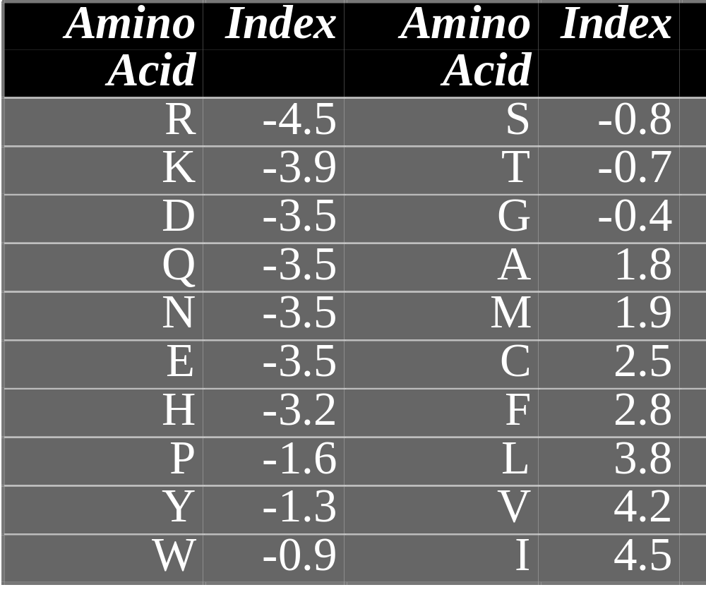
Kyte-Doolittle hydropathy

Slide 9
Basic Hydropathy/Hydrophilicity Plot
Calculate average hydropathy over a window (e.g., 7 amino acids) and slide window until entire sequence has been analyzed
Plot average for each window versus position of window in sequence

Slide 10
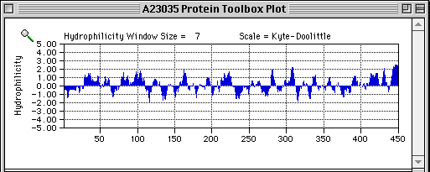
Example Hydrophilicity Plot
This plot is for a tubulin, a soluble cytoplasmic protein. Regions with high hydrophilicity are likely to be exposed to the solvent (cytoplasm), while those with low hydrophilicity are likely to be internal or interacting with other proteins.

Slide 11
Amphiphilicity/Amphipathicity
A structural domain of a protein (e.g., an α-helix) can be present at an interface between polar and non-polar environments
  Example: Domain of a membrane-associated protein that anchors it to membrane
Such a domain will ideally be hydrophilic on one side and hydrophobic on the other
This is termed an amphiphilic or amphipathic sequence or domain

Slide 12
Amphiphilicity/Amphipathicity
To find such sequences, we look for regions where short stretches of charged residues alternate with short stretches of hydrophobic residues with a repeat distance corresponding to the period of the structure
A helical wheel plot can aid finding such repeats

Slide 13
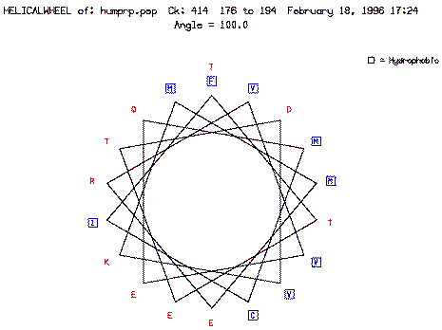
Helical Wheel for Prion Protein
from Susan Jean Johns and Steven M. Thompson

Slide 14
Hydrophobic Moment
Can avoid visual interpretation of helical wheel plots by considering each amino acid as being represented by a vector whose direction points orthogonally out from the backbone and whose sign and magnitude come from a hydrophilicity table and then calculating a “net” vector which is termed the hydrophobic moment
Approach developed by David Eisenberg

Slide 15
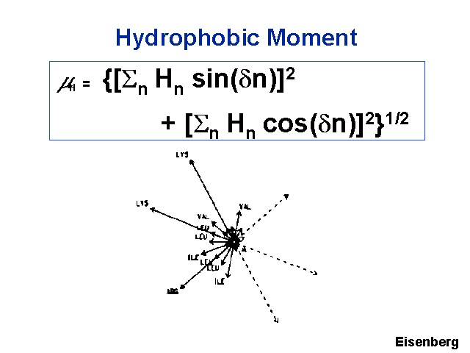
Hn = hydrophobicity value for residue n
δ = frequency of repeat of helix or sheet

