Slide 1

Worldwide Protein Data Bank
www.wwpdb.org

Slide 2
wwPDB
Formalization of current working practice
Members
  RCSB (Research Collaboratory for Structural Bioinformatics)
  PDBj (Osaka University)
  Macromolecular Structure Database (EBI)
MOU signed July 1, 2003
Announced in Nature Structural Biology November 21, 2003
Notes:
Use wwPDB logo done
Add URL done

Slide 3
Mission
Maintain a single archive of macromolecular structural data that is freely and openly available to the global community

Slide 4
Guidelines and Responsibilities
All members issue PDB ID’s and serve as distribution sites for data
One member is the archive keeper (RCSB)
  Manage entry ID’s
  Sole write access
All format documentation publicly available
Strict rules for redistribution of PDB files
All sites can create their own web sites

Slide 5
Maintain Format Standards
PDB
PDB Exchange (mmCIF)
  Mechanism for extension based on new demands
PDBML
  Derived from mmCIF
  All entries converted to XML
  Automatic translation from mmCIF data files and dictionaries
  3-styles of translation released
  PDBML: the representation of archival macromolecular structure data in XML. (2005) Bioinformatics 21, pp. 988-992

Slide 6
Progress Report
Publications
Exhibit stand at IUCr Meeting
New web site with pointers to member groups
DVD distribution with time stamp
Notification of availability of PDBML to computational biologists
Many phone conferences and regular email exchanges; staff exchange visits
Significant progress on uniformity and integration
Notes:
Changed to “exhibit stand” since it‘s a wwPDB exhibit stand -- we’re not sharing the space with another organization

Slide 7
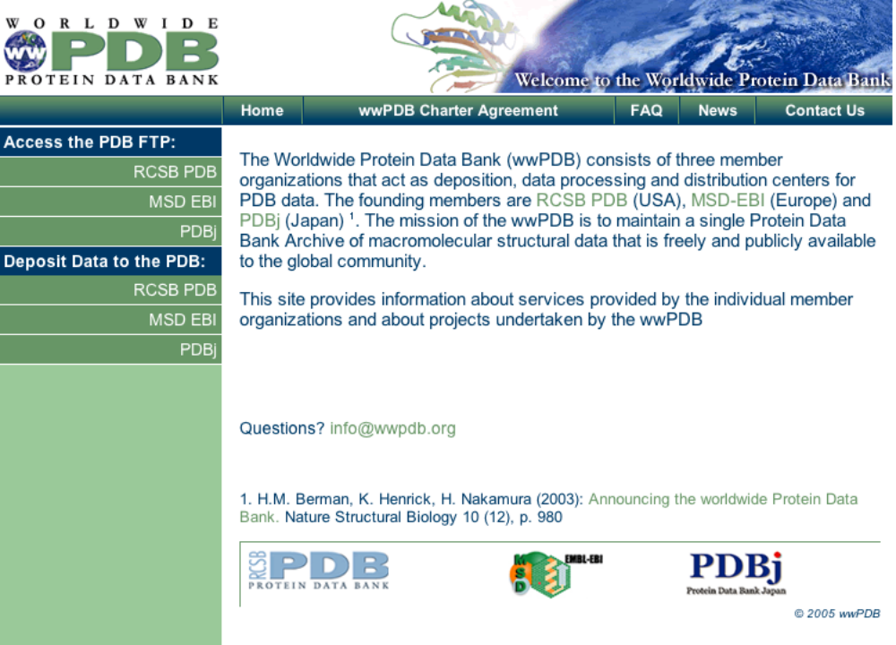

Slide 8
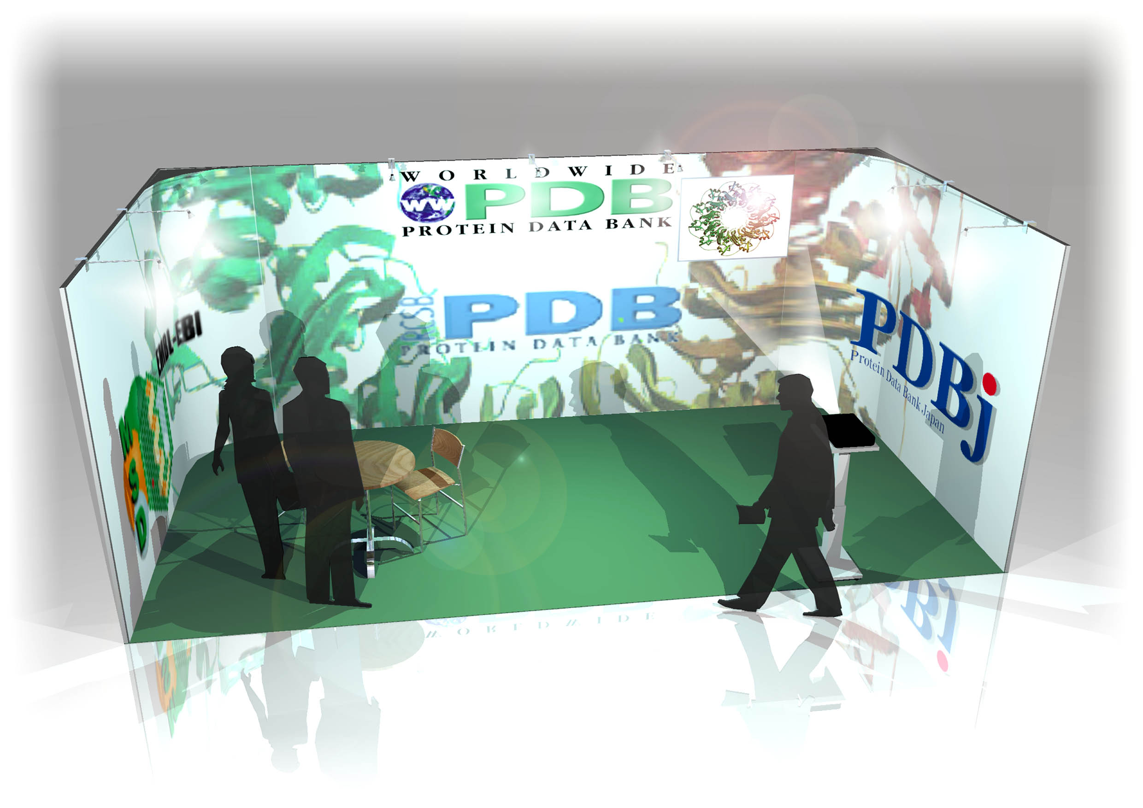

Slide 9
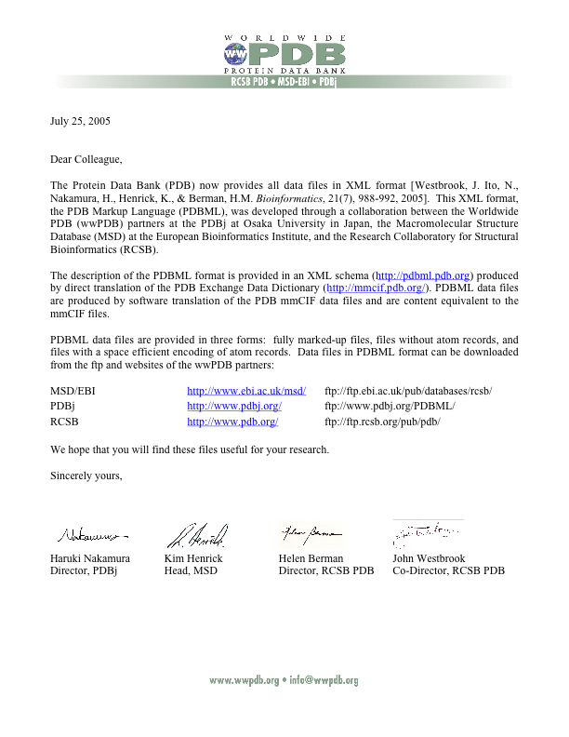
Notes:
Xml letter

Slide 10
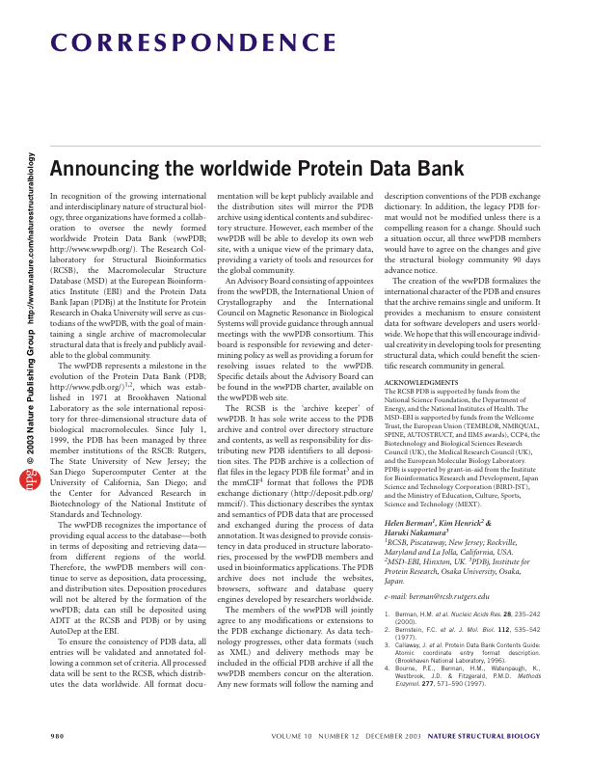
Web of Science Citations
Gupta, K; Thomas, D; Vidya, SV; et al. Detailed protein sequence alignment based on Spectral Similarity Score (SSS). BMC BIOINFORMATICS, 6: Art. No. 105. Westbrook, J; Ito, N; Nakamura, H; et al. PDBML: the representation of archival macromolecular structure data in XML. BIOINFORMATICS, 21 (7): 988-992 Kinoshita, K; Nakamura, H. Identification of the ligand binding sites on the molecular surface of proteins PROTEIN SCIENCE, 14 (3): 711-718 Brooksbank, C; Cameron, G; Thornton, J. The European Bioinformatics Institute's data resources: towards systems biology. NUCLEIC ACIDS RESEARCH, 33: D46-D53 Sp. Iss. SIMulder, NJ; Apweiler, R; Attwood, TK; et al. InterPro, progress and status in 2005.NUCLEIC ACIDS RESEARCH, 33: D201-D205 Sp. Iss. SI Velankar, S; McNeil, P; Mittard-Runte, V; et al. E-MSD: an integrated data resource for bioinformatics NUCLEIC ACIDS RESEARCH, 33: D262-D265 Sp. Iss. SIKersey, P; Bower, L; Morris, L; et al. Integr8 and Genome Reviews: integrated views of complete genomes and proteomes. NUCLEIC ACIDS RESEARCH, 33: D297-D302 Sp. Iss. SI Ragno, R; Frasca, S; Manetti, F; et al. HIV-reverse transcriptase inhibition: Inclusion of ligand-induced fit by cross-docking studies. JOURNAL OF MEDICINAL CHEMISTRY, 48 (1): 200-212Ragno, R; Artico, M; De Martino, G; et al. Docking and 3-D QSAR studies on indolyl aryl sulfones. Binding mode exploration at the HIV-1 reverse transcriptase non-nucleoside binding site and design of highly active N-(2-hydroxyethyl)carboxamide and N-(2-hydroxyethyl)carbohydrazide derivatives. JOURNAL OF MEDICINAL CHEMISTRY, 48 (1): 213-223Kleywegt, GJ; Harris, MR; Zou, JY; et al. The Uppsala Electron-Density Server. ACTA CRYSTALLOGRAPHICA SECTION D-BIOLOGICAL CRYSTALLOGRAPHY, 60: 2240-2249 Part 12 Sp. Iss. 1 Chen, Y; Kortemme, T; Robertson, T; et al. A new hydrogen-bonding potential for the design of protein-RNA interactions predicts specific contacts and discriminates decoys. NUCLEIC ACIDS RESEARCH, 32 (17): 5147-5162 2004 Yang, HW; Guranovic, V; Dutta, S; et al. Automated and accurate deposition of structures solved by X-ray diffraction to the Protein Data Bank ACTA CRYSTALLOGRAPHICA SECTION D-BIOLOGICAL CRYSTALLOGRAPHY, 60: 1833-1839 Opella, SJ; Marassi, FM. Structure determination of membrane proteins by NMR spectroscopy. CHEMICAL REVIEWS, 104 (8): 3587-3606 Cantley, M. Life sciences and GMOs: Still an uninsurable risk? GENEVA PAPERS ON RISK AND INSURANCE-ISSUES AND PRACTICE, 29 (3): 490-502 Nagpal, A; Valley, MP; Fitzpatrick, PF; et al. Crystallization and preliminary analysis of active nitroalkane oxidase in three crystal forms. ACTA CRYST SECT D60: 1456-1460 Tsuchiya, Y; Kinoshita, K; Nakamura, H. Structure-based prediction of DNA-binding sites on proteins using the empirical preference of electrostatic potential and the shape of molecular surfaces PROTEINS-STRUCTURE FUNCTION AND BIOINFORMATICS, 55 (4): 885-894
Notes:
Papers that mention wwPDB

Slide 11
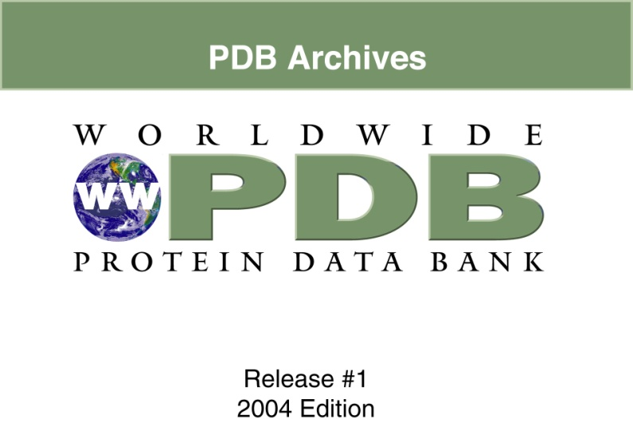
Time-stamped Record of PDB
36 Gbytes of data from the PDB FTP site on DVD
Includes:
  PDB format entries
  mmCIF format entries
  PDBML format entries (3 flavors)
  Experimental data
  Dictionary, schema and format documentation
8 DVD set

Slide 12
PDB Uniformity
Ligands: RCSB
Sequence, taxonomy, entities: MSD
Citations: PDBj

Slide 13
PDB & Ligand
Chemistry

Slide 14
Ligands
Currently ~5700 small molecules in library
  80,000 instances in the PDB
Before remediation
  No stereo information
  Not all names could be resolved into unique structure
  Unsure how well definitions equal instances
    Errors in deposited data?
    Errors in annotation?
Notes:
Jeramia-3 slides

Slide 15
Strategy
Stereo calculation for 80,000 ligands
  MSD - CACTVS
    Stereo signatures and SMILES strings for every instance
    Loaded into MSDChem - accessible for data mining AND systematic checking of errors
    Provided representative stereo SMILES to RCSB for comparison
  RCSB - OpenEye
    Stereo SMILES for every instance
    MSD SMILES standardization and comparison
Literature-based SMILES generation
  RCSB - CAS, SciFinder, Belstein Commander
  Verification of chemical identity and CAS number for 5000 ligand definitions

Slide 16
Systematic comparison
Ligand definitions which disagreed between MSD and RCSB efforts:
  Checked for chemical correctness
  Chemdraw, Ligand-Depot, Marvin, individual instances
Majority of differences
  Stereo isomers of instances (α-glucose vs β-glucose)
  Bond order disagreements (aromatic vs Kekule)

Slide 17
Results
Ligand dictionary now
  Unique stereo SMILES strings
  Names can be converted to unique structures
  Remaining ~200 are organometallic or other unusual chemistry - SMILES doesn’t work
  Representative coordinates
  Public update by end of year
Started
  Annotation of library <=> instance differences
  Gathering instances that need new definitions
Notes:
Jeramia-3 slides

Slide 18
PDB & Sequence
and Taxonomy

Slide 19
Sequence and Taxonomy
All analysis is based on chains
6745 mmCIF’s have no UniProt value
262 mmCIF’s have a different UniProt value than MSD
1666 mmCIF’s have Taxonomy different than MSD
845 mmCIF's have no Taxonomy data
Notes:
ChainID instead of chains?
Standardize language

Slide 20
6745 mmCIF’s do not have a UniProt value
Chains have no DBREF
Chains have GenBank or SwissProt reference
GB and SWS are redundant and/or obsolete
Example: 1A02
DBREF 1A02 N 399 678 GB 1353774 U43341 399 678
DBREF 1A02 F 140 192 SWS P01100 FOS_HUMAN 140 192
DBREF 1A02 J 267 318 SWS P05412 AP1_HUMAN 257 308
ACTION: use the MSD UniProt value
Notes:
Run on sentence, changed.

Slide 21
262 mmCIF’s have a UniProt value different to MSD
Example: 1a2c
PDB file:
DBREF 1A2C I 355 364 SWS P28501 ITHA_HIRME 55 64
mmCIF file:
_struct_ref_seq.pdbx_db_accession P09945

Slide 22
262 mmCIF’s have a UniProt value different to MSD
1a2c NGDFEEIPEEYL
P28501 …TGEGTPKPQSHNDGDFEEIPEEYLQ RCSB
P09945 …TGEGTPNPESHNNGDFEEIPEEYLQ MSD
ACTION: These have to be individually checked
*

Slide 23
1666 mmCIF’s with Taxonomy differences to MSD
1305 - no valid name
463 - chimera or strange
  mmCIF's have 2 species names on the same line
  counted as a difference
Example: 4mon
SOURCE 2 ORGANISM_SCIENTIFIC:
DIOSCOREOPHYLLUM CUMMINISII DIELS;
MSD: Dioscoreophyllum cumminsii
tax.id. 3457
ACTION: Use the MSD taxid

Slide 24
845 mmCIF's no taxonomy data
Examples: 9api 9gpb 9ins 9ldb 9ldt
ACTION: Take the MSD Taxid

Slide 25
Mismatched Entities between MSD and RCSB
ACTION: Check meaning of CHAIN and number of chains in entries concerned

Slide 26
ACTION: pass to RCSB
The corrected mmCIF categories
_entity_src_nat
_entity_src_gen (this is confirmation only)
_struct_ref
_struct_ref_seq
_struct_ref_seq_dif
For each matched
_entity (of type protein polymer)
_entity_poly_seq
Suggested new items:
_entity_src_gen.pdbx_taxid
_entity_src_gen.pdbx_host_taxid
_entity_src_nat.pdbx_taxid

Slide 27
PDB & Citations

Slide 28
Citations
~32,000 of the original PDB entries have incomplete primary citations
  Accurate primary citations are key archival data, are essential for linking to other databases, and for future semantic web
  Historically, BNL had an archive of the reprints of the primary citations, but they were not complete
  The three wwPDB members have made independent efforts to remediate the primary citation information

Slide 29
Citations
Before remediation
  Many PDB entries without primary citations (544 entries on May 10, 2005)
  Some PDB entries have erroneous information in the primary citations
  Many PDB entries lack PubMed identifiers for primary citations (4,300 entries on May 10, 2005)
  “To be published” citations require update (2,798 entries on May 10, 2005)

Slide 30
Strategy (1)
Systematic analysis of the current situation
  Incomplete citations (data on May 10, 2005)
    Consensus citation information (e.g. Journal abbrev., volume, start-page, end-page, year, PubMed ID) in mmCIF files, EBI-MSD database, and PDBj xPSSS annotated database, is completely identical
16,897
No information about primary citations or “To be published”
3,342
Non-consensus cases
      Lack of agreement in PubMed ID
10,466
      Missing PubMed ID
958

Slide 31
Strategy (2)
Construction of a new literature archive
A new literature archive is being constructed at PDBj by collecting primary citations, producing electronic copies as PDF files, and storing them in a TByte hard disk, by using the Osaka University Library with 12,000 journals.
Currently, ~7,000 PDF files for the primary citations have been curated.
Notes:
Are the primary citations being collected in some way other than downloading a PDF? Slide could be read as implying the PDFs are being generated/annotated

Slide 32
Cooperation in the wwPDB
PDBj effort:
Incomplete citations and citations without PubMed IDs have been manually annotated at PDBj by searching literature databases (PubMed and SciFinder scholar) and reading papers and dissertations for (958 + 3342) 4,258 entries
EBI-MSD effort:
Citations with PubMed IDs have been confirmed at EBI-MSD for 10,466 entries
RCSB-PDB effort:
Searching their literature archive for the citations that may exist in the PDB physical archive

Slide 33
Results
For citations without PubMed IDs (4,258 entries):
  Established the correct primary citations with PubMed IDs: 1,211
  Established the correct primary citations without PubMed IDs: 349
  Structural genomics primary citations may not be published: 693
  Confirmed that the citation is “Unpublished” by the authors: 73
  Obsolete or replaced ID after May 10, 2005: 65
  Stopped remediation for Theoretical models: 383
  total: 2,774
  (The remaining 1,526 are still being annotated at PDBj)
For citations with PubMed IDs (10,466)
  MSD-EBI annotated: 6,773
  RCSB annotated: 3,634
  PDBj annotated: 59
Notes:
Jeramia-3 slides

Slide 34
Next Action
The remediation of the primary citation will be completed
A new electronic literature archive will be created
The remediated citation information will be added to the archival files in PDB, mmCIF, and PDBML formats
Experience gained in this remediation effort will be used to shape future annotation of citation data
The original citation information in the legacy data should be retained

Slide 35
NMR Data

Slide 36
NMR Depositions
Chemical shifts and other primary experimental data deposited to BMRB
Coordinate and meta data deposited to all wwPDB sites

Slide 37
BMRB Interactions
RCSB
  ADIT-NMR for joint BMRB PDB deposition
  Will require BMRB to issue PDB ID
PDBj at Osaka (Prof. Hideo Akutsu)
  Mirror deposition and processing of NMR experimental data
EBI (Wim Vranken)
  RECOORD-recalculations of NMR structures using normalized and filtered PDB restraint files

Slide 38
Collaboration between BMRB and PDBj
Mirror deposition processing of NMR experimental data for BMRB with two curators from August 2005
Establishment of a reliable data flow and a common annotation system in the BMRB/PDBj database management system
Cooperation with RIKEN-Structural Genomics group to find a smooth data deposition scheme both for PDBj and BMRB
Development of ontology for the solid-state NMR for biological molecules

Slide 39
EM Data

Slide 40
wwPDB and EM
Current database based on
ftp://ftp.ebi.ac.uk/pub/databases/emdb/doc/XML-schema/emd_v1_4.xsd
Developed under the European Commission as the IIMS, QLRI-CT-2000-31237
http://www.ebi.ac.uk/msd/projects/IIMS.html

Slide 41
wwPDB and EM
http://www.ebi.ac.uk/msd-srv/emdep/
http://www.ebi.ac.uk/msd-srv/emsearch/

Slide 42
wwPDB and EM
The data definition dictionaries also covered extensions for deposition of fitted coordinates to the PDB
This is the result of an extensive collaboration between the EBI/IIMS partners and the RCSB, in particular with Monica Chagoyen (Madrid), Richard Newman (EBI) and John Westbrook (RCSB)
http://mmcif.pdb.org/dictionaries/mmcif_iims.dic/Index/
http://iims.ebi.ac.uk/3dem_pdb.html

Slide 43
wwPDB and EM
Support for EMdep has continued in Europe with the establishment of the PF6 Network of Excellence 3D-EM on New Electron Microscopy Approaches for Studying Protein Complexes and Cellular Supramolecular Architecture
www.3dem-noe.org

Slide 44
wwPDB and EM
Collaboration with US to further develop the data definitions required to enhance EMdep and EMdb, and to investigate how to improve the linking of PDB fitted coordinates from EM reconstructions with deposited maps.
RCSB workshop (October 23-24, 2004)
http://rcsb-cryo-em-development.rutgers.edu/workshop/
co-sponsored by the Computational Center for Biomolecular Complexes (C2BC)
http://ncmi.bcm.tmc.edu/ccbc

Slide 45
wwPDB and EM
New extensively revised dictionary resulted from the work of many contributors.
It will be the basis of further software workshop to be held at the EBI October 12-14, 2005.
http://rcsb-cryo-em-development.rutgers.edu/mmcif_iims.dic-rev/Categories/

Slide 46
wwPDB and EM
Proposal for Joint RCSB/EBI EM database/data deposition will be submitted in February 2006 to fully integrate EM maps with the PDB fitted coordinates

Slide 47
Models

Slide 48
Models in the PDB
Ambiguous policies over the years
Revisit decision to remove models

Slide 49
The Ambiguities
Define line between “pure” models and models based on data
Large experimental spectrum e.g. X-ray, NMR, EM, SAX, FRET models
Homology models especially as derived from structural genomics
Need a way to archive models that is totally compatible with PDB

Slide 50
Finding a solution
Workshop at the RCSB PDB to develop a white paper on models (November 19-20, 2005)

Slide 51
Deposition Issues

Slide 52
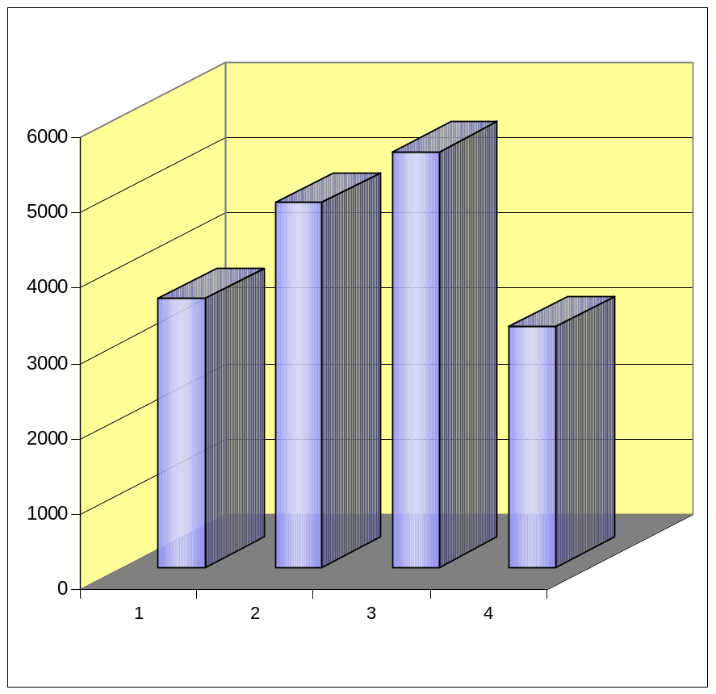
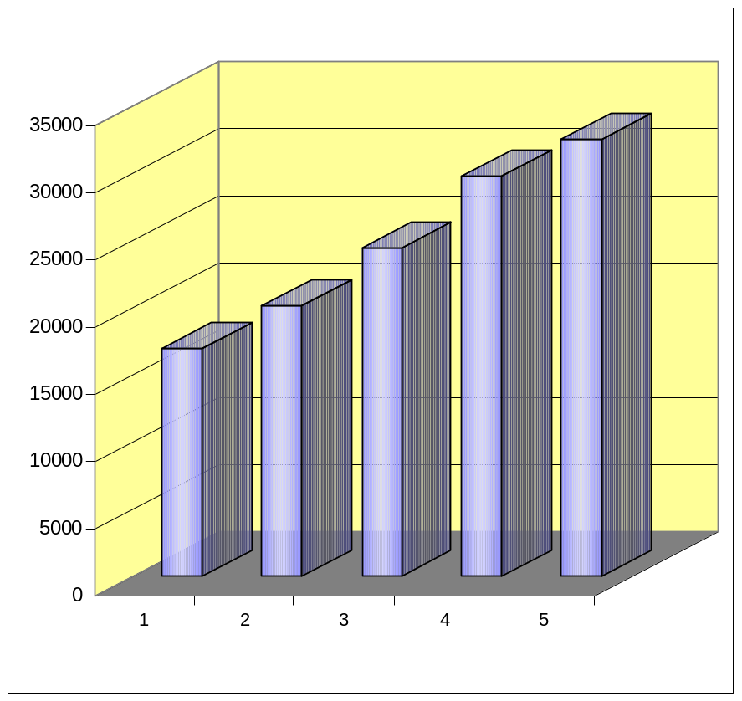
PDB doubled in less than 4 years
Number of Structures Processed
as of July 1, 2005
3564 in 2002 and 5507 in 2004
Total Number of Structures in PDB
as of July 1, 2005
16,972 in 2001 and 32,545 in 2005
2002 2003 2004 2005
2001 2002 2003 2004 2005

Slide 53
Annotator Staff
PDB annotation involves processing submissions to prepare standardised PDB entries.
It doesn’t involve UniProt curation of adding literature data to entries.
Standardisation of entries includes, standard format:
correct ligand chemistry
correct sequence identification
assignment of assembly information
 | 2002 | 2005
RCSB | 9 | 9
PDBj | 5 | 5
MSD | 5 | 4

Slide 54
Lack of Validation
Considerable automation in both ADIT and Autodep4
However, increasing problems with depositors depending upon the annotation process to reveal problems in validation
Many submissions involve re-refinement after deposition and annotation processing and re-submission of coordinates
This requires considerably more work for annotation staff
Both submissions tools not primarily designed for re-submissions of coordinates which arrive by email
At MSD, turn-around for processing is slowing down

Slide 55
Deposition Issues
Require help in:
Request pre-validation prior to submission
More effort has to be carried out by depositors
Expand user education activities – take up any opportunity to present validation and deposition talks at structural biology meetings

