Slide 1

Secondary Structure Prediction in Proteins

Slide 2
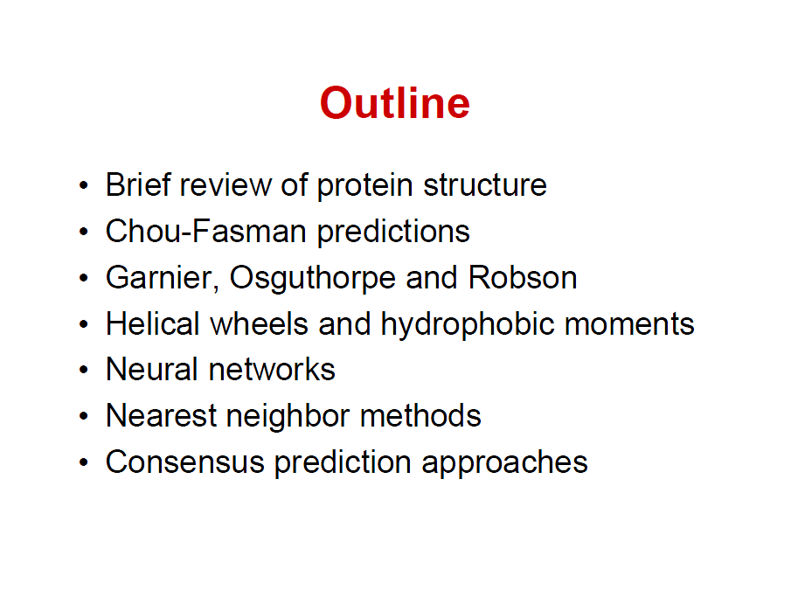

Slide 3
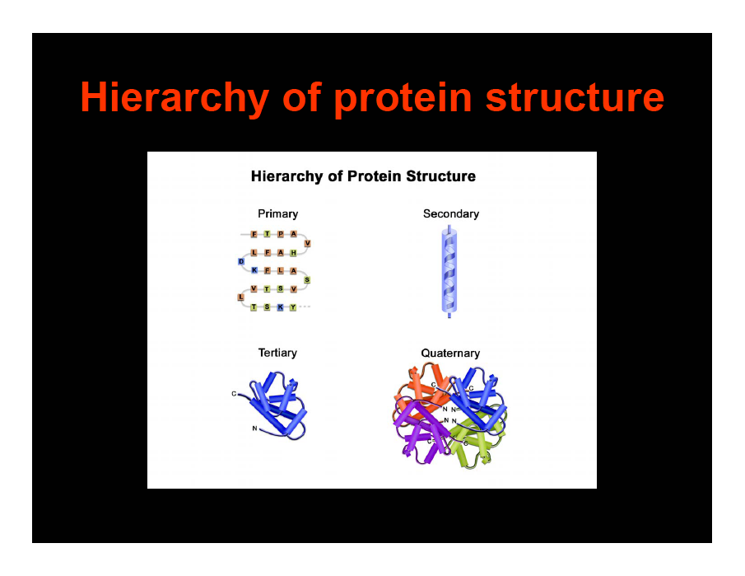

Slide 4
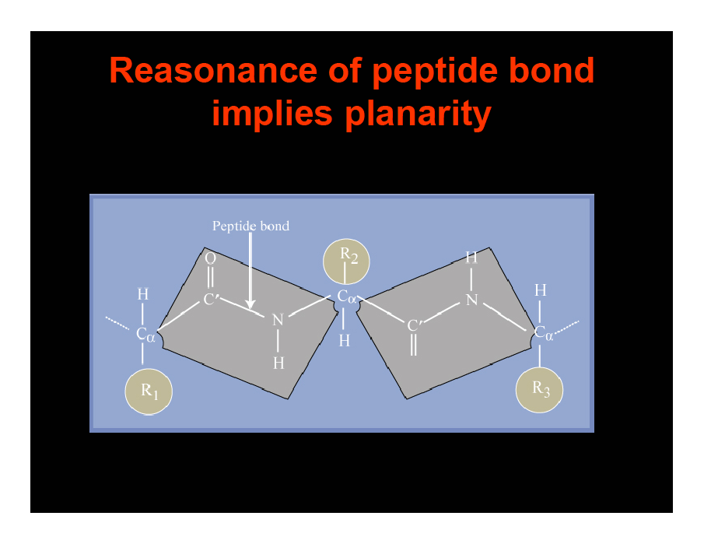

Slide 5
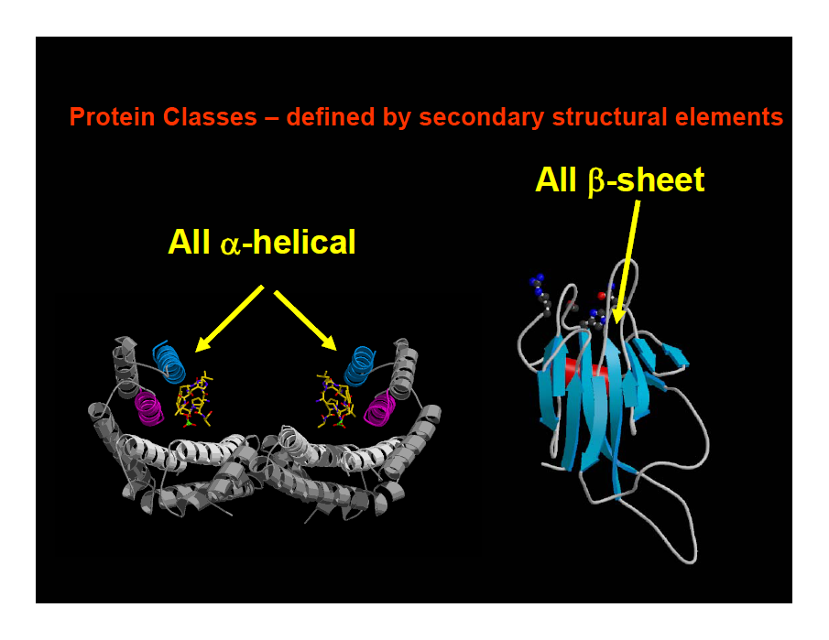

Slide 6
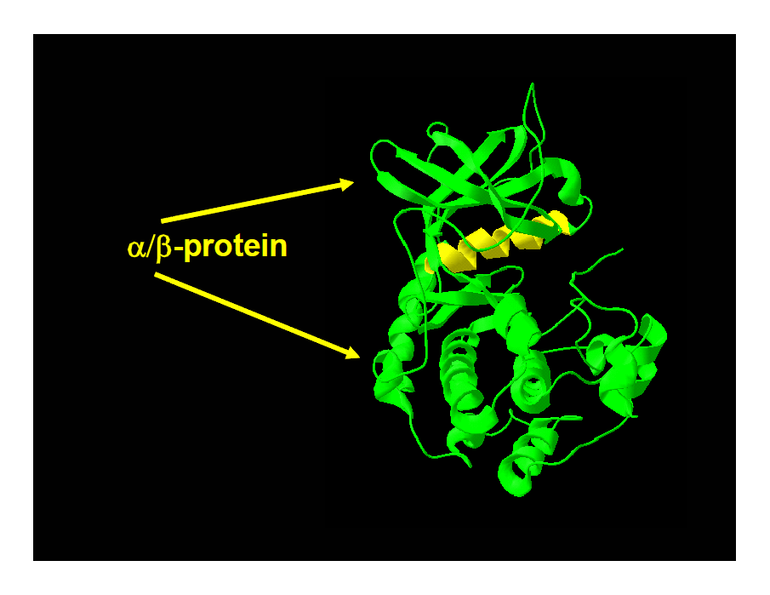

Slide 7
Why should secondary structure be predictable ?
There are statistical preferences
obvious
  alanine likes helices
  proline does not like helices (no H-bond donor)
less obvious
  β-strands more likely to be buried
  α-helices amphipathic
  residues have preferences (hydrophobic, polar, charged..)
  would expect predictable patterns

Slide 8
Conventions – different names and types of secondary structure
detailed |  | condensed
H |  | H | α-helix |  | most important
E |  | E | β-strand
B |  |  | β-bridge
G |  | H | 3-10 helix
I |  | other / L / coil/… | 5 helix
T |  |  | H bonded turn
S |  |  | bend
We will mostly stick to H, E, other (coil)

Slide 9
take set of representative proteins
assign secondary structure
count number of times residue occurs in each type
A better predictor
You cannot have an α-helix of one residue
  physically > 4 residues, usually more
  EEE__HEE not possible
  β-strands normally longer as well
Chou and Fasman (1978)
  look for stretches of 6 likely "H"
  5 likely "E" (β-strand)
About 50-60 % correct

Slide 10
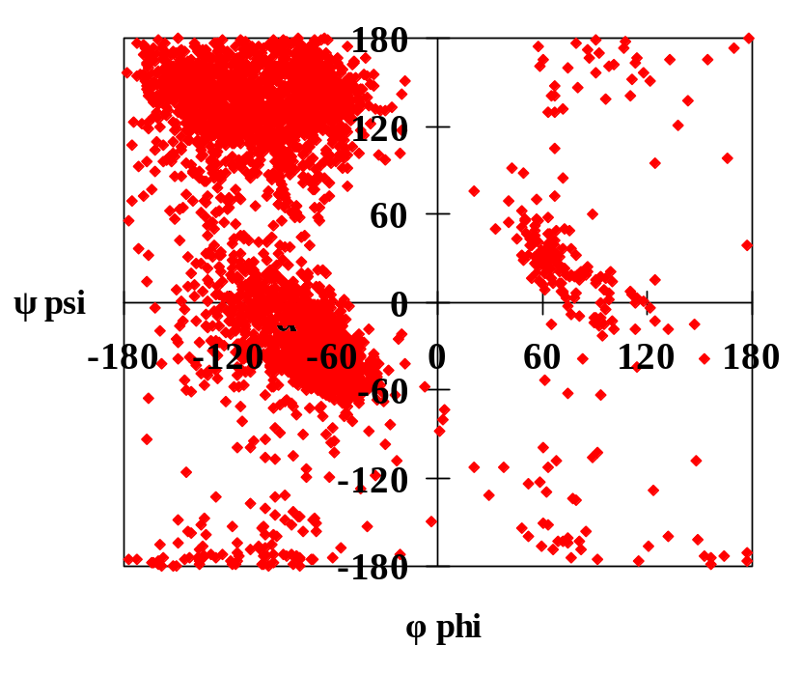
Defining secondary structure
Before going on, need some definitions
How rigorous is secondary structure ?
  defined by geometry or H-bonds ?
Maybe H-bonds are a bit better
ramachandran plot from http://www.cgl.ucsf.edu/home/glasfeld/tutorial/AAA/AAA.html

Slide 11
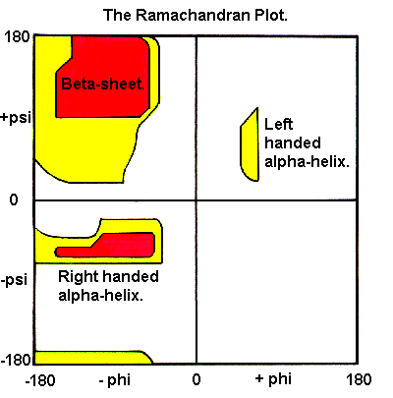

Slide 12
How well is an H-bond defined ?
H-bond is "in principle" well defined but
  proteins have errors / are an average
  not all geometry is ideal
  not all H-bonds are the same
Consequence
  slight arbitrary element
  how big is r_{NO} ?
  how flat is α ?
Different programs might differ
  about H-bonds
  about exact secondary structure
α
O
N
H
r_{NO}

Slide 13
Different definitions of secondary structure
Assignments will differ between programs
  most differences at ends
Where will you meet this ?
  spdbv, rasmol, …
  many programs for protein analysis
Most important ?
  DSSP (Kabsch and Sander)
    pascal -> C (astonishingly ugly, grässlich, nicht robust)
    free code, popular
  defines 8 types of secondary structure
  based on H-bond definition
  well described in paper
Kabsch, W & Sander, C, Biopolymers, 1983, 2577-2637, Dictionary of protein secondary structure

Slide 14
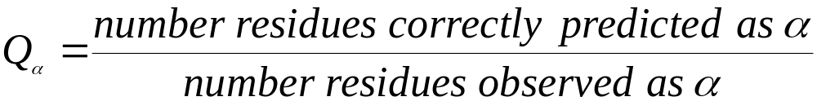
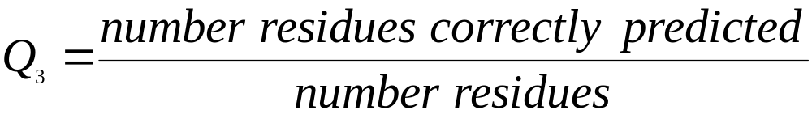
Measuring prediction accuracy Q3
how many α-helical residues are correct ?
  number of correct α-helix/number really α-helical
more generally

Slide 15
What is wrong with Q₃ ?
Not bad but
EEEHEEEEE is a bit silly
Does not tell us about
predicting
  too much / too little
different types of errors
Alternatives
segment based (SOV)
truth table
  too hard
Generally use Q₃
 |  | predicted
 |  | H | E | C
observed | H
 | E
 | C

Slide 16
The DSSP Code
There are several methods for defining protein secondary structure
(e.g. STRIDE^{[1]}, but DEFINE^{[2]}) the Dictionary of Protein Secondary Structure, DSSP, ^{[3]}
method is commonly used to describe the protein secondary structure with single
letter codes. The secondary structure is assigned based on hydrogen bonding patterns
as those initially proposed by Pauling et al. in 1951 (before any protein structure had
ever been experimentally determined). There are eight types of secondary structure
that DSSP defines:
G = 3-turn helix (3₁₀ helix). Min length 3 residues.
H = 4-turn helix (α helix). Min length 4 residues.
I = 5-turn helix (π helix). Min length 5 residues.
T = hydrogen bonded turn (3, 4 or 5 turn)
E = extended strand in parallel and/or anti-parallel β-sheet conformation. Min length 2 residues.
B = residue in isolated β-bridge (single pair β-sheet hydrogen bond formation)
S = bend (the only non-hydrogen-bond based assignment)

Slide 17

Amino acid residues which are not in any of the above conformations are assigned as the eighth type 'Coil': often codified as ' ' (space), C (coil) or '-' (dash). The helices (G,H and I) and sheet conformations are all required to have a reasonable length. This means that 2 adjacent residues in the primary structure must form the same hydrogen bonding pattern.
If the helix or sheet hydrogen bonding pattern is too short they are designated as T or B, respectively. Other protein secondary structure assignment categories exist
(sharp turns, Omega loops etc.), but they are less frequently used.
DSSP H-bond definition
Secondary structure is defined by hydrogen bonding, so the exact definition of a hydrogen bond is critical. The standard H-bond definition for secondary structure is that of DSSP, which is a purely electrostatic model. It assigns charges of
to the carbonyl carbon and oxygen, respectively, and charges of to the amide nitrogen and hydrogen, respectively. The electrostatic energy is
According to DSSP, an H-bond exists if and only if E is less than -0.5 kcal/mol. Although the DSSP formula is a relatively crude approximation of the physical H-bond energy, it is generally accepted as a tool for defining secondary structure.

Slide 18
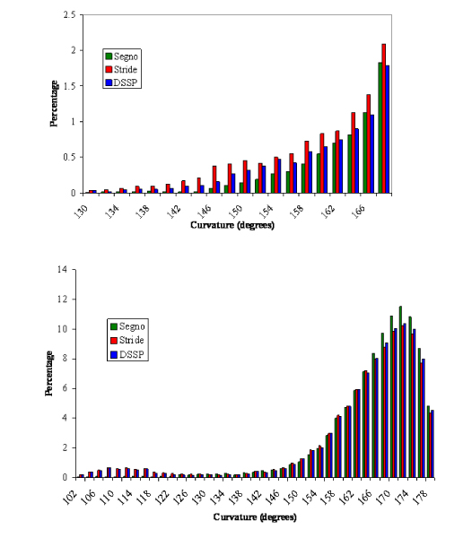
Curvature in secondary structures for (a) α-helices and (b) β-strands for the three programs'
definitions. The x-axis represents curvature in degrees in a given bin, with the y-axis
representing the percentage of residues in that bin. In (a) the bins >170° are omitted to
show the distribution in the more distorted region more clearly.
Cubellis et al. BMC Bioinformatics 2005 6(Suppl 4):S8

Slide 19
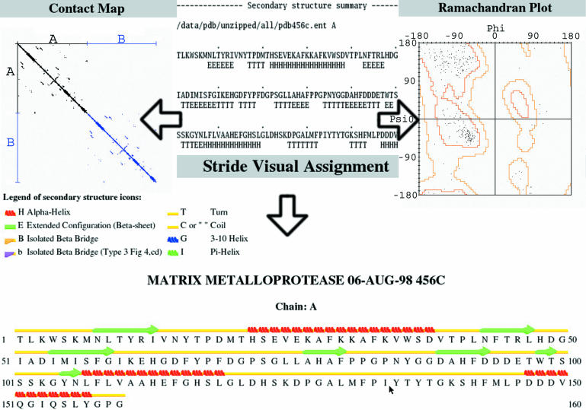
Available views of the secondary structure assignment created by STRIDE from the sample
structure 456c. Center top, original STRIDE output; left, contact map; right, Ramachandran
plot; bottom, cartoon representation of secondary structure.

Slide 20
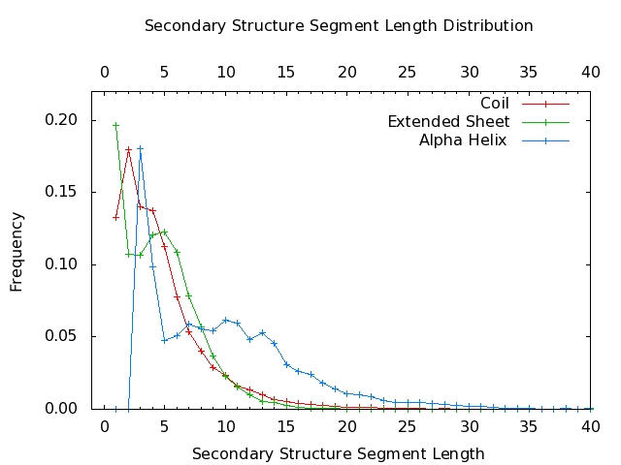
Distribution obtained from non-redundant pdb_select dataset (March 2006);
Secondary structure assigned by DSSP; 8 conformational states reduced to 3 states:
H=HGI, E=EB, C=STC; Visible are mixtures of (gaussian) distributions, resulting also
from the reduction of DSSP states

Slide 21
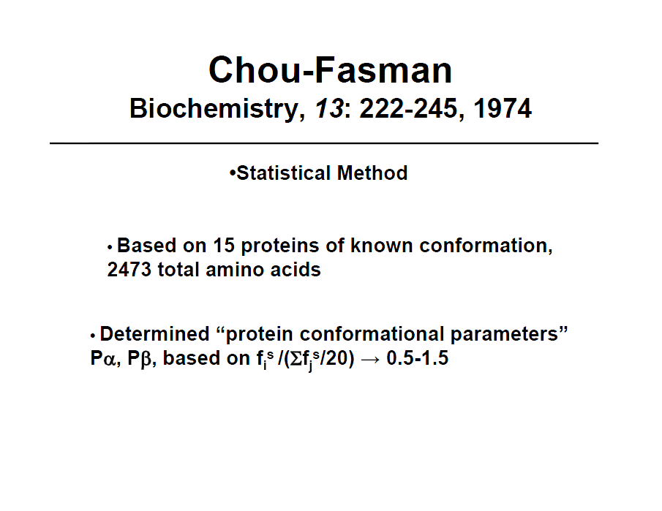

Slide 22
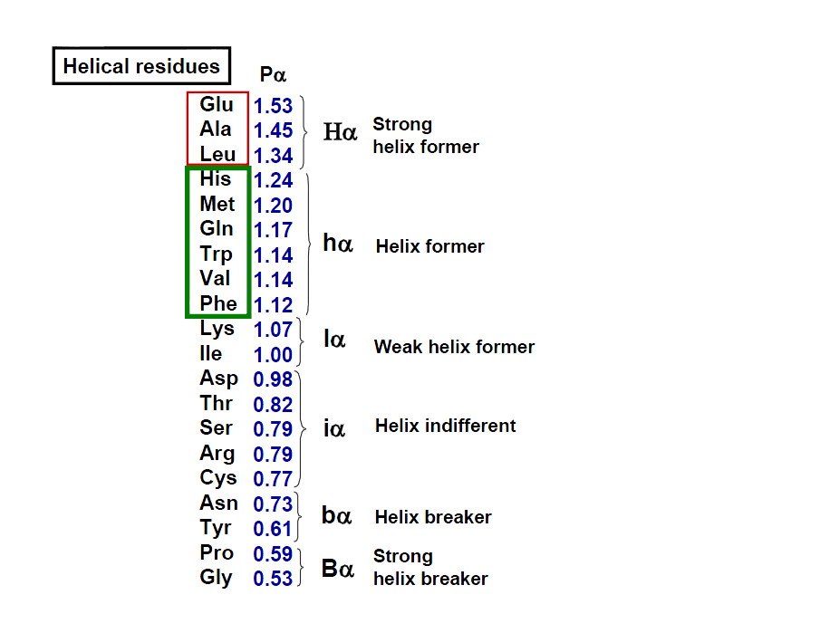

Slide 23
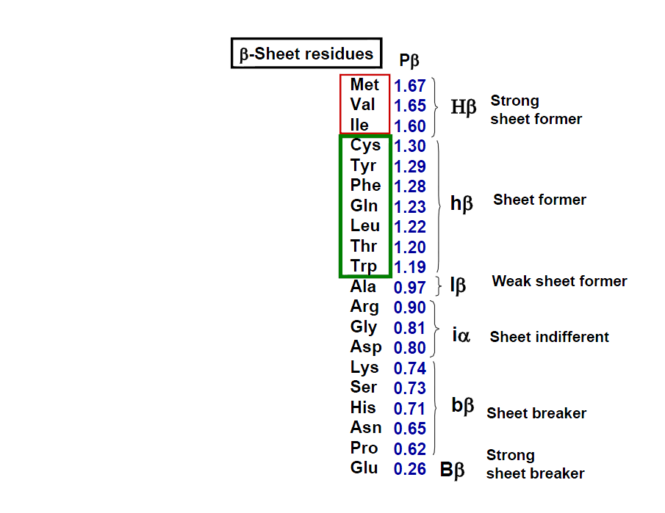

Slide 24
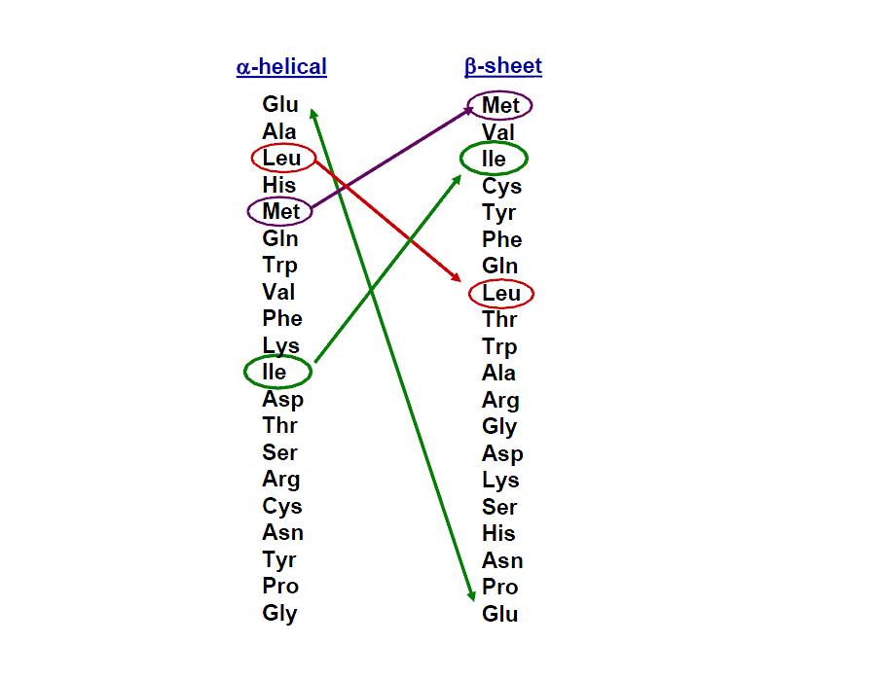

Slide 25
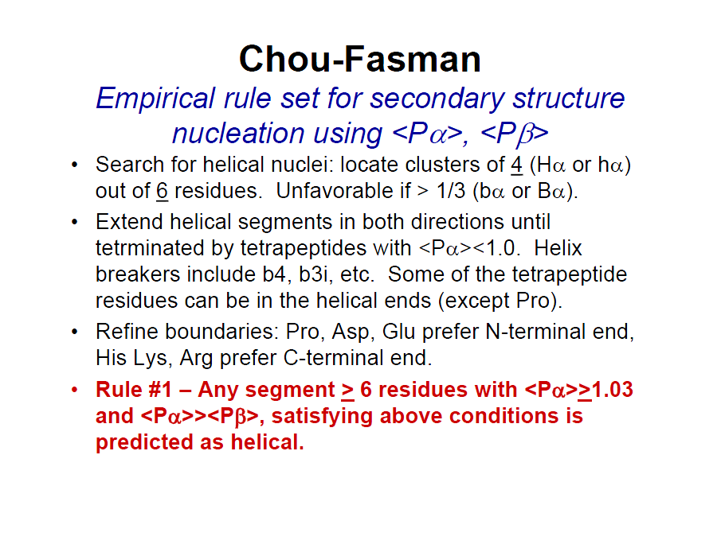

Slide 26
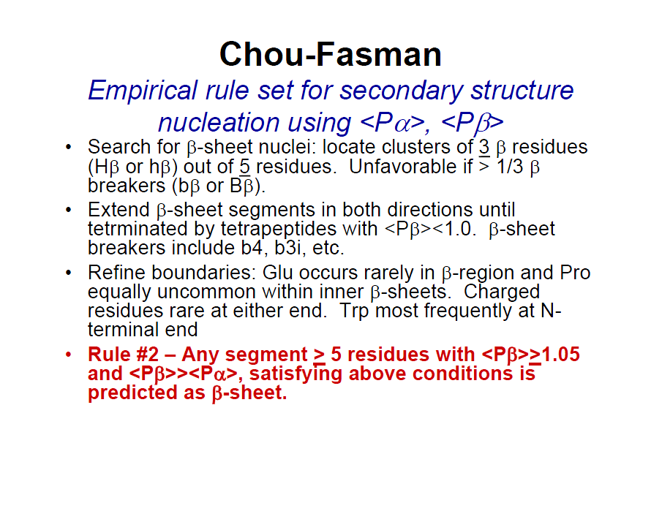

Slide 27
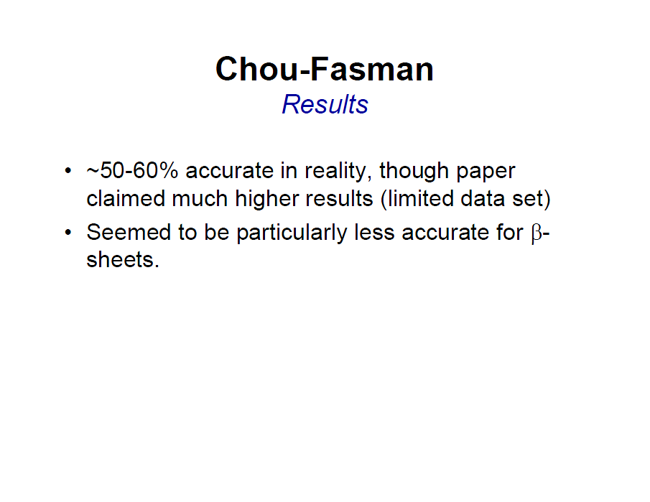

Slide 28
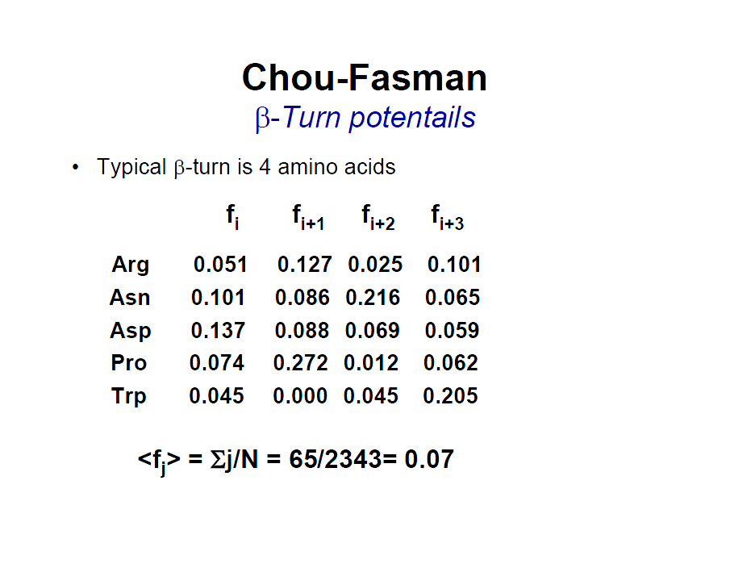

Slide 29
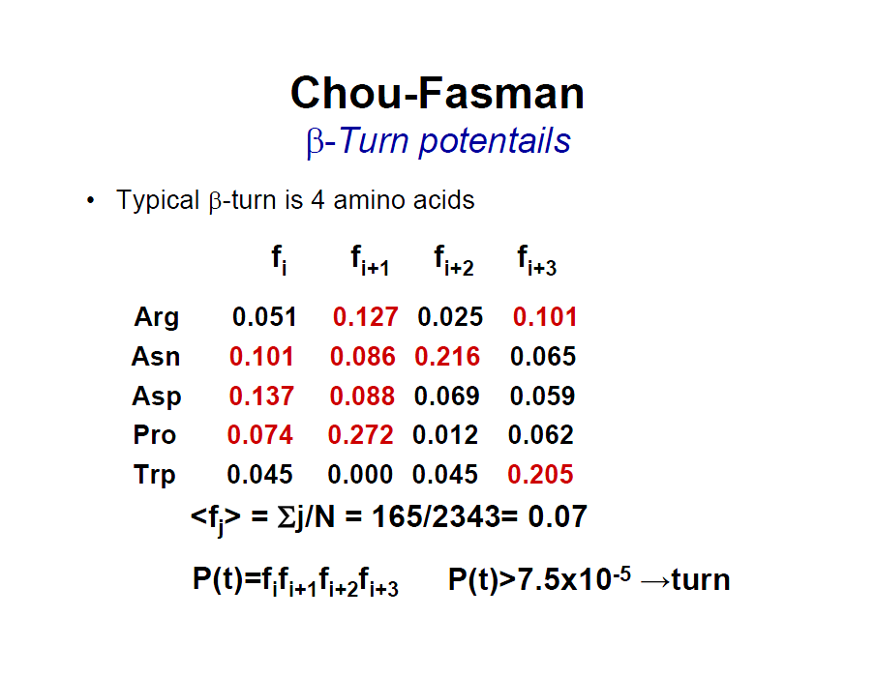

Slide 30
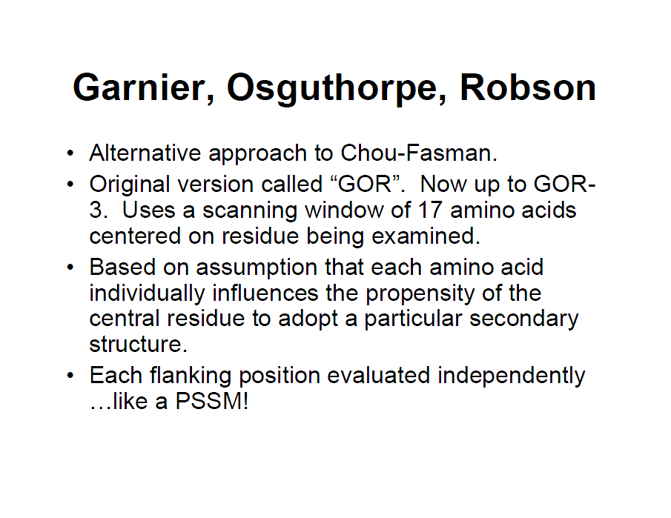

Slide 31
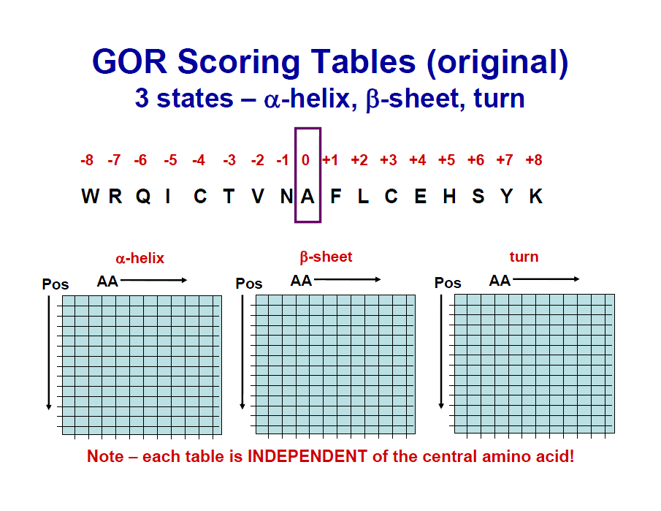

Slide 32
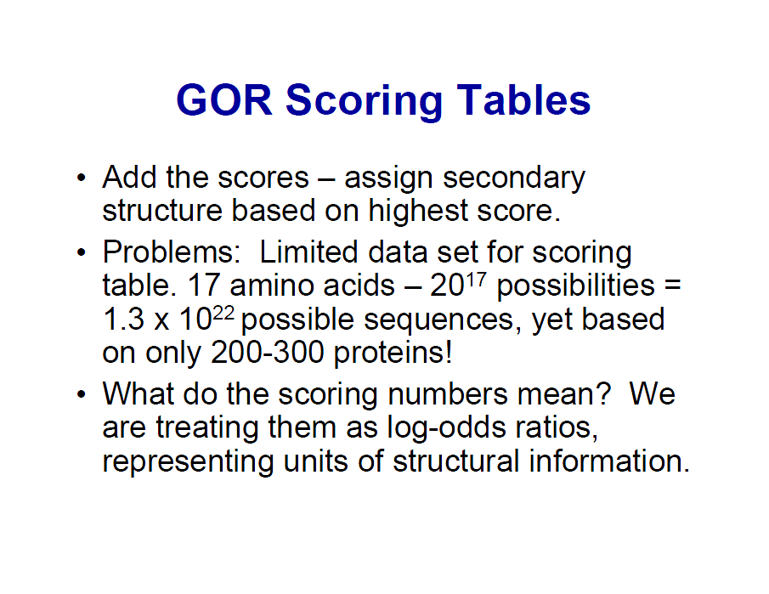

Slide 33
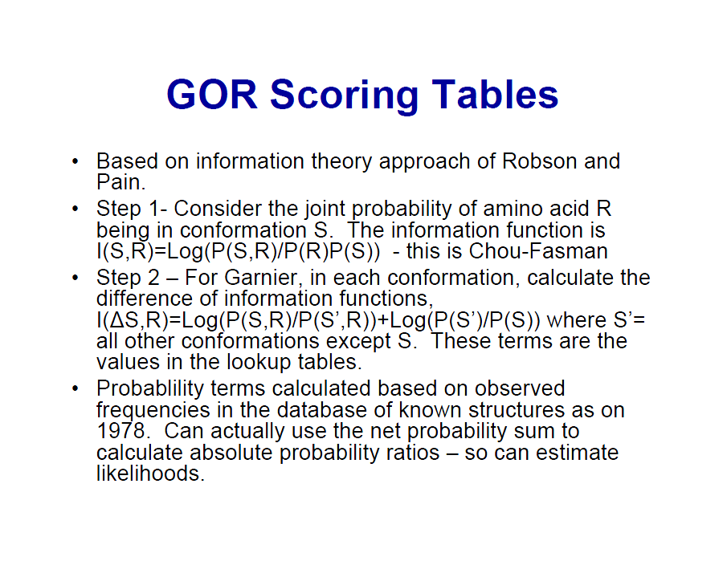

Slide 34
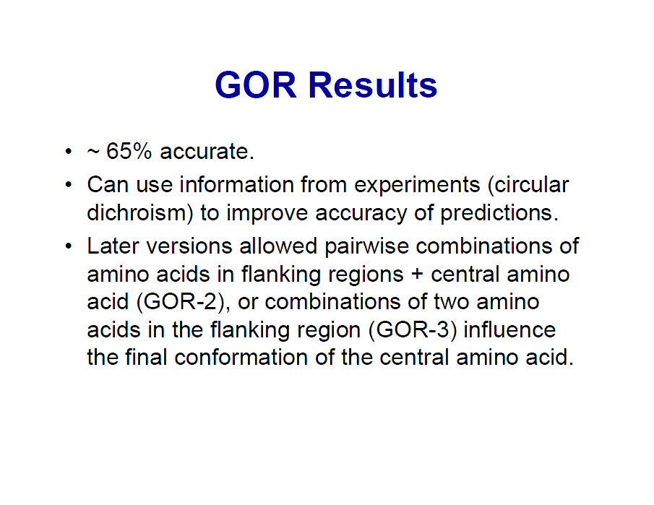

Slide 35
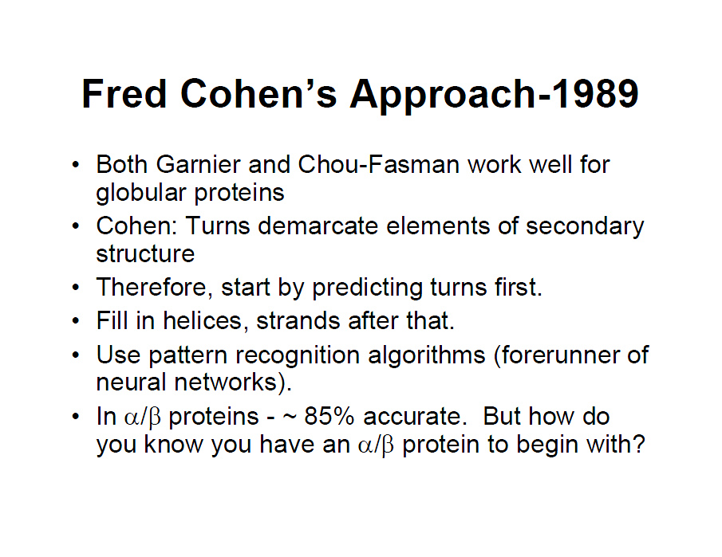

Slide 36
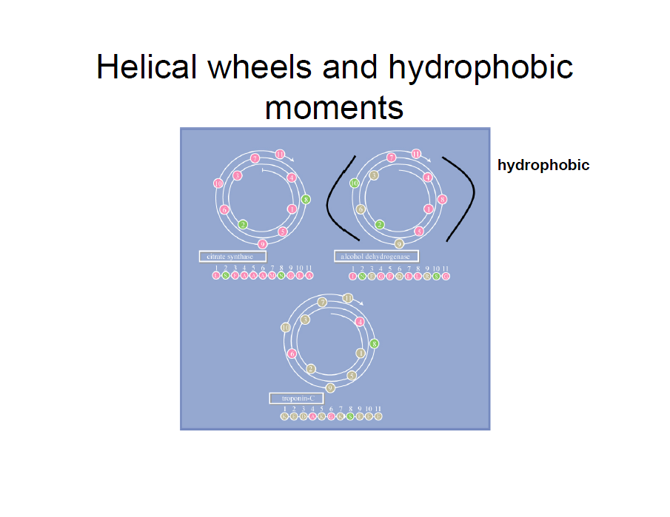

Slide 37
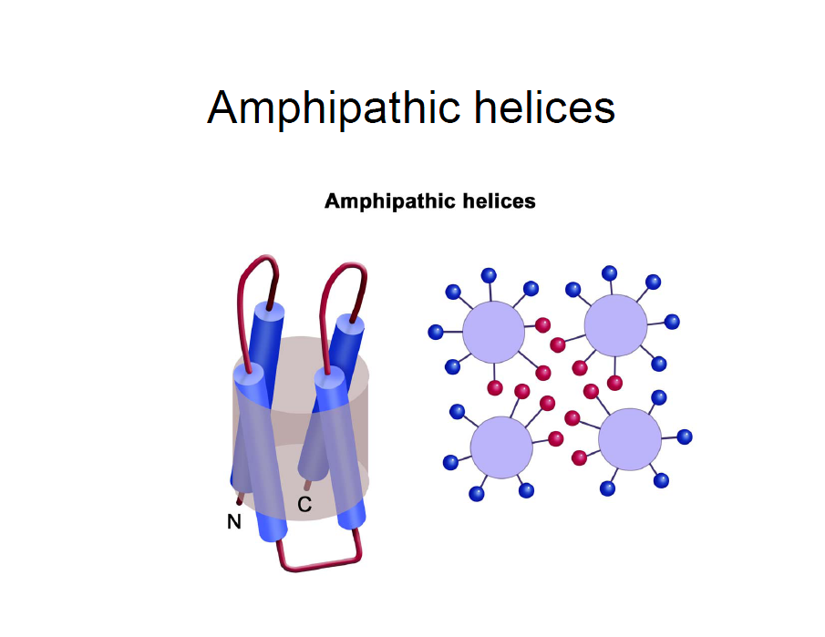

Slide 38
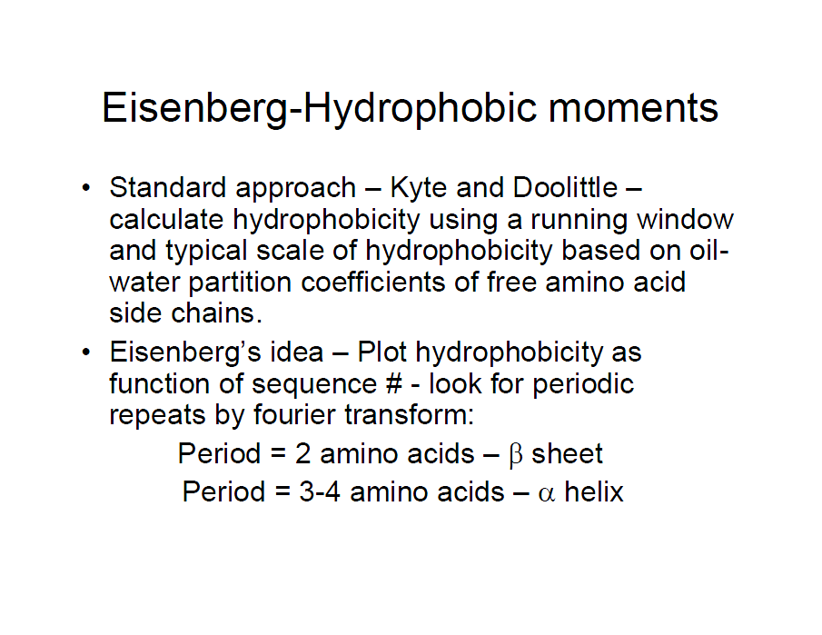

Slide 39
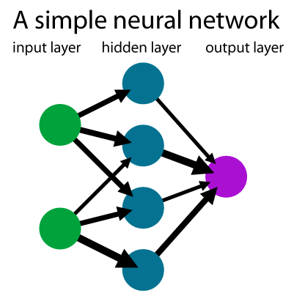

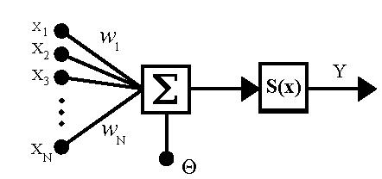

x_{i} jsou vstupy neuronu
w_{i} jsou synaptické váhy
Θ je práh
S(x) je přenosová funkce neuronu (někdy aktivační funkce)
Y je výstup neuronu
Velikost vah w_{i} vyjadřuje uložení zkušeností do neuronu. Čím je vyšší hodnota, tím je daný
vstup důležitější. V biologickém neuronu práh Θ označuje prahovou hodnotu aktivace neuronu.
Tzn. je-li menší než práh, neuron je v pasivním stavu.

Slide 40
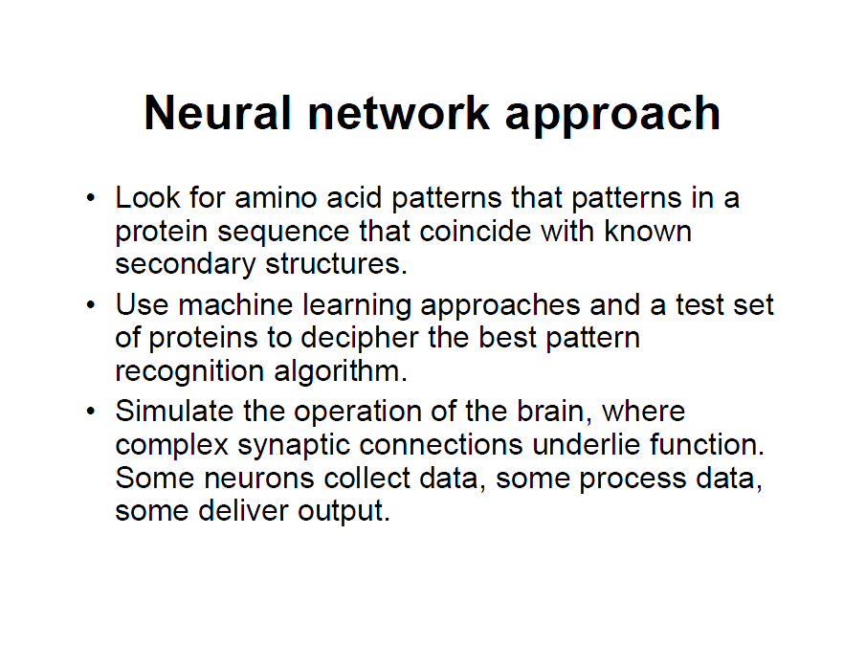

Slide 42
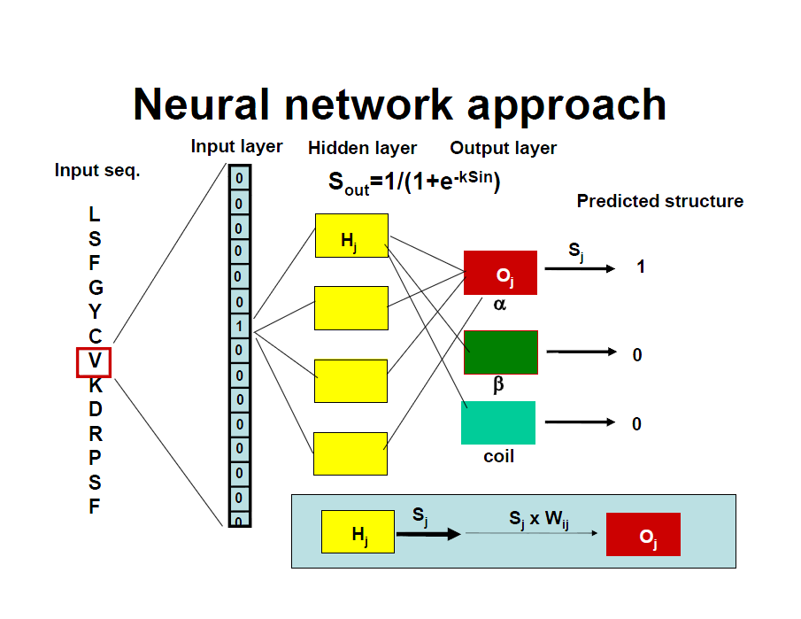

Slide 43
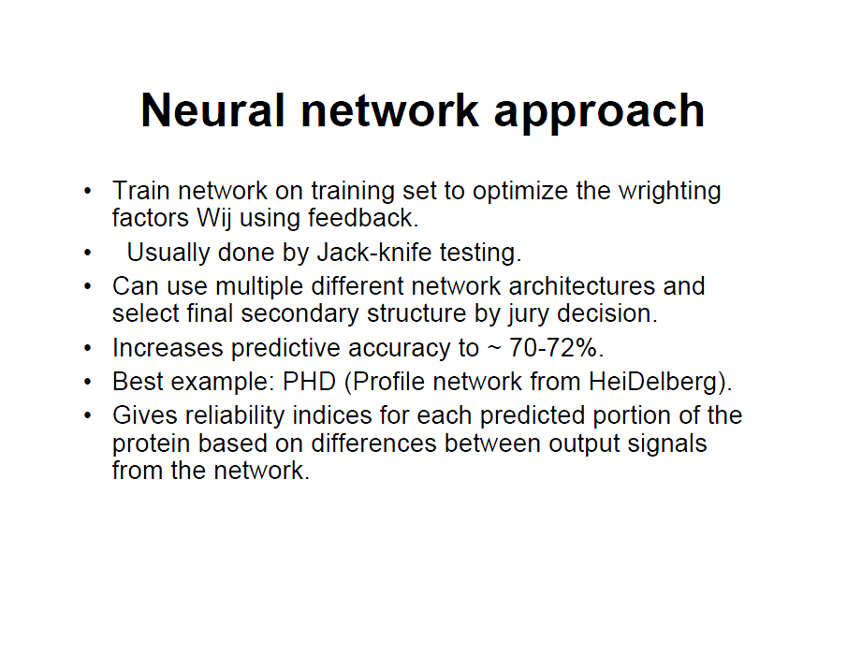

Slide 44
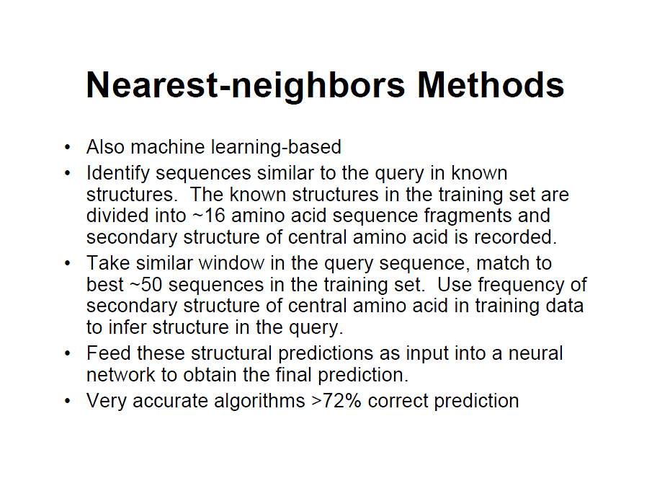

Slide 45
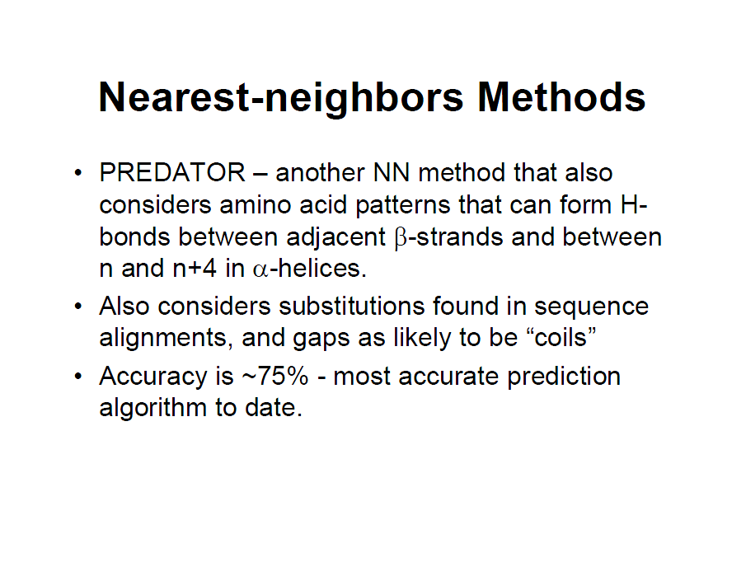

Slide 46
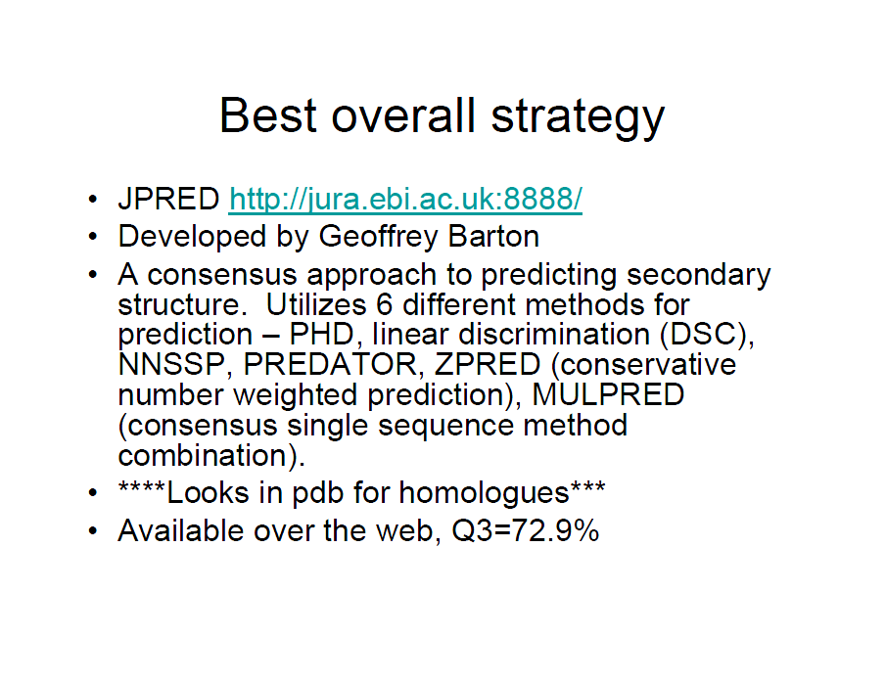

Slide 47
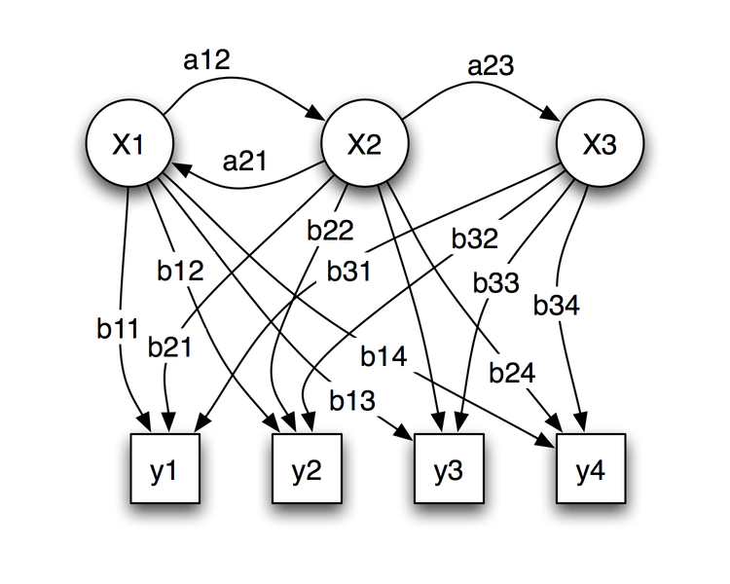
A hidden Markov model (HMM) is a statistical model in which the system being modeled is assumed to be
a Markov process with unobserved state. An HMM can be considered as the simplest dynamic Bayesian network.
In a regular Markov model, the state is directly visible to the observer, and therefore the state transition probabilities
are the only parameters. In a hidden Markov model, the state is not directly visible, but output dependent on the state
is visible.
Each state has a probability distribution over the possible output tokens. Therefore the sequence of tokens generated
by an HMM gives some information about the sequence of states. Note that the adjective 'hidden' refers to the state
sequence through which the model passes, not to the parameters of the model; Even if the model parameters are
known exactly, the model is still 'hidden'.
Hidden Markov models are especially known for their application in temporal pattern recognition such
as speech, handwriting, gesture recognition, part-of-speech tagging, musical score following, partial discharges and
bioinformatics.
Probabilistic parameters of a hidden Markov model
x — states
y — possible observations
a — state transition probabilities
b — output probabilities

Slide 48
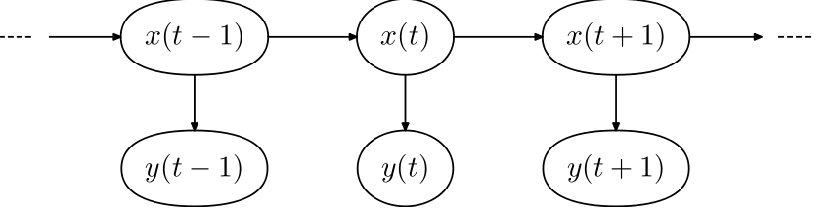
The diagram below shows the general architecture of an instantiated HMM. Each oval shape
represents a random variable that can adopt any of a number of values. The random variable
x(t) is the hidden state at time t (with the model from the above diagram, x(t) ∈ { x₁, x₂, x₃ }).
The random variable y(t) is the observation at time t (y(t) ∈ { y₁, y₂, y₃, y₄ }). The arrows in
the diagram (often called a trellis diagram) denote conditional dependencies.
From the diagram, it is clear that the conditional probability distribution of the hidden
variable x(t) at time t, given the value of the hidden variable x(t − 1), depends only on
the value of the hidden variable x(t − 1): the values at time t − 2 and before have
no influence. This is called the Markov property. Similarly, the value of the observed
variable y(t) only depends on the value of the hidden variable x(t) (both at time t).

Slide 49
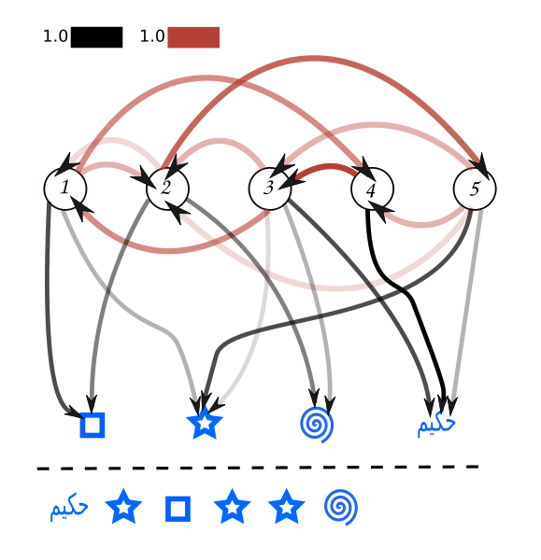
The observation sequence above can be produced by the following state sequences.
5 3 2 5 3 2
5 3 1 2 1 2
4 3 2 5 3 2
4 3 1 2 1 2
3 1 2 5 3 2
Transition and observation probabilities are indicated by the line opacity.

Slide 50

Probability of an observed sequence
The probability of observing a sequence
of length L is given by
where the sum runs over all possible hidden-node sequences
Brute-force calculation of P(Y) is intractable for most real-life problems, as the number
of possible hidden node sequences is typically extremely high and scales exponentially
with the length of the sequence. The calculation can however be sped up enormously
using the forward algorithm ^{[1]} or the equivalent backward algorithm.

Slide 51
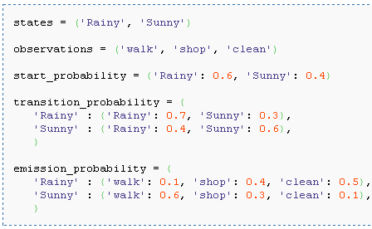
A concrete example
Consider two friends, Alice and Bob, who live far apart from each other and who talk
together daily over the telephone about what they did that day. Bob is only interested in
three activities: walking in the park, shopping, and cleaning his apartment.
The choice of what to do is determined exclusively by the weather on a given day.
Alice has no definite information about the weather where Bob lives, but she knows
general trends. Based on what Bob tells her he did each day, Alice tries to guess what
the weather must have been like.
Alice believes that the weather operates as a discrete Markov chain. There are two states,
"Rainy" and "Sunny", but she cannot observe them directly, that is, they are hidden from her.
On each day, there is a certain chance that Bob will perform one of the following activities,
depending on the weather: "walk", "shop", or "clean". Since Bob tells Alice about his
activities, those are the observations. The entire system is that of a hidden Markov
model (HMM).
Alice knows the general weather trends in the area, and what Bob likes to do on average.
In other words, the parameters of the HMM are known. They can be written down in the
Python programming language:

Slide 52
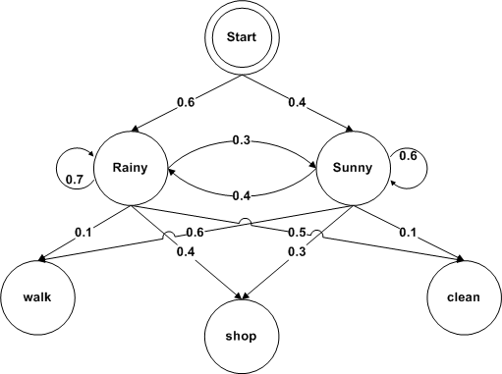
In this piece of code, start_probability represents Alice's belief about which state the HMM
is in when Bob first calls her (all she knows is that it tends to be rainy on average).
The particular probability distribution used here is not the equilibrium one, which is
(given the transition probabilities) actually approximately {'Rainy': 0.571, 'Sunny': 0.429}.
The transition_probability represents the change of the weather in the underlying
Markov chain. In this example, there is only a 30% chance that tomorrow will be sunny
if today is rainy. The emission_probability represents how likely Bob is to perform a certain
activity on each day. If it is rainy, there is a 50% chance that he is cleaning his apartment;
if it is sunny, there is a 60% chance that he is outside for a walk.

