Slide 1
Predicting protein disorder

Slide 2
Why do we want to predict disorder ?
Gap in knowledge (460 vs. thousands of IUPs)
Structural genomics initiatives
Bioinformatics studies
Single protein studies

Slide 3
How do we know disorder is prevalent ?
Heat-resistance of proteins (20% in Jurkat cells)
Low-complexity regions (25% in SwissProt)
Bioinformatics studies (12% in humans)

Slide 4
Prediction: classification problem
We look for the relationship of input data and a property, which is a function with free parameters
Input
Method
sequence
propensity vector
alignment (profile)
interaction energies
statistical methods
machine learning
structural approach
Output (property)
Assessment
binary
score
DisProt
PDB

Slide 5
Three basic approaches
Simple statistics
Machine learning
Structural approach

Slide 6
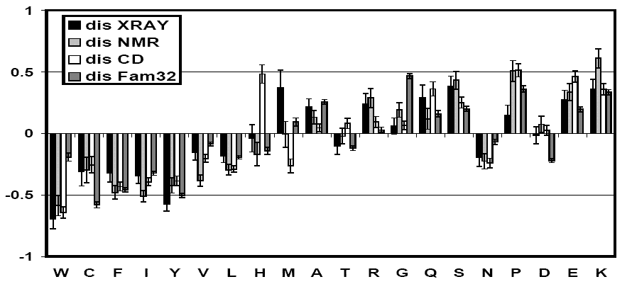
The unusual AA composition of IDPs
order-promoting
disorder-promoting
Dunker et al. (2001) J. Mol. Graph. Model. 19, 26

Slide 7
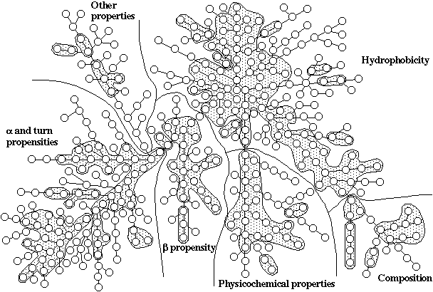
AA feature space: AAindex database http://www.genome.jp/aaindex
A number is associated with every amino acid, which quantitatively describes how characteristic the given feature is to the AA (has 517 different scales at present)

Slide 8
Two things you might not want to do…
1) SEG: low complexity regions

Slide 9
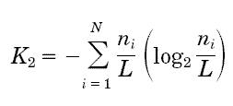
Sequence complexity (SEG)
Sequence databases contain a lot of regions in which only a few amino acids occur (simple), or some dominate (biased), this can be described by an entropy function - Wootton (1993)
Shannon`s entropy
L > 20; window size,
N alphabet size (20),

Slide 10
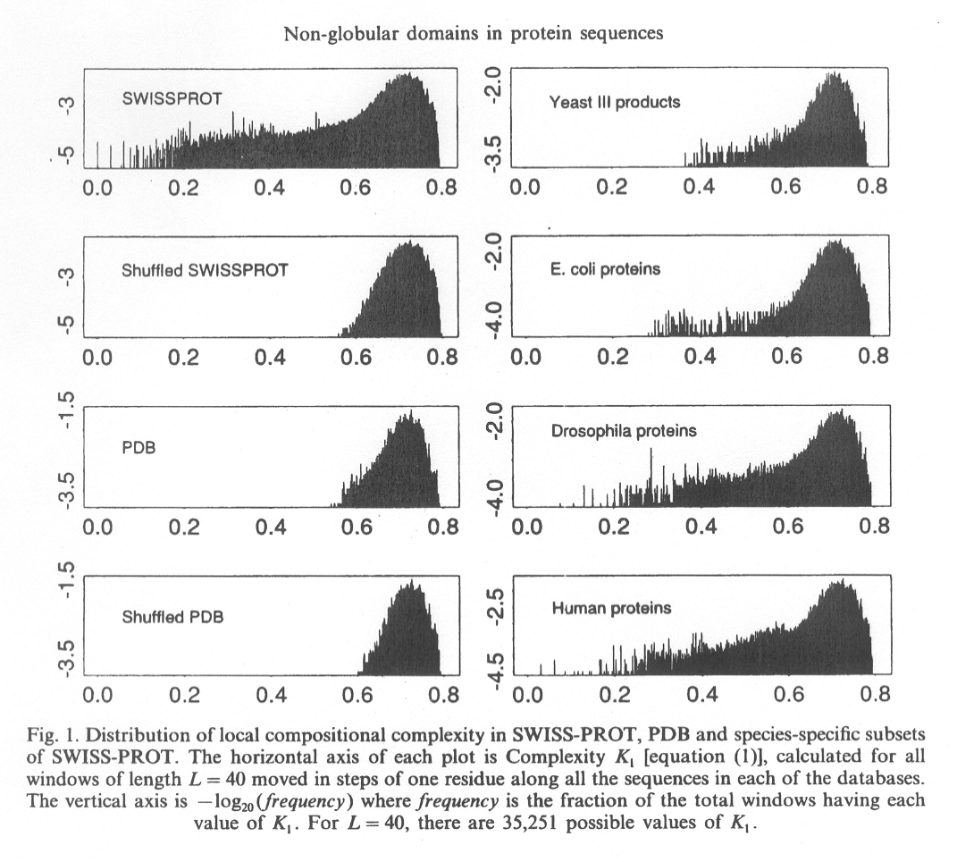
Low-complexity regions in proteins
Wootton (1994) Comp. Chem. 18, 269

Slide 11
…may correspond to disorder
>SRY_MOUSE TRANSCRIPTIONAL ACTIVATOR
1-143 MEGHVKRPMNAFMVWSRGERHKLAQQNPSM QNTEISKQLGCRWKSLTEAEKRPFFQEAQR LKILHREKYPNYKYQPHRRAKVSQRSGILQ PAVASTKLYNLLQWDRNPHAITYRQDWSRA AHLYSKNQQSFYWQPVDIPTGHL
qqqqqqqqqqqfhnhhqqqqqfydhhqqqq 144-366
qqqqqqqqfhdhhqqkqqfhdhhqqqqqfh
dhhhhhqeqqfhdhhqqqqqfhdhqqqqqq
qqqqqfhdhhqqkqqfhdhhhhqqqqqfhd
hqqqqqqfhdhqqqqhqfhdhpqqkqqfhd
hpqqqqqfhdhhhqqqqkqqfhdhhqqkqq
fhdhhqqkqqfhdhhqqqqqfhdhhqqqqq
qqqqqqqqfhdqq
367-395 LTYLLTADITGEHTPYQEHLSTALWLAVS

Slide 12
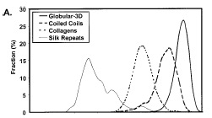
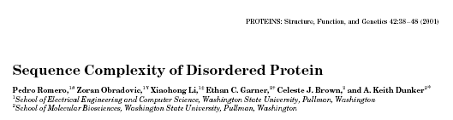
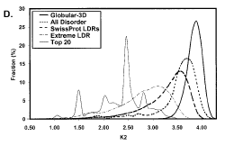
The relationship of low complexity and disorder

Slide 13
Two things you might not want to do…
2) NORSp: regions w/o secondary structure
NORSp - predictor of NOn-Regular Secondary Structure

Slide 14
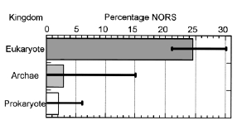
NORSp seems to capture disorder…
NORSp:
1) uses PSI-BLAST to generate a sequence profile
2) predicts secondary structure and solvent accessibility by PROFphd
3) predicts transmembrane helices by PHDhtm
4) predicts coiled coils by COILS
5) combines info and merges overlapping regions
LDR (40<) protein, %
60
E
40
20
A
B
0
Domain of life

Slide 15
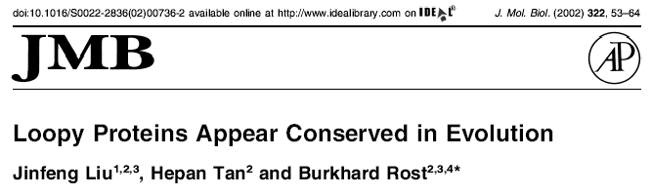
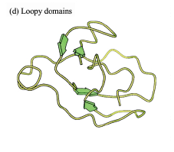
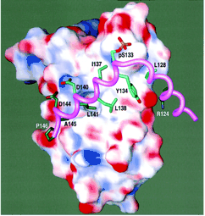
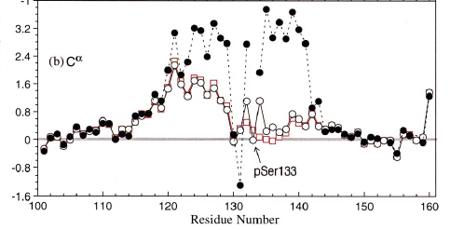
…but there are globular proteins without and IDPs with secondary structure
CREB KID
1tbi
Radhakrishnan (1997) Cell 91, 741
Radhakrishnan (1998) FEBS Lett. 430, 317

Slide 16
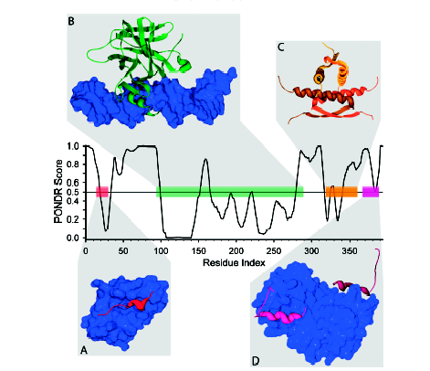
Tumor suppressor p53
Uversky et al. (2005) J. Mol. Recogn. 18, 343

Slide 17
1) Simple statistics

Slide 18
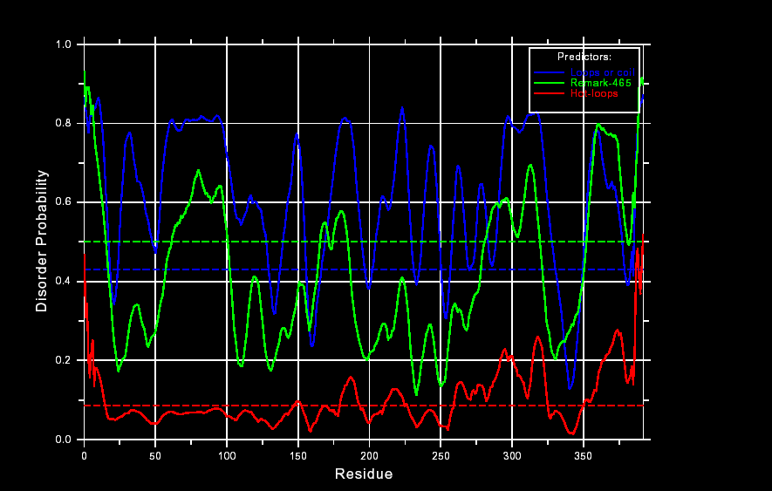
DisEMBL (single parameter)
p53
remark 465
remark 465:
missing from PDB
coil
hot loops

Slide 19
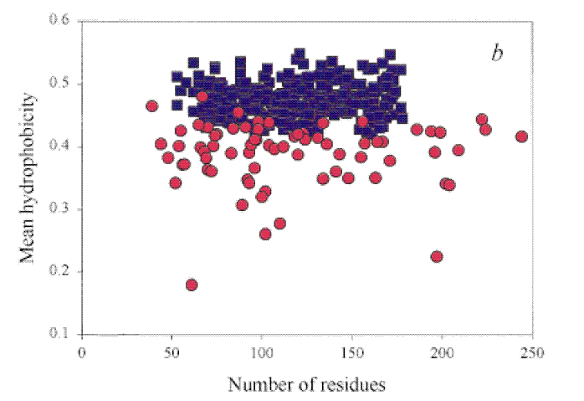
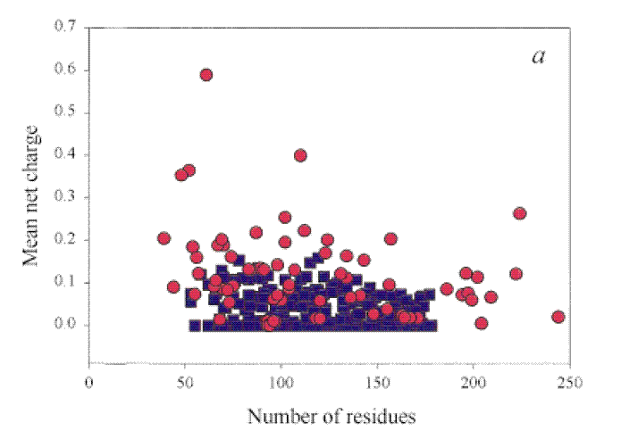
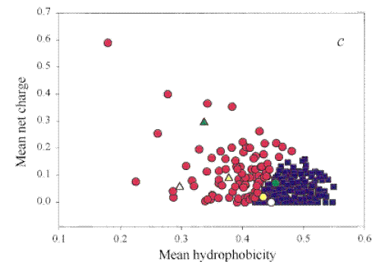
Uversky plot: charge-hydrophobicity (two parameters)
Mean net charge
Mean hydrophobicity
Uversky (2002) Eur. J. Biochem. 269, 2

Slide 20
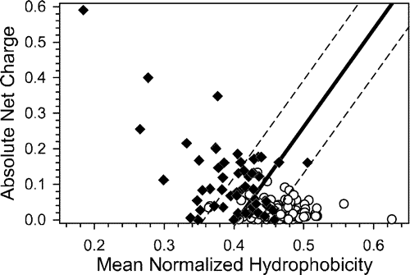
Uversky plot: a little improved
Oldfield (2005) Biochemistry 44, 1989

Slide 21
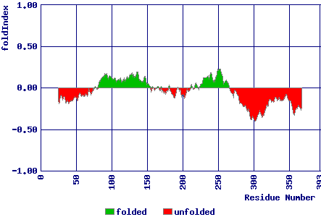
Making it position specific: FoldIndex
p53
Prilusky (2005) Bioinformatics 21, 3435

Slide 22
3) Input vector of features, machine learning…
2) Machine learning

Slide 23
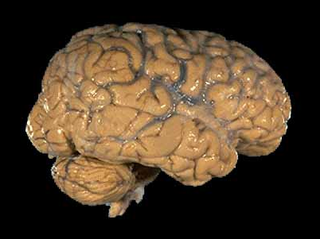
Artificial neural network (NN)
input
score

Slide 24
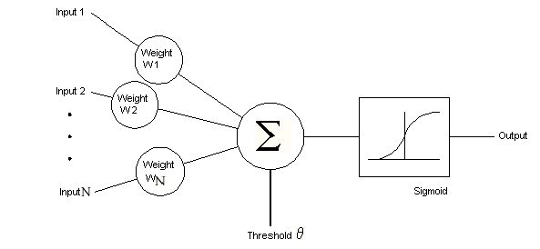

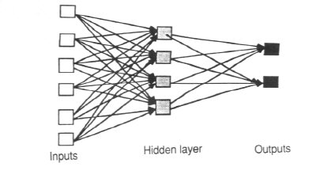
Artificial neural networks
Basic unit: a neuron
Hidden layer
training
ordered
disordered

Slide 25
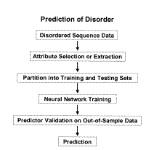
Predictor of naturally disordered regions (PONDR®)
Input
18 amino acids
Hydrophobicity
Sequence complexity
VL2, VL3
VLXT
VSL2

Slide 26
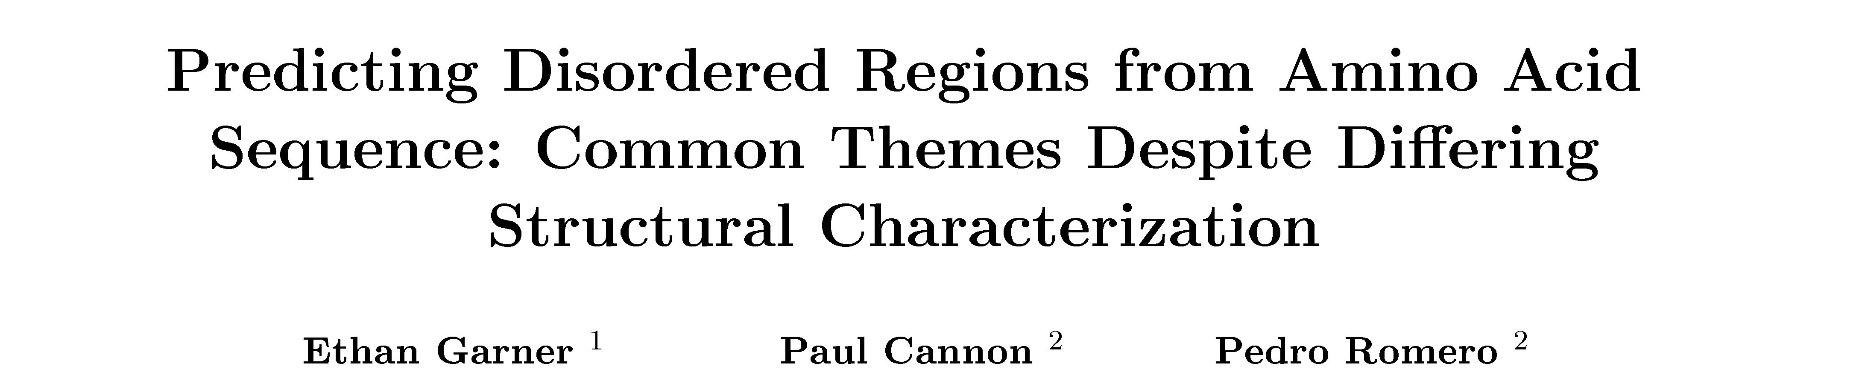

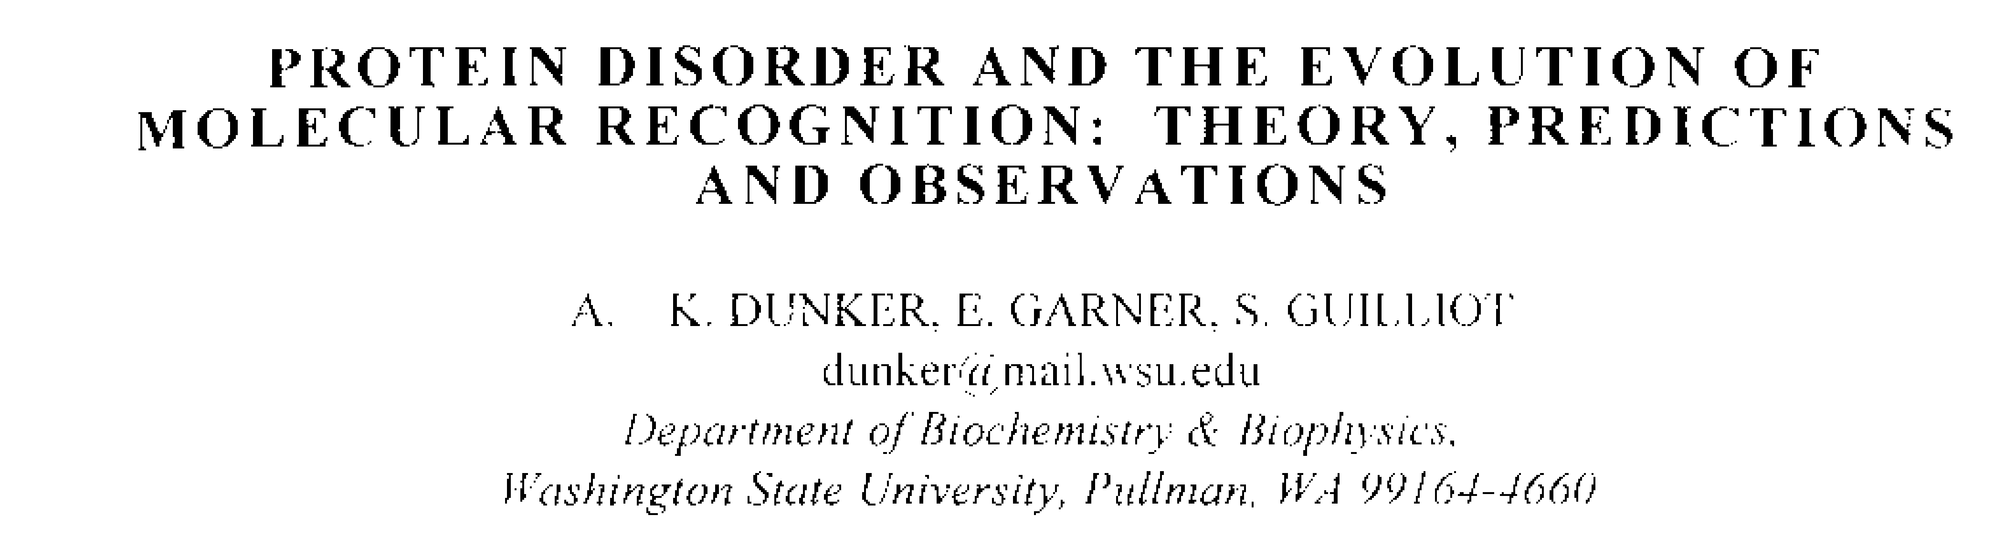
Dunker, 1998

Slide 27
Tumor suppressor p53
Uversky et al. (2005) J. Mol. Recogn. 18, 343

Slide 28
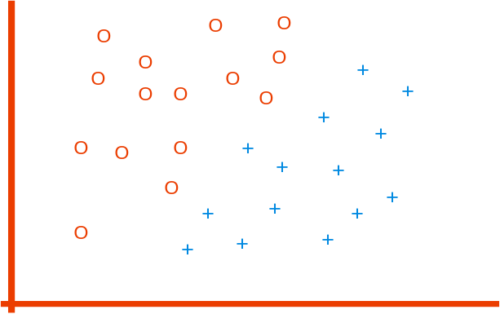
Support vector machine (SUV)
f(x,w,b) = sign (w,x – b)
f(x,w,b) = sign (w,x – b)
How would you classify this data?
But which is best?
f(x,w,b) = sign (w,x – b)
Support vectors
against which the
margin pushes up
This is the simplest
SVM, the linear SVM
(LSVM)
The maximum margin linear classifier is considered best

Slide 29
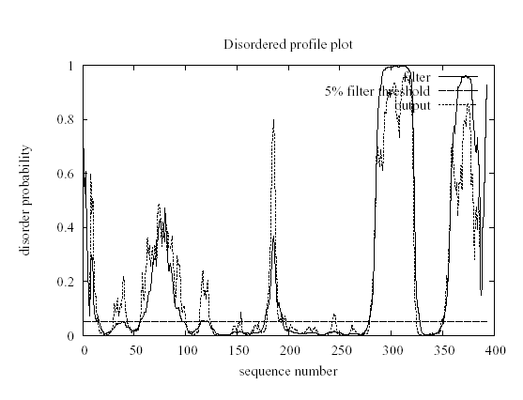
DISOPRED 2 (input: missing X-ray, alignment)
p53
45

Slide 30
3) Structural approach (interaction potential)

Slide 31
The protein non-folding problem
Protein folding problem
How does amino acid sequence determine protein structure ?
Protein non-folding problem
How does amino acid sequence determine the lack of protein structure ?

Slide 32
The protein non-folding problem
Globular proteins have special sequences that enable the formation of a large number of favorable interactions
IDPs contain (disorder-promoting) amino acids, which tend to avoid interacting with each other.
An IDP thus cannot fold into a low-energy conformation.

Slide 33
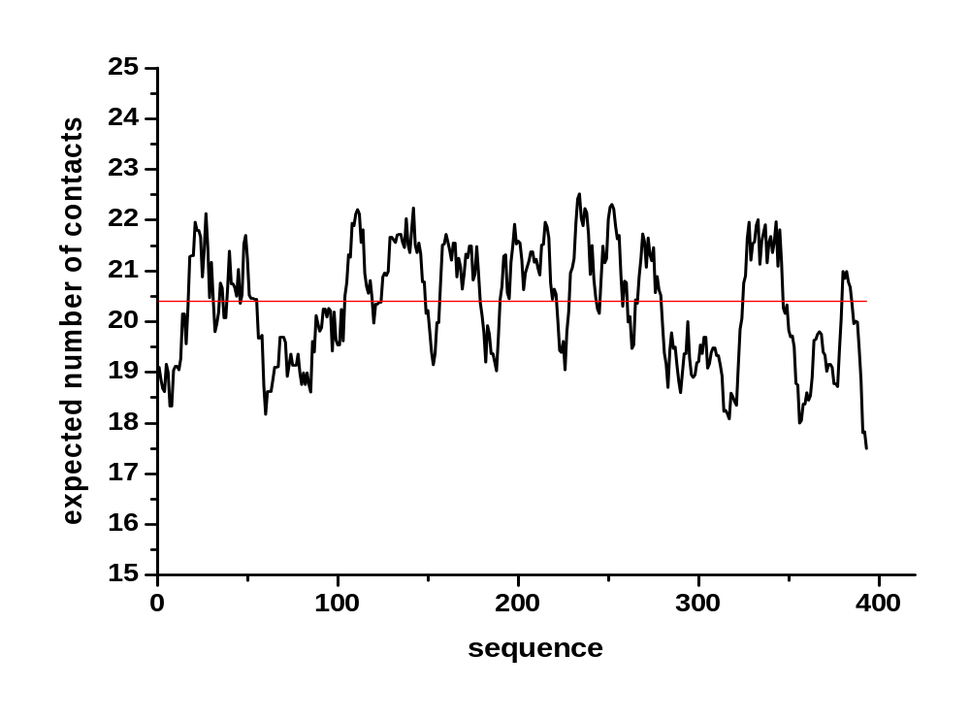
A simple implementation, FoldUnfold
Calculates the contact number of amino acids
Calculates the contact number of amino acids
p53

Slide 34
Estimating the total pairwise interresidue interaction energy of a sequence: IUPred
1) Calculate interresidue interaction energies from structure
2) Try to estimate the energy without knowing the structure
3) Apply the estimation to sequences w/o structure (e.g. to IDPs, which have no structure)

Slide 35
Estimating the total pairwise interresidue interaction energy of a sequence: IUPred
Statistical potentials
Interactions that occur more frequently are probably more favorable
Take logarithm of frequency
  It is an energy-like feature

Slide 36
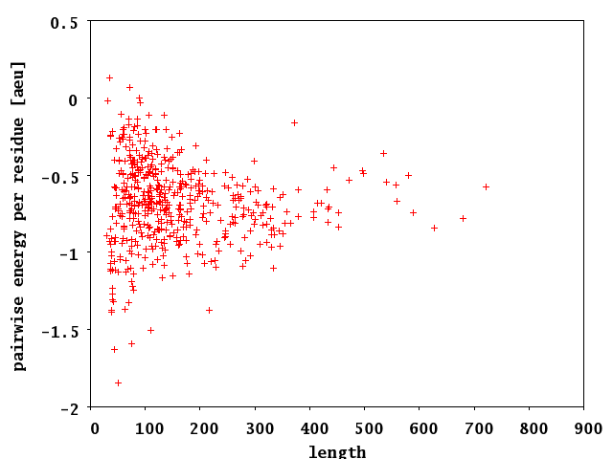
Interresidue interaction energy calculated for known structures
Dosztanyi (2005) J. Mol. Biol. 347, 827

Slide 37
How to estimate the interresidue interaction energy of a protein of unknown structure or w/o structure?
Structure
MODEL 1
ATOM 1 N MET A 23 2.191 28.312 -4.381
ATOM 2 CA MET A 23 2.394 27.327 -3.305
ATOM 3 C MET A 23 3.514 26.377 -3.706
ATOM 4 O MET A 23 3.589 25.977 -4.867
Calculated energy per residue
Sequence
MKVPPHSIEA EQSVLGGLML
DNERWDDVAE RVVADDFYTR
PHRHIFTEMA RLQESGSPID
LITLAESLER QGQLDSVGGF
AYLAELSKNT PSAANISAYA
DIVRERAVVR EMIS
?
Estimated energy per residue

Slide 38
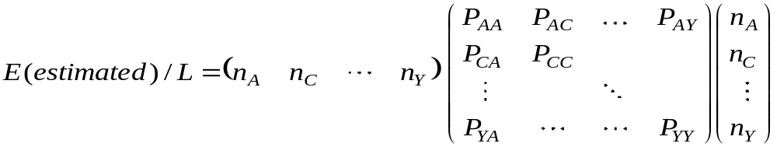
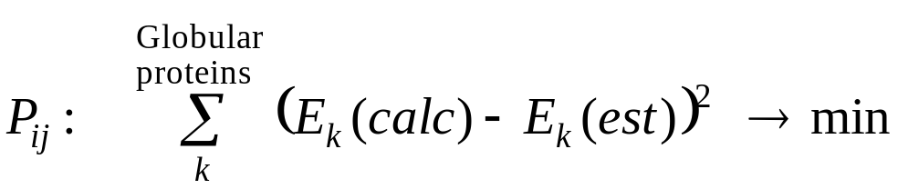
Estimation of pairwise interresidue interaction energy from sequence
The contribution of individual AAs depends on its potential partners, i.e. its neighborhood. A quadratic formula is needed to take this into consideration.
The relationship between AA composition and energy is given by an optimized 20x20 energy predictor matrix, P_{ij}

Slide 39
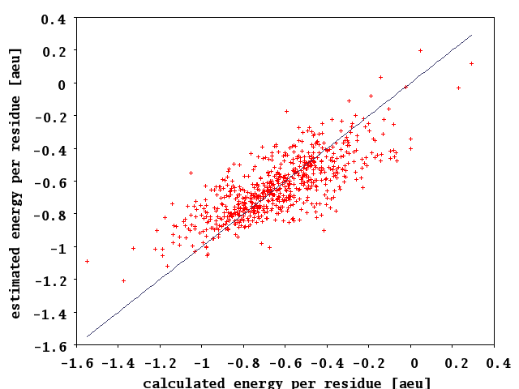
Correlation of calculated and estimated interaction energies
Corr. coeff. 0.74
Dosztanyi (2005) J. Mol. Biol. 347, 827

Slide 40
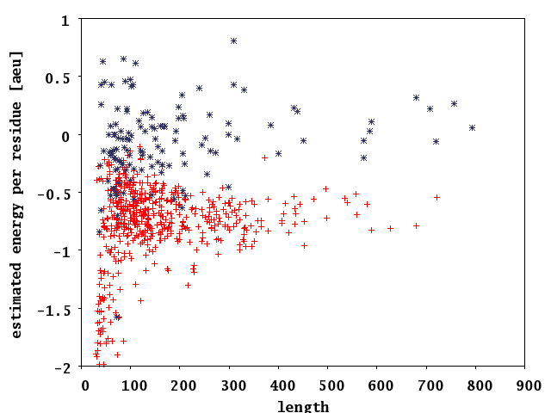
The estimated energy for globular proteins and IDPs
IDP
GLOB
Dosztanyi (2005) J. Mol. Biol. 347, 827

Slide 41
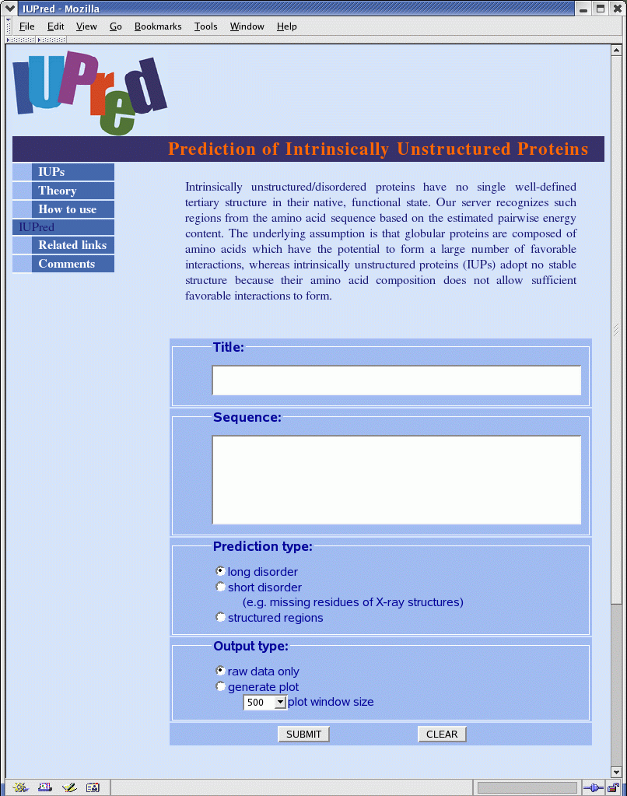
Making it position-specific: the IUPred algorithm
IUPred: http://iupred.enzim.hu

Slide 42
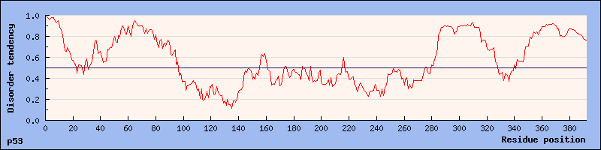
IUPred, p53

Slide 43
4) A new development: distinguishing
long from short disorder

Slide 44
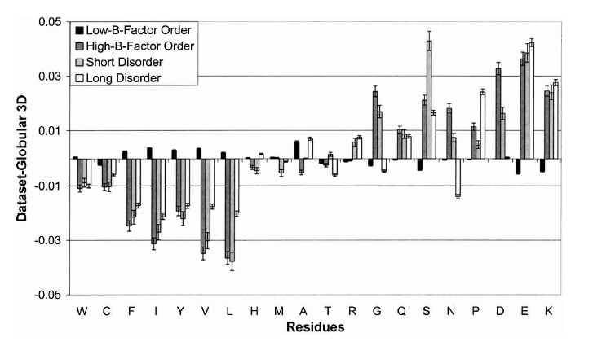
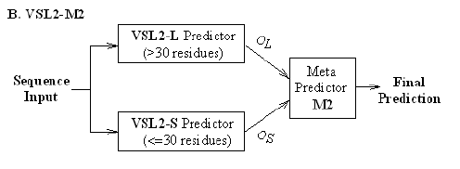
PONDR VSL2: short vs. long disorder
Radivojac (2004) Prot. Sci. 13, 71
Peng (2006) BMC Bioinfo. 7, 208

Slide 45
Which is the best predictor ?
The CASP experiment
Means two things at least:
  how user friendly it is (e-mail return, graphic output, downloadable, speed, scriptable, can be parametrized)
  how accurately it predicts disorder
Cannot be answered in general, because
  binary or continuous
  different kinds of disorder
  short and long disorder
  problems with disordered protein data
  number of glob. vs IUP residues
  not clear how to evaluate

Slide 46
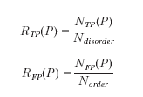


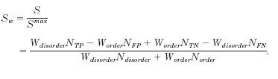
Evaluation criteria in CASP6
Receiver operating characteristic
(ROC) curve and its integral
(S_{roc})
Sensitivity, specifity
and their ratio
(Q2)
Weighted score of sensitivity an specifity (S_{w})

Slide 47
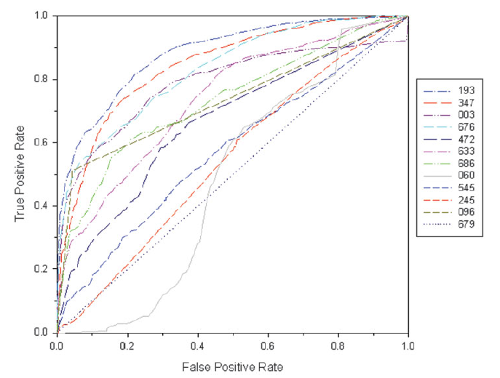
ROC curves in CASP6
DRIPpred
PONDR
IUPred
DISOPRED

Slide 48
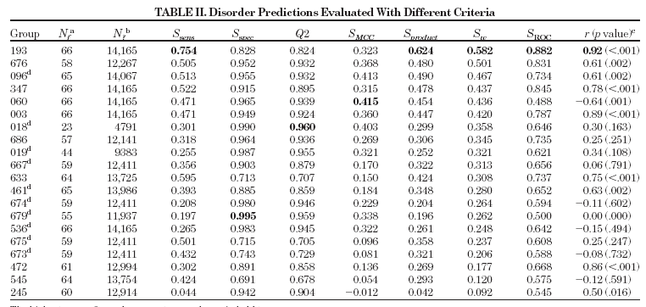
Overall evaluation in CASP6
PONDR
IUPred
DRIPpred
DISOPRED
DISpro

Slide 49
Why do we want to predict disorder ?
Gap in knowledge (460 vs. thousands of IUPs)
Structural genomics initiatives
Bioinformatics studies
Single protein studies

Slide 50
1) Protein disorder: an evo. success-story
LDR (40<) protein, %
60
E
40
A
20
B
0
kingdom
Tompa et al. (2006) J. Proteome Res. 5, 1996

Slide 51
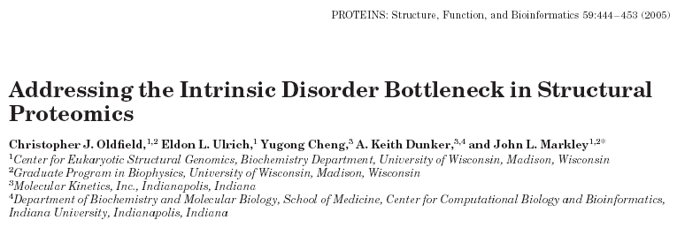
2) Structural genomics:filtering for disorder helps
Center for Eukaryotic Structural Genomics (CESG) targets
  retrospective prioritization by PONDR (71 targets)
  evaluation by considering HSQC fingerprinting
  modest increase of viable targets (36% to 41%)

Slide 52
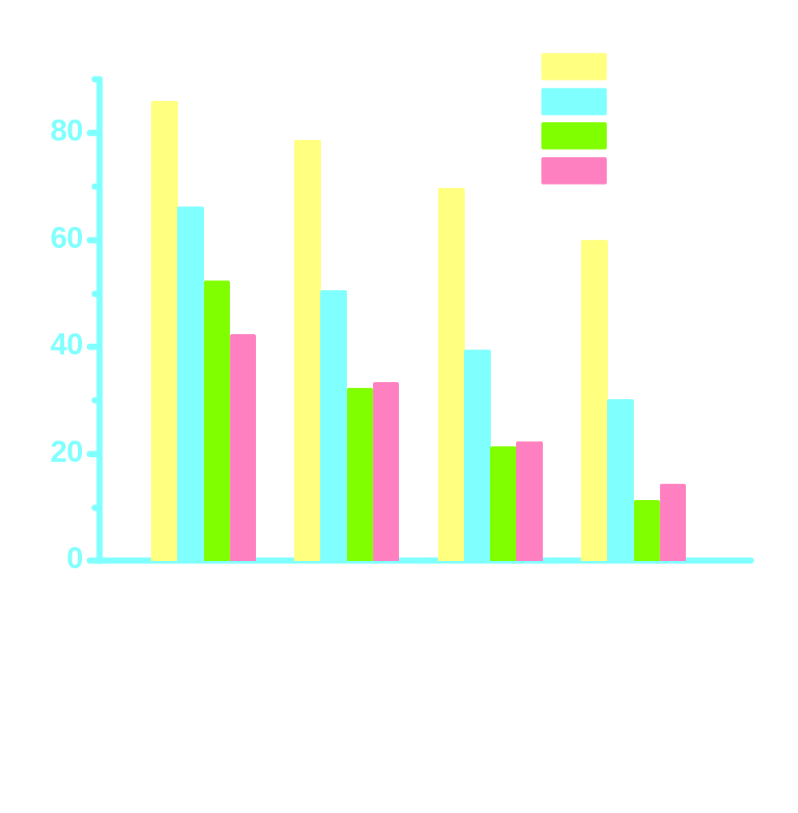
3) Bioinformatics studies: disorder prevails in regulatory proteins
regulatory
signaling
biosynthetic
metabolic
protein (%)
30< 40< 50< 60 <
length of disordered region
Iakoucheva et al. (2002) J. Mol. Biol. 323, 573

Slide 53
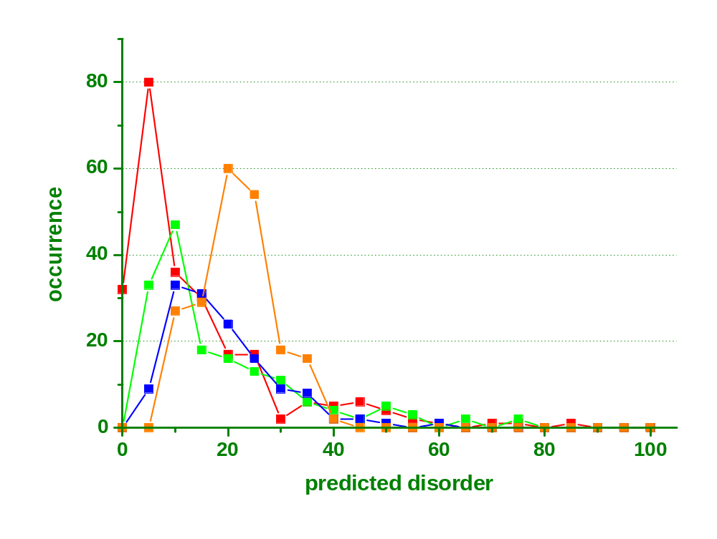
3) Bioinformatic studies: disorder correlates with complex size
single
11-100
2-4
5-10
Hegyi et al. (2007) BMC Struct. Biol. 7, 65

Slide 54
4) Single protein studies

