Slide 1
Motifs & Domains

Slide 2

Protein domains
Pairwise sequence comparison of proteins led to strange results
A domain is an independent folding unit
A domain is the next step up in complexity from a motif
There appear to be a limited number of folds (domains) that can be made from the 20 natural aa’s
Domain unit of evolution
Mixing and matching can create new function and regulation
Most proteins involved in cell signalling consist exclusively of small domains interspersed by linker regions. The linkers may be unstructured as described in the following section.

Slide 3
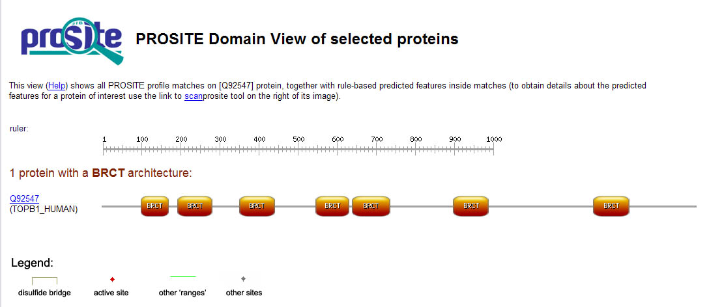
How proteins are made from domains.
Some proteins consist only of domains that have no enzymatic activity. It is thought that they function as scaffolds for specific complex formation.
SH3
SH3
GRB2
BRCT domains are a good example of divergent evolution. An ancient domain found in pro- and eukaryotes, it is characterised by a conserved fold despite significant sequence divergence. BRCTs are known to bind DNA and other proteins. Protein-protein interactions included self binding, binding BRCTs on other proteins, binding non-BRCT domains and binding to phosphoserine peptides.

Slide 4
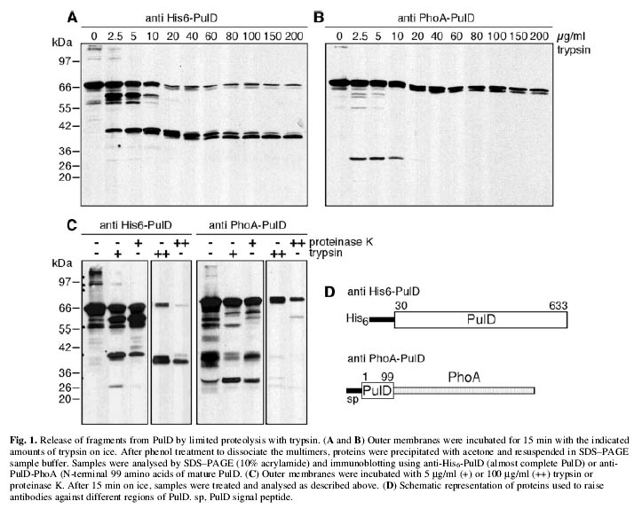
Determining Domain Structure by Limited Proteolysis

Slide 5
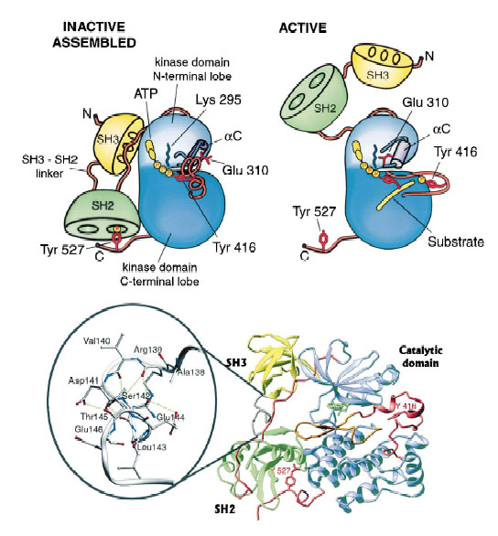
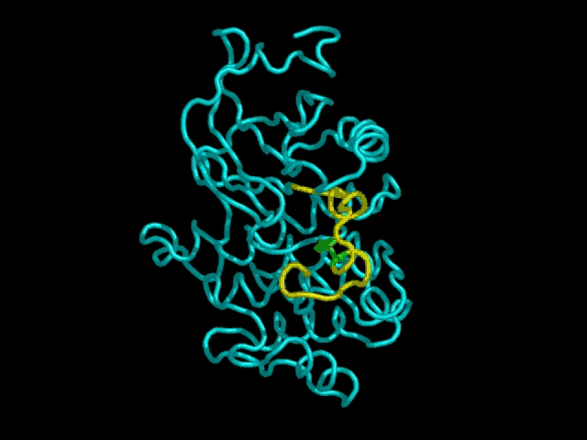
Protein regulation by coordinated action of domains
Having multiple domains in one protein can serve a variety of functions, one of which is illustrated here. The kinases, Src, Lck and Hck, all of which can cause aberrent growth signalling, are regulated by an internal Y phophorylation.
When Y527 is phosphorylated, SH2 and SH3 are “locked”, forcing lobes of kinase down and blocking access to the active site.
Young et al., 2001, Cell, v. 105, p.115

Slide 6
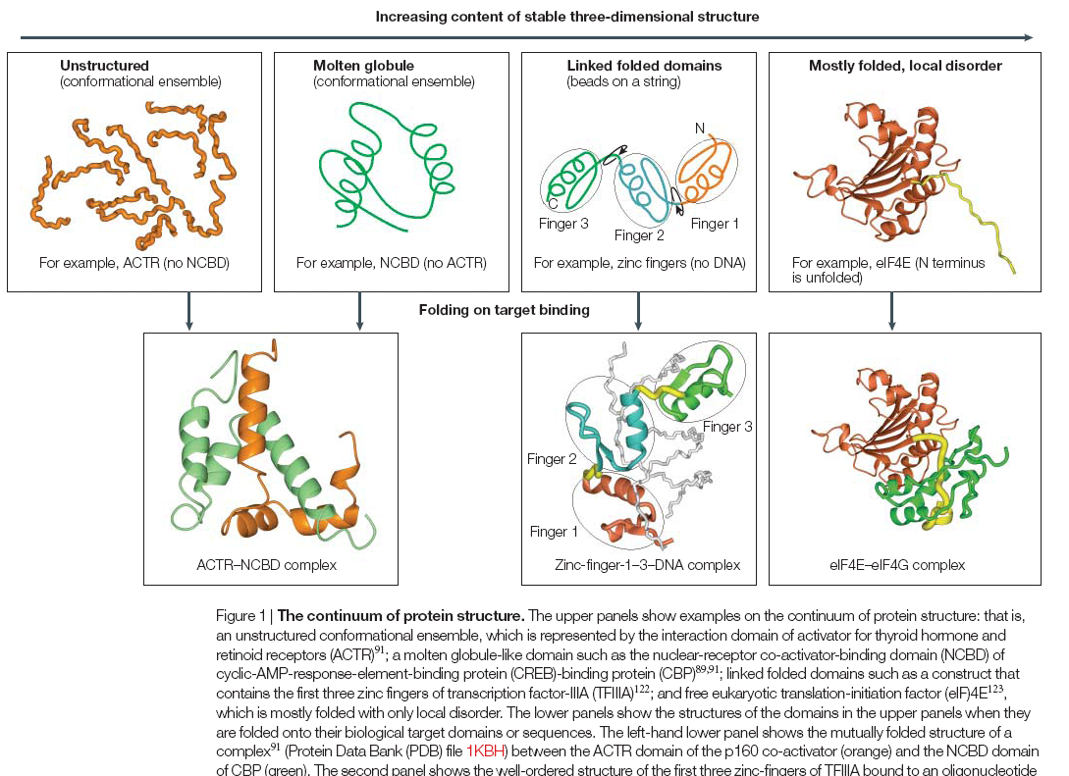
A continuum of protein structures

Slide 7
Motifs & Domains
Family is a set of sequences that are related (functionally/structurally).
Motif is a simple combination of a few secondary structures, that appear in several different proteins in nature.

Slide 8
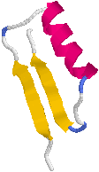
Motifs & Domains
A collection of motifs forms a domain.
Domain is a more complex combination of secondary structures, that is common in a family. It has a very specific function.
A protein may contain more than one domain.
Beta-Alpha-Beta motif
For further reading:
http://www.expasy.org/swissmod/course/text/chapter4.htm
http://www.ii.uib.no/~inge/talks/sverige00/sld003.htm

Slide 9
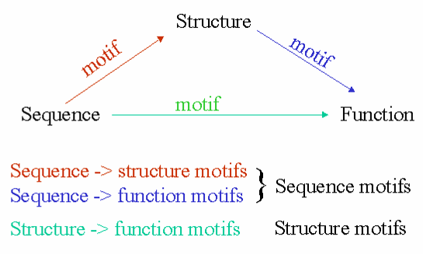
Motifs in Protein Analysis
http://www.ii.uib.no/~inge/talks/ebi-nov-99/sld009.htm

Slide 10
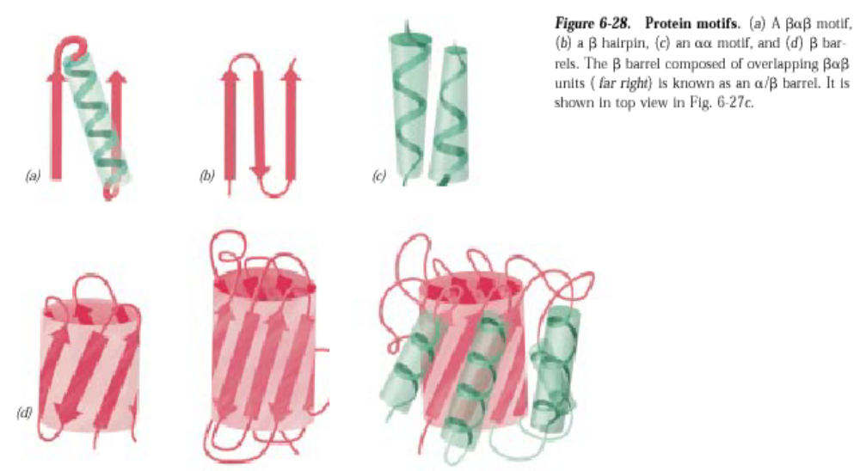
Grouping of Secondary Structures Elements -
Super-secondary Structures or Motifs
Motifs:
Certain arrangements of two or three consecutive secondary structural elements.
βαβ
β-hairpin
αα
β-barrels

Slide 11
Structural Alignment

Slide 12
Why structural alignment?
In evolutionary related proteins structure is much better preserved than sequence
Structural motifs may predict similar biological function
Getting insight into protein folding

Slide 13
Applications:
Classification of protein databases by structure
Search of partial and disconnected structural patterns in large databases
Comparison and detection of drug receptor active sites (structurally similar receptor cavities could bind similar drugs)
Similar substructures in drugs acting on a given receptor

Slide 14
The superimposition pattern is unknown – pattern discovery
The matching recovered can be inexact
We are not necessarily looking for the largest superimposition, since other matching may have biological meaning

Slide 15
Human Myoglobin pdb:2mm1
Human Hemoglobin alpha-chain pdb:1jebA
Sequence id: 27%
Structural id: 90%

Slide 16
What is the best transformation that
superimposes the unicorn on the lion?

Slide 17
Solution:
Regard the shapes as sets of points
and try to “match”
these sets using a transformation

Slide 18
This is not a good result….

Slide 19
Good result:

Slide 20
Kinds of transformations:
Rotation
Translation
Scaling
and more….

Slide 21
Translation:
Y
X

Slide 22
Rotation:
Y
X

Slide 23
Scale:
Y
X

Slide 24
We represent a protein as a geometric object in the plane.
The object consists of points represented by coordinates (x, y, z).
Lys
Met
Gly
Thr
Glu
Ala

Slide 25
The aim:
Given two proteins
Find the transformation that produces the best Superimposition of one protein onto the other

Slide 26
Correspondence is Unknown
Given two configurations of points in the three dimensional space:
+

Slide 27
find those rotations and translations of one of the point sets which produce “large” superimpositions of corresponding 3-D points
?

Slide 28
The best transformation:
T

Slide 29
Simple case – two closely related proteins with the same number of amino acids.
+
Question:
how do we asses the quality of the transformation?

Slide 30
Scoring the Alignment
Two point sets: A={a_{i}} i=1…n
B={b_{j}} j=1…m
Pairwise Correspondence:
(a_{k1},b_{t1}) (a_{k2},b_{t2})… (a_{kN},b_{tN})
(1) Bottleneck max ||a_{ki} – b_{ti}||
(2) RMSD (Root Mean Square Distance)
Sqrt( Σ||a_{ki} – b_{ti}||²/N)

Slide 31
RMSD – Root Mean Square Deviation
Given two sets of 3-D points :
P={p_{i}}, Q={q_{i}} , i=1,…,n;
rmsd(P,Q) = √ Σ _{i}|p_{i} - q_{i} |² /n
Find a 3-D transformation T* such that:
rmsd( T*(P), Q ) = min_{T} √ Σ _{i}|T(p_{i}) - q_{i} |² /n
Find the highest number of atoms aligned with the lowest RMSD

Slide 32
Pitfalls of RMSD
all atoms are treated equally
(residues on the surface have a higher degree of freedom than those in the core)
best alignment does not always mean minimal RMSD
does not take into account the attributes of the amino acids
Notes:
Atoms on the surface have a higher degree of freedom than those in the core

Slide 33
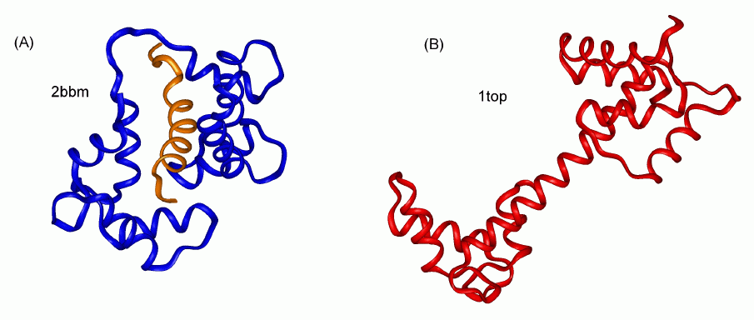
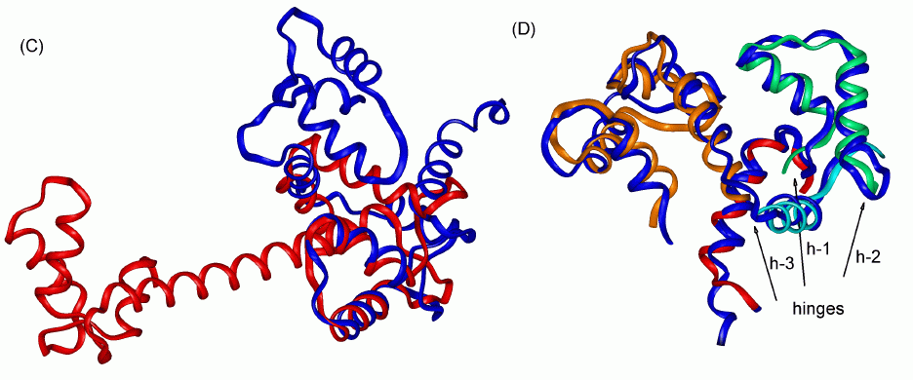
Flexible alignment vs. Rigid alignment
Flexible alignment
Rigid alignment

Slide 34
Structure alignment approaches:
Geometric-intermolecular
Algorithms may do this by minimizing the
RMSD in superimposed alpha-carbon positions.
Geometric-intramolecular
Algorithms minimize the difference between
aligned contact maps or distance matrices.
Non-Geometric
Algorithms align structural properties, such as
%buried, or secondary structure type.

Slide 35
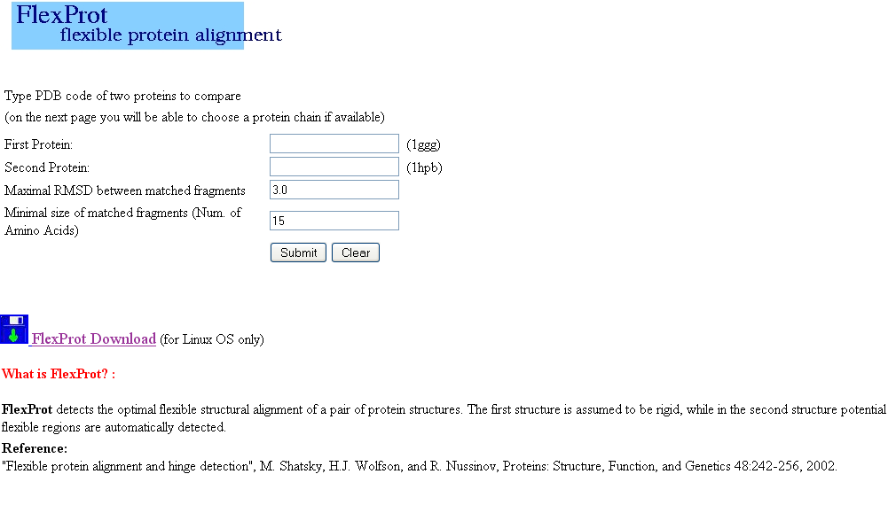

Slide 36
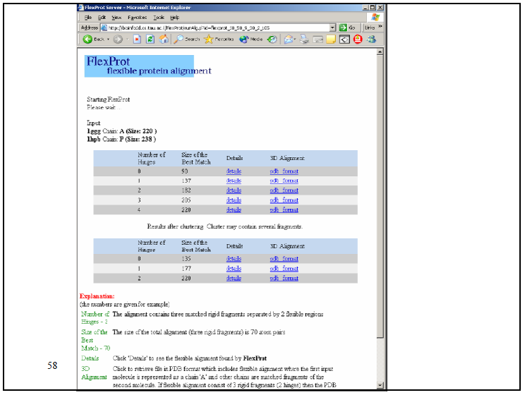

Slide 37
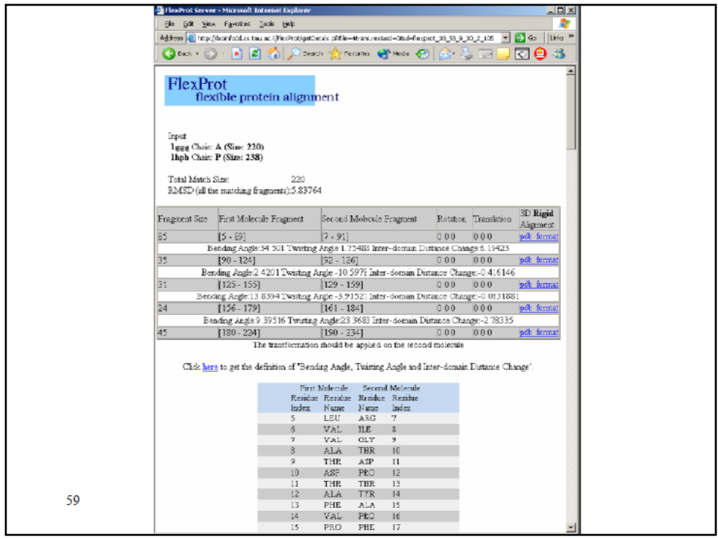

Slide 38
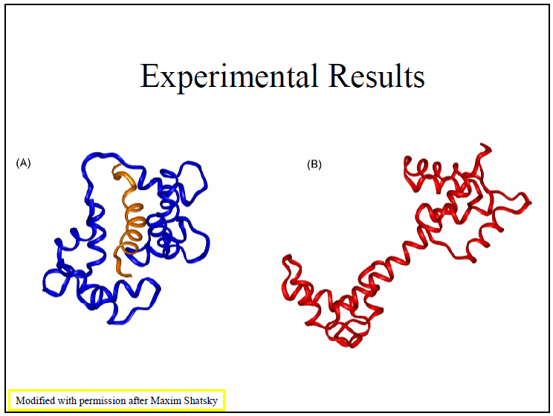

Slide 39
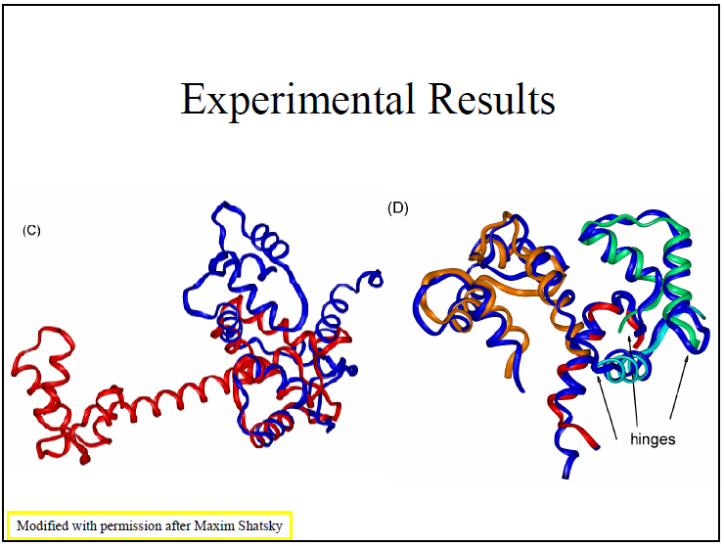

Slide 40
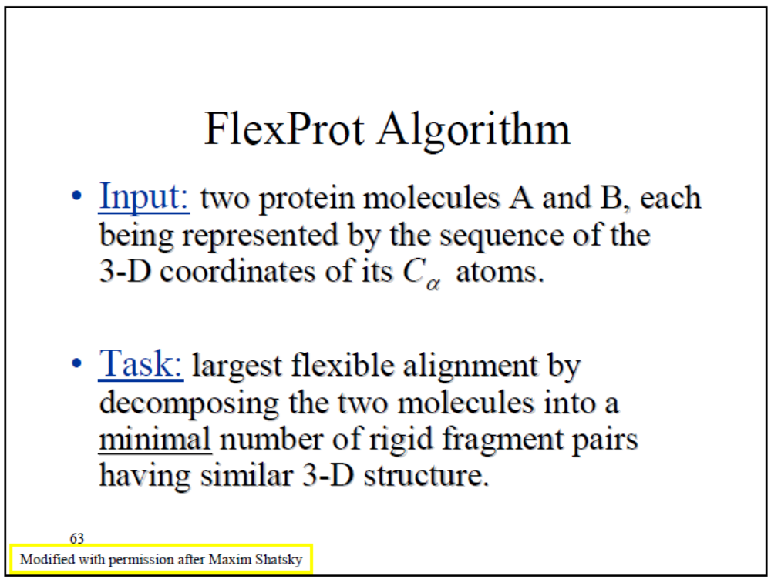

Slide 41
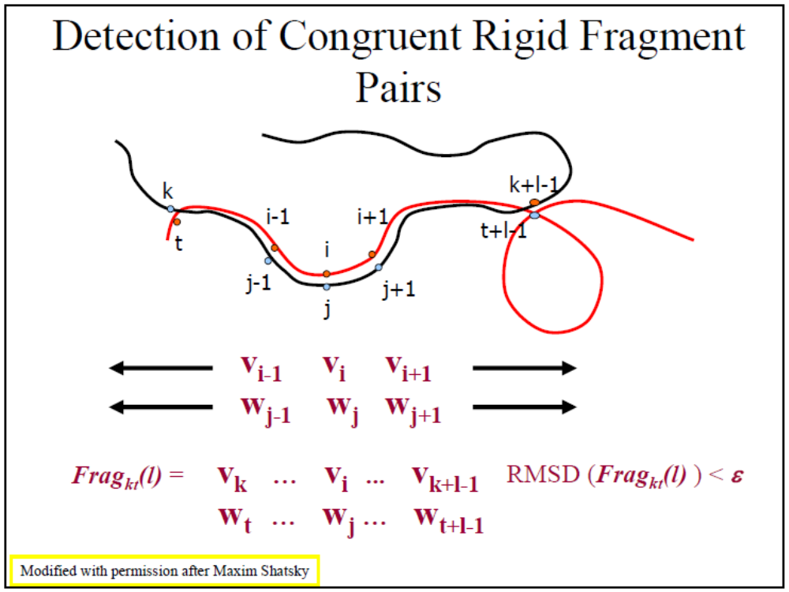

Slide 42
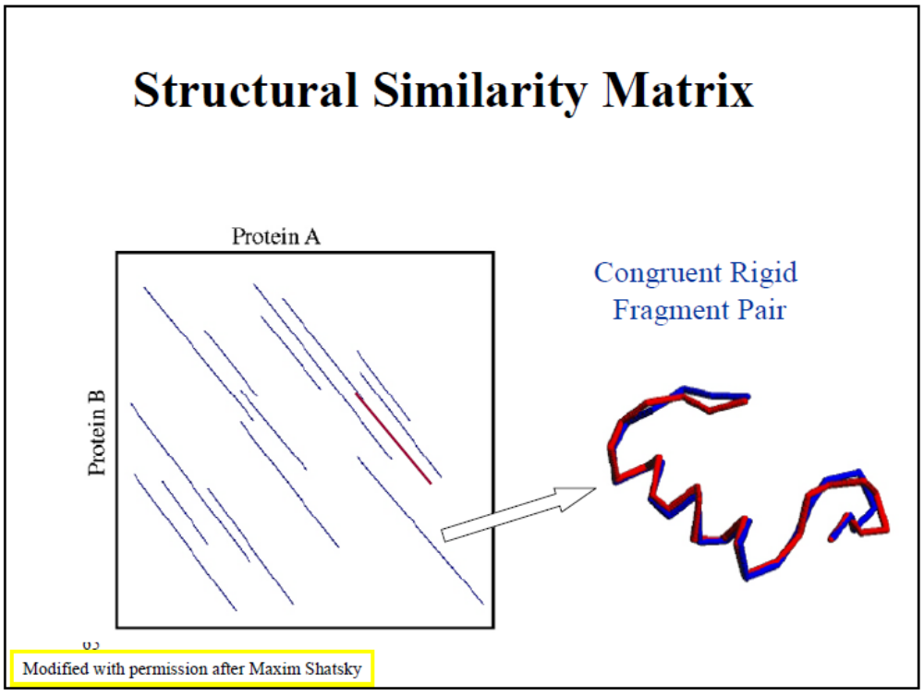

Slide 43
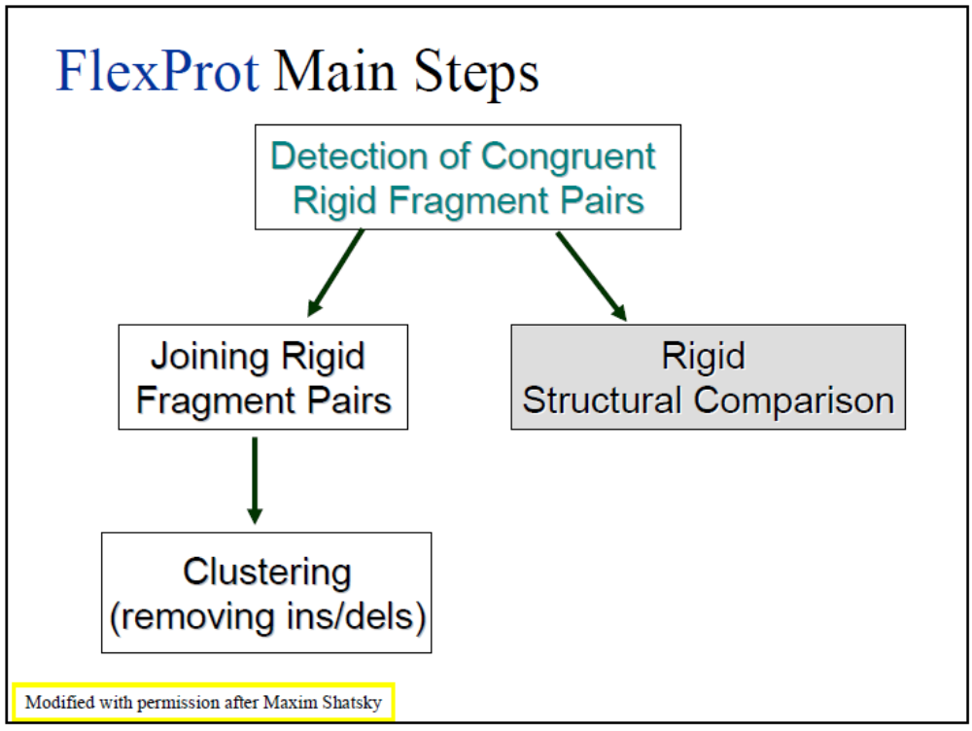

Slide 44
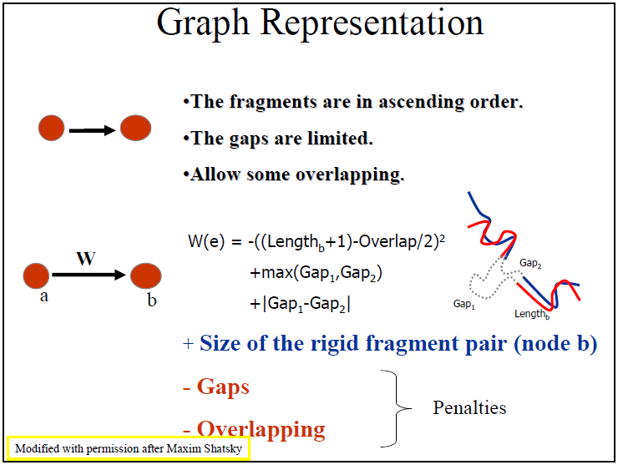

Slide 45
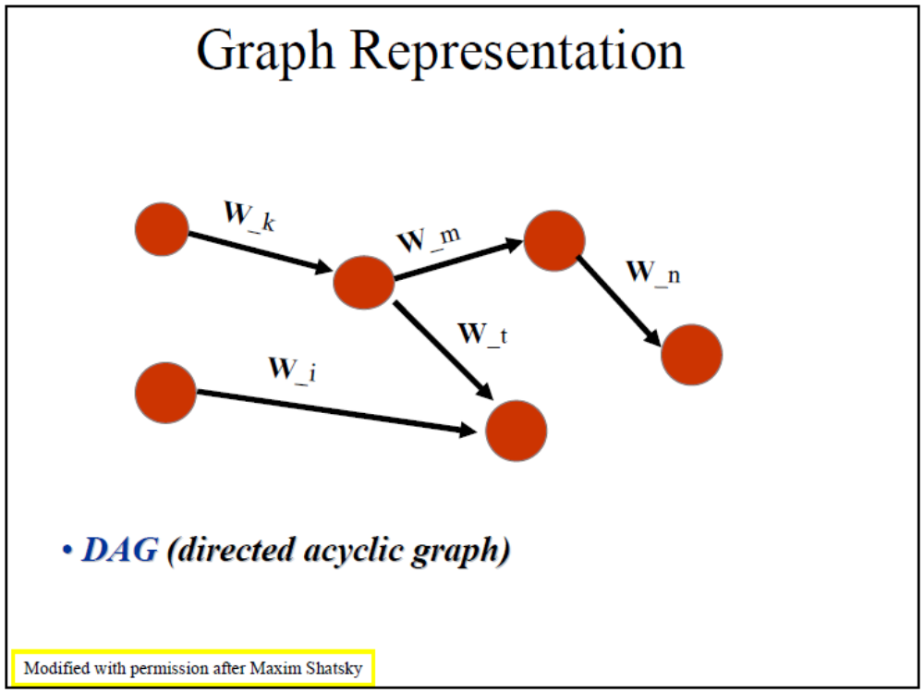

Slide 46
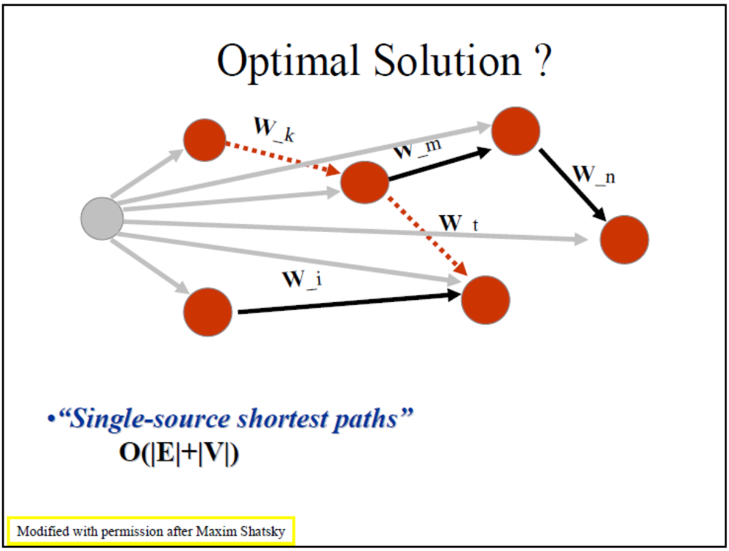

Slide 47
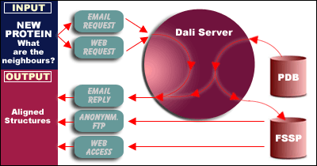
DALI: an intramolecular geometric structural alignment algorithm
http://www.ebi.ac.uk/dali/

Slide 48
DALI
Generate a distance matrix for each protein.
The distance matrix contains all pairwise distances. (symmetrical)
Dij = distance between Calpha i and Calpha j.

Slide 49
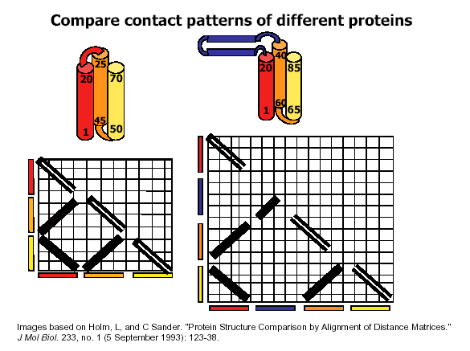

Slide 50
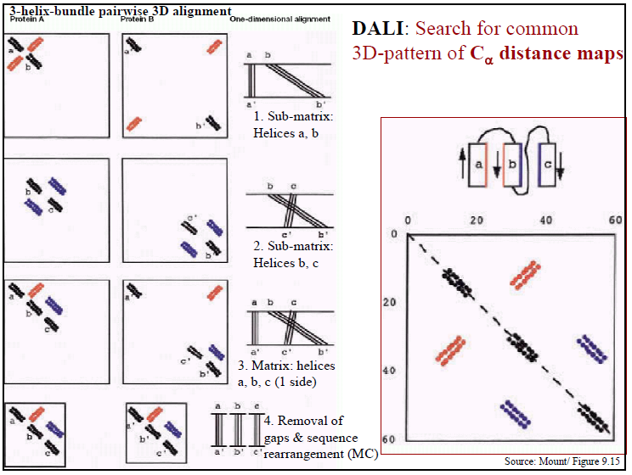

Slide 51
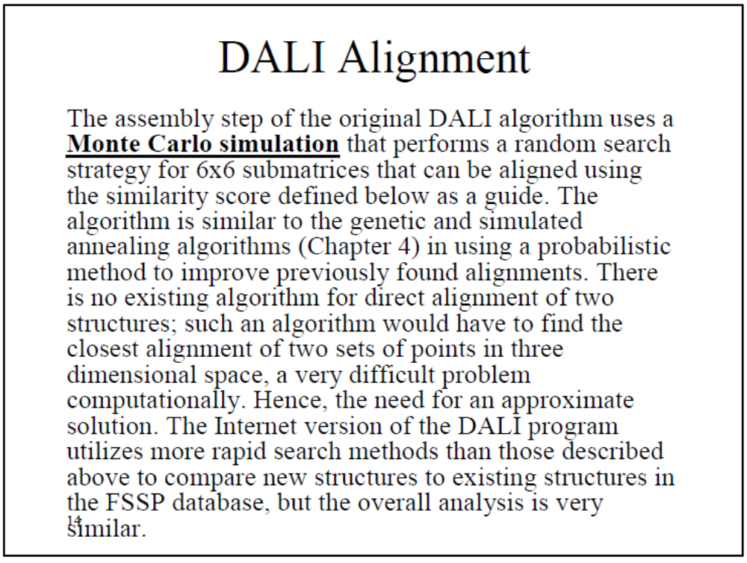

Slide 52
FSSP - fold classification and structural alignments
The Dali database is based on exhaustive all-against-all 3D structure comparison of protein structures currently in the Protein Data Bank
http://ekhidna.biocenter.helsinki.fi/dali/start

Slide 53
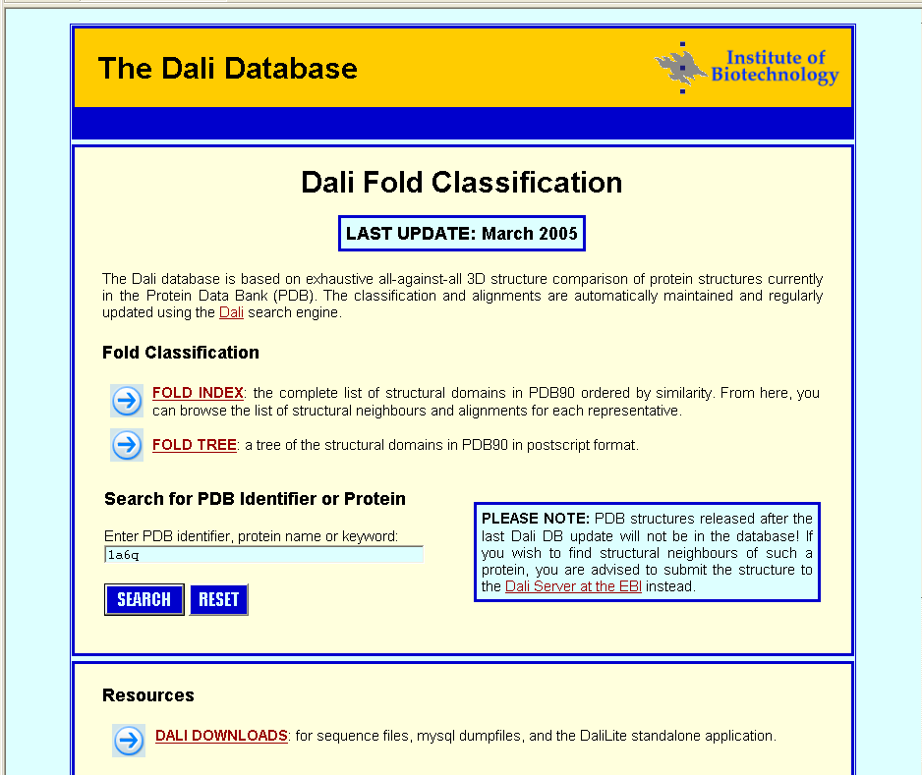

Slide 54
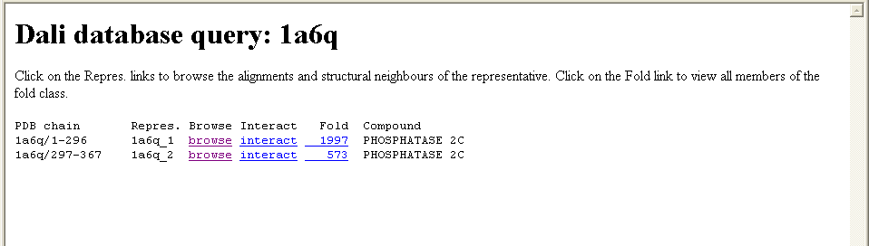
Structural neighbors

Slide 55
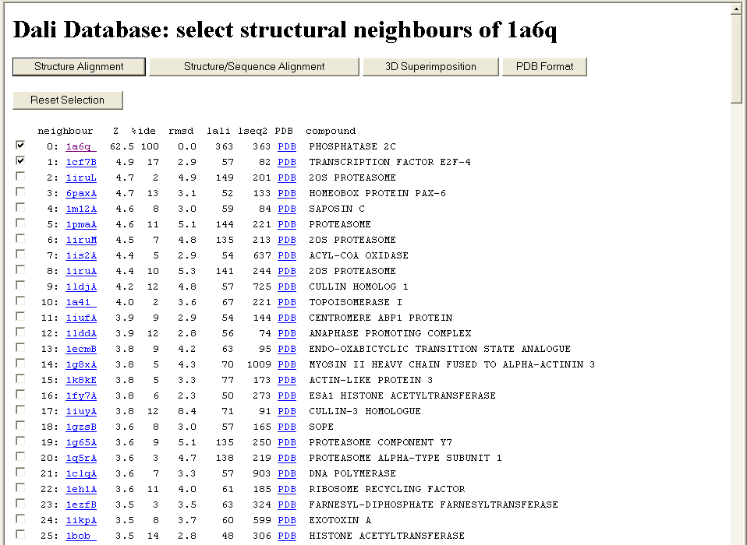
The superimposition in PDB format.
RMSD

Slide 56
Methods of Structural alignment
DALI
A common and popular structural alignment method is the DALI, or distance alignment matrix method,
which breaks the input structures into hexapeptide fragments and calculates a distance matrix by evaluating
the contact patterns between successive fragments. Secondary structure features that involve residues
that are contiguous in sequence appear on the matrix's main diagonal; other diagonals in the matrix reflect
spatial contacts between residues that are not near each other in the sequence. When these diagonals are
parallel to the main diagonal, the features they represent are parallel; when they are perpendicular, their
features are antiparallel. This representation is memory-intensive because the features in the square matrix
are symmetrical (and thus redundant) about the main diagonal.

Slide 57
When two proteins' distance matrices share the same or similar features in approximately the same positions,
they can be said to have similar folds with similar-length loops connecting their secondary structure elements.
DALI's actual alignment process requires a similarity search after the two proteins' distance matrices are built;
this is normally conducted via a series of overlapping submatrices of size 6x6.
Submatrix matches are then reassembled into a final alignment via a standard score-maximization algorithm
- the original version of DALI used a Monte Carlo simulation to maximize a structural similarity score
that is a function of the distances between putative corresponding atoms. In particular, more distant atoms
within corresponding features are exponentially downweighted to reduce the effects of noise introduced by
loop mobility, helix torsions, and other minor structural variations.[13] Because DALI relies on an all-to-all
distance matrix, it can account for the possibility that structurally aligned features might appear in different
orders within the two sequences being compared. The DALI method has also been used to construct a
database known as FSSP (Fold classification based on Structure-Structure alignment of Proteins, or Families
of Structurally Similar Proteins) in which all known protein structures are aligned with each other to
determine their structural neighbors and fold classification. There is an searchable database based on DALI
as well as a downloadable program and web search based on a standalone version known as DaliLite.

Slide 58
Combinatorial extension
The combinatorial extension (CE) method is similar to DALI in that it too breaks each structure in the
query set into a series of fragments that it then attempts to reassemble into a complete alignment. A series
of pairwise combinations of fragments called aligned fragment pairs, or AFPs, are used to define a
similarity matrix through which an optimal path is generated to identify the final alignment. Only AFPs
that meet given criteria for local similarity are included in the matrix as a means of reducing the necessary
search space and thereby increasing efficiency.[15] A number of similarity metrics are possible;
the original definition of the CE method included only structural superpositions and inter-residue
distances but has since been expanded to include local environmental properties such as secondary structure,
solvent exposure, hydrogen-bonding patterns, and dihedral angles.[15]
An alignment path is calculated as the optimal path through the similarity matrix by linearly progressing
through the sequences and extending the alignment with the next possible high-scoring AFP pair.
The initial AFP pair that nucleates the alignment can occur at any point in the sequence matrix.
Extensions then proceed with the next AFP that meets given distance criteria restricting the alignment
to low gap sizes. The size of each AFP and the maximum gap size are required input parameters but are
usually set to empirically determined values of 8 and 30 respectively

Slide 59
GANGSTA+
GANGSTA+ is a combinatorial algorithm for non-sequential structural alignment of proteins and
similarity search in databases (http://gangsta.chemie.fu-berlin.de). It uses a combinatorial approach
on the secondary structure level to evaluate similarities between two protein structures based on
contact maps. Different SSE assignment modes can be used. The assignment of SSEs can be performed
respecting the sequential order of the SSEs in the polypeptide chains of the considered protein pair
(sequential alignment) or by ignoring this order (non-sequential alignment). Furthermore, SSE pairs
can optionally be aligned in reverse orientation. The highest ranking SSE assignments are transfered
to the residue level by a pointmatching approach[16]. To obtain an initial common set of atomic
coordinates for both proteins, pairwise attractive interactions of the C-alpha atom pairs are defined
by inverse Lorentzians and energy minimized. For more algorithmic details see [17].

Slide 60
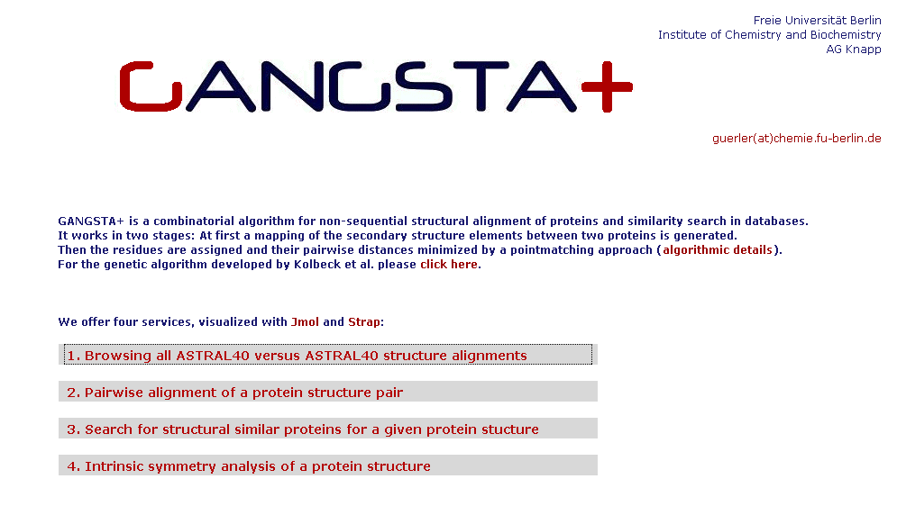

Slide 61
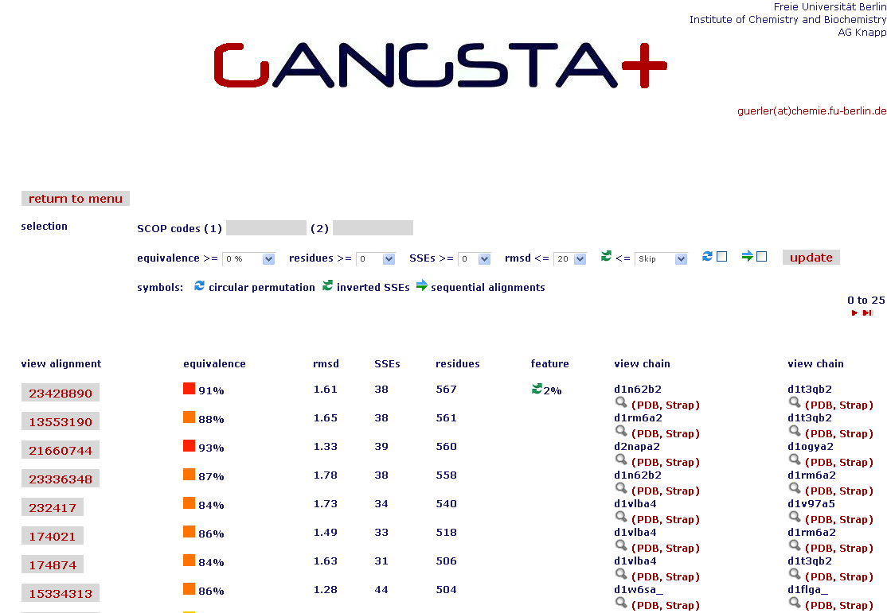

Slide 62
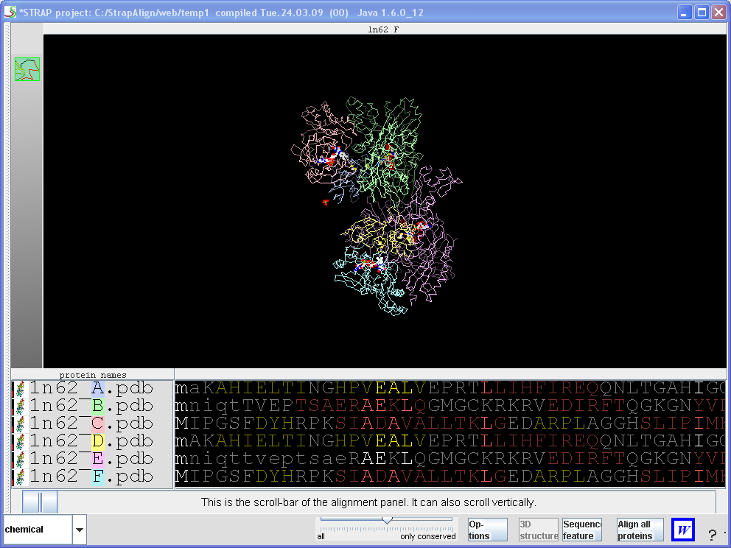

Slide 63
MAMMOTH
MAtching Molecular Models Obtained from THeory. As its name suggests, MAMMOTH was
originally developed for comparing models coming from structure prediction (THeory) since
it is tolerant of large unalignable regions, but it has proven to work well with experimental
models, especially when looking for remote homology. Benchmarks on targets of blind
structure prediction (the CASP experiment) and automated GO annotation have shown it is
tightly rank correlated with human curated annotation. A highly complete database
of mammoth-based structure annotation for the predicted structures of unknown proteins
Covering 150 genomes facilitates genomic scale normalization.

Slide 64
MAMMOTH-based structure alignment methods decomposes the protein structure into short
peptides (heptapeptides) which are compared with the heptapeptides of another protein.
Similarity score between two heptapeptides is calculated using a unit-vector RMS (URMS)
method. These scores are stored in a similarity matrix, and with a hybrid (local-global)
dynamic programming the optimal residue alignment is calculated. Protein similarity scores
calculated with MAMMOTH is derived from the likelihood of obtaining a given structural
alignment by chance.
MAMMOTH-mult is an extension of the MAMMOTH algorithm to be used to align related
family of protein structures. This algorithm is very fast and produces consistent and high
quality structural alignments. Multiple structural alignments calculated with
MAMMOTH-mult produces structurally-implied sequence alignments that can be further
used for multiple-template homology modeling, HMM-based protein structure prediction,
and profile-type PSI-BLAST searches.

Slide 65
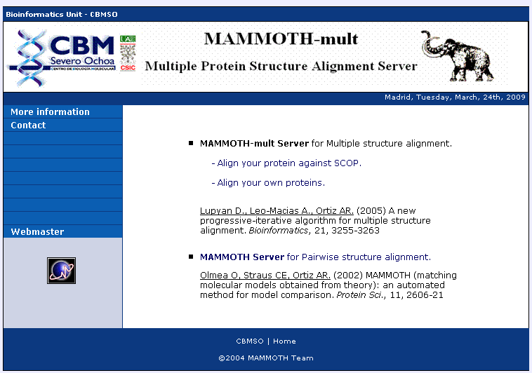

Slide 66
RAPIDO
Rapid Alignment of Proteins In terms of DOmains. RAPIDO is a web server for the 3D alignment of crystal
structures of different protein molecules, in the presence of conformational changes. Similar to what CE does as a
first step, RAPIDO identifies fragments that are structurally similar in the two proteins using an approach based on
difference distance matrices. The Matching Fragment Pairs (MFPs) are then represented as nodes in a graph which
are chained together to form an alignment by means of an algorithm for the identification of the longest path on a
DAG (Directed Acyclic Graph). The final step of refinement is performed to improve the quality of the alignment.
After aligning the two structures the server applies a genetic algorithm for the identification of conformationally
invariant regions These regions correspond to groups of atoms whose interatomic distances are constant
(within a defined tolerance). In doing so RAPIDO takes into account the variation in the reliability of atomic
coordinates by employing weighting-functions based on the refined B-values. The regions identified as conformationally
invariant by RAPIDO represent reliable sets of atoms for the superposition of the two structures that can be used for
a detailed analysis of changes in the conformation. In addition to the functionalities provided by existing tools,
RAPIDO can identify structurally equivalent regions even when these consist of fragments that are distant in terms
of sequence and separated by other movable domains.

Slide 67
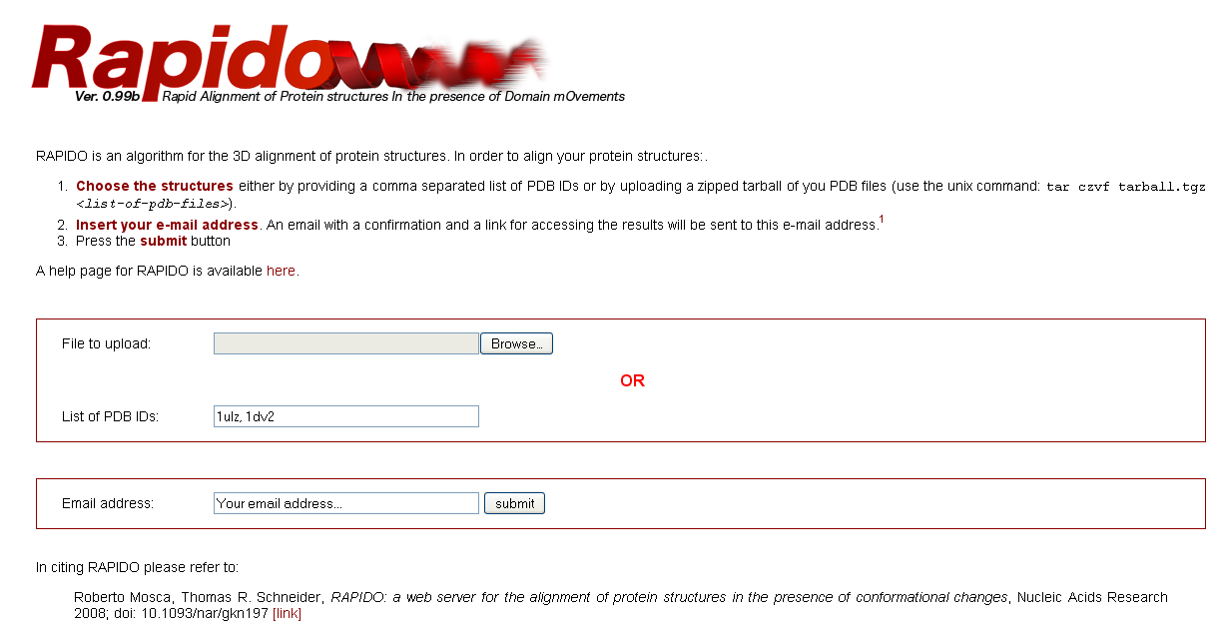

Slide 68
SABERTOOTH
SABERTOOTH uses structural profiles to perform structural alignments. The underlying
structural profiles expresses the global connectivity of each residue. Despite the very
condensed vectorial representation, the tool recognizes structural similarities with accuracy
comparable to established alignment tools based on
coordinates and performs comparably in quality.
Furthermore, the algorithm has favourable scaling of computation time with chain length.
Since the algorithm is independent of the details of the structural representation, the
framework can be generalized to sequence-to-sequence and sequence-to-structure comparison
within the same setup, and it is therefore more general than other tools. SABERTOOTH
can be used online at http://www.fkp.tu-darmstadt.de/sabertooth/

Slide 69
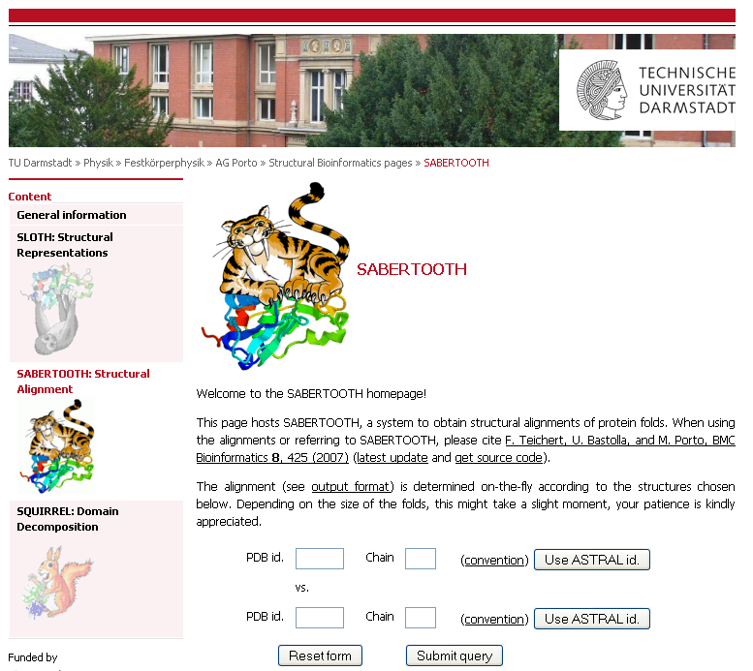

Slide 70
SSAP
The SSAP (Sequential Structure Alignment Program) method uses double dynamic programming to produce a structural alignment based on atom-to-atom vectors in structure space.
Instead of the alpha carbons typically used in structural alignment, SSAP constructs its vectors from the beta carbons for all residues except glycine, a method which thus takes into account the rotameric state of each residue as well as its location along the backbone. SSAP works by first constructing a series of inter-residue distance vectors between each residue and its nearest non-contiguous neighbors on each protein. A series of matrices are then constructed containing the vector differences between neighbors for each pair of residues for which vectors were constructed. Dynamic programming applied to each resulting matrix determines a series of optimal local alignments which are then summed into a "summary" matrix to which dynamic programming is applied again to determine the overall structural alignment.
SSAP originally produced only pairwise alignments but has since been extended to multiple alignments as well.It has been applied in an all-to-all fashion to produce a hierarchical fold classification scheme known as CATH (Class, Architecture, Topology, Homology),which has been used to construct the CATH Protein Structure Classification database.

Slide 71
TOPOFIT
In the TOPOFIT method [1], similarity of protein structures is analyzed using three-dimensional
Delaunay triangulation patterns derived from backbone representation. It has been found that
structurally related proteins have a common spatial invariant part, a set of tetrahedrons,
mathematically described as a common spatial sub-graph volume of the three-dimensional
contact graph derived from Delaunay tessellation (DT). Based on this property of protein
structures we present a novel common volume superimposition (TOPOFIT) method to produce
structural alignments of proteins. The superimposition of the DT patterns allows one to objectively
identify a common number of equivalent residues in the structural alignment, in other words,
TOPOFIT identifies a feature point on the RMSD/Ne curve, a topomax point, until which
two structures correspond to each other including backbone and inter-residue contacts, while
the growing number of mismatches between the DT patterns occurs at larger RMSD (Ne) after
topomax point. The topomax point is present in all alignments from different protein structural
classes; therefore, the TOPOFIT method identifies common, invariant structural parts between
proteins. The TOPOFIT method adds new opportunities for the comparative analysis of protein
structures and for more detailed studies on understanding the molecular principles of tertiary
structure organization and functionality..

Slide 72
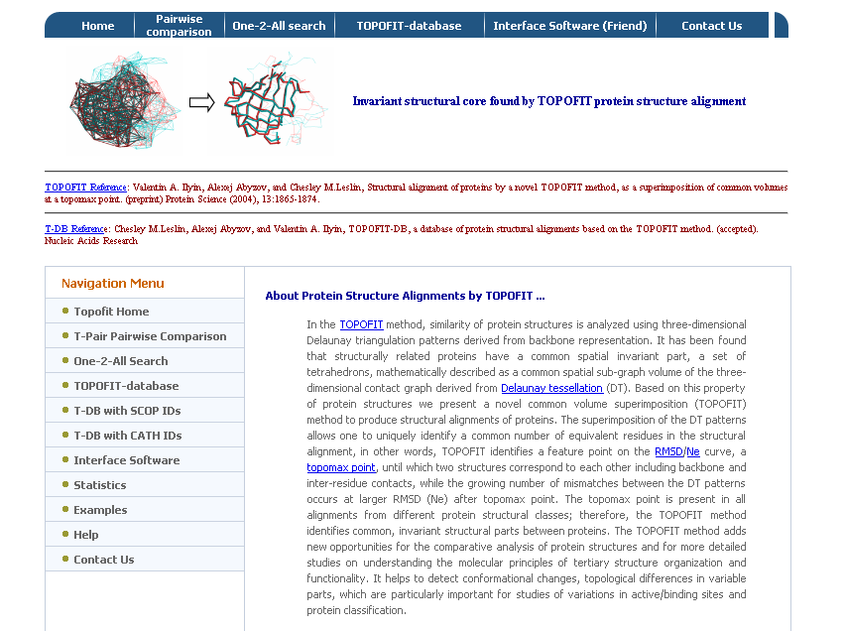

Slide 73
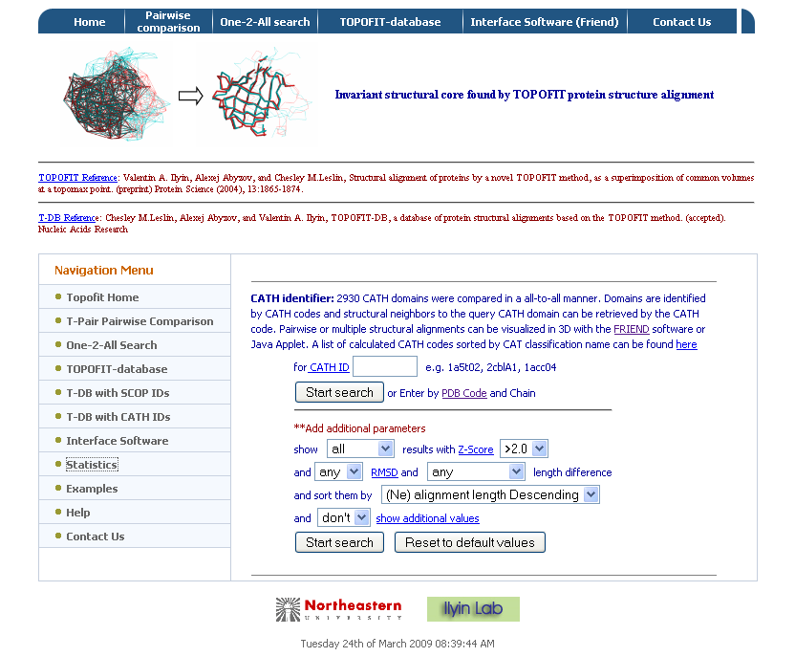

Slide 74
Structural alignment tools
Bioinfo3D tools –
  The Structural Bioinformatics group at Tau of Nussinov-Wolfson
  pairwise & multiple alignments
  Geometric-intermolecular
DALI –
  European Bioinformatics Institute
  Geometric-intramolecular

Slide 75
Bioinfo3D Tools (pairwise -alignment)
FlexProt – Flexible alignment
c_alpha_match – The protein's backbones are structurally compared using their c-alpha atoms coordinates.
SiteEngine - Recognizes regions on the surface of one protein that resemble a specific binding site of another.

Slide 76
FlexProt - Flexible protein alignment:
The first structure is assumed to be rigid, while in the second structure potential flexible regions are automatically detected.
Input: two pdb ids (specific chain)
Output: list of alignments according the number of hinges.

Slide 77
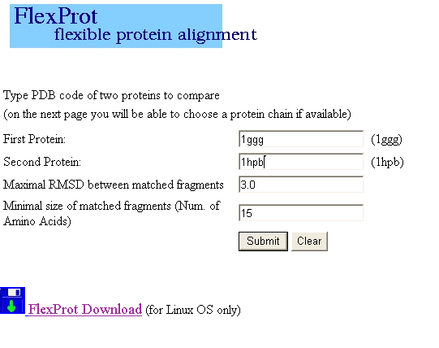

Slide 78
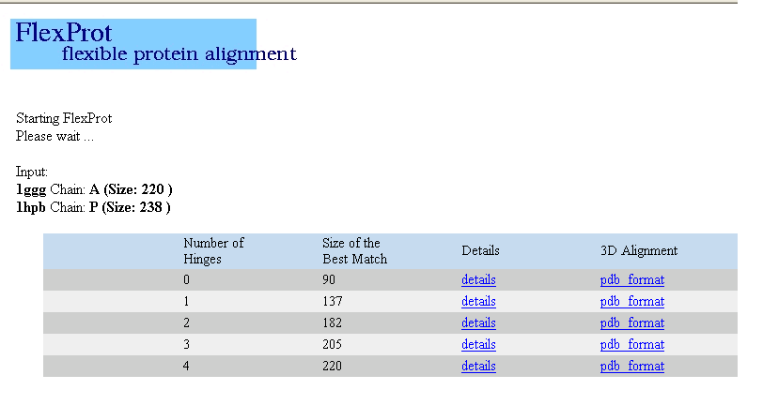
Result:

Slide 79
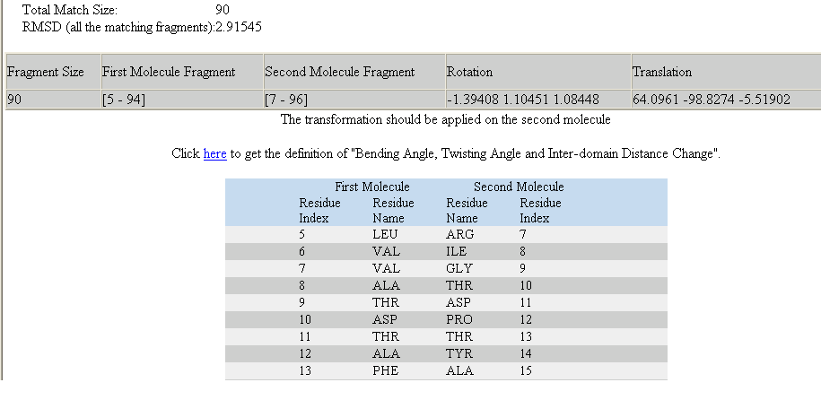
Result without hinge:

Slide 80
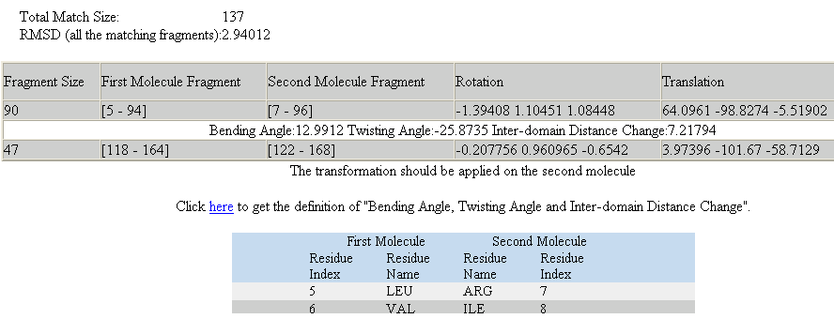
Result with one hinge:

Slide 81
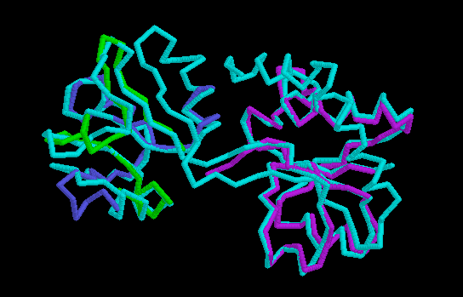
Visualization of the 3D alignment
The results can be viewed with PDB viewers: Protein explorer or Rasmol. The aligned proteins are marked as different chains.

Slide 82
C_alpha_match
Rigid pairwise alignement
Based on c-alpha atoms
Input:
  Two pdb files or ids
  These protein's backbones are structurally compared using their c-alpha atoms coordinates.
Output:
  A set of high scoring conformations
  May be viewed in a PDB viewer.

Slide 83
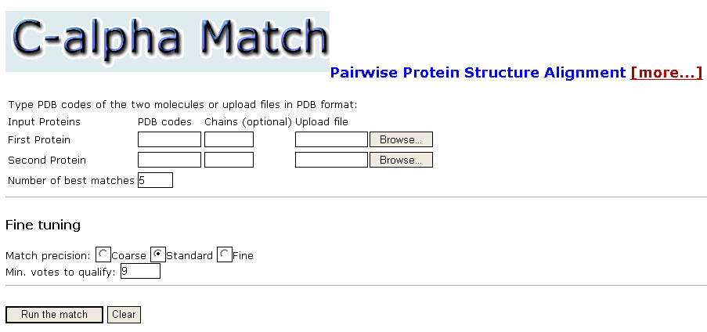

Slide 84
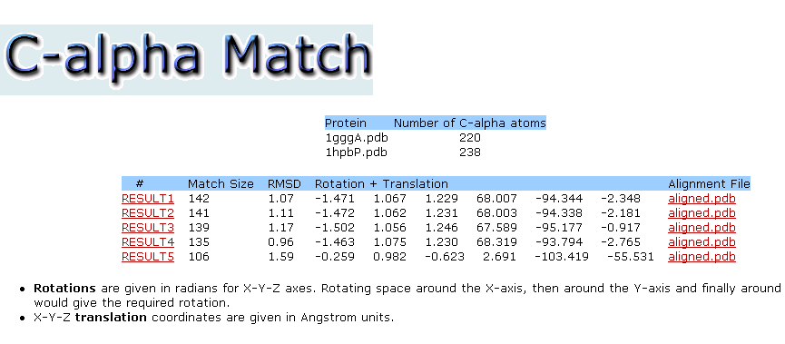
Result:

Slide 85
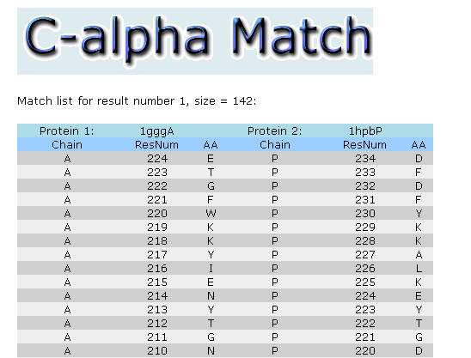
Result:

Slide 86
SiteEngine
Based in surfaces
Recognizes regions on the surface of one protein that resemble a specific binding site of another.
This may suggest the similarity of their binding partners and biological functions.
Takes into account the physico-chemical properties of both the backbone and the side-chains.
Therefore it can recognize similar binding patterns shared by proteins that have no sequence or fold similarity.
Highly efficient and suitable for large scale database searches of the entire PDB.

Slide 87
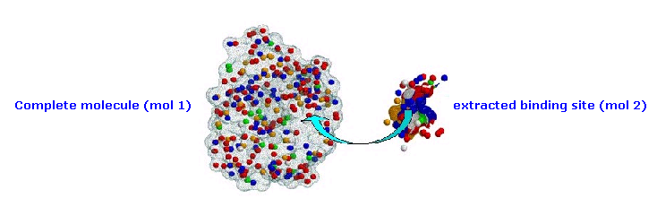
searches the structure of the complete molecule for regions similar to the binding site of interest

Slide 88
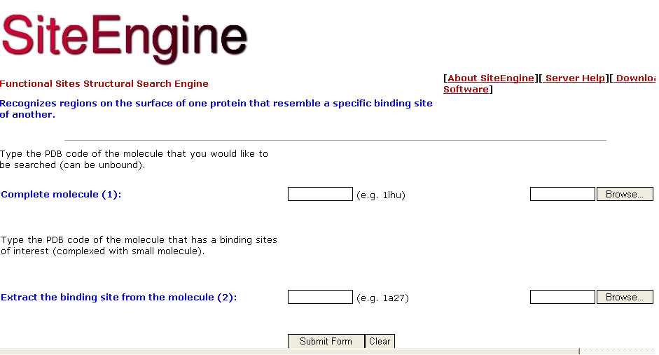

Slide 89
Results:
10 top ranking solutions are presented
Each solution includes the surface of the complete molecule that are recognized to be most similar to the binding site of interest
Pdb file of the superimposition

Slide 90
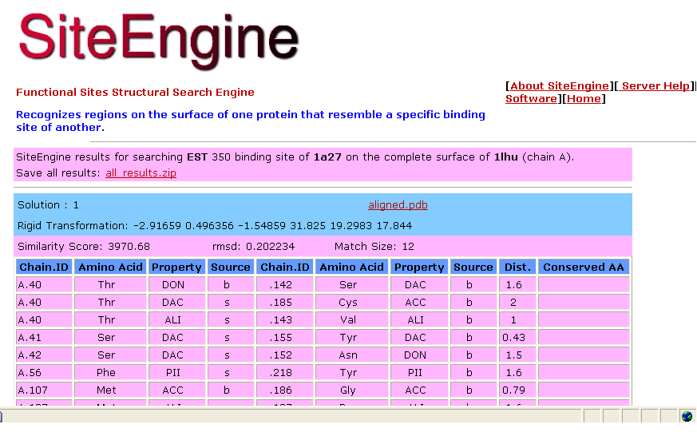
Result:

Slide 91
Property:
The physico-chemical property
Representation of each amino acid of a protein as a set of features that are important for its interaction with other molecules.
The abbreviations of these features are:
  DON - Hydrogen bond donor
  ACC - Hydrogen bond acceptor
  DAC - Hydrogen bond donor and acceptor (e.g in histidine)
  ALI - Aliphatic Hydrophobic property
  PII - Aromatic property (pi contacts)

Slide 92
Bioinfo3D Tools (multiple -alignment)
MultiProt
MASS

Slide 93
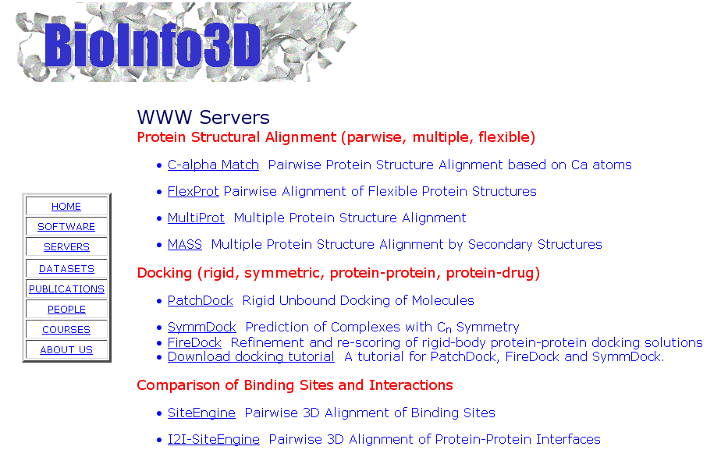

Slide 94
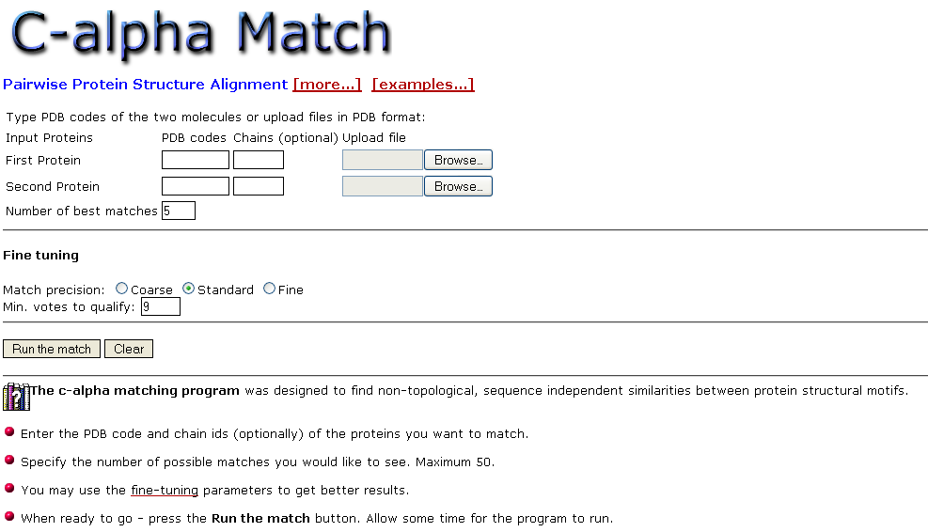

Slide 95


Slide 96


Slide 97


