Slide 1
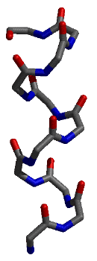
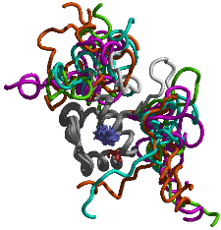
Visualizing Protein Structures and Computing
Structural Properties

Slide 2
What we hope to learn
Review of Forces that drive folding
Motifs or supersecondary structure
Structural Domains
Finding out more about structures
UniProt Classification Databases
Discussion of Chapter 2 (C&H)
Assignments:
Start VMD Laboratory

Slide 3
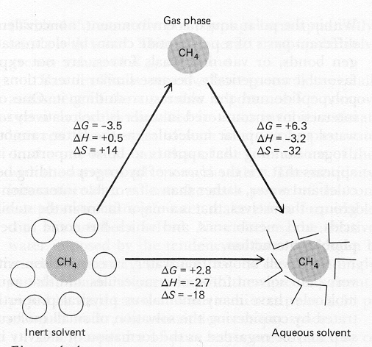
Hydrophobic effect: non-polar molecules want to associate
2
+ 4
ΔG favors association due to “freeing” of water
“With nonpolar solutes, the interactions between water and the solute appear to be negligible relative to the initial unfavorable energy required to form the initial cavity in water. Consequently, an inverse linear relationship is found between the solubility of hydrocarbons in water and the surface area of the cavity required to accommodate the solute”
Creighton, Proteins, pg 146

Slide 4
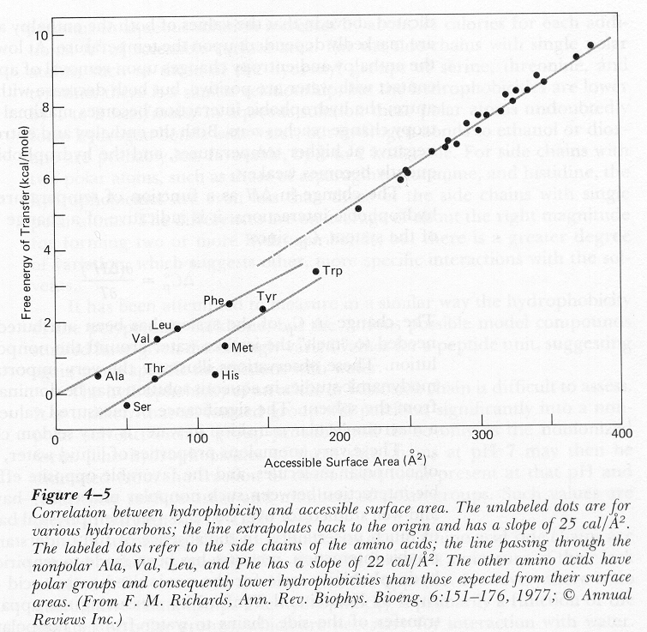
…the line passing through the nonpolar Ala, Val, Leu and Phe has a slope of 22 cal/Å²

Slide 5
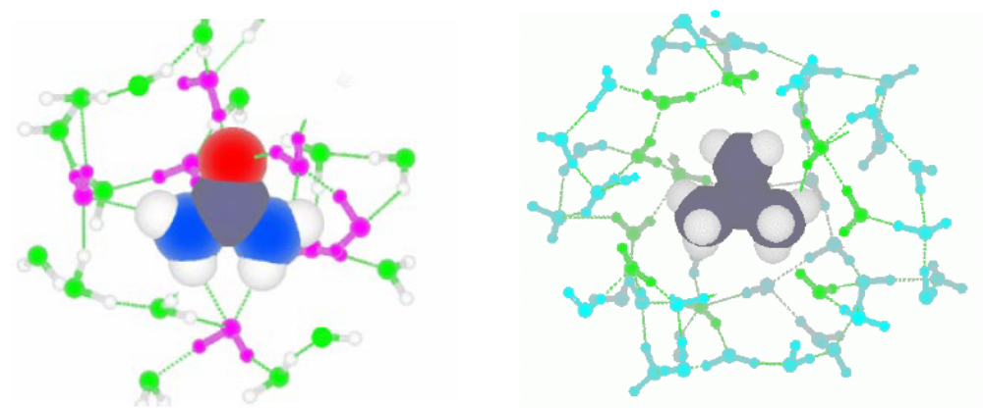
Hydrophobic and Hydrophilic Solutes
POLAR AND NON-POLAR SOLUTES have very different effects on water structure. We show two solutes that have the same Y-shaped geometry but different partial charges. The polar solute, urea (left), has partial charges on its atoms. Consequently, it is able hydrogen-bond to water molecules and to fit right into the water hydrogen-bond network. In contrast, the non-polar solute, isobutene (right), does not have (substantial) partial charges on any of its atoms. It, thus, can not hydrogen-bond to water. Rather, the water molecules around it “turn away” and interact strongly only with other water molecules, forming a sort of hydrogen-bond “ice cage” around the isobutene.

Slide 6
Summary of Protein Folding Interactions
Electrostatic Interactions
Core
Hydrogen bonds -1.0 to -10.0 kcal/mol dipole-dipole interaction
1/r² Short range, angle dependent
van der Waals -0.2 to -1.0 kcal/mol Induced dipole
1/r⁶ Very Short range. Temperature dependent
Ionic ±5.0+ kcal/mol ion-ion interaction
1/r least affected by temperature and distance
Hydrophobic Interactions
Hydrophilic ΔG = ΔH – T Δ S Solvation is favored by ΔH < 0
reduces ion-ion interactions
Hydrophobic ΔG = ΔH – T Δ S Desolvation is favored by Δ S > 0
Surface area and Temperature dependent

Slide 7
Discovery Questions: Sequence identity
Use bl2seq to calculate the % identity in the three regions of COX1.
Use bl2seq to compare COX1 and COX2
a. What is the overall amino acid identity? What is the nucleotide identity?
b. What is the percent positive similarity?
c. Which parts of the protein are not well conserved?
d. Use the browser’s “Find” function to locate the active site sequence GAPFS.
Genetics Place

Slide 8
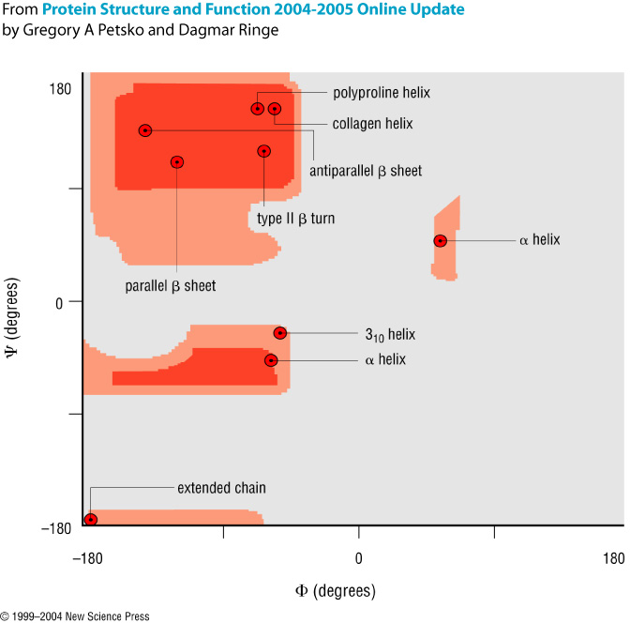
Secondary Structure

Slide 9
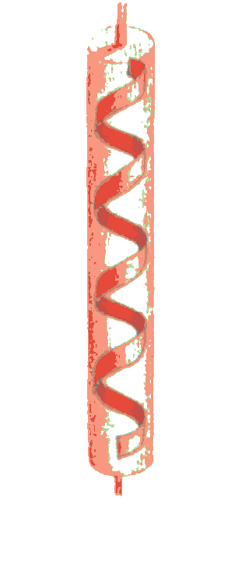
Secondary structure
α-helix
β-sheet
loop or turn
random coil
From: Brandon & Tooze, “Introduction to Protein Structure”

Slide 10
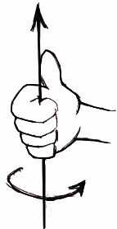
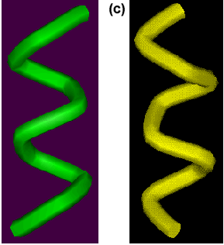
Secondary structure
α-helix
From: Brandon & Tooze, “Introduction to Protein Structure”

Slide 11
i to i+4 connectivity
3.6 residues per turn
(phi, psi) ~= (-60º, -50º)
α-helix

Slide 12
C=O --
i to i+4 connectivity
3.6 residues per turn
(phi, psi) ~= (-60º, -50º)
All NH and C=O groups are connected
except for first NH group and last C=O
ends are polar (hence usually at protein surface)
orientation of h-bonds leads to net dipole
NH +
α-helix

Slide 13
i to i+4 connectivity
3.6 residues per turn
(phi, psi) ~= (-60º, -50º)
All NH and C=O groups are connected
except for first NH group and last C=O
ends are polar (hence usually at protein surface)
orientation of h-bonds leads to net dipole
Different side chains have different helical propensities
ALA, GLU, LEU, MET: good α-helix formers
PRO, GLY, TYR, SER: poor α-helix formers
α-helix
PRO is OK as a N-cap
ASP is a good N-cap (balances +)

Slide 14
hydrophillic
hydrophobic
i to i+4 connectivity
3.6 residues per turn
(phi, psi) ~= (-60º, -50º)
All NH and C=O groups are connected
except for first NH group and last C=O
ends are polar (hence usually at protein surface)
orientation of h-bonds leads to net dipole
Different side chains have different helical propensities
ALA, GLU, LEU, MET: good α-helix formers
PRO, GLY, TYR, SER: poor α-helix formers
α-helix
…weak tendency (not strong enough for prediction since hydrophobic residue can be on surface) for amino acids to change from hydrophillic to hydrophobic with a periodicity of 3-4 residues

Slide 15
Left handed helix is also possible,
(phi, psi) ~= (+60°, +60°)
i to i+3: 3₁₀ helix
i to i+5: π helix
hydrophillic
hydrophobic
i to i+4 connectivity
3.6 residues per turn
(phi, psi) ~= (-60º, -50º)
All NH and C=O groups are connected
except for first NH group and last C=O
ends are polar (hence usually at protein surface)
orientation of h-bonds leads to net dipole
Different side chains have different helical propensities
ALA, GLU, LEU, MET: good α-helix formers
PRO, GLY, TYR, SER: poor α-helix formers
α-helix
…weak tendency (not strong enough for prediction since hydrophobic residue can be on surface) for amino acids to change from hydrophillic to hydrophobic with a periodicity of 3-4 residues

Slide 16
β-sheet structure
built up from combinations of several regions of polypeptide chain
β-strands are usually 5-10 residues long
β-strands are usually almost fully extended
β-strands are usually aligned adjacent to one another to form C=O
to N-H bonds between the strands
when several β-strands are together, this is called pleated (with C_{α}
atoms above and below plane). antiparallel or parallel

Slide 17
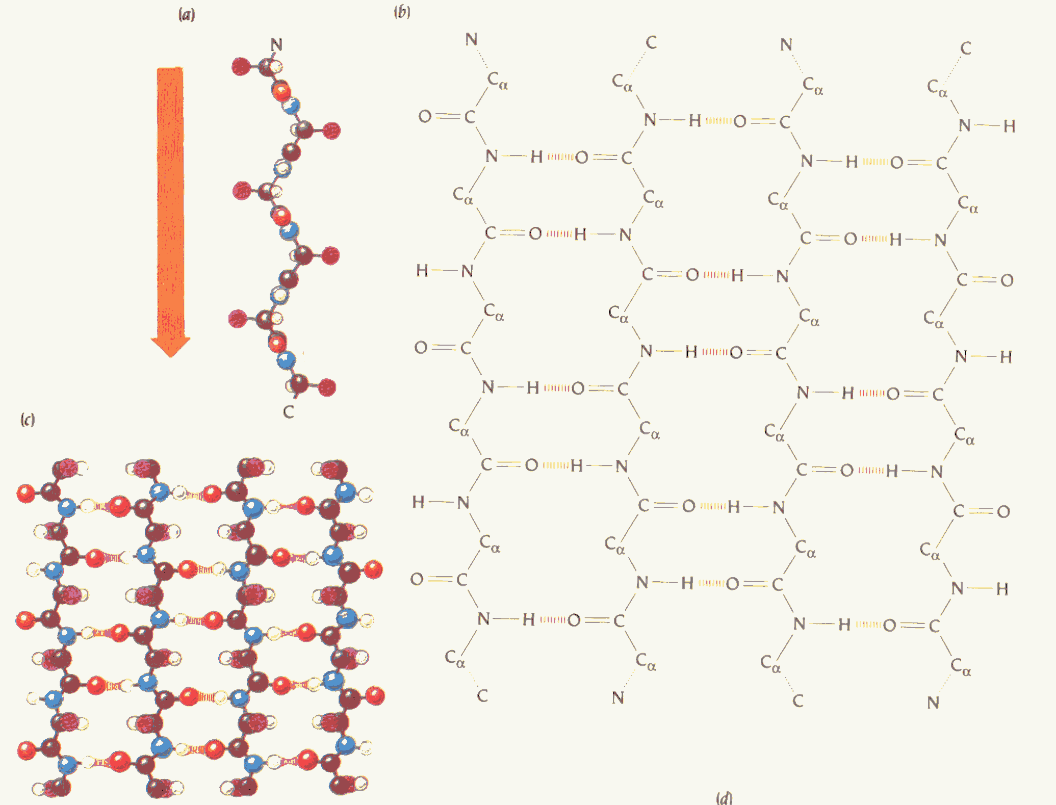
antiparallel β-sheet

Slide 18
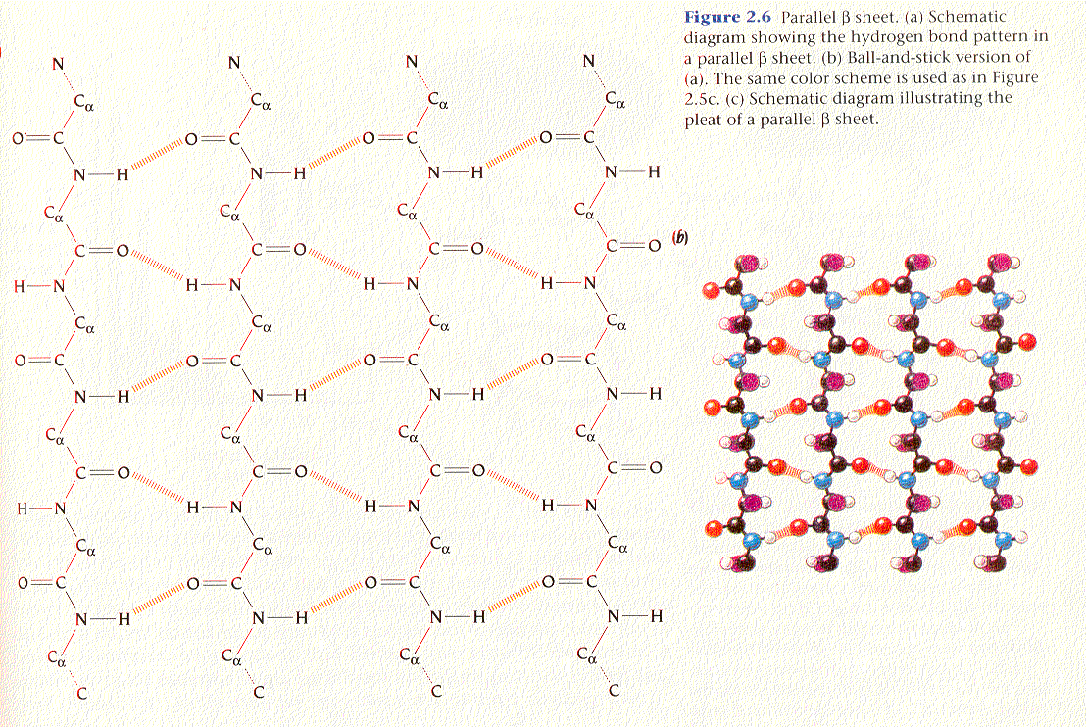
parallel β-sheet

Slide 19
anti-parallel vs. parallel β-sheet

Slide 20
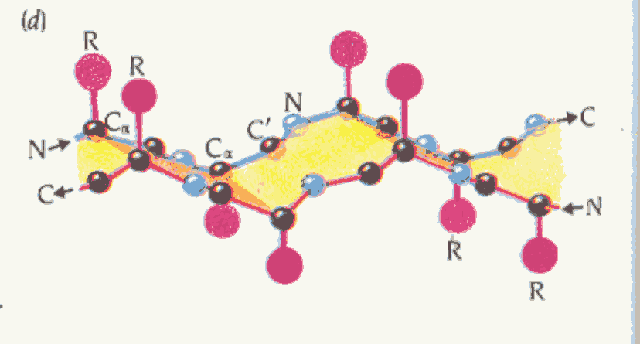
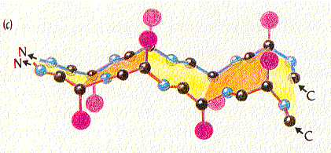
pleating in antiparallel vs. parallel β-sheet

Slide 21
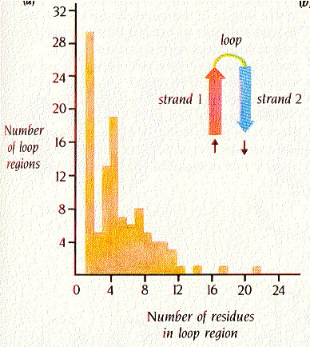
loops and turns:
β turn 2
Ω loops 6-16
Figure 2.8, Brandon & Tooze

Slide 22
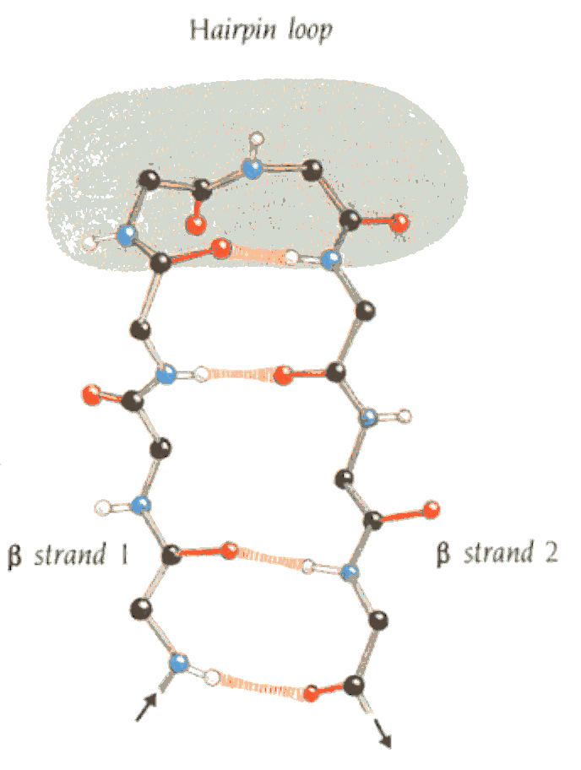
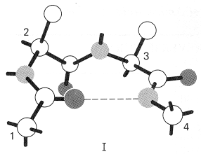
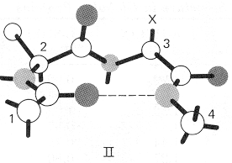
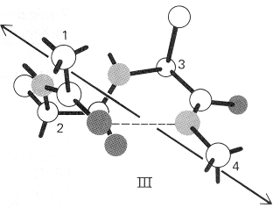
Loops and turns:
Reverse turns or β bends
GLY only
Resembles 3₁₀ helix
Figure 2.8, Brandon & Tooze

Slide 23
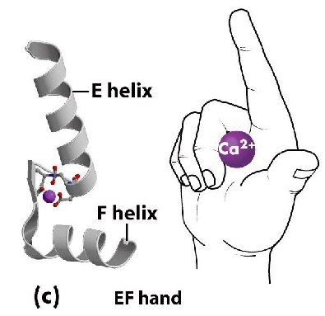
protein structural motifs
Simple combinations of secondary structural elements,
called motifs or supersecondary structure.
Examples:

Slide 24
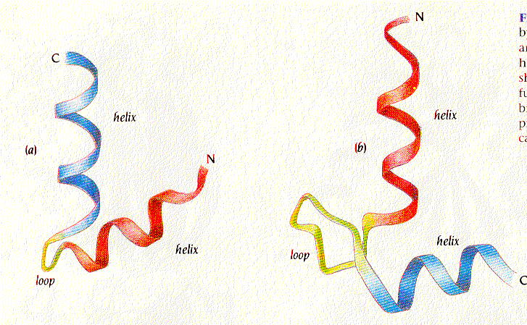
protein structural motifs
Simple combinations of secondary structural elements,
called motifs or supersecondary structure.
Examples:
helix-turn-helix or helix-loop-helix
Figure 2.12 Brandon & Tooze

Slide 25
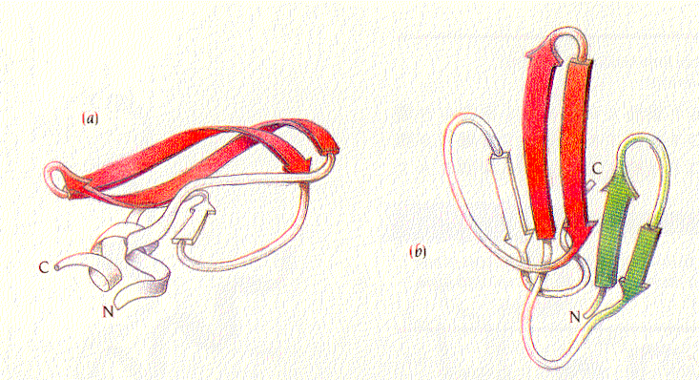
protein structural motifs
Simple combinations of secondary structural elements,
called motifs or supersecondary structure.
Examples:
helix-turn-helix or helix-loop-helix
hairpin β
Figure 2.14 Brandon & Tooze

Slide 26

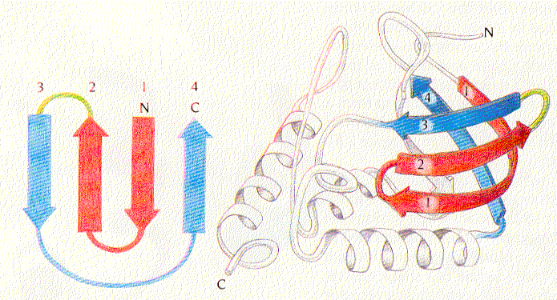
protein structural motifs
Simple combinations of secondary structural elements,
called motifs or supersecondary structure.
Examples:
helix-turn-helix or helix-loop-helix
hairpin β
Greek key
Figure 2.15 Brandon & Tooze

Slide 27
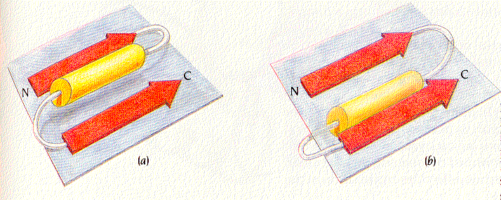
protein structural motifs
Simple combinations of secondary structural elements,
called motifs or supersecondary structure.
Examples:
helix-turn-helix or helix-loop-helix
hairpin β
Greek key
beta-alpha-beta
Found almost in every protein structure with a parallel β-sheet
2 possible hands: left-handed connection (shown on the right) has only been found in 1-protein (subtilisin)
Figure 2.18 Brandon & Tooze

Slide 28
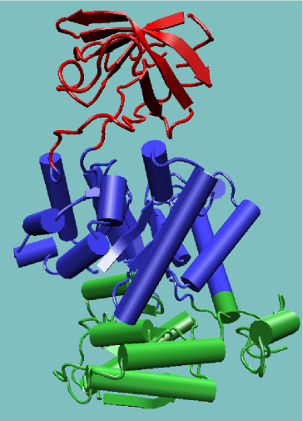
Domains are built from structural motifs
3 main classes of protein structures:
α-domains
β-domains (antiparallel β)
α/β domains
1PKN
Pyruvate
Kinase

Slide 29
Discovery Questions: Conserved Domains
Go to the HGNC and perform a gene search for cyclooxygenase to see how many cyclooxygenase genes there are in the human genome. How does this compare to a OMIM search for COX3? Any surprises?
Perform a CD search for the accession number AAC83646. How many different CDs does it have? What are the Evalues?
Click on the “gnl/CDD/7333”. Does this domain have an important function?
Characterize the uncharacterized protein. Determine as much as you can about its structure and function.
Genetics Place

Slide 30
Domains are built from structural motifs
(can exist independently)
3 main classes of protein structures:
α-domains β-domains (antiparallel β) α/β domains
14729 PDB Entries (1 Oct 2001). 35685 Domains. 35 Literature References (excluding nucleic acids and theoretical models)
Class Number of folds # superfamilies # families
All alpha proteins 144 231 363
All beta proteins 104 190 303
α/β proteins 107 180 409
α + β proteins 194 276 428
Multi-domain proteins 32 32 45
Membrane/cell surface 11 17 28
Small proteins 56 81 123
Total 648 1007 1699
(evolution)
(sequence > 35%)

Slide 31
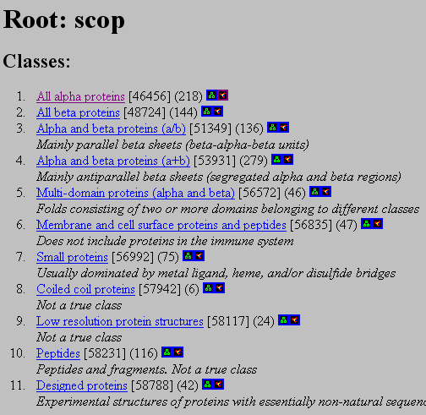
Structural Classification Of Proteins http://scop.mrc-lmb.cam.ac.uk/scop/
Hand curated hierarchical taxonomy of proteins based on their structural and evolutionary relationships.
Classes
Fold Level
Super Families
Families
Superfamily
Family
Chothia, Murzin (Cambridge)

Slide 32
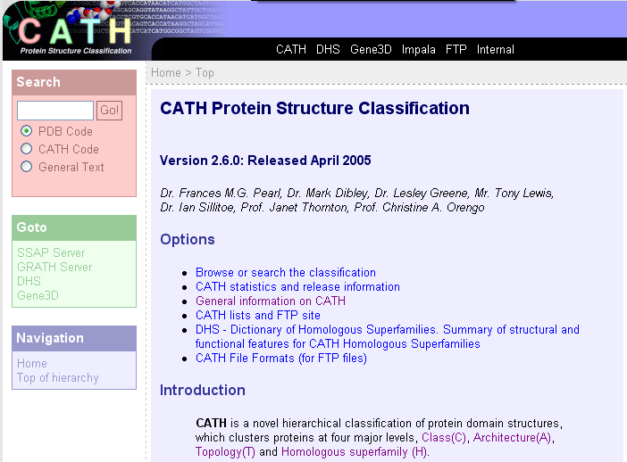
CATH Protein Structural Data Base http://www.biochem.ucl.ac.uk/bsm/cath/cath.html
Semiautomatic domain classification of PDB crystal structures.
Thornton (London)
Class
Architecture
Topology
Homology
Sequence

Slide 33
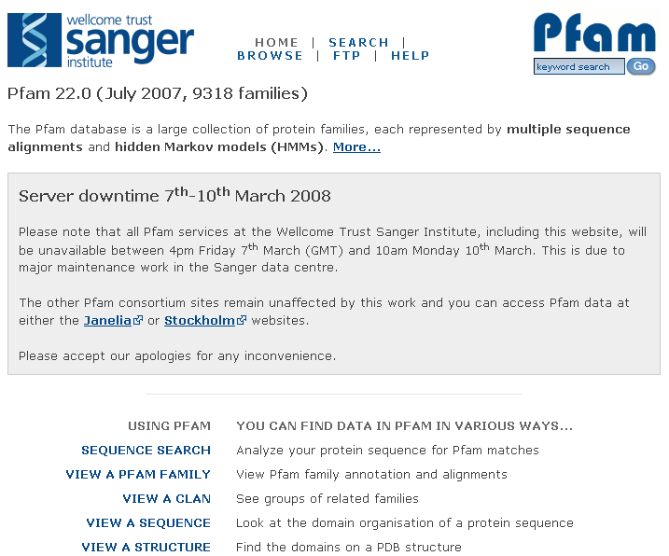
http://pfam.sanger.ac.uk/

Slide 34
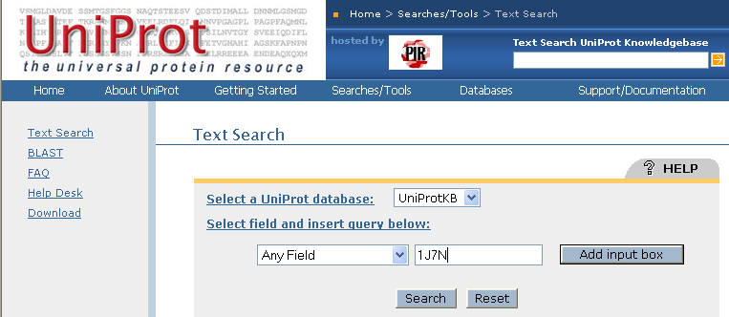
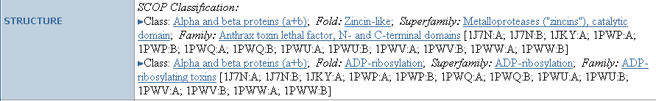
UniProt http://www.uniprot.org/

Slide 35
Discovery Questions: ESTs
Search NCBI’s Human Map Viewer using the term “obesity”. How many obesity loci do you see? Are they clustered or distributed throughout the genome?
Go to Electronic PCR and enter the accession number “M18533”. What gene have you located? How many STS markers are there? Do you have all the information that you need to amplify this STS?
BLASTn the mystery sequence against the “est_mouse” data base. What can you learn based on these hits.
What is the utility of the EST data base now that the genome is completed?
Go to the UniGene Statistics paged and calculate the average number of ESTs for each human gene (assuming 23,000 genes)
Genetics Place

