Slide 1
Housekeeping
Your performance on the exam has caused me to re-evaluate how homework will be handled
I will now be picking up every problem assigned on the Course Schedule
  It was readily apparent that very few of you actually did the problems
If you are not spending AT LEAST 1 hour a day on this course, you are not going to do very well.

Slide 2
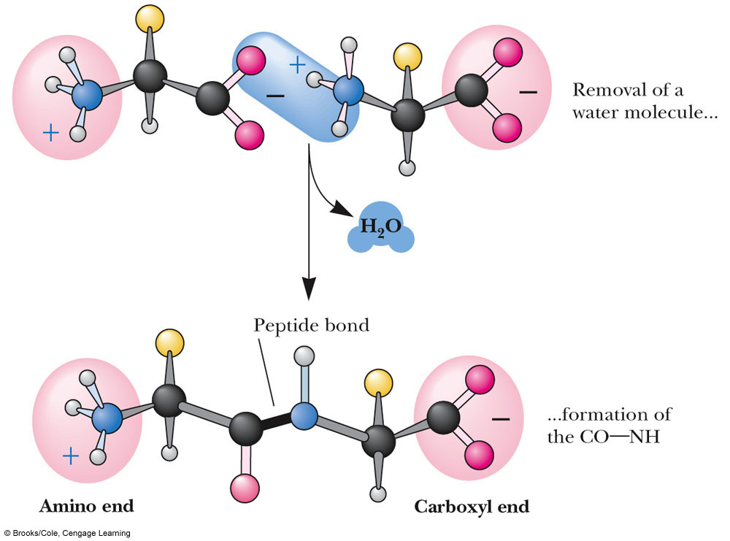
The Peptide Bond
Amino acids are joined together in a condensation reaction that forms an amide known as a peptide bond

Slide 3
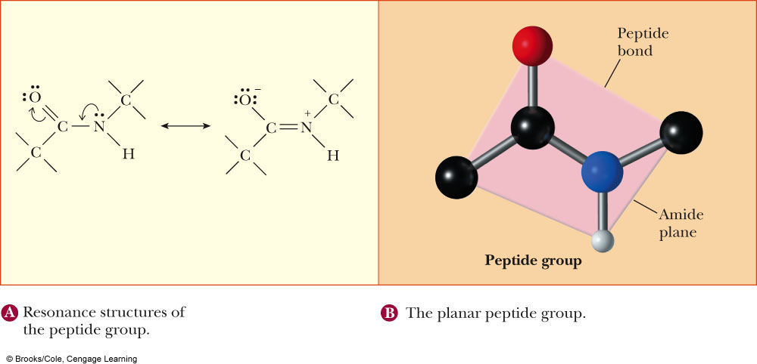
The Peptide Bond
A peptide bond has planar character due to resonance hybridization of the amide
This planarity is key to the three dimensional structure of proteins

Slide 4
Proteins
What have we learned so far?
  Acid/Base Behaviour
  Intermolecular forces
  Organic Compounds: Functional Groups and Names
  Amino Acid Names and Structure
  3 basic Organic Chemistry reaction types
Now, we need to start putting everything together and start looking at Proteins.

Slide 5
Proteins
A protein is a biological macromolecule composed of hundreds of amino acids
  A peptide is less than 50 amino acids
A protein can fold into tens of thousands of different three dimensional shapes or Conformations
  Usually only one conformation is biologically active
  Many diseases such as Alzheimer’s, Mad Cow Disease and various cancers result from the misfolding of a protein
We can break the structure of a protein down to three levels…

Slide 6
Protein Structure: Primary (1°) Structure
The primary structure of a protein is the order in which the amino acids are covalently linked together
  Remember: A chain of amino acids has directionality from NH₂ to COOH
Do not be confused:
R-G-H-K-L-A-S-M
And
G-H-K-A-M-S-L-R
May have the same amino acid composition but they have completely different primary structures and are therefore, completely different peptides

Slide 7
Proteins: Secondary (2°) Structure
The secondary structure of a protein arises from the interactions and folding of the primary structure onto itself
  Hydrogen bonding, hydrphobic interactions and electrostatic interactions
Every amino acid has 2 bonds that areof primary importance to the formation of secondary structure
  Φ angle: Phi angle. The amino group-α−carbon bond angle
  Ψ angle: Psi angle. The α-carbon-carbonyl carbon bond angle

Slide 8
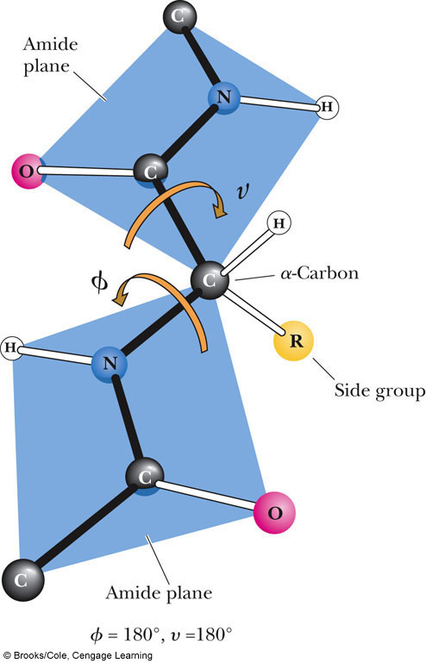
angle
(note typo in textbook)
The amide peptide bond has planar character due to resonance
Look at the Φ/Ψ angles as the rotation of 2 playing cards connected at their corners
Φ angle

Slide 9
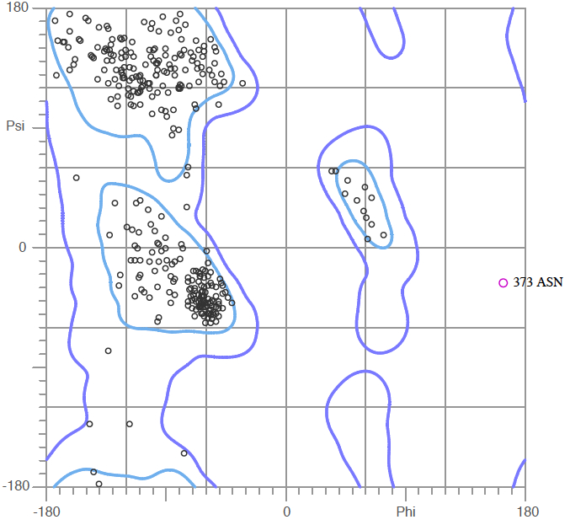
Ramachandran Plot
In 1963, G.N. Ramachandran studied the rotations of the phi/psi angles and determined that each amino acid had a preferred set of them
AND
That particular combinations of phi/psi angles led to stable secondary structures
β-sheet
α-helix

Slide 10
Secondary Structures: α-helices and β-sheets
The 2 secondary structures that proteins are primarily composed of ar:
  α-helix: a rod-like coil held together by hydrogen bonds
  β-helix: A ribbon-like structure held together by hydrogen bonds
Both types of structure are Periodic
  Their features repeat at regular intervals

Slide 11
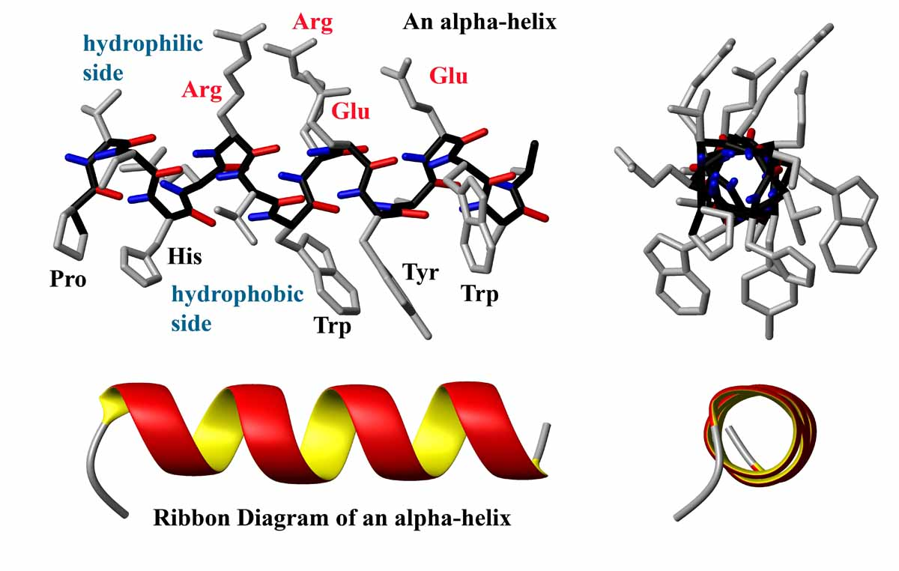
α-helices
Held together by hydrogen bonds running parallel to the helical axis
The carboxyl group of one amino acid is H-bonded to an amino-group hydrogen 4 residues down the chain
For every turn of the helix, there are 3.6 amino acid residues
The pitch (gap between residues above and below the gap between turns) is 5.4 Å (1 Å = 1x10⁻¹⁰ m)

Slide 12
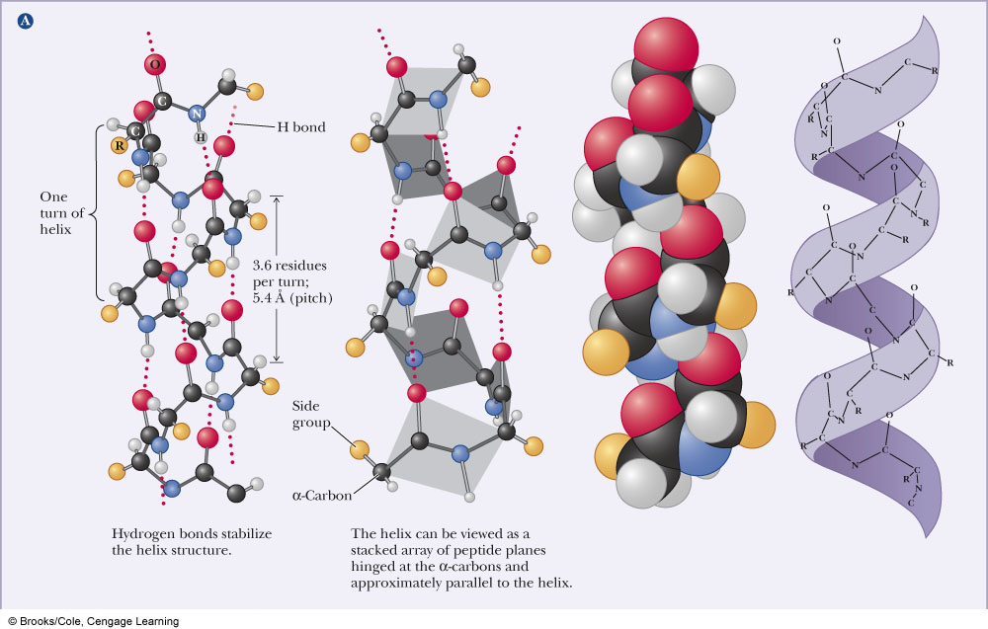

Slide 13
α-helices
Some proteins consist entirely of them
  Myoglobin for example
Proline breaks a helix (Why?)
The helical conformation gives a linear arrangement of the atoms involved in hydrogen bonds which maximizes their strength
  H-bond distance ~3.0Å
Stretches of charged amino acids will disrupt a helix as will a stretch of amino acids with bulky side chains
  Charge repulsion and steric repulsion

Slide 14
β-sheets
A beta sheet is composed of individual beta strands: stretches of polypeptide in an extended conformation
  Linear arrangement of amino acids
Hydrogen bonds can form between amino acids of the same strand (intrachain) or adjacent strands (interchain)
β-sheets can be parallel (the strands run in the same direction) or antiparallel (the strands run in opposite directions).

Slide 15
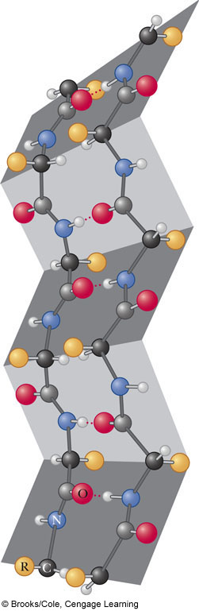
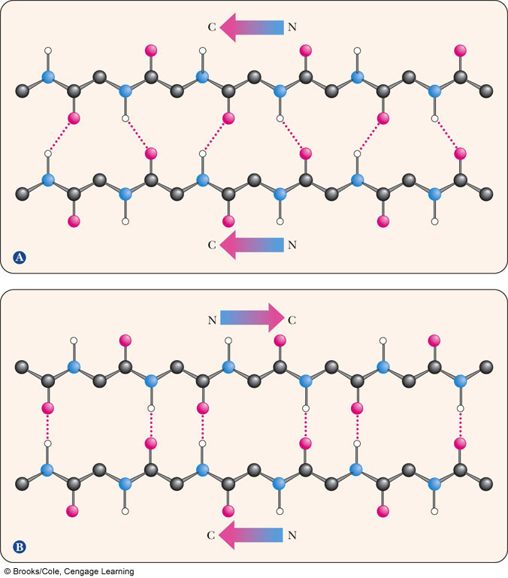

Slide 16
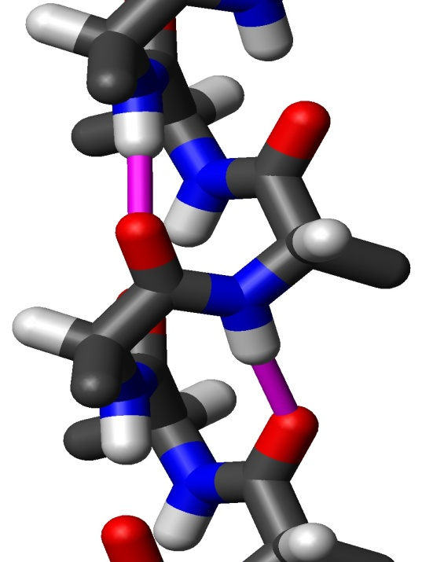
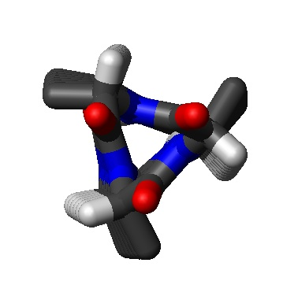
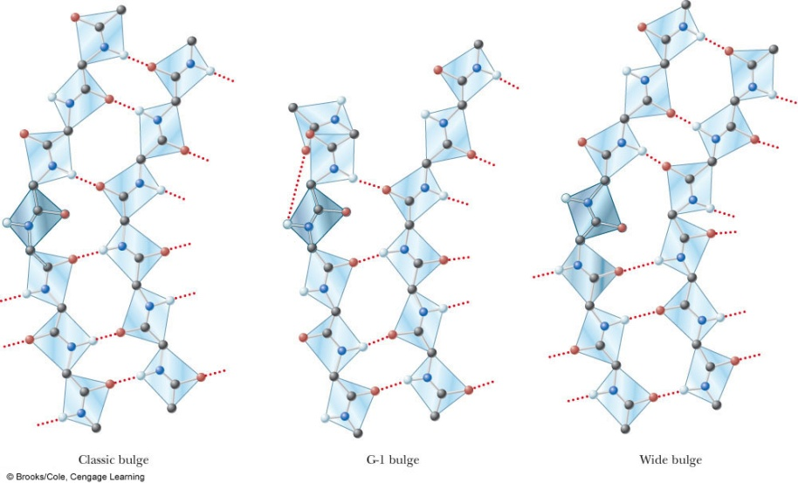
Secondary Structural Elements other than α-helices and β-sheets
3₁₀, 2₇ and 4.4₁₆ helices: The 1st number tells you how many amino acids exist per turn and the second tells you how many atoms are in the H-bond ring made b/w H-bonded residues
β-bulge: An irregularity in antiparallel β-sheets
3₁₀ helix

Slide 17
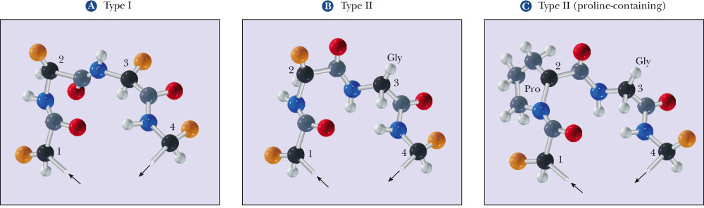
Reverse Turns
A structure that reverses the direction of the amino acid chain
Glycine is often found in turns. Why?
Proline is often found in turns, why?
Type I Turn:
Any amino acid can be at position 3
Type II Turn:
Glycine must be at position 3
Type II Turn with Proline:
Proline is at position 2

Slide 18
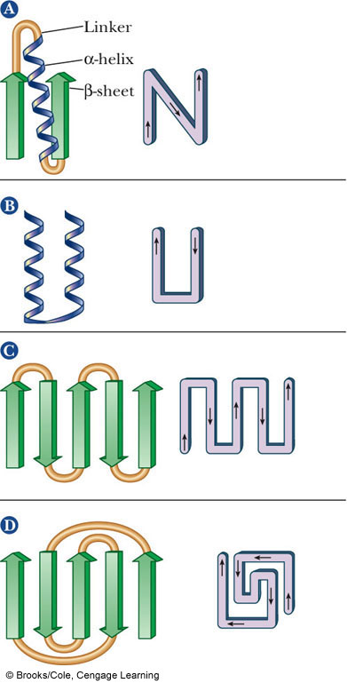
Motifs
Stretches of amino acids can fold into different combinations of secondary structural elements that interact
  These combinations are called motifs
βαβ
αβα
β−meander
Greek Key

Slide 19
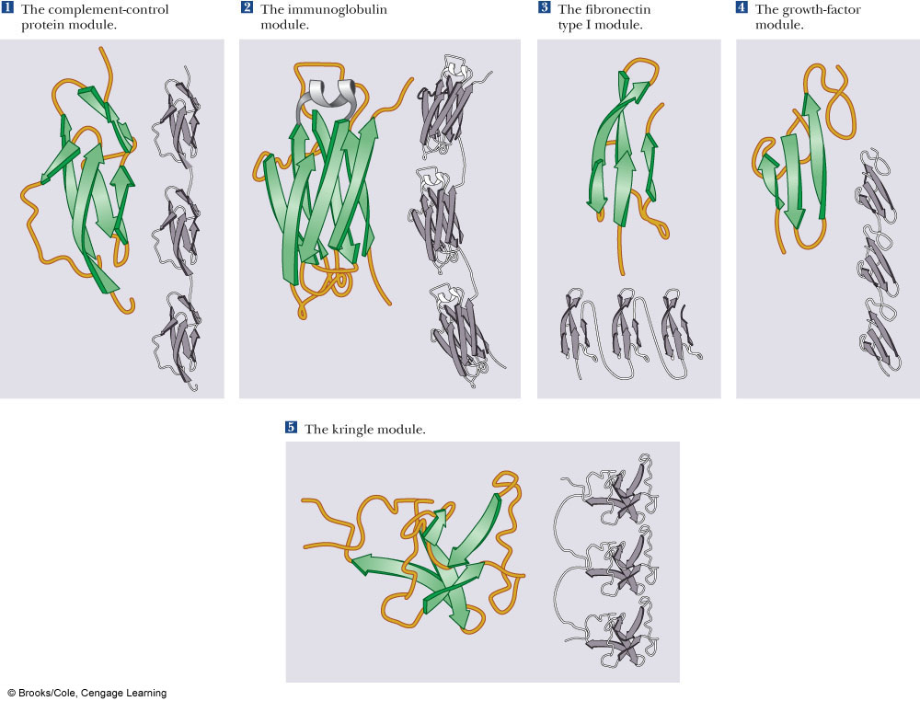
Motifs

Slide 20
Domains and Tertiary Structure
Several motifs pack together to form Domains
  A protein Domain is a stable unit of protein structure that will fold spontaneously
  Domains have similar function in different proteins
    Domains tend to evolve as a unit.
There are some good websites to look at protein domains:
  CATH: www.cathdb.info
  SCOP: scop.mrc-lmb.cam.ac.uk/scop/

Slide 21

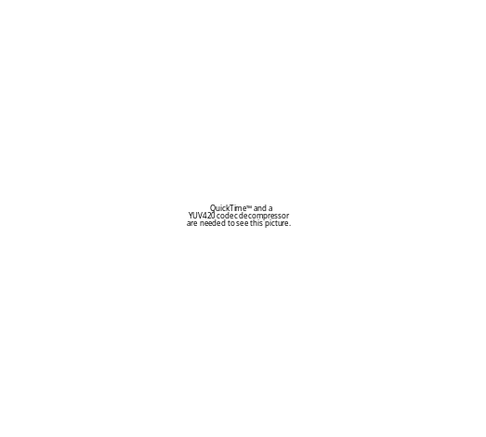
Tertiary (3°) Structure
Many all α-helix proteins exist
  Myoglobin
The β-barrel domain is seen in many proteins
  Xylanase C

Slide 22
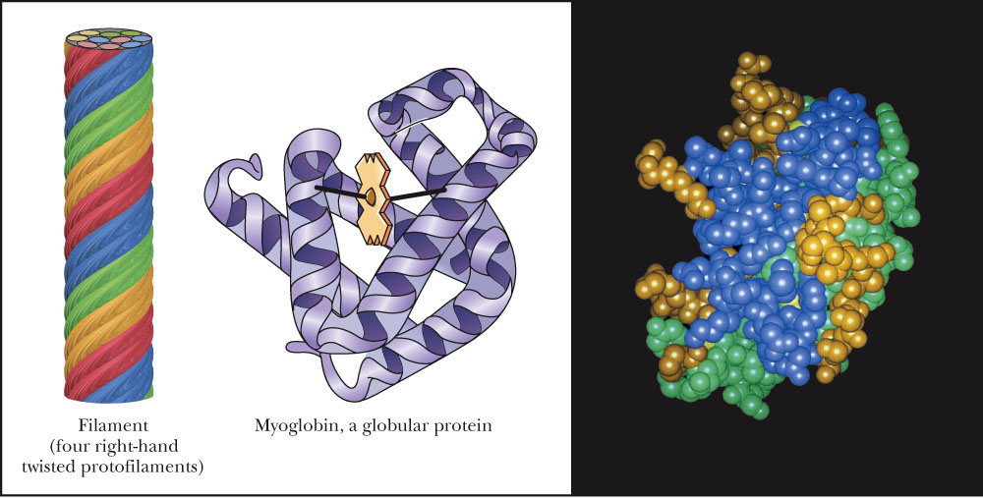
Tertiary Structure
The three dimensional arrangement of all atoms in the molecule
This includes any non-amino acid atoms such as porphyrin rings and metal ions
The overall shape of most proteins is either fibrous or globular

Slide 23
Forces Important in Maintaining Tertiary Structure
Peptide bonds = Covalent bonds
2° and 3° structures = Noncovalent interactions
Let’s look at these non-covalent interactions:
  Hydrogen bonding:
    H-bonds between backbone atoms (C=O and H-N)
    H-bonds between sidechains (COO- and -O-H)
  Hydrophobic interactions:
    Nonpolar amino acids tend to be found in the core of the protein due to phydrophobic interactions
  Electrostatic Interactions:
    Metal/Side Chain interactions
    Side chain/Ion interactions
  Disulfide bonds:
    Two cysteine side chains can form S-S bonds, thereby linking two different sections of the polypeptide chain together
    Not every protein has disulfide bonds!

Slide 24
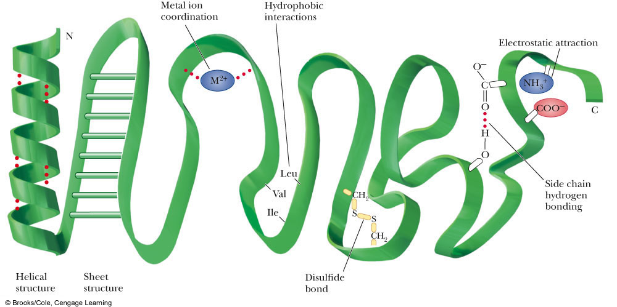

Slide 25
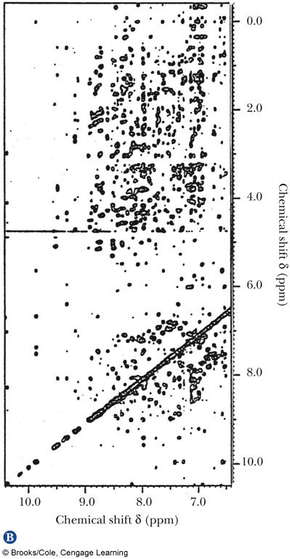
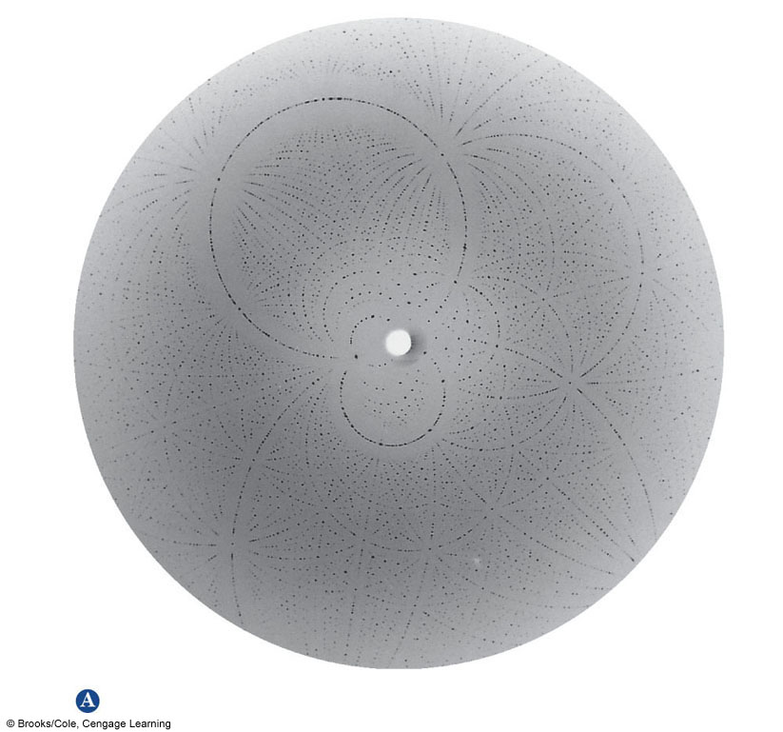
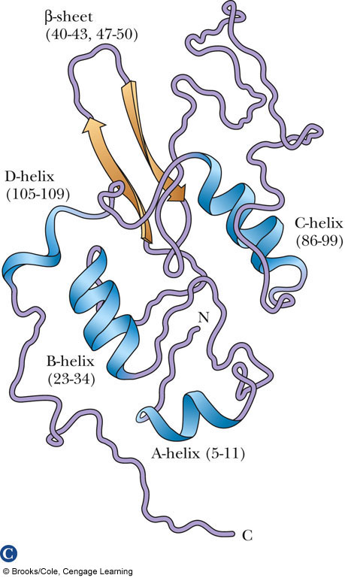
Methods for Determining Protein Structure
X-ray Crystallography
NMR Spectroscopy

Slide 26
Protein Structure: Quaternary Structure
The quaternary structure of a protein (4°) is the collection of discrete tertiary structures.
For example: Hemoglobin is a dimeric protein comprised of an α and a β subunit.
The functional form of hemoglobin found in red blood cells is actually a dimer of the α/β dimers.
The quaternary structure of active hemoglobin is therefore 2α subunits and 2β subunits.
Many proteins are monomers; their quaternary structure is the same as their tertiary structure

